Slide 1
Cooperative Base Groups
For Personal and Academic Support

Slide 2
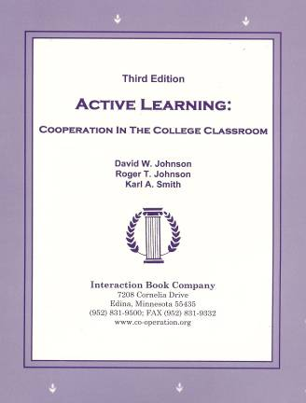
Active Learning: Cooperation in the College Classroom
Informal Cooperative Learning Groups
Formal Cooperative Learning Groups
Cooperative Base Groups
Notes: Cooperative Learning
Handout (CL-College-814.doc)
[CL-College-814.doc]

Slide 3
Cooperative Learning
Kurt Lewin - Social Interdependence Theory
1.The essence of a group is the interdependence among members (created by common goals) which results in the group being a "dynamic whole" so that a change in the state of any member of subgroup changes the state of any other member or subgroup
2.An intrinsic state of tension within group members motivates movement toward the accomplishment of the desired common goals.

Slide 4
Cooperative Base Groups Provide
a Base of Support
Two types of support:
1.Academic Support: Classmates and faculty provide the assistance and help students to succeed academically.
2.Personal Support: Classmates and faculty care about and are personally committed to the well- being of each student.
Johnson, David W., Johnson, Roger T. and Smith, Karl A. 2006. Active learning: Cooperation in the college classroom, 3rd Ed. Edina, MN: Interaction Book.

Slide 5
The Greater the Social Support,
The Greater Academic Challenges May Be
Must Balance:
1.Academic Challenge: An academic demand that may be beyond the student=s capacity to achieve
2.Social Support: Significant others helping students mobilize her or his resources to advance on the challenges

Slide 6
Creative Performance From Students
(& Faculty) Requires Maintaining
a Creative Tension Between
Challenge and Security
Pelz, Donald, and Andrews, Frank. 1966. Scientists in Organizations: Productive Climates for Research and Development. Ann Arbor: Institute for Social Research, University of Michigan.
Pelz, Donald. 1976. Environments for creative performance within universities. In Samuel Messick (Ed.), Individuality in learning, pp. 229-247. San Francisco: Jossey-Bass
Edmonson, A.C. 2008. The competitive advantage of learning. Harvard Business Review 86 (7/8): 60-67.

Slide 7
Edmonson-Competitive_Advantage_of_Learning-HBR-2008.pdf

Slide 8
Edmonson-Competitive_Advantage_of_Learning-HBR-2008.pdf
Edmonson, A. 1999. Psychological safety and learning in work teams. Administrative Science Quarterly, Vol. 44, No. 2

Slide 9
Cooperative Base Groups
Are Heterogeneous
Are Long Term (at least one quarter or semester)
Are Small (3-5 members)
Are for support
May meet at the beginning of each session or may meet between sessions
Review for quizzes, tests, etc. together
Share resources, references, etc. for individual projects
Provide a means for covering for absentees

