Slide 1
Teaming Up – Learning as
Cooperative Experiences
Karl A. Smith
STEM Education Center / Technological Leadership Institute / Civil Engineering – University of Minnesota &
Engineering Education – Purdue University
ksmith@umn.edu - http://www.ce.umn.edu/~smith
University of Iowa
Center for Teaching
September 24, 2013

Slide 2
Session Layout
Welcome & Overview
Cooperative Learning Basics
Course Design Foundations
Design and Implementation of Cooperative Learning

Slide 3
Overall Goal
Build your repertoire of cooperative learning strategies as well as skills and confidence for implementing them

Slide 4
Workshop Objectives
Participants will be able to :
  Describe key features of cooperative learning and effective, interactive strategies for facilitating learning
  Summarize key elements of Course Design Foundations
    How People Learn (HPL)
    Understanding by Design (UbD) process – Content (outcomes) – Assessment – Pedagogy
  Explain key features of and rationale for Cooperative Learning
  Identify connections between cooperative learning and desired outcomes of courses and programs
Participants will begin applying key elements to the design on a course, class session or learning module

Slide 5
Reflection and Dialogue
Individually reflect on Effective, Interactive Strategies for Facilitating Learning. Write for about 1 minute
  Context? Subject, Year, School/Department
  Structure/Procedure?
  Outcome? Evidence of Success
Discuss with your neighbor for about 2 minutes
  Select Story, Comment, Question, etc. that you would like to present to the whole group if you are randomly selected

Slide 6
Seven Principles for Good Practice in Undergraduate Education
Good practice in undergraduate education:
  Encourages student-faculty contact
  Encourages cooperation among students
  Encourages active learning
  Gives prompt feedback
  Emphasizes time on task
  Communicates high expectations
  Respects diverse talents and ways of learning
Chickering & Gamson, June, 1987
http://learningcommons.evergreen.edu/pdf/fall1987.pdf

Slide 7
Process Metallurgy
Dissolution Kinetics – liquid-solid interface
Iron Ore Desliming – solid-solid interface
Metal-oxide reduction roasting – gas-solid interface
Notes:
My process metallurgy experience was at interfaces, which I think helped position me for work at the engineering and education interface

Slide 8
Dissolution Kinetics
Theory – Governing Equation for Mass Transport
Research – rotating disk
Practice – leaching of silver bearing metallic copper

Slide 9
First Teaching Experience
Practice – Third-year course in metallurgical reactions – thermodynamics and kinetics

Slide 10
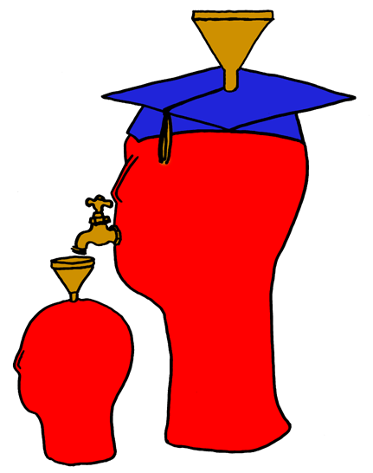
Lila M. Smith
Notes:
8:30-9:30?Take copies of Active Lrn, HTMI, New Paradigms,

Slide 11
Engineering Education
Practice – Third-year course in metallurgical reactions – thermodynamics and kinetics
Research – ?
Theory – ?
Theory
Research
Evidence
Practice

Slide 12
University of Minnesota College of Education
Social, Psychological and Philosophical Foundations of Education
Statistics, Measurement, Research Methodology
Assessment and Evaluation
Learning and Cognitive Psychology
Knowledge Acquisition, Artificial Intelligence, Expert Systems
Development Theories
Motivation Theories
Social psychology of learning – student – student interaction

Slide 13
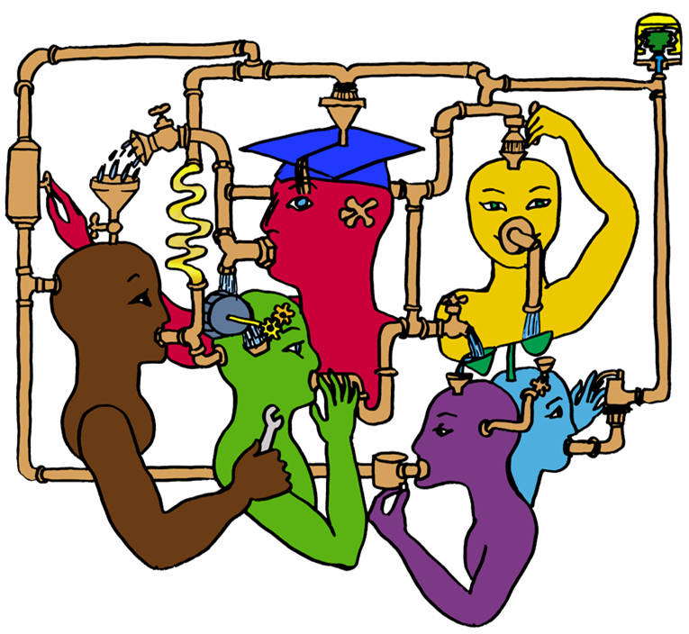
Lila M. Smith
Notes:
8:30-9:30?Take copies of Active Lrn, HTMI, New Paradigms,

Slide 14
Cooperative Learning
Theory – Social Interdependence – Lewin – Deutsch – Johnson & Johnson
Research – Randomized Design Field Experiments
Practice – Formal Teams/Professor’s Role
Theory
Research
Evidence
Practice

Slide 15
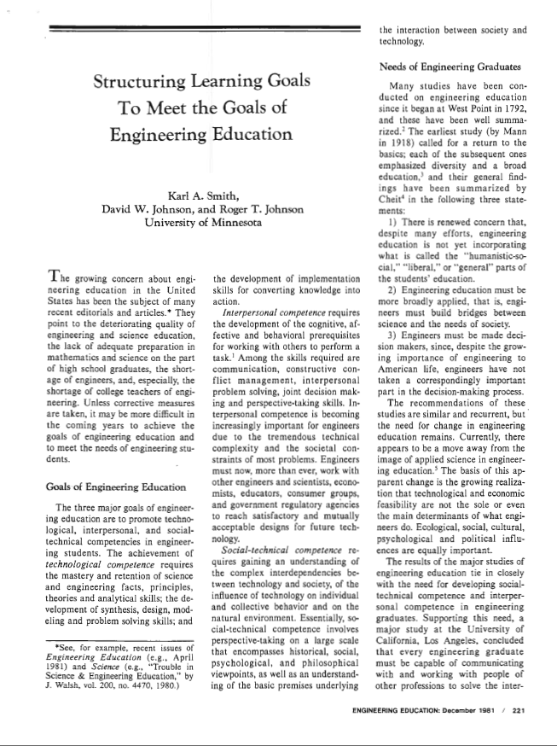
Cooperative Learning Introduced to Engineering – 1981
Smith, K.A., Johnson, D.W. and Johnson, R.T., 1981. The use of cooperative learning groups in engineering education. In L.P. Grayson and J.M. Biedenbach (Eds.), Proceedings Eleventh Annual Frontiers in Education Conference, Rapid City, SD, Washington: IEEE/ASEE, 26‑32.
JEE December 1981

Slide 16
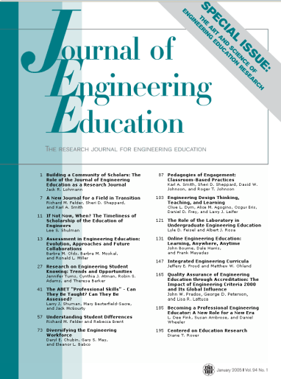

Cooperative Learning Research Support
Johnson, D.W., Johnson, R.T., & Smith, K.A. 1998. Cooperative learning returns to college: What evidence is there that it works? Change, 30 (4), 26-35.
• Over 300 Experimental Studies
• First study conducted in 1924
• High Generalizability
• Multiple Outcomes
Outcomes
1. Achievement and retention
2. Critical thinking and higher-level
reasoning
3. Differentiated views of others
4. Accurate understanding of others' perspectives
5. Liking for classmates and teacher
6. Liking for subject areas
7. Teamwork skills
January 2005
March 2007
Notes:
Table summarizes my perception of the shift. A version of this table is available in New Paradigms for Engineering Education -- FIE Conf proceedings 97 (avail on the www)
One of the most significant changes that has occurred is the shift from "pouring in knowledge" to "creating a climate where learning flows among students and the professor"

Slide 17
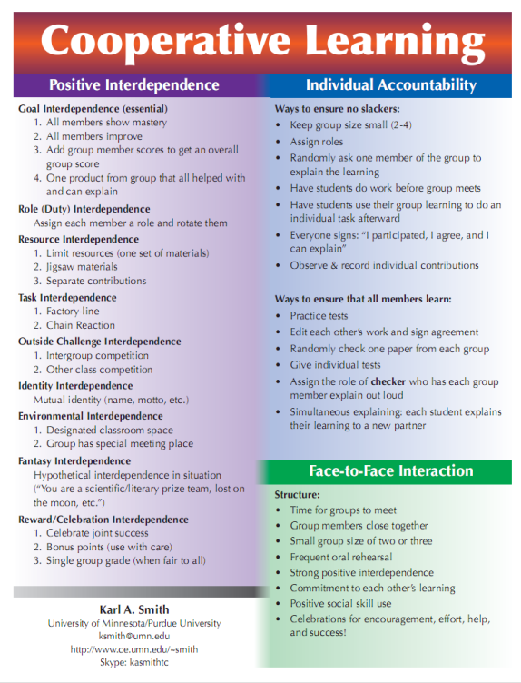
Cooperative Learning is instruction that involves people working in teams to accomplish a common goal, under conditions that involve both positive interdependence (all members must cooperate to complete the task) and individual and group accountability (each member is accountable for the complete final outcome).
Key Concepts
•Positive Interdependence
•Individual and Group Accountability
•Face-to-Face Promotive Interaction
•Teamwork Skills
•Group Processing
http://www.ce.umn.edu/~smith/docs/Smith-CL%20Handout%2008.pdf
Notes:
Table summarizes my perception of the shift. A version of this table is available in New Paradigms for Engineering Education -- FIE Conf proceedings 97 (avail on the www)
One of the most significant changes that has occurred is the shift from "pouring in knowledge" to "creating a climate where learning flows among students and the professor"

Slide 18
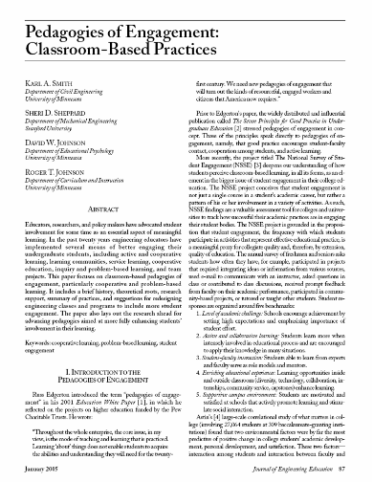
“Throughout the whole enterprise, the core issue, in my view, is the mode of teaching and learning that is practiced. Learning ‘about’ things does not enable students to acquire the abilities and understanding they will need for the twenty-first century. We need new pedagogies of engagement that will turn out the kinds of resourceful, engaged workers and citizens that America now requires.”
Russ Edgerton (reflecting on higher education projects funded by the Pew Memorial Trust)
http://www.asee.org/publications/jee/issueList.cfm?year=2005#January2005

Slide 19
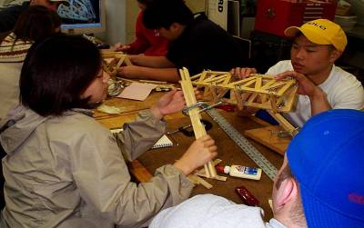
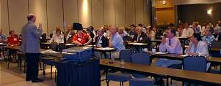
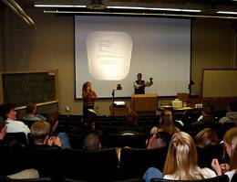
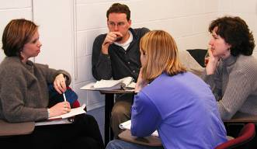
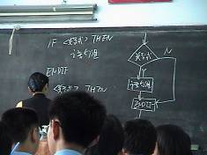
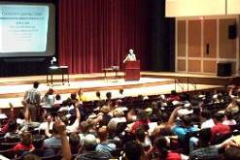
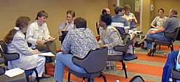
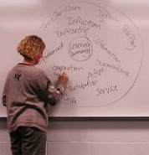
Pedagogies of Engagement

Slide 20
The American College Teacher:
National Norms for 2007-2008
Methods Used in “All” or “Most” | All – 2005 | All – 2008 | Assistant - 2008
Cooperative Learning | 48 | 59 | 66
Group Projects | 33 | 36 | 61
Grading on a curve | 19 | 17 | 14
Term/research papers | 35 | 44 | 47
http://www.heri.ucla.edu/index.php

Slide 21
Undergraduate Teaching Faculty, 2011*
Methods Used in “All” or “Most” | STEM women | STEM men | All other women | All other men
Cooperative learning | 60% | 41% | 72% | 53%
Group projects | 36% | 27% | 38% | 29%
Grading on a curve | 17% | 31% | 10% | 16%
Student inquiry | 43% | 33% | 54% | 47%
Extensive lecturing | 50% | 70% | 29% | 44%
*Undergraduate Teaching Faculty. National Norms for the
2010-2011 HERI Faculty Survey, www.heri.ucla.edu/index.php
Notes:
Karl

Slide 22
Student Engagement Research Evidence
Perhaps the strongest conclusion that can be made is the least surprising. Simply put, the greater the student’s involvement or engagement in academic work or in the academic experience of college, the greater his or her level of knowledge acquisition and general cognitive development …(Pascarella and Terenzini, 2005).
Active and collaborative instruction coupled with various means to encourage student engagement invariably lead to better student learning outcomes irrespective of academic discipline (Kuh et al., 2005, 2007).
See Smith, et.al, 2005 and Fairweather, 2008, Linking Evidence and Promising Practices in Science, Technology, Engineering, and Mathematics (STEM) Undergraduate Education - http://www7.nationalacademies.org/bose/Fairweather_CommissionedPaper.pdf

Slide 23
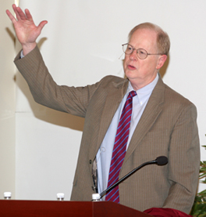
“It could well be that faculty members of the twenty-first century college or university will find it necessary to set aside their roles as teachers and instead become designers of learning experiences, processes, and environments.”
James Duderstadt, 1999
Nuclear Engineering Professor; Former Dean, Provost and President of the University of Michigan

Slide 24

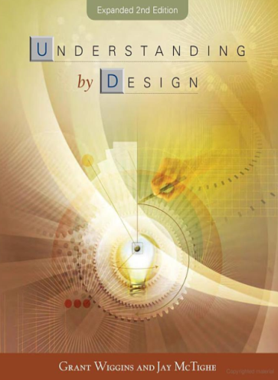
Course Design Foundations
Science of Instruction (UbD)
 | No | Yes
Yes | Good Theory/ Poor Practice | Good Theory & Good Practice
No |  | Good Practice/ Poor Theory
Science of Learning
(HPL)
Bransford, Brown & Cocking. 1999. How People Learn. National Academy Press.
Wiggins & McTighe, 2005. Understanding by Design, 2ed. ASCD.
Notes:
Karl
Models of how learning works – (1) learning as response strengthening, (2) learning as information acquisition, (3) learning as knowledge construction and (4) learning as social knowledge construction

Slide 25
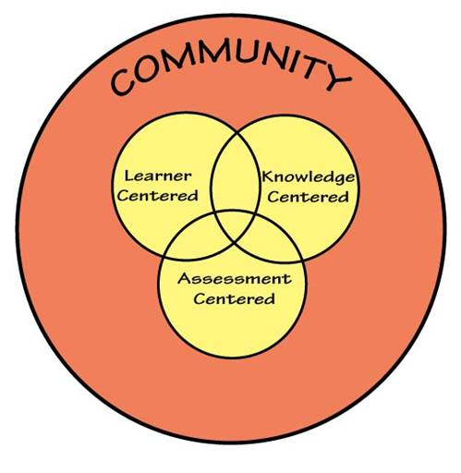
How People Learn (HPL)
HPL Framework
Expertise implies (Ch. 2):
  a set of cognitive and metacognitive skills
  an organized body of knowledge that is deep and contextualized
  an ability to notice patterns of information in a new situation
  flexibility in retrieving and applying that knowledge to a new problem
Bransford, Brown & Cocking. 1999. How people learn. National Academy Press.
Notes:
Karl

Slide 26
Understanding by Design
Stage 1. Identify Desired Results
  Enduring understanding (enduring outcomes)
  Important to know and do
  Worth being familiar with
Stage 2. Determine Acceptable Evidence
Stage 3. Plan Learning Experiences and Instruction
Overall: Are the desired results, assessments, and learning activities ALIGNED?
Wiggins & McTighe, 1997, 2005. Understanding by Design. Alexandria, VA: ASCD.
Notes:
26
Karl

Slide 27
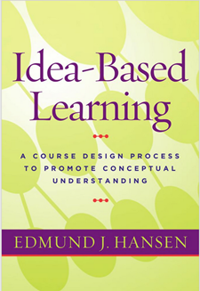

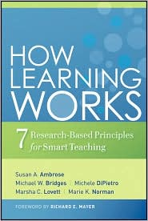
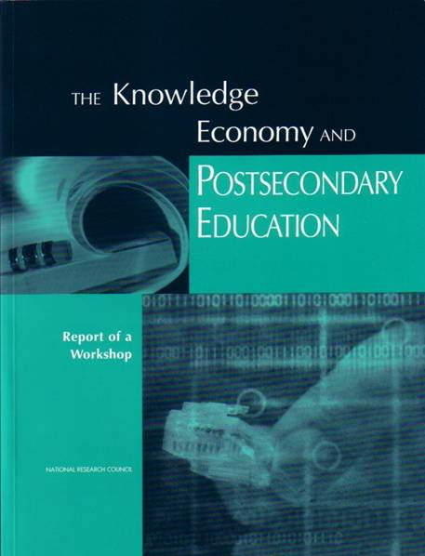
Bransford, Vye and Bateman – Creating High Quality Learning Environments
Notes:
Karl

Slide 28
Interactive Learning Continuum
Informal
Group
Activities
Structured
Team
Activities
Problems
Drive the
Course
Make the
lecture active
Instructor
Centered
Student
Centered
Active
Learning
Collaborative
Learning
Formal
Cooperative
Learning
Problem-
Based
Learning
Strong Evidence Base – Cooperative
Learning & Challenge-Based Learning
Prince, M. (2010). NAE FOEE

Slide 29
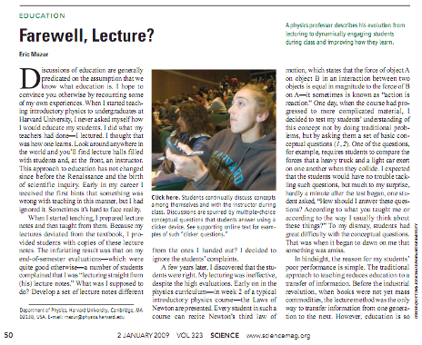
Informal Cooperative Learning
January 2, 2009—Science, Vol. 323 – www.sciencemag.org
Calls for evidence-based instruction practices

Slide 30
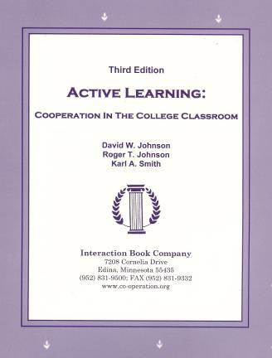
Active Learning: Cooperation in the College Classroom
Informal Cooperative Learning Groups
Formal Cooperative Learning Groups
Cooperative Base Groups
See Cooperative Learning
Handout (CL College-912.doc)

Slide 31
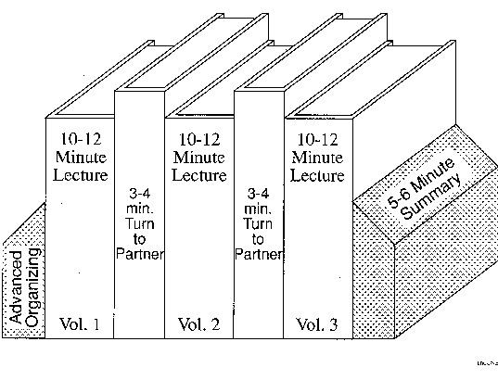
Book Ends on a Class Session
Smith, K.A. 2000. Going deeper: Formal small-group learning in large classes. Energizing large classes: From small groups to learning communities. New Directions for Teaching and Learning, 2000, 81, 25-46. [NDTL81Ch3GoingDeeper.pdf]

Slide 32
Book Ends on a Class Session
Advance Organizer
Formulate-Share-Listen-Create (Turn-to-your-neighbor) -- repeated every 10-12 minutes
Session Summary (Minute Paper)
        What was the most useful or meaningful thing you learned during this session?
        What question(s) remain uppermost in your mind as we end this session?
        What was the “muddiest” point in this session?
Notes:
Table summarizes my perception of the shift. A version of this table is available in New Paradigms for Engineering Education -- FIE Conf proceedings 97 (avail on the www)
One of the most significant changes that has occurred is the shift from "pouring in knowledge" to "creating a climate where learning flows among students and the professor"

Slide 33
Formulate-Share-Listen-Create
Informal Cooperative Learning Group
Introductory Pair Discussion of a
FOCUS QUESTION
Formulate your response to the question individually
Share your answer with a partner
Listen carefully to your partner's answer
Work together to Create a new answer through discussion

Slide 34
Informal CL (Book Ends on a Class Session) with Concept Tests
Physics
Peer Instruction
Eric Mazur - Harvard – http://galileo.harvard.edu
Peer Instruction – www.prenhall.com
Richard Hake – http://www.physics.indiana.edu/~hake/
Chemistry
Chemistry ConcepTests - UW Madison www.chem.wisc.edu/~concept
Video: Making Lectures Interactive with ConcepTests
ModularChem Consortium – http://mc2.cchem.berkeley.edu/
STEMTEC
Video: How Change Happens: Breaking the “Teach as You Were Taught” Cycle – Films for the Humanities & Sciences – www.films.com
Harvard – Derek Bok Center
Thinking Together & From Questions to Concepts: Interactive Teaching in Physics – www.fas.harvard.edu/~bok_cen/

Slide 35
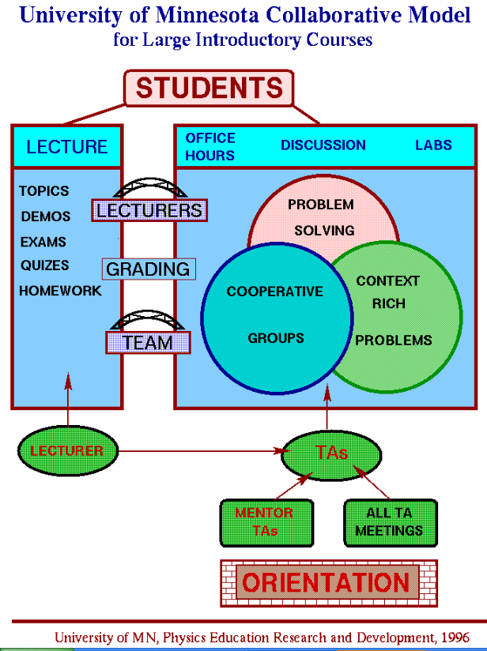
http://groups.physics.umn.edu/physed/Research/MNModel/Model.html

Slide 36
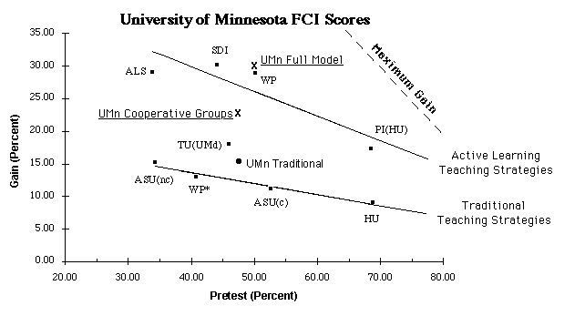
Conceptual Understanding
http://groups.physics.umn.edu/physed/Research/MNModel/FCI.html

Slide 37
Physics (Mechanics) Concepts:
The Force Concept Inventory (FCI)
A 30 item multiple choice test to probe student's understanding of basic concepts in mechanics.
The choice of topics is based on careful thought about what the fundamental issues and concepts are in Newtonian dynamics.
Uses common speech rather than cueing specific physics principles.
The distractors (wrong answers) are
based on students' common inferences.

Slide 38
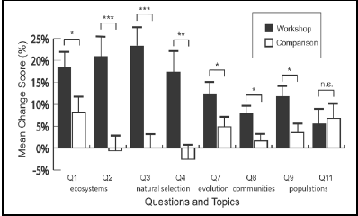
Workshop Biology
Traditional passive lecture vs. “Workshop biology”
Source: Udovic et al. 2002

Slide 39
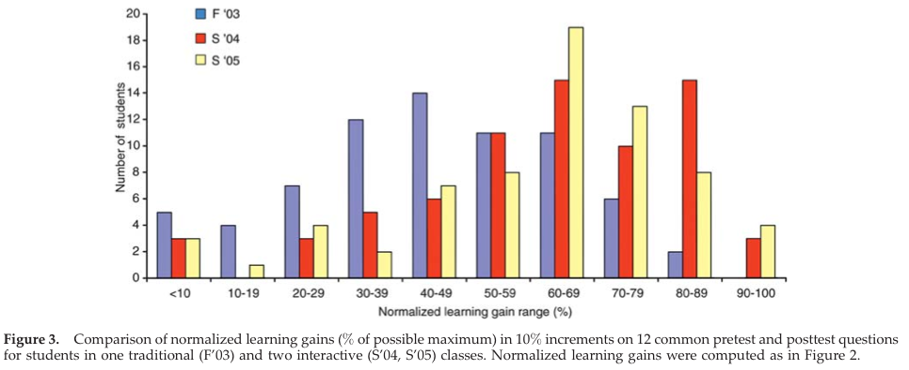
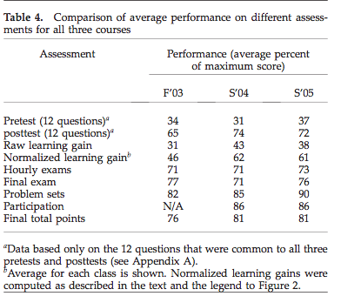
Biology
Source: Knight, J. and Wood, W. (2005). Teaching more by lecturing less. Cell Biol Educ. 4(4): 298–310.

Slide 40
Informal Cooperative
Learning Groups
Can be used at any time
Can be short term and ad hoc
May be used to break up a long lecture
Provides an opportunity for students to process material they have been listening to (Cognitive Rehearsal)
Are especially effective in large lectures
Include "book ends" procedure
Are not as effective as Formal Cooperative Learning or Cooperative Base Groups
Notes:
Barr & Tagg's From teaching to learing is the most often requested article from Change mangazine
Bill Camplbell and I started working on New Paradigms in 1993.

Slide 41
Strategies for Energizing Large Classes: From Small Groups to
Learning Communities:
Jean MacGregor,
James Cooper,
Karl Smith,
Pamela Robinson
New Directions for Teaching and Learning, No. 81, 2000.
Jossey- Bass
Notes:
Table summarizes my perception of the shift. A version of this table is available in New Paradigms for Engineering Education -- FIE Conf proceedings 97 (avail on the www)
One of the most significant changes that has occurred is the shift from "pouring in knowledge" to "creating a climate where learning flows among students and the professor"

Slide 42
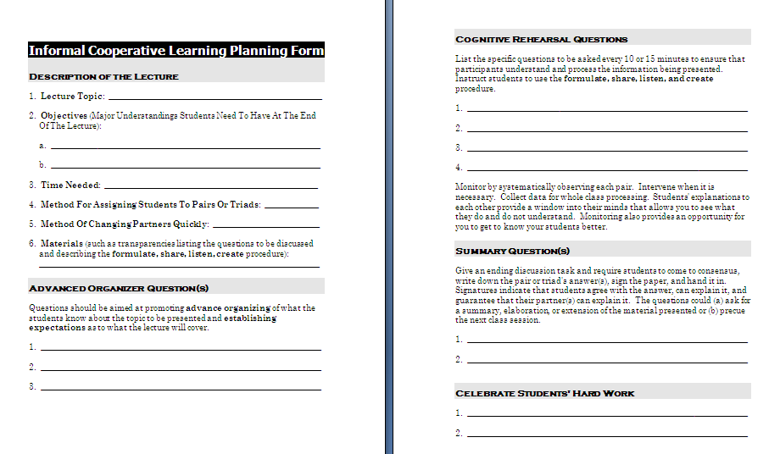

Slide 43
Active Learning: Cooperation in the College Classroom
Informal Cooperative Learning Groups
Formal Cooperative Learning Groups
Cooperative Base Groups
See Cooperative Learning
Handout (CL College-912.doc)

Slide 44
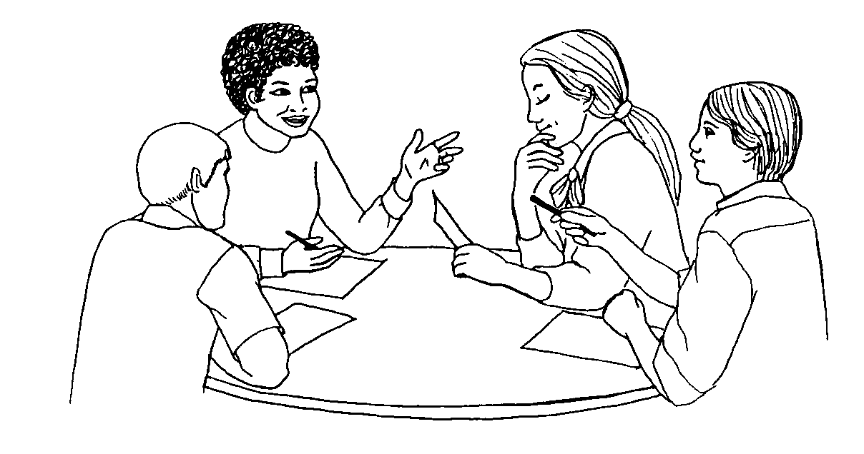
Formal Cooperative Learning Task Groups
Notes:
Barr & Tagg's From teaching to learing is the most often requested article from Change mangazine
Bill Camplbell and I started working on New Paradigms in 1993.

Slide 45
Design team failure is usually due to failed team dynamics
(Leifer, Koseff & Lenshow, 1995).
It’s the soft stuff that’s hard, the hard stuff is easy
(Doug Wilde, quoted in Leifer, 1997)
Professional Skills
(Shuman, L., Besterfield-Sacre, M., and McGourty, J., “The
ABET Professional Skills-Can They Be Taught? Can They Be Assessed?” Journal of Engineering Education, Vo. 94, No. 1, 2005, pp. 41–55.)

Slide 46
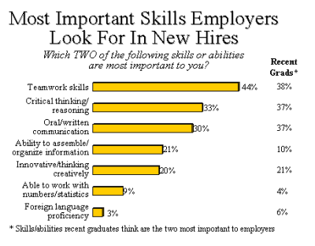

http://www.aacu.org/advocacy/leap/documents/Re8097abcombined.pdf

Slide 47

Top Three Main Engineering Work Activities
Engineering Total
Design – 36%
Computer applications – 31%
Management – 29%
Civil/Architectural
Management – 45%
Design – 39%
Computer applications – 20%
Burton, L., Parker, L, & LeBold, W. 1998. U.S. engineering career trends. ASEE Prism, 7(9), 18-21.

Slide 48
Teamwork

Slide 49
Characteristics of Effective Teams?
?
?

Slide 50
A team is a small number of people with complementary skills who are committed to a common purpose, performance goals, and approach for which they hold themselves mutually accountable
• SMALL NUMBER
• COMPLEMENTARY SKILLS
• COMMON PURPOSE & PERFORMANCE GOALS
• COMMON APPROACH
• MUTUAL ACCOUNTABILITY
--Katzenbach & Smith (1993)
The Wisdom of Teams

Slide 51
Cooperative Learning is instruction that involves people working in teams to accomplish a common goal, under conditions that involve both positive interdependence (all members must cooperate to complete the task) and individual and group accountability (each member is accountable for the complete final outcome).
Key Concepts
•Positive Interdependence
•Individual and Group Accountability
•Face-to-Face Promotive Interaction
•Teamwork Skills
•Group Processing
http://www.ce.umn.edu/~smith/docs/Smith-CL%20Handout%2008.pdf
Notes:
Table summarizes my perception of the shift. A version of this table is available in New Paradigms for Engineering Education -- FIE Conf proceedings 97 (avail on the www)
One of the most significant changes that has occurred is the shift from "pouring in knowledge" to "creating a climate where learning flows among students and the professor"

Slide 52
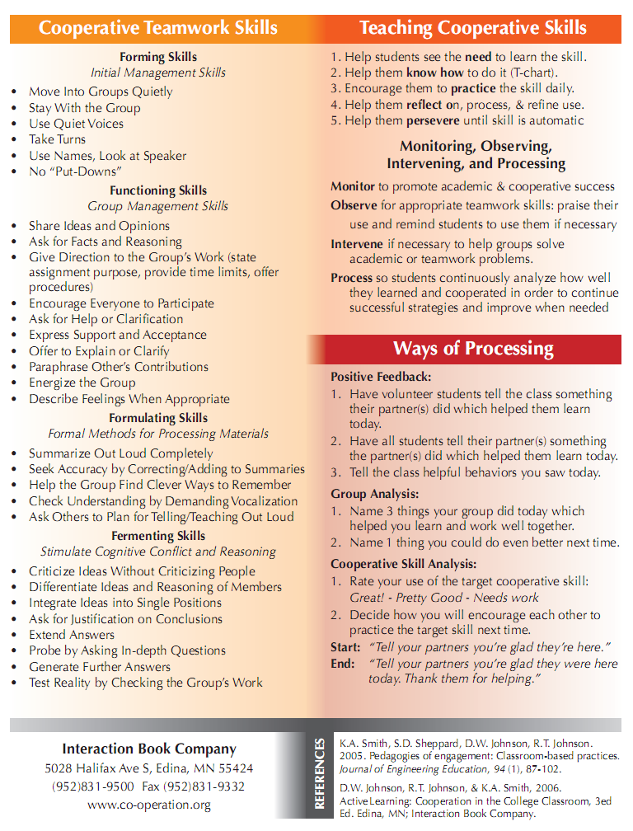
Teamwork Skills
Communication
    Listening and Persuading
Decision Making
Conflict Management
Leadership
Trust and Loyalty

Slide 53
Professor's Role in
Formal Cooperative Learning
Specifying Objectives
Making Decisions
Explaining Task, Positive Interdependence, and Individual Accountability
Monitoring and Intervening to Teach Skills
Evaluating Students' Achievement and Group Effectiveness

Slide 54
Decisions,Decisions
Group size?
Group selection?
Group member roles?
How long to leave groups together?
Arranging the room?
Providing materials?
Time allocation?

Slide 55
Formal Cooperative Learning – Types of Tasks
Jigsaw – Learning new conceptual/procedural material
2. Peer Composition or Editing
3. Reading Comprehension/Interpretation
4. Problem Solving, Project, or Presentation
5. Review/Correct Homework
6. Constructive Controversy
7. Group Tests
Notes:
Table summarizes my perception of the shift. A version of this table is available in New Paradigms for Engineering Education -- FIE Conf proceedings 97 (avail on the www)
One of the most significant changes that has occurred is the shift from "pouring in knowledge" to "creating a climate where learning flows among students and the professor"

Slide 56

Cooperative Jigsaw
JIGSAW SCHEDULE
COOPERATIVE GROUPS (3-4 members)
PREPARATION PAIRS
CONSULTING/SHARING PAIRS
TEACHING/LEARNING IN COOPERATIVE GROUPS
WHOLE CLASS REVIEW
www.jigsaw.org/‎

Slide 57
Formal Cooperative Learning – Types of Tasks
Jigsaw – Learning new conceptual/procedural material
2. Peer Composition or Editing
3. Reading Comprehension/Interpretation
4. Problem Solving, Project, or Presentation
5. Review/Correct Homework
6. Constructive Controversy
7. Group Tests
Notes:
Table summarizes my perception of the shift. A version of this table is available in New Paradigms for Engineering Education -- FIE Conf proceedings 97 (avail on the www)
One of the most significant changes that has occurred is the shift from "pouring in knowledge" to "creating a climate where learning flows among students and the professor"

Slide 58
Challenge-Based Learning
Problem-based learning
Case-based learning
Project-based learning
Learning by design
Inquiry learning
Anchored instruction
John Bransford, Nancy Vye and Helen Bateman. Creating High-Quality Learning Environments: Guidelines from Research on How People Learn

Slide 59
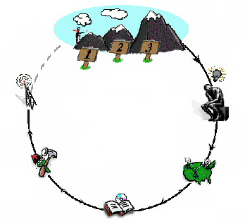
Challenge-Based Instruction with the Legacy Cycle
The Challenges
Go Public
Generate Ideas
Legacy
Cycle
Test Your Mettle
Multiple Perspectives
Research & Revise
https://repo.vanth.org/portal/public-content/star-legacy-cycle/star-legacy-cycle
59
Notes:
59
We use a learning cycle to assist us in organizing learning activities to meet specific goals. This cycle basically scaffolds the inquiry process necessary to identify potential solutions to a problem, research those opportunities, and revise them over time. However, part of the learning process is monitoring understanding of critical concepts and receiving opportunities to go deeper into specific concepts. Therefore, we use formative assessment methods where students can test their mettle and return to do additional Research & Revise activities which will help to revise their understanding.

Slide 60
Problem-Based Learning
START
Apply it
Problem posed
Learn it
Identify what we
need to know

Slide 61
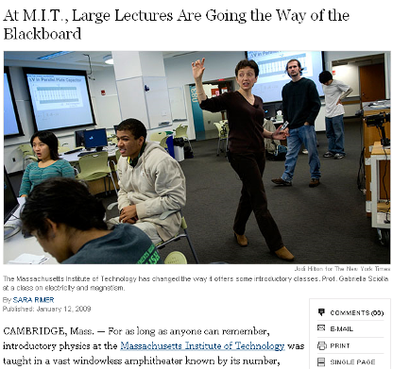
Problem-Based Cooperative Learning
January 13, 2009—New York Times – http://www.nytimes.com/2009/01/13/us/13physics.html?em

Slide 62
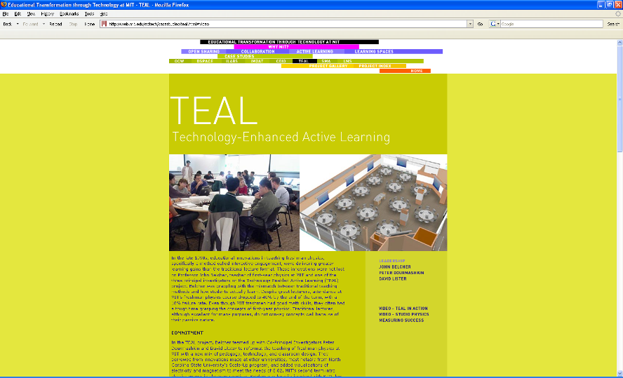
http://web.mit.edu/edtech/casestudies/teal.html#video

Slide 63
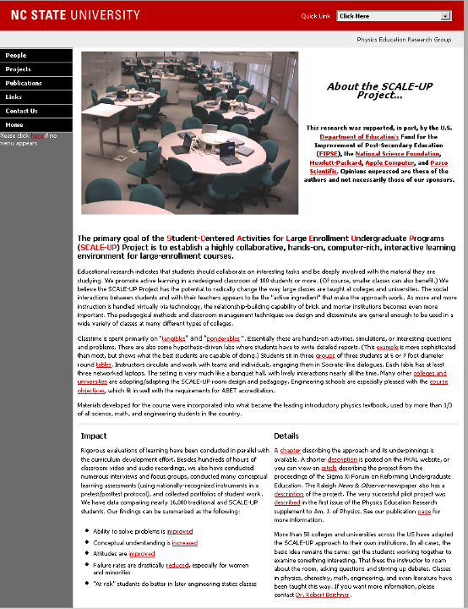
http://www.ncsu.edu/PER/scaleup.html

Slide 64


http://mediamill.cla.umn.edu/mediamill/embed/78755
http://www1.umn.edu/news/news-releases/2010/UR_CONTENT_248261.html
http://www.youtube.com/watch?v=lfT_hoiuY8w
http://youtu.be/lfT_hoiuY8w

Slide 65
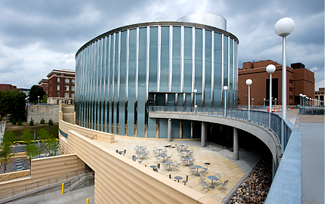
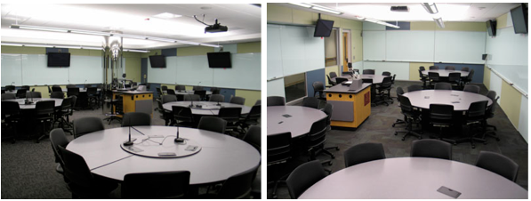
Inside an Active Learning Classroom
STSS at the University of Minnesota
http://vimeo.com/andyub/activeclassroom
“I love this space! It makes me feel appreciated as a student, and I feel intellectually invigorated when I work and learn in it.”

Slide 66

http://tile.uiowa.edu/

Slide 67
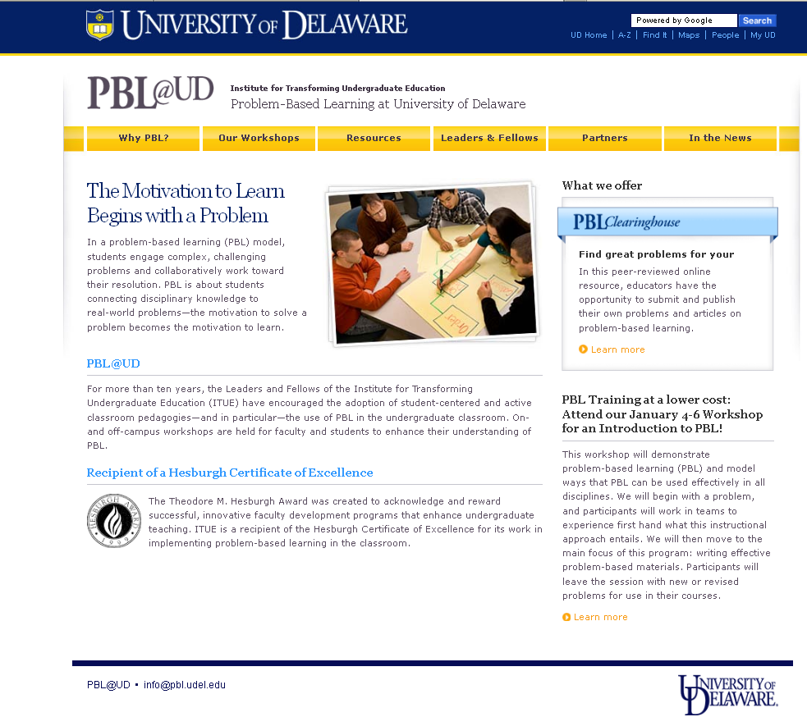
http://www.udel.edu/inst/

Slide 68
Problem-Based Cooperative Learning
Karl A. Smith
Engineering Education – Purdue University
Civil Engineering - University of Minnesota
ksmith@umn.edu
http://www.ce.umn.edu/~smith
Estimation Exercise

Slide 69
First Course Design Experience
UMN – Institute of Technology
Thinking Like an Engineer
Problem Identification
Problem Formulation
Problem Representation
Problem Solving
Problem-Based Learning

Slide 70
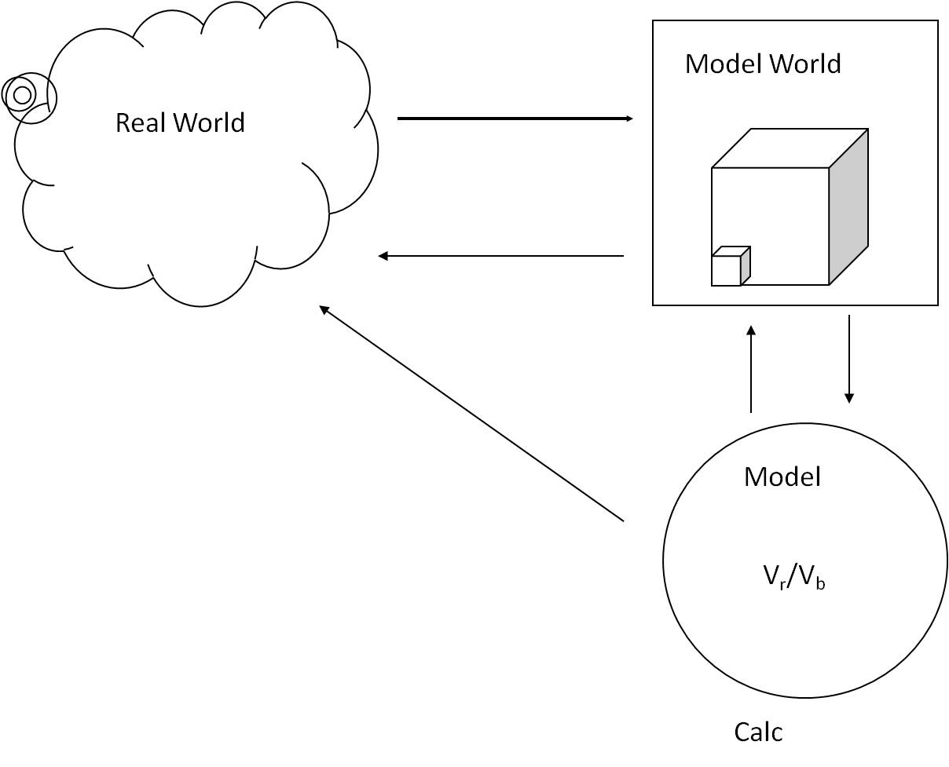
*Based on First Year Engineering course – Problem-based cooperative learning How to Model It published in 1990.

Slide 71
Problem Based Cooperative Learning Format
TASK: Solve the problem(s) or Complete the project.
INDIVIDUAL: Estimate answer. Note strategy.
COOPERATIVE: One set of answers from the group, strive for agreement, make sure everyone is able to explain the strategies used to solve each problem.
EXPECTED CRITERIA FOR SUCCESS: Everyone must be able to explain the strategies used to solve each problem.
EVALUATION: Best answer within available resources or constraints.
INDIVIDUAL ACCOUNTABILITY: One member from your group may be randomly chosen to explain (a) the answer and (b) how to solve each problem.
EXPECTED BEHAVIORS: Active participating, checking, encouraging, and elaborating by all members.
INTERGROUP COOPERATION: Whenever it is helpful, check procedures, answers, and strategies with another group.

Slide 72
Active Learning: Cooperation in the College Classroom
Informal Cooperative Learning Groups
Formal Cooperative Learning Groups
Cooperative Base Groups
See Cooperative Learning
Handout (CL College-912.doc)

Slide 73
Cooperative Base Groups
Are Heterogeneous
Are Long Term (at least one quarter or semester)
Are Small (3-5 members)
Are for support
May meet at the beginning of each session or may meet between sessions
Review for quizzes, tests, etc. together
Share resources, references, etc. for individual projects
Provide a means for covering for absentees

Slide 74
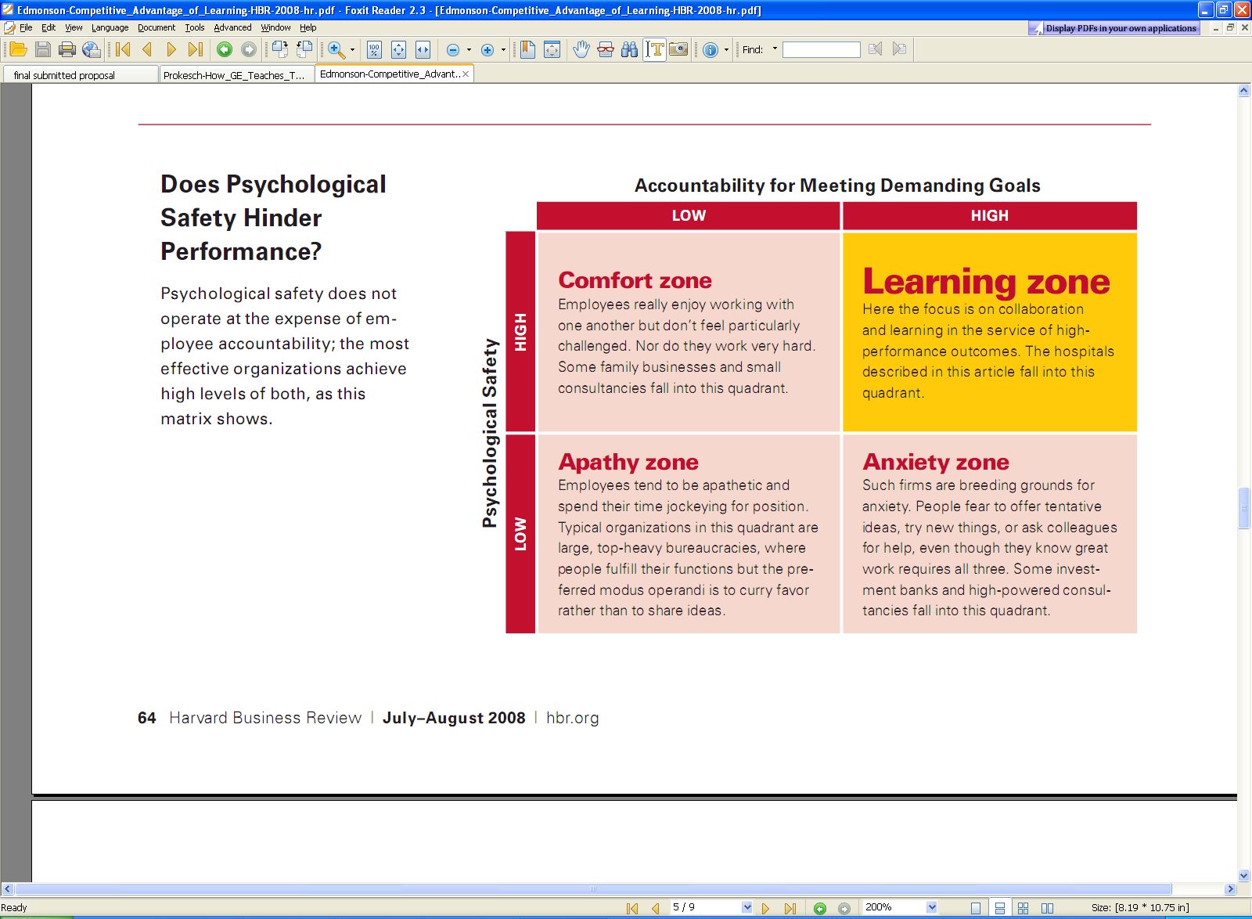
Edmonson-Competitive_Advantage_of_Learning-HBR-2008.pdf

Slide 76
Designing and Implementing Cooperative Learning
Think like a designer
Ground practice in robust theoretical framework
Start small, start early and iterate
Celebrate the successes; problem-solve the failures

Slide 77
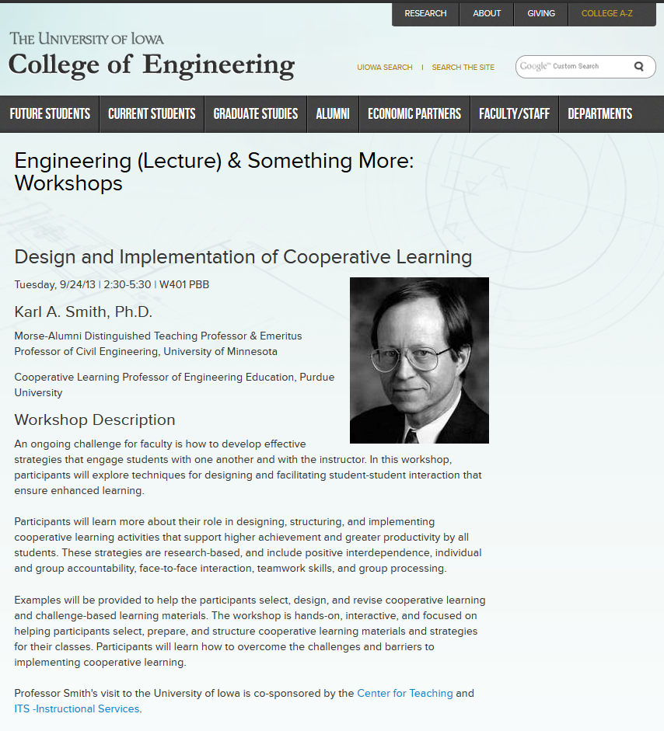

Slide 78
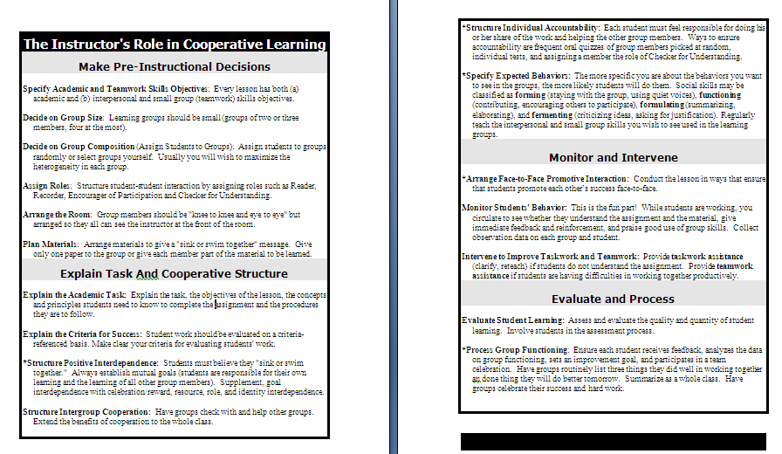

Slide 79
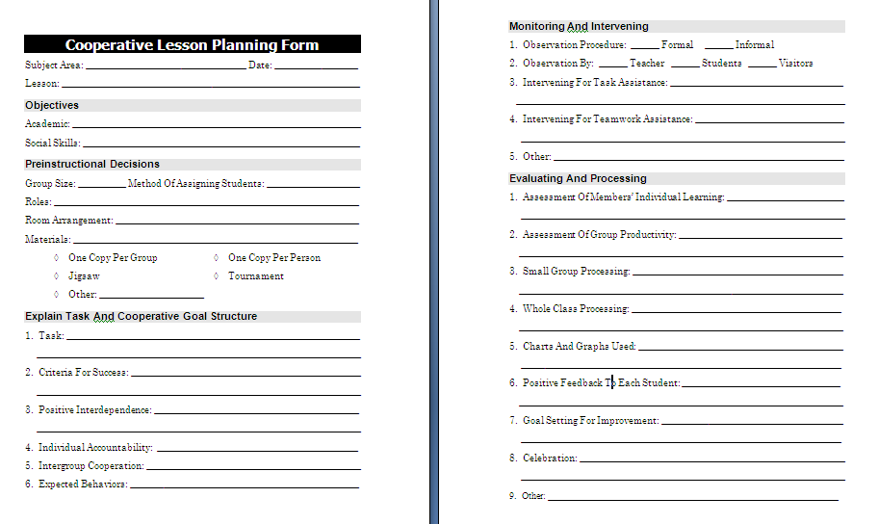

Slide 80
Resources
Design Framework – How People Learn (HPL) & Understanding by Design (UdB) Process
  Ambrose, S., et.al. 2010. How learning works: 7 research based principles for smart teaching. Jossey-Bass
  Bransford, John, Vye, Nancy, and Bateman, Helen. 2002. Creating High-Quality Learning Environments: Guidelines from Research on How People Learn. The Knowledge Economy and Postsecondary Education: Report of a Workshop. National Research Council. Committee on the Impact of the Changing Economy of the Education System. P.A. Graham and N.G. Stacey (Eds.). Center for Education. Washington, DC: National Academy Press. http://www.nap.edu/openbook/0309082927/html/
  Pellegrino, J. 2006. Rethinking and redesigning curriculum, instruction and assessment: What contemporary research and theory suggests. http://www.skillscommission.org/commissioned.htm
  Smith, K. A., Douglas, T. C., & Cox, M. 2009. Supportive teaching and learning strategies in STEM education. In R. Baldwin, (Ed.). Improving the climate for undergraduate teaching in STEM fields. New Directions for Teaching and Learning, 117, 19-32. San Francisco: Jossey-Bass.
  Streveler, R.A., Smith, K.A. and Pilotte, M. 2012. Content, Assessment and Pedagogy (CAP): An Integrated Engineering Design Approach. In Dr. Khairiyah Mohd Yusof, Dr. Shahrin Mohammad, Dr. Naziha Ahmad Azli, Dr. Mohamed Noor Hassan, Dr. Azlina Kosnin and Dr. Sharifah Kamilah Syed Yusof (Eds.). Outcome-Based Education and Engineering Curriculum: Evaluation, Assessment and Accreditation, Universiti Teknologi Malaysia, Malaysia [Streveler-Smith-Pilotte_OBE_Chapter-CAP-v11.pdf]
  Wiggins, G. & McTighe, J. 2005. Understanding by Design: Expanded Second Edition. Prentice Hall.
Content Resources
  Donald, Janet. 2002. Learning to think: Disciplinary perspectives. San Francisco: Jossey-Bass.
  Middendorf, Joan and Pace, David. 2004. Decoding the Disciplines: A Model for Helping Students Learn Disciplinary Ways of Thinking. New Directions for Teaching and Learning, 98.
Cooperative Learning
  Cooperative Learning (Johnson, Johnson & Smith) - Smith web site – www.ce.umn.edu/~smith
  Smith (2010) Social nature of learning: From small groups to learning communities. New Directions for Teaching and Learning, 2010, 123, 11-22 [NDTL-123-2-Smith-Social_Basis_of_Learning-.pdf]
  Smith, Sheppard, Johnson & Johnson (2005) Pedagogies of Engagement [Smith-Pedagogies_of_Engagement.pdf]
  Johnson, Johnson & Smith. 1998. Cooperative learning returns to college: What evidence is there that it works? Change, 1998, 30 (4), 26-35. [CLReturnstoCollege.pdf]
Other Resources
  University of Delaware PBL web site – www.udel.edu/pbl
  PKAL – Pedagogies of Engagement – http://www.pkal.org/activities/PedagogiesOfEngagementSummit.cfm
  Fairweather (2008) Linking Evidence and Promising Practices in Science, Technology, Engineering, and Mathematics (STEM) Undergraduate Education - http://www7.nationalacademies.org/bose/Fairweather_CommissionedPaper.pdf

