Slide 1
Advancing the Practice of
Engineering Education
Karl A. Smith
Engineering Education – Purdue University
STEM Education Center/Civil Eng – University of Minnesota
ksmith@umn.edu - http://www.ce.umn.edu/~smith/
South African Society for
Engineering Education
Stellenbosch, South Africa
10-12 August, 2011

Slide 2
Engineering
A principal feature of the engineering method is advancing the state of the art (Koen, 2009).
The engineering method is the use of heuristics to cause the best change in a poorly understood situation within the available resources – (Koen, 1971, 2000)
The engineering method is design under constraints – Wm. Wulf, Past President, U.S. National Academy of Engineering

Slide 3
Questions Shaping the Keynote
How do we embrace engineering principles in engineering education?
  How do we cultivate innovative practices in engineering education
How do we close the loop between research and practice?
  What is the role of engineering education research?
What is RREE, Rigorous Research in Engineering Education?
  How is it similar and different from traditional engineering research and practice?

Slide 4
Engineering Education Research & Innovation – Karl Smith
Research
Process Metallurgy 1970 -1992
Learning ~1974
Design ~1995
Engineering Education Research & Innovation ~ 2000
Innovation – Cooperative Learning
Need identified ~1974
Introduced ~1976
FIE conference 1981
JEE paper 1981
Research book 1991
Practice handbook 1991
Change paper 1998
Teamwork and project management 2000
JEE paper 2005
National Academy of Engineering - Frontiers of Engineering Education Symposium - December 13-16, 2010 - Slides PDF [Smith-NAE-FOEE-HPL-UbD-12-10-v8.pdf]
Notes:
In this seminar I plan to provide links between my experience as a researcher and an innovation that I’m associated with. I’m using Denning and Dunhams (2010) definition of innovation as the adoption of a new practice in a community. Several researchers argue that a principal aspect of innovation is novel combinations, and I will highlight this aspect, too. Individual reflection – what link between research and innovation are you or would you like to be know for?

Slide 5
Process Metallurgy
Dissolution Kinetics – liquid-solid interface
Iron Ore Desliming – solid-solid interface
Metal-oxide reduction roasting – gas-solid interface

Slide 6
Dissolution Kinetics
Theory – Governing Equation for Mass Transport
Research – rotating disk
Practice – leaching of silver bearing metallic copper

Slide 7
Iron Ore Desliming
Theory – DLVO [V(h) = V_{A}(h) + V_{R}(h)]
Research – streaming potential
Practice – recovery of iron from low-grade Fe₂O₃ ores (Selective removal of silicates)

Slide 8
Metal Oxide Reduction Roasting
Theory – catalyzed gas-solid reactions
Boudouard Reaction [CO₂ + C = 2CO]
Research method – thermogravimetric analysis
Practice – extraction of Ti from FeTiO₃, Al from Al₂O₃ – bearing minerals

Slide 9
First Teaching Experience
Practice – Third-year course in metallurgical reactions – thermodynamics and kinetics

Slide 10
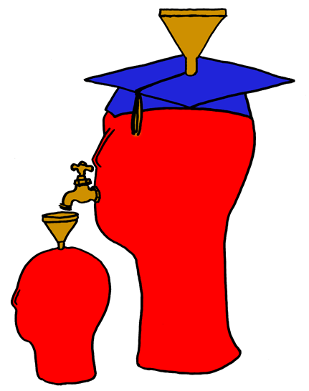
Lila M. Smith
Notes:
8:30-9:30?Take copies of Active Lrn, HTMI, New Paradigms,

Slide 11
Engineering Education
Practice – Third-year course in metallurgical reactions – thermodynamics and kinetics
Research – ?
Theory – ?
Theory
Research
Practice

Slide 12
University of Minnesota College of Education
Social, Psychological and Philosophical Foundations of Education
Statistics, Measurement, Research Methodology
Assessment and Evaluation
Learning and Cognitive Psychology
Knowledge Acquisition, Artificial Intelligence, Expert Systems
Social psychology of learning – student – student interaction

Slide 13
Acquisition of Expertise
Fitts P, & Posner MI. Human Performance. Belmont, CA: Brooks/Cole, 1967.
Cognition: Learn from instruction or observation what knowledge and actions are appropriate
Associative: Practice (with feedback) allowing smooth and accurate performance
Automaticity: “Compilation” or performance and associative sequences so that they can be done without large amounts of cognitive resources
“The secret of expertise is that there is no secret. It takes at least 10 years of concentrated effort to develop expertise.” Herbert Simon

Slide 14
Paradox of Expertise
The very knowledge we wish to teach others (as well as the knowledge we wish to represent in computer programs) often turns out to be the knowledge we are least able to talk about.
Notes:
In 1934, Polanyi, at about the same time as G. I. Taylor and Egon Orowan, realised that the plastic deformation of ductile materials could be explained in terms of the theory of dislocations developed by Vito Volterra in 1905. The insight was critical in developing the field of solid mechanics.

Slide 15

Expertise Implies:
a set of cognitive and metacognitive skills
an organized body of knowledge that is deep and contextualized
an ability to notice patterns of information in a new situation
flexibility in retrieving and applying that knowledge to a new problem
Bransford, Brown & Cocking. 1999. How people learn. National Academy Press.

Slide 16
University of Minnesota College of Education
Social, Psychological and Philosophical Foundations of Education
Statistics, Measurement, Research Methodology
Assessment and Evaluation
Learning and Cognitive Psychology
Knowledge Acquisition, Artificial Intelligence, Expert Systems
Social psychology of learning – student – student interaction

Slide 17
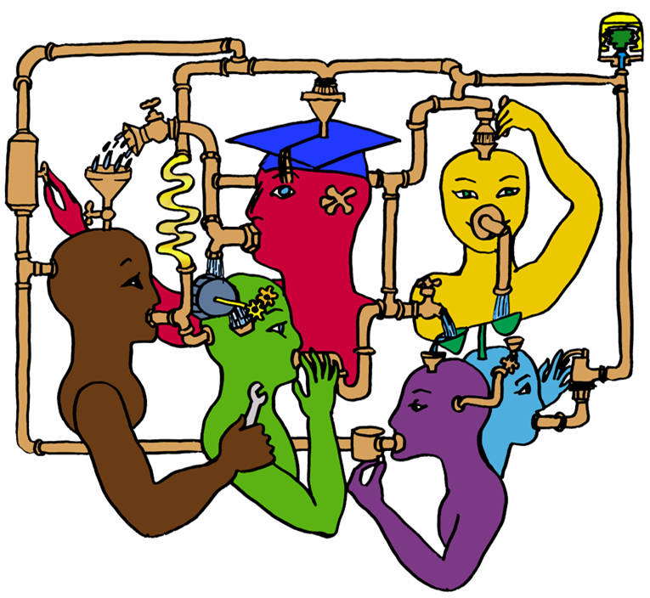
Lila M. Smith
Notes:
8:30-9:30?Take copies of Active Lrn, HTMI, New Paradigms,

Slide 18
Cooperative Learning
Theory – Social Interdependence – Lewin – Deutsch – Johnson & Johnson
Research – Randomized Design Field Experiments
Practice – Formal Teams/Professor’s Role
Theory
Research
Evidence
Practice

Slide 19
Lewin’s Contributions
Founded field of social psychology
Action Research
Force-Field analysis
B = f(P,E)
Social Interdependence Theory
“There is nothing so practical as a good theory”

Slide 20

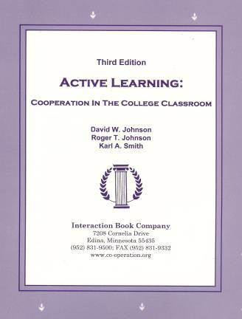
Cooperative Learning
•Positive Interdependence
•Individual and Group Accountability
•Face-to-Face Promotive Interaction
•Teamwork Skills
•Group Processing
[*First edition 1991]

Slide 21
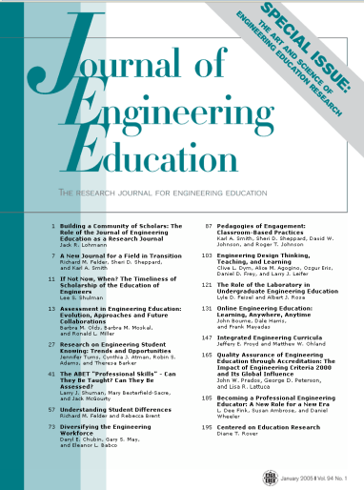

Cooperative Learning Research Support
Johnson, D.W., Johnson, R.T., & Smith, K.A. 1998. Cooperative learning returns to college: What evidence is there that it works? Change, 30 (4), 26-35.
• Over 300 Experimental Studies
• First study conducted in 1924
• High Generalizability
• Multiple Outcomes
Outcomes
1. Achievement and retention
2. Critical thinking and higher-level
reasoning
3. Differentiated views of others
4. Accurate understanding of others' perspectives
5. Liking for classmates and teacher
6. Liking for subject areas
7. Teamwork skills
January 2005
March 2007
Notes:
Table summarizes my perception of the shift. A version of this table is available in New Paradigms for Engineering Education -- FIE Conf proceedings 97 (avail on the www)
One of the most significant changes that has occurred is the shift from "pouring in knowledge" to "creating a climate where learning flows among students and the professor"

Slide 22
Small-Group Learning: Meta-analysis
Springer, L., Stanne, M. E., & Donovan, S. 1999. Effects of small-group learning on undergraduates in science, mathematics, engineering, and technology: A meta-analysis. Review of Educational Research, 69(1), 21-52.
Small-group (predominantly cooperative) learning in postsecondary science, mathematics, engineering, and technology (SMET). 383 reports from 1980 or later, 39 of which met the rigorous inclusion criteria for meta-analysis.
The main effect of small-group learning on achievement, persistence, and attitudes among undergraduates in SMET was significant and positive. Mean effect sizes for achievement, persistence, and attitudes were 0.51, 0.46, and 0.55, respectively.
Notes:
Table summarizes my perception of the shift. A version of this table is available in New Paradigms for Engineering Education -- FIE Conf proceedings 97 (avail on the www)
One of the most significant changes that has occurred is the shift from "pouring in knowledge" to "creating a climate where learning flows among students and the professor"

Slide 23
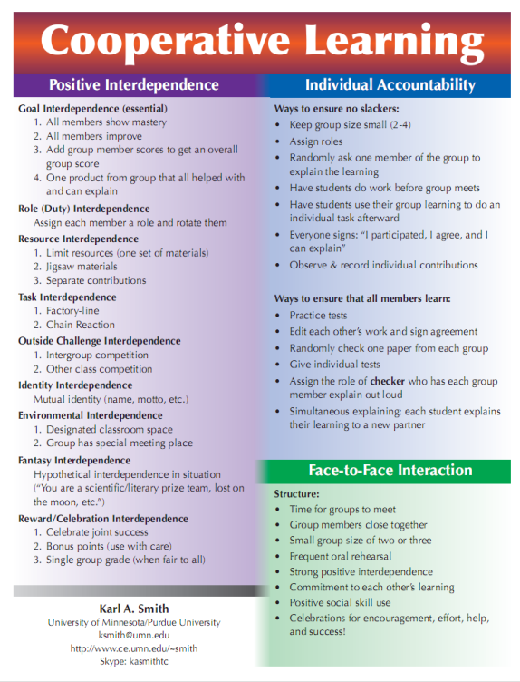
Cooperative Learning is instruction that involves people working in teams to accomplish a common goal, under conditions that involve both positive interdependence (all members must cooperate to complete the task) and individual and group accountability (each member is accountable for the complete final outcome).
Key Concepts
•Positive Interdependence
•Individual and Group Accountability
•Face-to-Face Promotive Interaction
•Teamwork Skills
•Group Processing
http://www.ce.umn.edu/~smith/docs/Smith-CL%20Handout%2008.pdf
Notes:
Table summarizes my perception of the shift. A version of this table is available in New Paradigms for Engineering Education -- FIE Conf proceedings 97 (avail on the www)
One of the most significant changes that has occurred is the shift from "pouring in knowledge" to "creating a climate where learning flows among students and the professor"

Slide 24
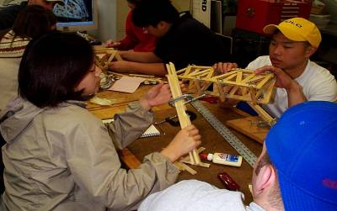
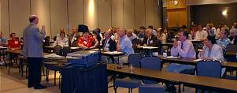
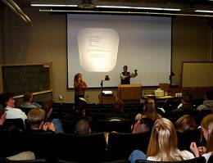
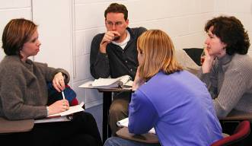
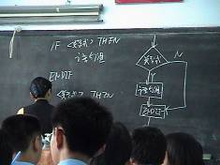
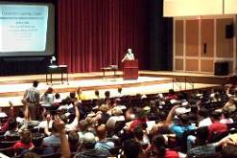
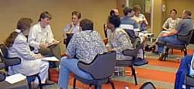
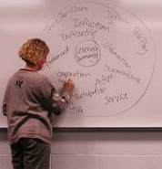
Pedagogies of Engagement

Slide 25
The Active Learning Continuum
Informal
Group
Activities
Structured
Team
Activities
Problems
Drive the
Course
Make the
lecture active
Instructor
Centered
Student
Centered
Active
Learning
Collaborative
Learning
Cooperative
Learning
Problem-
Based
Learning
Prince, M. (2010). NAE FOEE
My work is situated here – Cooperative
Learning & Challenge-Based Learning

Slide 26
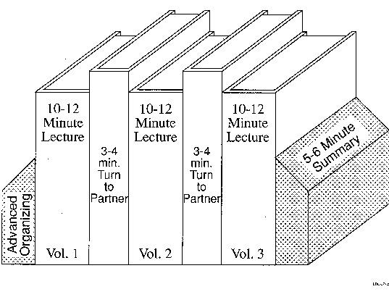
Book Ends on a Class Session

Slide 27
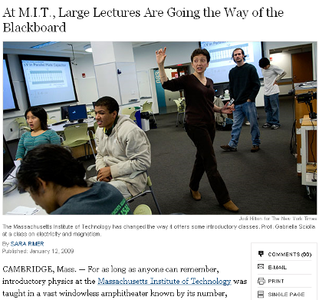
Problem-Based Cooperative Learning
January 13, 2009—New York Times – http://www.nytimes.com/2009/01/13/us/13physics.html?em

Slide 28
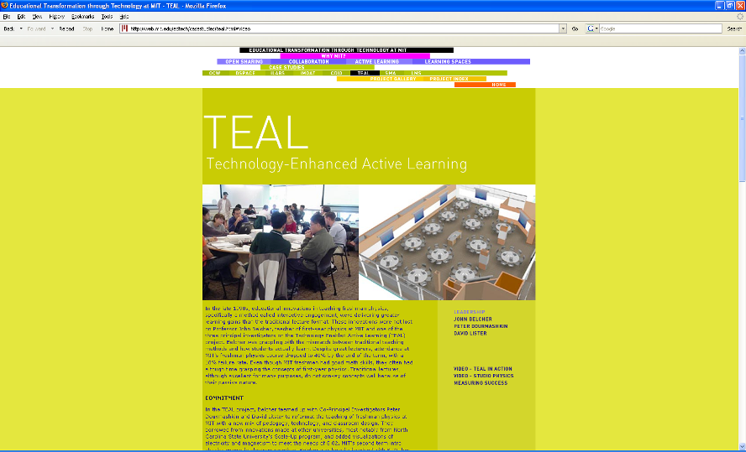
http://web.mit.edu/edtech/casestudies/teal.html#video

Slide 29
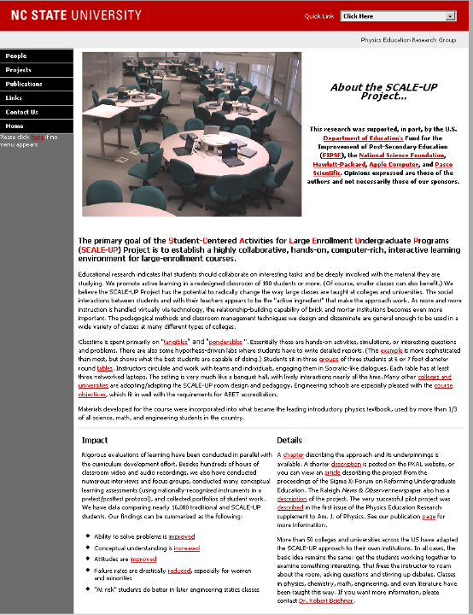
http://www.ncsu.edu/PER/scaleup.html

Slide 30


http://mediamill.cla.umn.edu/mediamill/embed/78755
http://www1.umn.edu/news/news-releases/2010/UR_CONTENT_248261.html

Slide 31
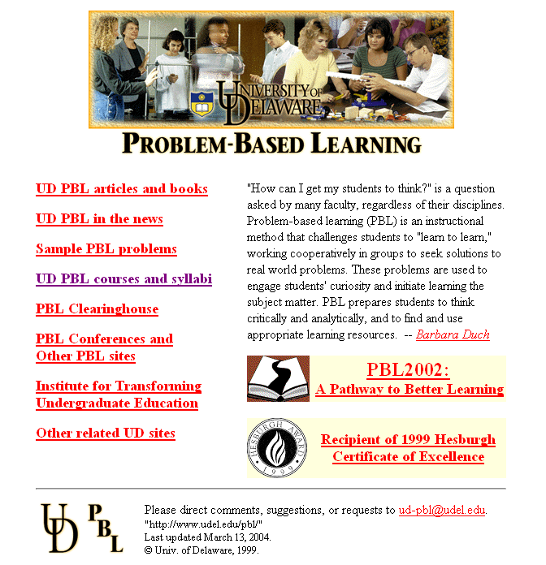
http://www.udel.edu/pbl/

Slide 32
Cooperative Learning Adopted
The American College Teacher:
National Norms for 2007-2008
Methods Used in “All” or “Most” | All – 2005 | All – 2008 | Assistant - 2008
Cooperative Learning | 48 | 59 | 66
Group Projects | 33 | 36 | 61
Grading on a curve | 19 | 17 | 14
Term/research papers | 35 | 44 | 47
http://www.heri.ucla.edu/index.php

Slide 33

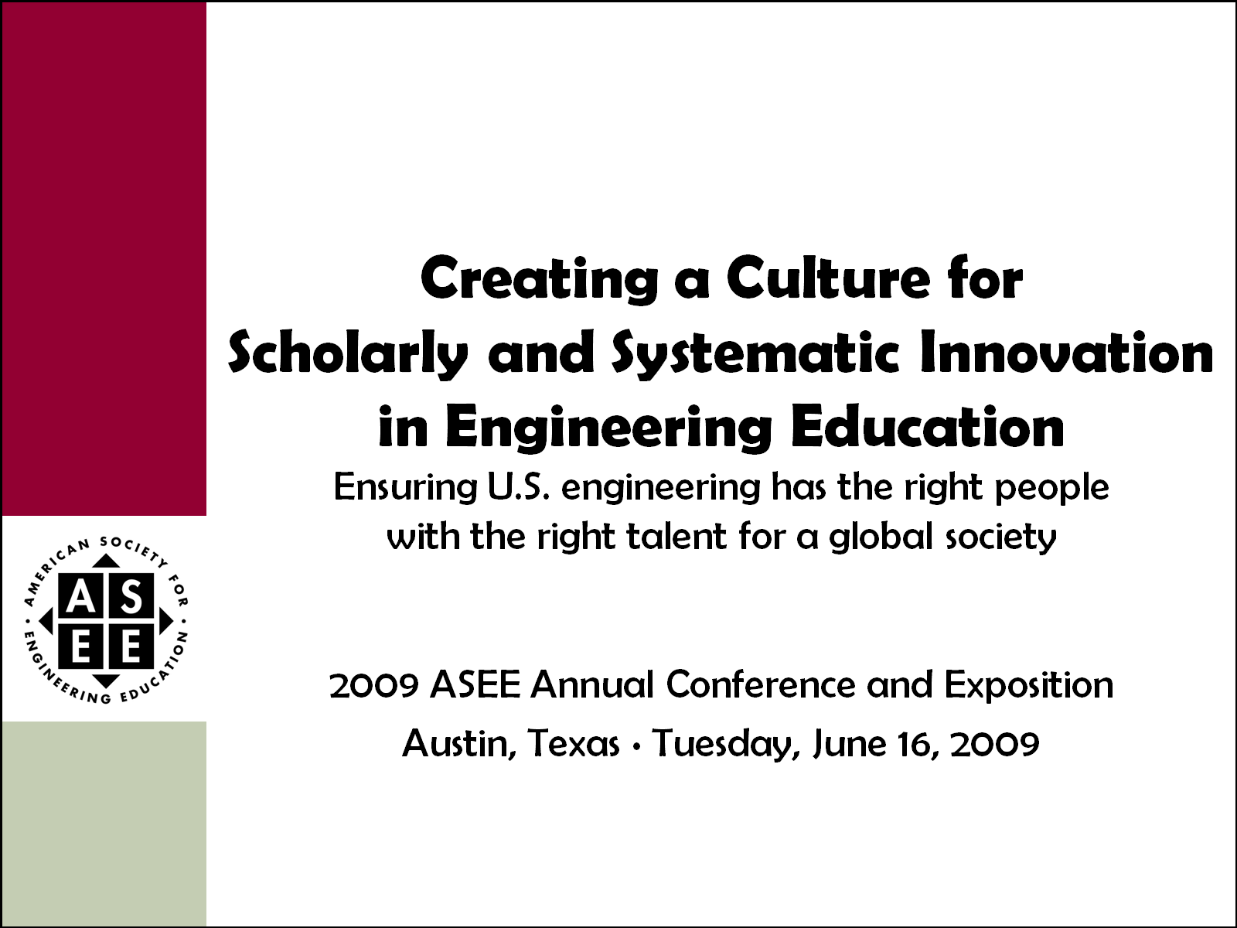
Celebration of Two Major
ASEE Milestones
2011 ASEE Annual Conference and Exposition
Vancouver, British Columbia ∙ Monday, June 27, 2011

Slide 34
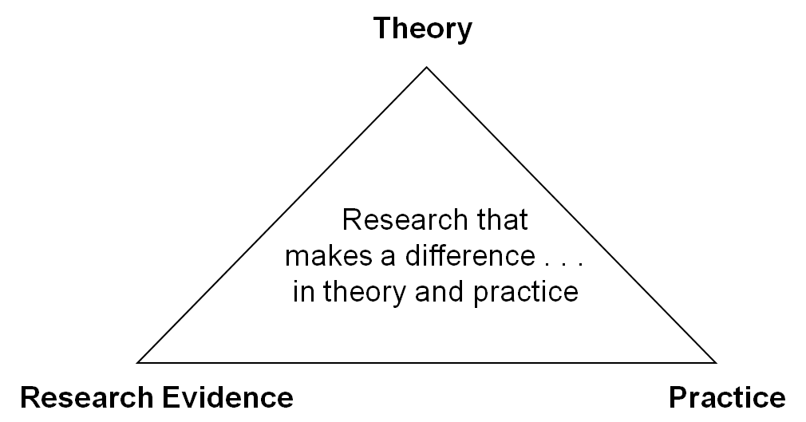
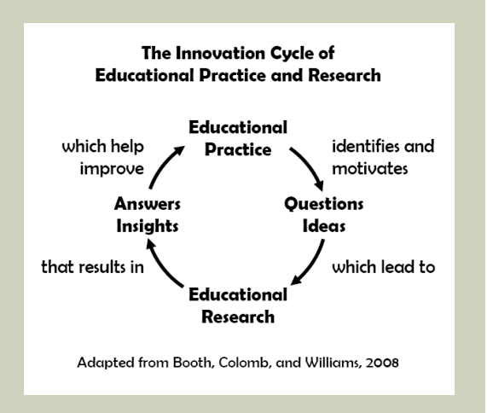

One BIG Idea; Two Perspectives
Jamieson & Lohmann (2009)
Engineering Education Innovation

Slide 35
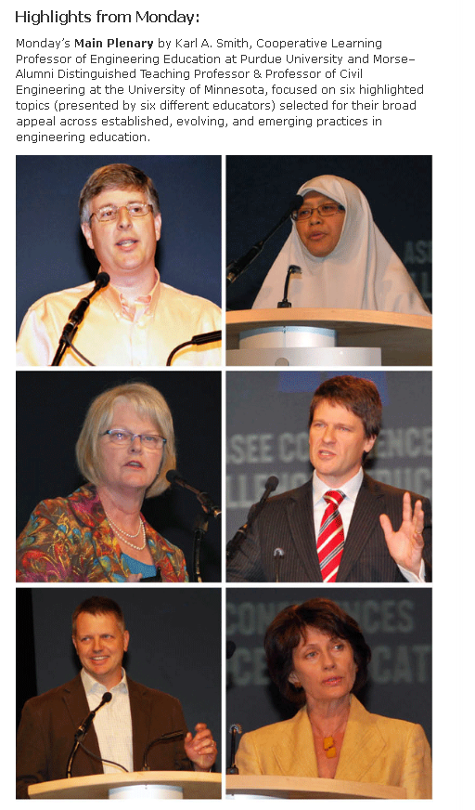
ASEE Main Plenary, 8:45 a.m. – 10:15 a.m.
Vancouver International Conference Centre, West Ballroom CD
Expected to draw over 2,000 attendees, this year’s plenary features Karl A. Smith, Cooperative Learning Professor of Engineering Education at Purdue University and Morse–Alumni Distinguished Teaching Professor & Professor of Civil Engineering at the University of Minnesota.
Smith has been at the University of Minnesota since 1972 and has been active in ASEE since he became a member in 1973. For the past five years, he has been helping start the engineering education Ph.D. program at Purdue University. He is a Fellow of the American Society for Engineering Education and past Chair of the Educational Research and Methods Division. He has worked with thousands of faculty all over the world on pedagogies of engagement, especially cooperative learning, problem-based learning, and constructive controversy.
On the occasion of the 100th anniversary of the Journal of Engineering Education and the release of ASEE’s Phase II report Creating a Culture for Scholarly and Systematic Innovation in Engineering Education (Jamieson/Lohmann report), the plenary will celebrate these milestones and demonstrate rich, mutual interdependences between practice and inquiry into teaching and learning in engineering education. Depth and range of the plenary will energize the audience and reflects expertise and interests of conference participants. One of ASEE’s premier educators and researchers, Smith will draw upon our roots in scholarship to set the stage and weave the transitions for six highlighted topics selected for their broad appeal across established, evolving, and emerging practices in engineering education.

Slide 36


Innovation is the adoption
of a new practice in a community
- Denning & Dunham (2010)

Slide 37
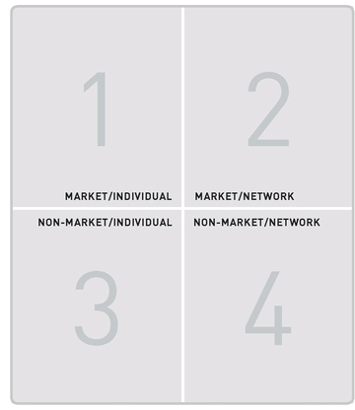
What is the distribution of innovations?
Did it change over time? If so, how?
Where does your innovation fit?
Notes:
What is the distribution of innovations in these 4 quadrants? Did it change over time, and if so, how? Where does your innovation fit?

Slide 38
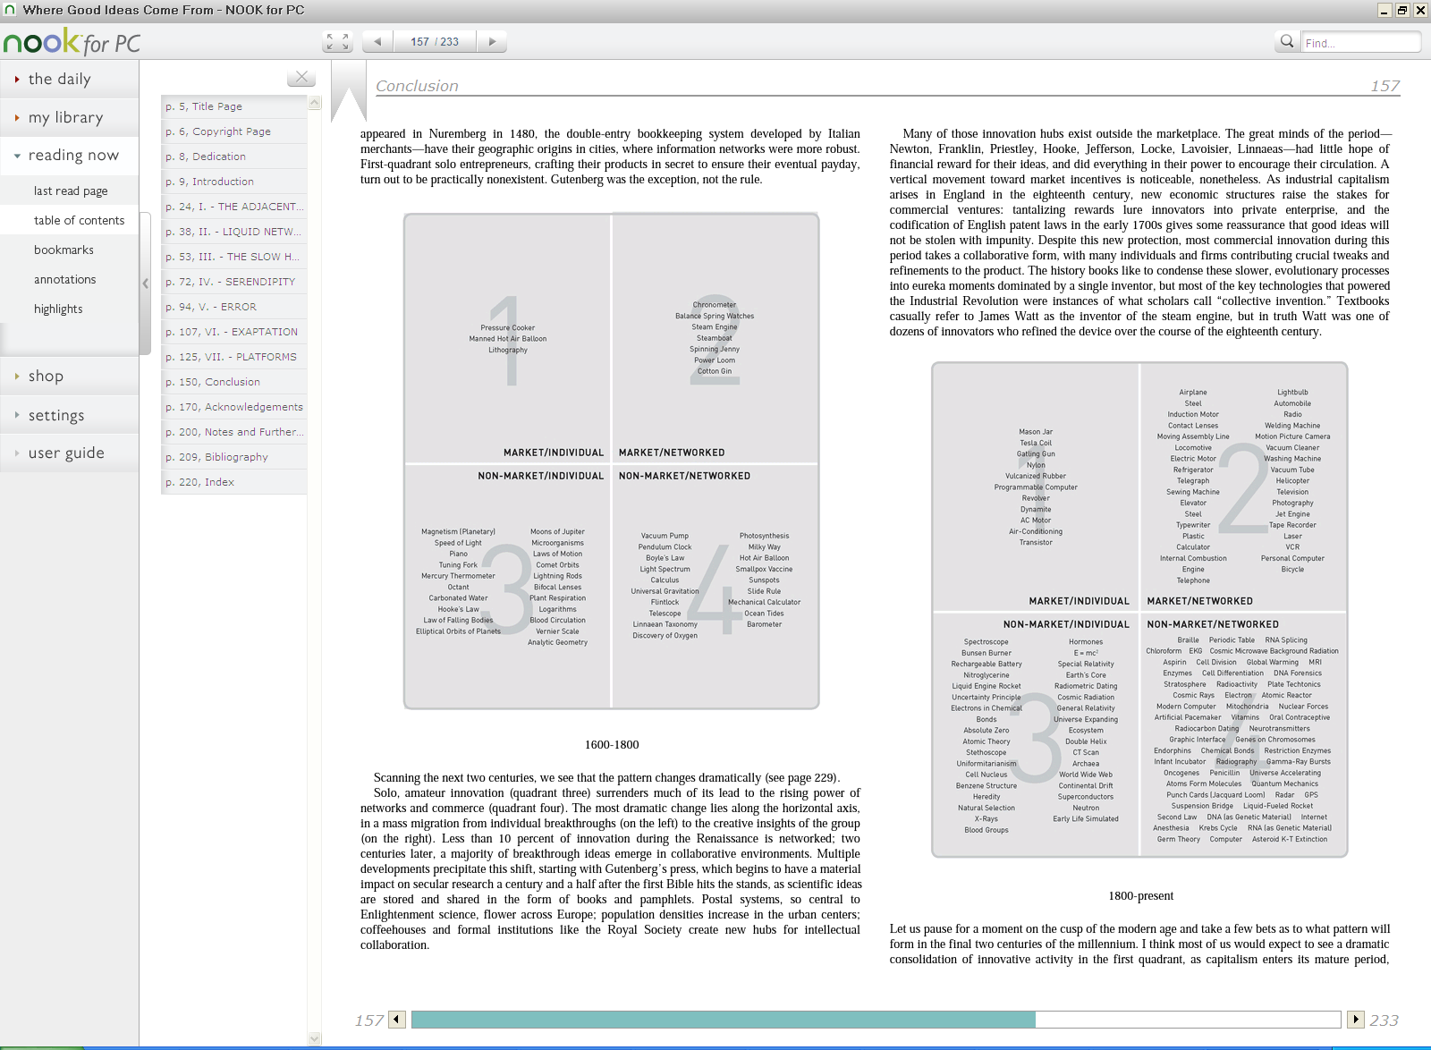
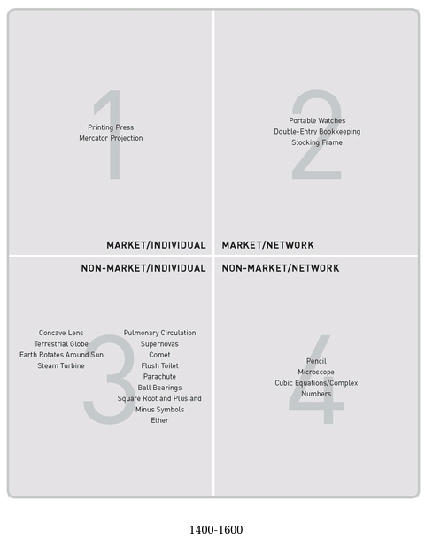

Slide 39


Technology
Three definitions of technology (Arthur, 2009)
A means to fulfill a human purpose
An assemblage of practices and components
The entire collection of devices and engineering practices available to a culture
Three fundamental principles (Arthur, 2009):
All technologies are combinations
Each component of technology is itself in miniature a technology
All technologies harness and exploit some effect or phenomena, usually several

Slide 40
Definitions
Technology – OED
  ☺☹
  systematic treatment of art, craft
Engineering – OED
  The action of the verb ENGINEER; the work done by, or the profession of, an engineer.
Smith – OED
  One who works in iron or other metal
  Original sense – craftsman, skilled worker in metal, wood or other material

Slide 41
Engineering in Popular Media
"Houston, we've got a problem.” Apollo 13
MacGyver?
Myth Busters?
Petroski

Slide 42
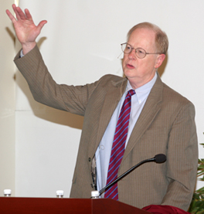
It could well be that faculty members of the twenty-first century college or university will find it necessary to set aside their roles as teachers and instead become designers of learning experiences, processes, and environments.
James Duderstadt, 1999 [Nuclear Engineering Professor; Dean, Provost and President of the University of Michigan]

Slide 43
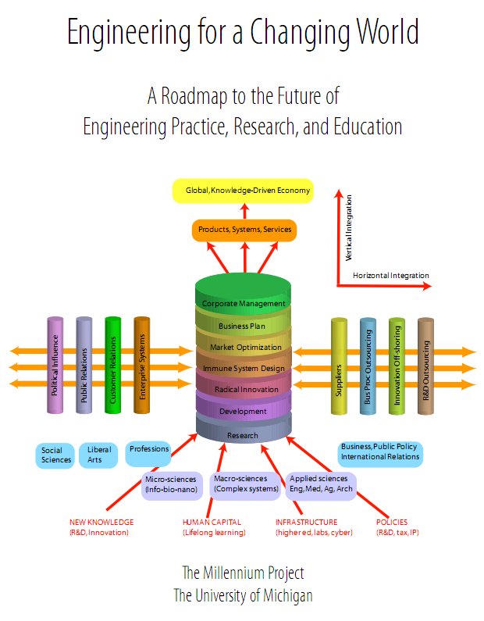
…objectives for engineering practice, research, and education:
To adopt a systemic, research-based approach to innovation and continuous improvement of engineering education, recognizing the importance of diverse approaches–albeit characterized by quality
and rigor–to serve the highly diverse technology needs of our society
http://milproj.ummu.umich.edu/publications/EngFlex%20report/download/EngFlex%20Report.pdf

Slide 44
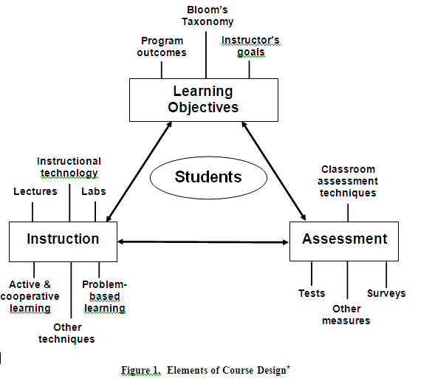
*R.M. Felder and R. Brent. (2003). Designing and Teaching Courses to Satisfy the ABET Engineering Criteria. J. Engr. Education, 92(1), 7–25.

Slide 45
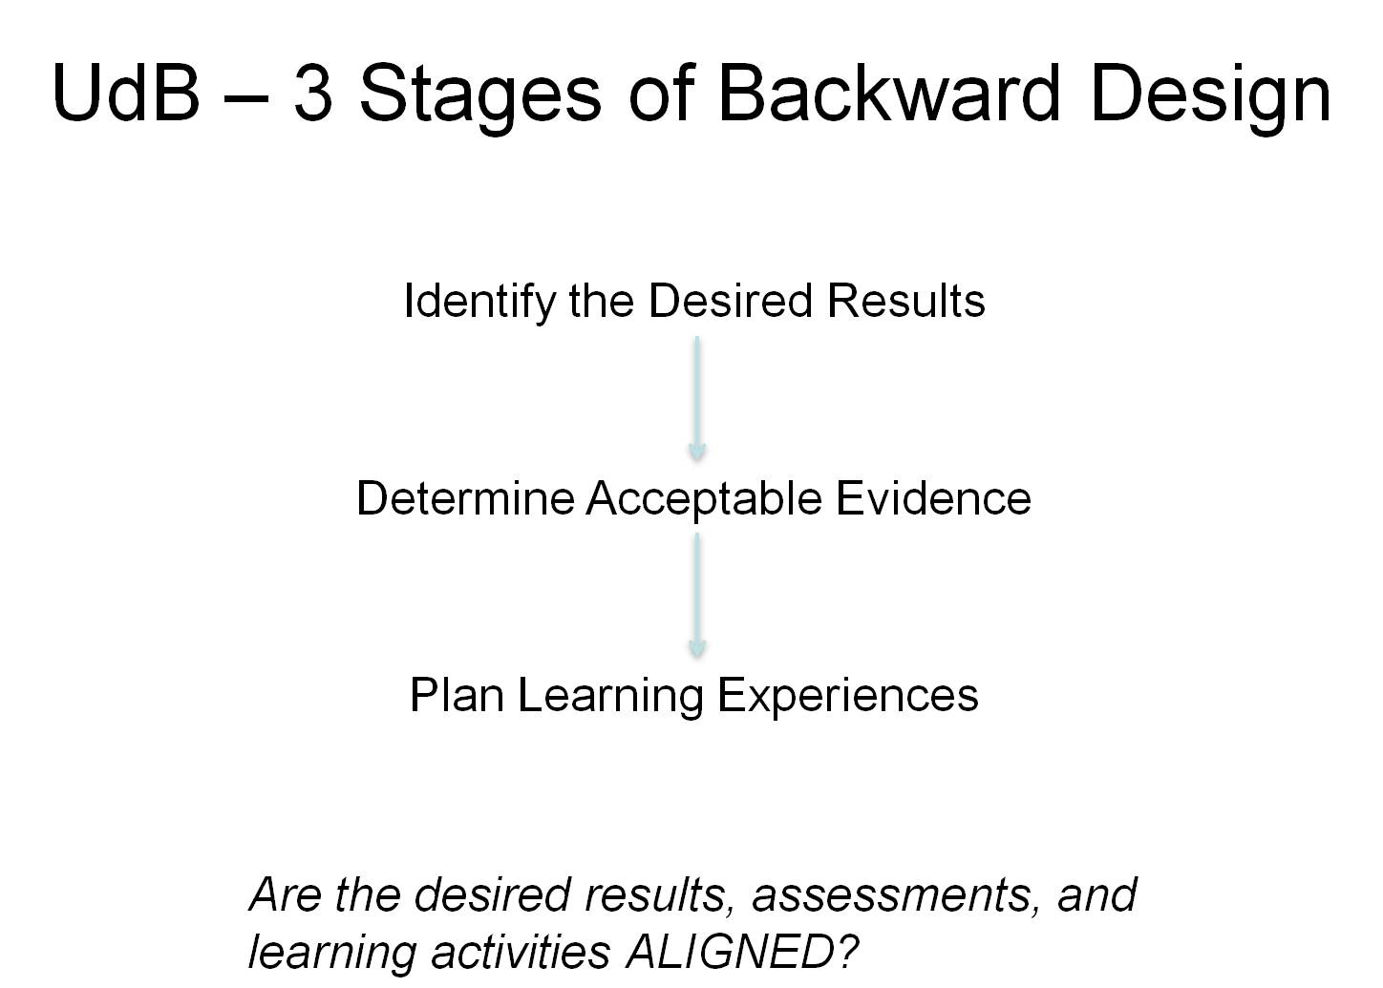
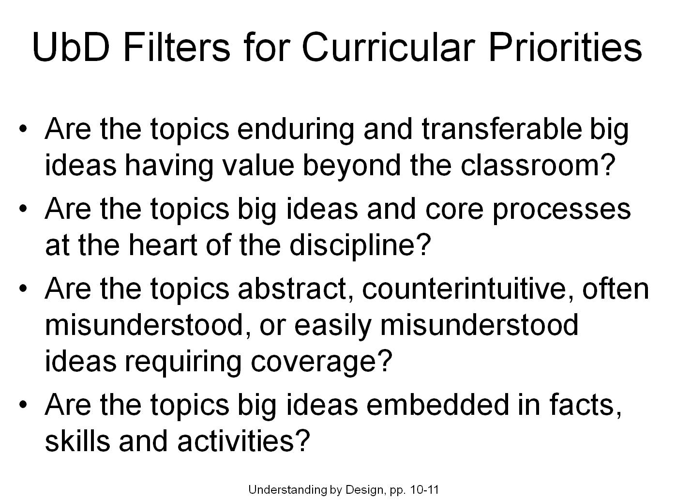
Content-Assessment-Pedagogy (CAP) Design Process Flowchart
Understanding by Design (Wiggins & McTighe, 2005)
Start
Context
Backward Design
Content
Assessment
Pedagogy
No
C & A & P
Alignment?
Yes
End
Streveler, Smith & Pilotte (2011)
Notes:
45

Slide 46
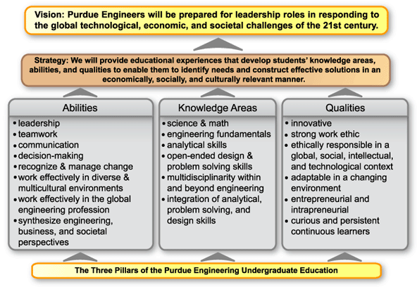
https://engineering.purdue.edu/Engr/Academics/Engineer2020/?pp=1

Slide 47
Desired Attributes of a Global Engineer*
A multidisciplinary, systems perspective, along with a product focus
An awareness of the boundaries of one’s knowledge, along with an appreciation for other areas of knowledge and their interrelatedness with one’s own expertise
An awareness of and strong appreciation for other cultures and their diversity, their distinctiveness, and their inherent value
A strong commitment to team work, including extensive experience with and understanding of team dynamics
High ethical standards (honesty, sense of personal and social responsibility, fairness, etc)
An ability to think both critically and creatively, in both independent and cooperative modes
  *A Manifesto for Global Engineering Education, Summary Report of the Engineering Futures Conference, January 22-23, 1997. The Boeing Company & Rensselaer Polytechnic Institute.

Slide 48

Successful Attributes for the Engineer of 2020
Possess strong analytical skills
Exhibit practical ingenuity; posses creativity
Good communication skills with multiple stakeholders
Business and management skills; Leadership abilities
High ethical standards and a strong sense of professionalism
Dynamic/agile/resilient/flexible
Lifelong learners

Slide 49

Engineering Education Research
Colleges and universities should endorse research in engineering education as a valued and rewarded activity for engineering faculty and should develop new standards for faculty qualifications.

Slide 50
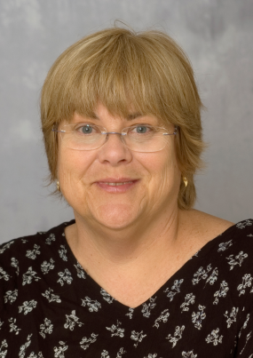
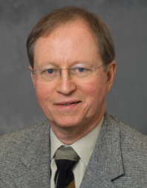
Getting Started in Engineering Education Research
Fundamentals of Engineering Education Research
sponsored by the
ASEE Educational Research
and Methods Division
in partnership with
Rigorous Research in Engineering Education Initiative
CLEERhub.org
And the Journal of Engineering Education
ASEE Annual Conference – June 20, 2010 – Session 0230
Ruth A.Streveler Purdue University
Karl A. Smith Purdue University and University of Minnesota

Slide 51
Levels of Engineering Education Inquiry
Level 0 Teacher
  Teach as taught (“distal pedagogy”)
Level 1 Effective Teacher
  Teach using accepted teaching theories and practices
Level 2 Scholarly Teacher
  Assesses performance and makes improvements
Level 3 Scholar of Teaching and Learning
  Engages in educational experimentation, shares results
Level 4 Engineering Education Researcher
  Conducts educational research, publishes archival papers
Source: Streveler, R., Borrego, M. and Smith, K.A. 2007. Moving from the “Scholarship of Teaching and Learning” to “Educational Research:” An Example from Engineering. Improve the Academy, Vol. 25, 139-149.

Slide 52
Some history about this workshop
Rigorous Research in Engineering Education (RREE1)
  One-week summer workshop, year-long research project
  Funded by National Science Foundation (NSF), 2004-2006
  About 150 engineering faculty participated
Goals
  Identify engineering faculty interested in conducting engineering education research
  Develop faculty knowledge and skills for conducting engineering education research (especially in theory and research methodology)
  Cultivate the development of a Community of Practice of faculty conducting engineering education research

Slide 53
RREE Approach
Theory
(study grounded in theory/conceptual framework)
Research that makes a difference . . . in theory and practice
Research Evidence
Practice
(appropriate design and methodology)
(implications for teaching)
http://inside.mines.edu/research/cee/ND.htm

Slide 54

Guiding Principles for
Scientific Research in Education
Question: pose significant question that can be investigated empirically
Theory: link research to relevant theory
Methods: use methods that permit direct investigation of the question
Reasoning: provide coherent, explicit chain of reasoning
Replicate and generalize across studies
Disclose research to encourage professional scrutiny and critique
National Research Council, 2002
Notes:
Purposes: Exploration, description, explanation

Slide 55
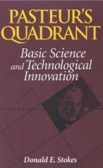
Research can be inspired by …
Use (Applied)
 | No | Yes
Yes | Pure basic research (Bohr) | Use-inspired basic research (Pasteur)
No |  | Pure applied research (Edison)
Understanding
(Basic)
Source: Stokes, D. 1997. Pasteur’s quadrant: Basic science and technological innovation. Washington, DC: Brookings Institution.

Slide 56
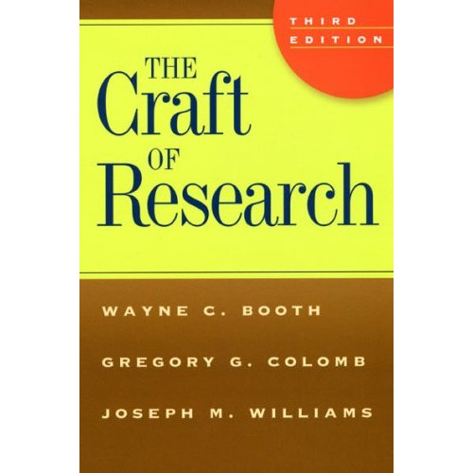
Research Process
Practical
Problem
and helps
motivates
Research Answer
Research Question
leads to
informs
Warrant
Research Problem
Claim Reason Evidence
Research Process
Acknowledgment and Response
Research Reasoning

Slide 57
RREE2
Follow-up proposal has been awarded (RREE2)
Includes a series of 5 short courses*
  Fundamentals of Engineering Education Research
  Selecting Conceptual Frameworks
  Understanding Qualitative Research
  Designing Your Research Study
  Collaborating with Learning and Social Scientists
*To be recorded and posted on the CLEERhub.org

Slide 58
Status of RREE Project
EER workshops and EER – JEE Collaboration
  Fundamentals of Educational Research
    ASEE 2010 - FIE 2010 - SASEE 2011
  Selecting Conceptual Frameworks for Engineering Education Research
    RCEE/UTM Malaysia 2010 - ASEE 2010
  Understanding Qualitative Research
    FIE 2010
  Designing Your Research Study
    ASEE 2011
Collaboratory for Engineering Education Research (CLEERhub.org)

Slide 59

http://cleerhub.org

Slide 60
An emerging global community
Groups, centers, departments
Engineering education societies
Forums for dissemination
What follows is a sample — it is NOT an exhaustive list!

Slide 61
Groups, centers, departments…
EERG
ELC
UCPBLEE
Purdue
ESC
CRLT North
CELT
CASEE
Utah St
VT
FIC
Clemson
UTM
UDLAP
NITTT&R
CREE
UICEE
Engineering Teaching and Learning Centers ― Australia: UICEE, UNESCO International Centre for Engineering Education; Denmark: UCPBLEE, UNESCO Chair in Problem Based Learning in Engineering Education; South Africa: CREE, Centre for Research in Engineering Education, U of Cape Town; Sweden: Engineering Education Research Group, Linköping U; UK: ESC, Engineering Subject Centre, Higher Education Academy; USA: CELT, Center for Engineering Learning and Teaching, U of Washington; CRLT North, Center for Research on Learning and Teaching, U of Michigan; Faculty Innovation Center, U of Texas-Austin; Engineering Learning Center, U of Wisconsin-Madison; CASEE, Center for the Advancement of Scholarship in Engineering Education, National Academy of Engineering.
Engineering Education Degree-granting Departments ― USA: School of Engineering Education, Purdue U; Department of Engineering Education, Virginia Tech; Department of Engineering and Science Education, Clemson U; Department of Engineering and Technology Education, Utah State U; Malaysia: Engineering Education PhD program, Universiti Teknologi Malaysia; India: National Institute for Technical Teacher Training and Research; Mexico: Universidad de las Americas, Puebla
Notes:
Mention the Diplomado Puebla-Tlaxcala (I might have brochures)
Ask participants if they know other groups, centers, or departments in Mexico

Slide 62








Engineering education societies…
Societies with Engineering Education Research Groups ― ASEE, American Society for Engineering Education, Educational Research Methods Division; SEFI, Société Européenne pour la Formation des Ingénieurs (European Society for Engineering Education), Engineering Education Research Working Group; Australasian Association for Engineering Education, Engineering Education Research Working Group; Community of Engineering Education Research Scholars, Latin America and Caribbean Consortium for Engineering Institutions
Societies with Engineering Education Research Interests ― Indian Society for Technical Education, Latin American and Caribbean Consortium of Engineering Institutions, Asociación Nacional de Facultades y Escuelas de Ingeniería (National Association of Engineering Colleges and Schools in Mexico), Internationale Gesellschaft für Ingenieurpädagogik (International Society for Engineering Education), International Federation of Engineering Education Societies, South African Engineering Education Association (SASEE)

Slide 63
Forums for dissemination…
ASEE 2011
FIE 2010
SEFI 2009
GCEE 2009
SEFI/IGIP 2010
ASEE 2010
FIE 2009
GCEE 2010
SASEE 2011
AAEE 2009
REES 2009
Conferences with engineering education research presentations:
ASEE — Annual Conference, American Society for Engineering Education, see www.asee.org
AAEE — Annual Conference, Australasian Association for Engineering Education, see www.aaee.com.au
FIE — Frontiers in Education, sponsored by ERM/ASEE, IEEE Education Society and Computer Society, /fie-conference.org/erm
GCEE — Global Colloquium on Engineering Education, sponsored by ASEE and local partners where the meeting is held, see www.asee.org
SEFI — Annual Conference, Société Européenne pour la Formation des Ingénieurs , see www.sefi.be
REES — Research on Engineering Education Symposium, rees2009.pbwiki.com/
SASEE – South African Society for Engineering Education,

Slide 64
Engineering Education Research Networking Session
Connecting Engineering Education Research Programs from Around the World
sponsored by the
ASEE International Division
in partnership with
Rigorous Research in Engineering Education Initiative
CLEERhub.org
And the Journal of Engineering Education
ASEE Annual Conference – June 22, 2010 – Session 2123
Facilitated By
Karl A. Smith Purdue University and University of Minnesota
Ruth A. Streveler Purdue University
Jack Lohmann
Georgia Tech
Satish Udpa
Michigan State University
Hans Hoyer
ASEE
Stephanie Eng
ASEE

Slide 65
ASEE 2010 – EER PhD Program Briefings
Utah State University – Kurt Becker
Purdue University – David Radcliffe & Robin Adams
Universidad de las Americas, Puebla, Mexico – Enrique Palou
Virginia Tech – Maura Borrego
Universiti Teknologi Malaysia – Zaini Ujang
Clemson University – Lisa Benson
NITTTRs – India – R. Natarajan
Arizona State University – Tirupalavanam Ganesh & Chell Roberts
University of Washington – Cindy Atman
Ohio State University – Lisa Abrams
Carnegie Mellon University – Paul Steif
University of Michigan – Cindy Finelli
Washington State University – Denny Davis
University of Georgia – Nadia Kellam & Joachim Walther
Michigan State University – Jon Sticklen
University of Colorado – Boulder – Daria Kotys-Schwartz
Session slides and links to programs posted to CLEERhub.org

Slide 66
Thank you!
An e-copy of this presentation will be posted to:
http://www.ce.umn.edu/~smith/links.html &
http://CLEERhub.org &
South African Society for Engineering Education (SASEE) – August 10, 2011
ksmith@umn.edu

