Slide 1
Designing Courses for High Quality Learning: An Engineering Approach
Karl A. Smith
STEM Education Center / Technological Leadership Institute / Civil Engineering – University of Minnesota &
Engineering Education – Purdue University
ksmith@umn.edu - http://www.ce.umn.edu/~smith
Oregon State University
College of Engineering
April 28, 2014

Slide 2
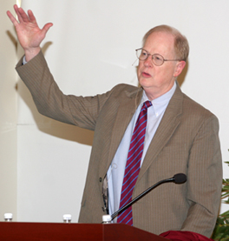
“It could well be that faculty members of the twenty-first century college or university will find it necessary to set aside their roles as teachers and instead become designers of learning experiences, processes, and environments.”
James Duderstadt, 1999
Nuclear Engineering Professor; Former Dean, Provost and President of the University of Michigan

Slide 3










Global Calls
for Reform
Research-based Transformation
K-12 Engineering

Slide 4


Discipline-Based Education Research (DBER)
Understanding and Improving Learning in Undergraduate Science and Engineering
http://www.nap.edu/catalog.php?record_id=13362

Slide 5


Study Charge
Synthesize empirical research on undergraduate teaching and learning in physics, chemistry, engineering, biology, the geosciences, and astronomy.
Examine the extent to which this research currently influences undergraduate science instruction.
Describe the intellectual and material resources that are required to further develop DBER.
Notes:
DBER had been emerging in various disciplines for nearly two decades, with little effort to synthesize the research. NSF and BOSE recognized a critical opportunity to synthesize the literature at a time of increasing calls for improved undergraduate science and engineering education.
Make sure to list the disciplines covered by the study.

Slide 6
Committee on the Status, Contributions, and Future Directions of Discipline-Based Education Research
SUSAN SINGER (Chair), Carleton College
ROBERT BEICHNER, North Carolina State University
STACEY LOWERY BRETZ, Miami University
MELANIE COOPER, Clemson University
SEAN DECATUR, Oberlin College
JAMES FAIRWEATHER, Michigan State University
KENNETH HELLER, University of Minnesota
KIM KASTENS, Columbia University
MICHAEL MARTINEZ, University of California, Irvine
DAVID MOGK, Montana State University
LAURA R. NOVICK, Vanderbilt University
MARCY OSGOOD, University of New Mexico
TIMOTHY F. SLATER, University of Wyoming
KARL A. SMITH, University of Minnesota and Purdue University
WILLIAM B. WOOD, University of Colorado
Notes:
The NRC carries out all of its work through expert volunteers. Every study has a committee of expert volunteers who are selected specifically for that study. Each committee is carefully constructed to include a diverse range of expertise and perspectives and to be balanced along many other dimensions, such as gender, geography, ethnicity, and previous NRC committee service.
The Committee on the Status, Contributions, and Future Directions of Discipline-Based Education Research contained a mix of DBER scholars in physics, chemistry, engineering, biology, the geosciences, and astronomy; Cognitive scientists and educational psychologists; and higher-education policy and organization scholars.
Because this was a consensus study, the committee was required to come to consensus about the evidence related to each element of the study charge. The report that I am discussing today is the result of those deliberations, and was jointly authored by the committee.
Acknowledge Michael Martinez.

Slide 7
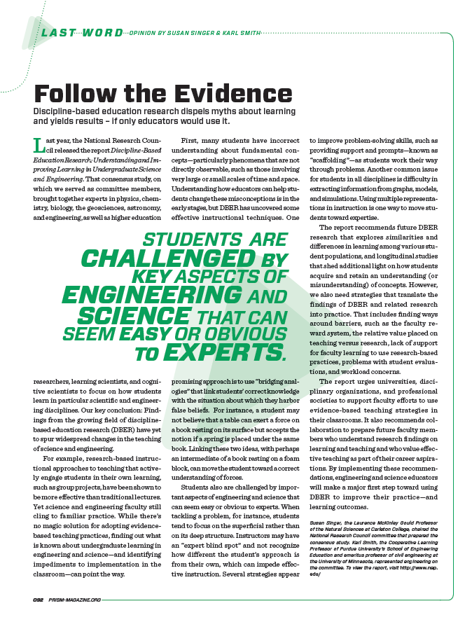
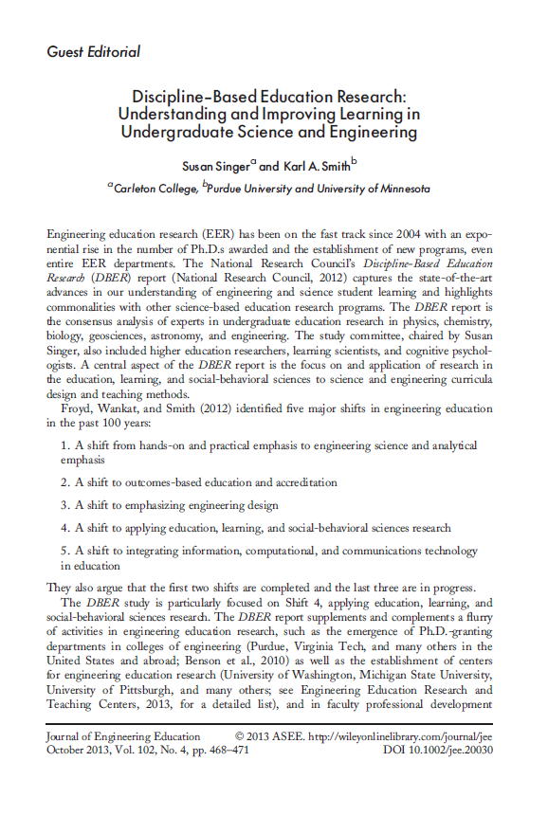
Discipline-Based Education Research (DBER) Report Update
ASEE Prism Summer 2013
National Research Council
Summer 2012 – http://www.nap.edu/
catalog.php?record_id=13362
Journal of Engineering Education
Editorial – October, 2013
Practitioner Guide - In Preparation

Slide 8
Reflection and Dialogue
Individually reflect on Designing Courses for High-Quality Learning. Think/Write for about 1 minute
  Promising Approaches & Innovations
  Ideas for encouraging adoption by colleagues
Discuss with your neighbor for about 2 minutes
  How to propagate and scale education innovations

Slide 9
Understanding Misunderstanding
A Private Universe – www.learner.org
Also see Minds of Our Own (Annenberg/CPB Math and Science Collection – www.learner.org)
Can we believe our eyes?
Lessons from thin air
Under construction
http://www.youtube.com/watch?v=Ng5qzH39nyg

Slide 10
Seminar Layout
Welcome & Overview
Engineering Method
How People Learn and Course Design Foundations
Pedagogies of Engagement (PoE)
  Cooperative Learning
Design and Implementation (Tuesday Workshop)

Slide 11
Seminar/Workshop Objectives
Participants will be able to :
  Articulate an engineering approach to course design
  Summarize research on How People Learn (HPL)
  Describe key features of the Understanding by Design (UbD) process – Content (outcomes) – Assessment – Pedagogy
  Explain key features of and rationale for Pedagogies of Engagement – Cooperative Learning
  Identify connections between cooperative learning and desired outcomes of courses and programs
Participants will begin applying key elements to the design on a course, class session or learning module

Slide 12

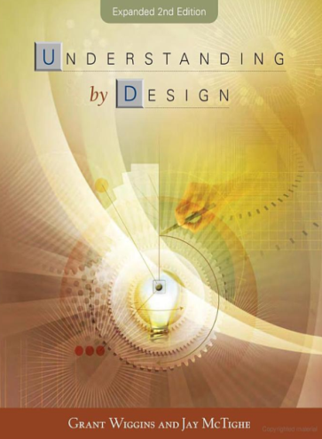
Design Foundations
Science of Instruction (UbD)
 | No | Yes
Yes | Good Theory/ Poor Practice | Good Theory & Good Practice
No |  | Good Practice/ Poor Theory
Science of Learning
(HPL)
Sources: Bransford, Brown & Cocking. 1999. How people learn. National Academy Press.
Wiggins, G. & McTighe, J. 2005. Understanding by design, 2ed. ASCD.
Notes:
Models of how learning works – (1) learning as response strengthening, (2) learning as information acquisition, (3) learning as knowledge construction and (4) learning as social knowledge construction

Slide 13
Engineering
A scientist discovers that which exists. An engineer creates that which never was -- Theodore von Kármán (1881-1963)
The engineering method is design under constraints – Wm. Wulf, Past President, National Academy of Engineering

Slide 14
Engineering
The engineering method is design under constraints – Wm. Wulf, Former President, National Academy of Engineering
The engineering method (design) is the use of state-of-the-art heuristics to create the best change in an uncertain situation within the available resources – Billy Koen, Mechanical Engineering Professor, UT-Austin, author Discussion of the Method, 2003, 2011

Slide 15
Engineering
The engineering method is the use of heuristics to cause the best change in a poorly understood situation within the available resources – Billy Koen, Discussion of the Method (2003)
The engineering method (design) is the use of state-of-the-art heuristics to create the best change in an uncertain situation within the available resources. Billy Koen, 2011

Slide 16
Engineering = Design
Design in a major sense is the essence of engineering; it begins with the identification of a need and ends with a product or system in the hands of a user. It is primarily concerned with synthesis rather than the analysis which is central to engineering science. Design, above all else, distinguishes engineering from science (Hancock, 1986, National Science Foundation Workshop).

Slide 17
Understanding by Design (UbD) Process
vs. Engineering Design Process
Understanding by Design
Identify the desired results
Determine acceptable evidence
Engineering Design
Determine requirements specifications
Develop or use established metrics to measure against outcomes
Plan learning experiences
Plan and develop process, system, etc. to implement
Think about it…
Why is it important to understand the parallels between these two processes?
Notes:
Ask the class if they can think of some other similarities between the two processes.
ADD INSTRUCTOR NOTES

Slide 18
Engineering Education: Advancing the Practice Karl Smith
Research
Process Metallurgy 1969 -1992
Learning ~1974
Design ~1995
Engineering Education Research & Innovation ~ 2000
STEM Education ~ 2010
STEM Innovation – NSF I-Corps-L ~ 2013
Innovation – Cooperative Learning
Need identified ~1974
Introduced ~1976
FIE conference 1981
JEE paper 1981
Research book 1991
Practice handbook 1991…2006
Change paper 1998
Teamwork and project management 2000…2014
JEE paper 2005
Ed Psy Review paper 2007
National Academy of Engineering - Frontiers of Engineering Education Symposium - December 13-16, 2010 - Slides PDF [Smith-NAE-FOEE-HPL-UbD-12-10-v8.pdf]
Notes:
In this seminar I plan to provide links between my experience as a researcher and an innovation that I’m associated with. I’m using Denning and Dunhams (2010) definition of innovation as the adoption of a new practice in a community. Several researchers argue that a principal aspect of innovation is novel combinations, and I will highlight this aspect, too. Individual reflection – what link between research and innovation are you or would you like to be know for?

Slide 19
Process Metallurgy
Dissolution Kinetics – liquid-solid interface
Iron Ore Desliming – solid-solid interface
Metal-oxide reduction roasting – gas-solid interface
Notes:
My process metallurgy experience was at interfaces, which I think helped position me for work at the engineering and education interface

Slide 20
Dissolution Kinetics
Theory – Governing Equation for Mass Transport
Research – rotating disk
Practice – leaching of silver bearing metallic copper & printed circuit-board waste

Slide 21
First Teaching Experience
Practice – Third-year course in metallurgical reactions – thermodynamics and kinetics

Slide 22
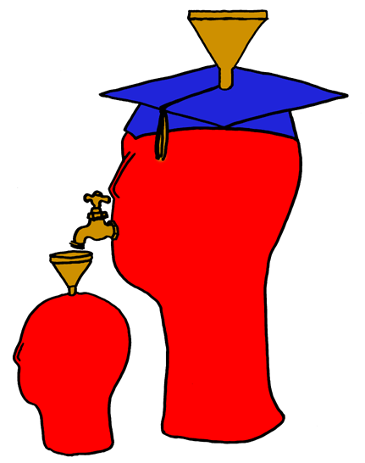
Lila M. Smith
Notes:
8:30-9:30?Take copies of Active Lrn, HTMI, New Paradigms,

Slide 23
Engineering Education
Practice – Third-year course in metallurgical reactions – thermodynamics and kinetics
Research – ?
Theory – ?
Theory
Research
Evidence
Practice

Slide 24
Pedago-pathologies
Amnesia
Fantasia
Inertia
Lee Shulman – MSU Med School – PBL Approach (late 60s – early 70s), President Emeritus of the Carnegie Foundation for the Advancement of College Teaching
Shulman, Lee S. 1999. Taking learning seriously. Change, 31 (4), 11-17.
Notes:
8:30-9:30?Take copies of Active Lrn, HTMI, New Paradigms,

Slide 25
What do we do about these pathologies?
Activity – Engage learners in meaningful and purposeful activities
Reflection – Provide opportunities
Collaboration – Design interaction
Passion – Connect with things learners care about
Shulman, Lee S. 1999. Taking learning seriously. Change, 31 (4), 11-17.

Slide 26
University of Minnesota College of Education
Social, Psychological and Philosophical Foundations of Education
Statistics, Measurement, Research Methodology
Assessment and Evaluation
Learning and Cognitive Psychology
Knowledge Acquisition, Artificial Intelligence, Expert Systems
Development Theories
Motivation Theories
Social psychology of learning – student – student interaction

Slide 27
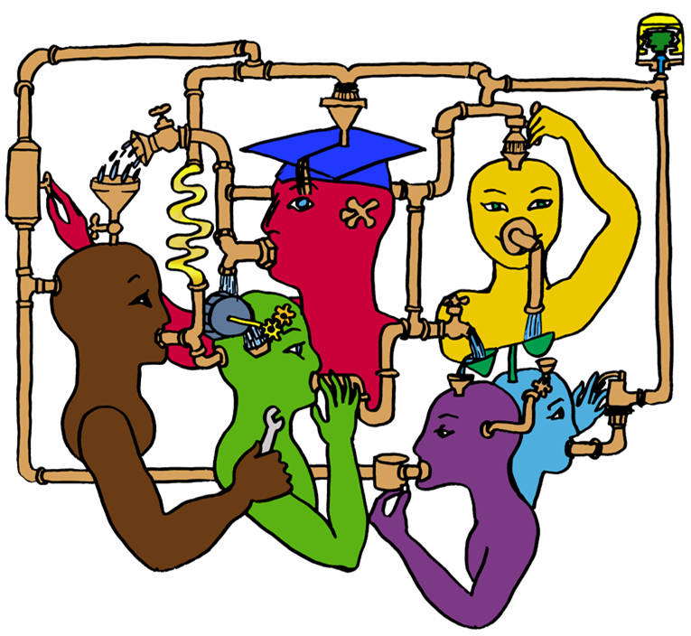
Lila M. Smith
Notes:
8:30-9:30?Take copies of Active Lrn, HTMI, New Paradigms,

Slide 28
Cooperative Learning
Theory – Social Interdependence – Lewin – Deutsch – Johnson & Johnson
Research – Randomized Design Field Experiments
Practice – Formal Teams/Professor’s Role
Theory
Research
Evidence
Practice

Slide 29
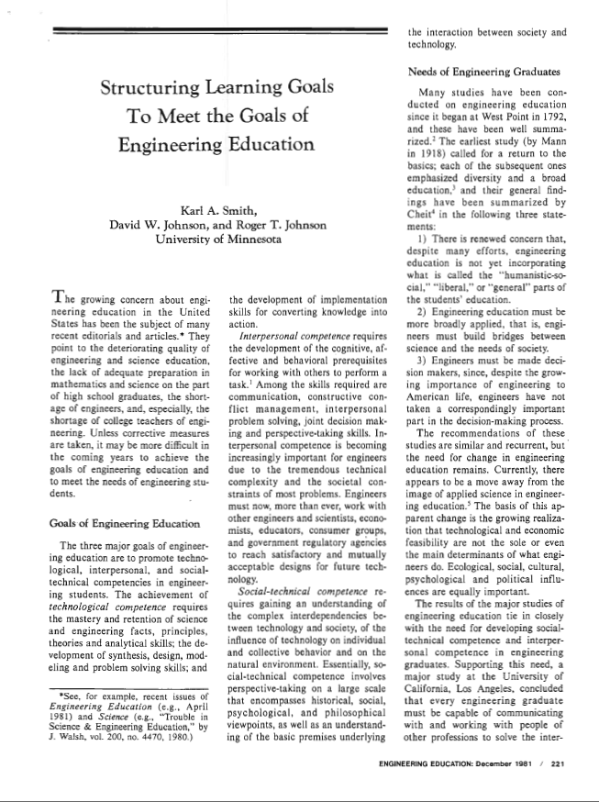
Cooperative Learning Introduced to Engineering – 1981
Smith, K.A., Johnson, D.W. and Johnson, R.T., 1981. The use of cooperative learning groups in engineering education. In L.P. Grayson and J.M. Biedenbach (Eds.), Proceedings Eleventh Annual Frontiers in Education Conference, Rapid City, SD, Washington: IEEE/ASEE, 26‑32.
JEE December 1981

Slide 30
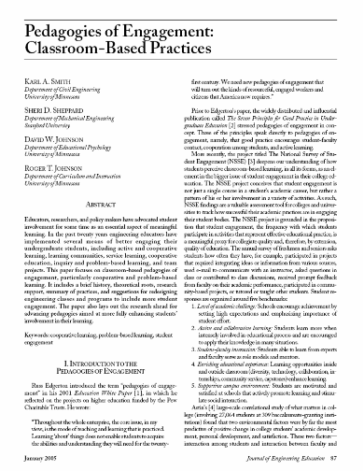
“Throughout the whole enterprise, the core issue, in my view, is the mode of teaching and learning that is practiced. Learning ‘about’ things does not enable students to acquire the abilities and understanding they will need for the twenty-first century. We need new pedagogies of engagement that will turn out the kinds of resourceful, engaged workers and citizens that America now requires.”
Russ Edgerton - 2001 (reflecting on higher education projects funded by the Pew Memorial Trust)
http://www.asee.org/publications/jee/issueList.cfm?year=2005#January2005

Slide 31
Cooperative Learning Adopted
The American College Teacher:
National Norms for 2007-2008
Methods Used in “All” or “Most” | All – 2005 | All – 2008 | Assistant - 2008
Cooperative Learning | 48 | 59 | 66
Group Projects | 33 | 36 | 61
Grading on a curve | 19 | 17 | 14
Term/research papers | 35 | 44 | 47
http://www.heri.ucla.edu/index.php

Slide 32
Undergraduate Teaching Faculty, 2011*
Methods Used in “All” or “Most” | STEM women | STEM men | All other women | All other men
Cooperative learning | 60% | 41% | 72% | 53%
Group projects | 36% | 27% | 38% | 29%
Grading on a curve | 17% | 31% | 10% | 16%
Student inquiry | 43% | 33% | 54% | 47%
Extensive lecturing | 50% | 70% | 29% | 44%
*Undergraduate Teaching Faculty. National Norms for the
2010-2011 HERI Faculty Survey, www.heri.ucla.edu/index.php
Notes:
Karl

Slide 33
Lewin’s Contributions
Founded field of social psychology
Action Research
Force-Field analysis
B = f(P,E)
Social Interdependence Theory
“There is nothing so practical as a good theory”

Slide 34

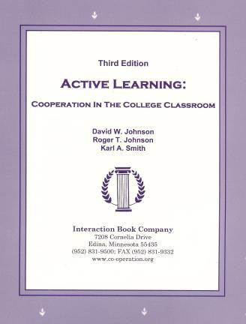
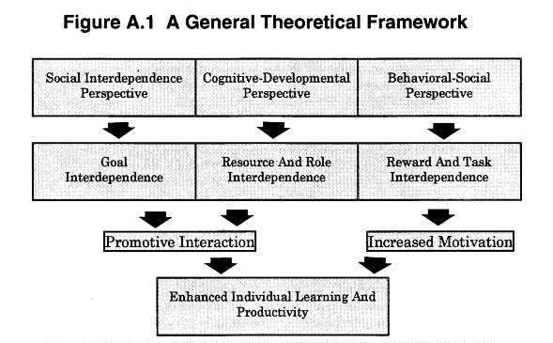
Cooperative Learning
•Positive Interdependence
•Individual and Group Accountability
•Face-to-Face Promotive Interaction
•Teamwork Skills
•Group Processing
[*First edition 1991]

Slide 35
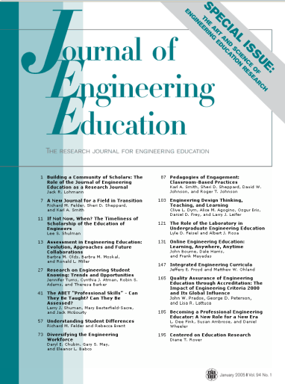

Cooperative Learning Research Support
Johnson, D.W., Johnson, R.T., & Smith, K.A. 1998. Cooperative learning returns to college: What evidence is there that it works? Change, 30 (4), 26-35.
• Over 300 Experimental Studies
• First study conducted in 1924
• High Generalizability
• Multiple Outcomes
Outcomes
1. Achievement and retention
2. Critical thinking and higher-level
reasoning
3. Differentiated views of others
4. Accurate understanding of others' perspectives
5. Liking for classmates and teacher
6. Liking for subject areas
7. Teamwork skills
January 2005
March 2007
Notes:
Table summarizes my perception of the shift. A version of this table is available in New Paradigms for Engineering Education -- FIE Conf proceedings 97 (avail on the www)
One of the most significant changes that has occurred is the shift from "pouring in knowledge" to "creating a climate where learning flows among students and the professor"

Slide 36
Student Engagement Research Evidence
Perhaps the strongest conclusion that can be made is the least surprising. Simply put, the greater the student’s involvement or engagement in academic work or in the academic experience of college, the greater his or her level of knowledge acquisition and general cognitive development …(Pascarella and Terenzini, 2005).
Active and collaborative instruction coupled with various means to encourage student engagement invariably lead to better student learning outcomes irrespective of academic discipline (Kuh et al., 2005, 2007).
See Smith, et.al, 2005 and Fairweather, 2008, Linking Evidence and Promising Practices in Science, Technology, Engineering, and Mathematics (STEM) Undergraduate Education - http://www7.nationalacademies.org/bose/Fairweather_CommissionedPaper.pdf

Slide 37
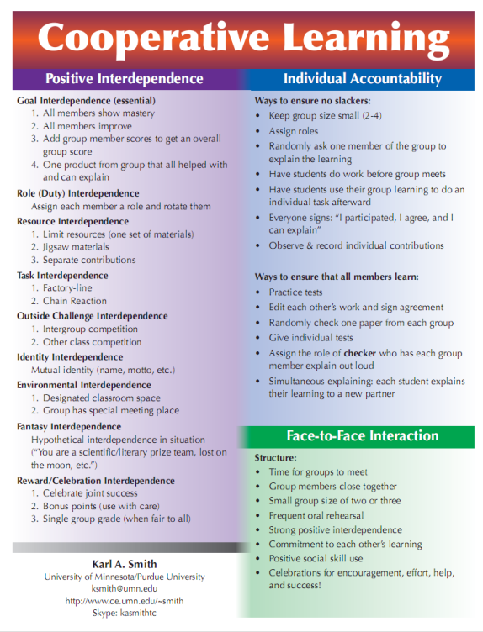
Cooperative Learning is instruction that involves people working in teams to accomplish a common goal, under conditions that involve both positive interdependence (all members must cooperate to complete the task) and individual and group accountability (each member is accountable for the complete final outcome).
Key Concepts
•Positive Interdependence
•Individual and Group Accountability
•Face-to-Face Promotive Interaction
•Teamwork Skills
•Group Processing
http://www.ce.umn.edu/~smith/docs/Smith-CL%20Handout%2008.pdf
Notes:
Table summarizes my perception of the shift. A version of this table is available in New Paradigms for Engineering Education -- FIE Conf proceedings 97 (avail on the www)
One of the most significant changes that has occurred is the shift from "pouring in knowledge" to "creating a climate where learning flows among students and the professor"

Slide 38
Design Foundations
Science of Instruction (UbD)
 | No | Yes
Yes | Good Theory/ Poor Practice | Good Theory & Good Practice
No |  | Good Practice/ Poor Theory
Science of Learning
(HPL)
Sources: Bransford, Brown & Cocking. 1999. How people learn. National Academy Press.
Wiggins, G. & McTighe, J. 2005. Understanding by design, 2ed. ASCD.
Notes:
Models of how learning works – (1) learning as response strengthening, (2) learning as information acquisition, (3) learning as knowledge construction and (4) learning as social knowledge construction

Slide 39

Part I – Introduction
1 Learning: From Speculation to Science 3
Part II – Learners and Learning
2 How Experts Differ from Novices 31
3 Learning and Transfer 51
4 How Children Learn 79
5 Mind and Brain 114
Part III – Teachers and Teaching
6 The Design of Learning Environments 131
7 Effective Teaching: Examples in History, Mathematics, and Science 155
8 Teacher Learning 190
9 Technology to Support Learning 206
Part IV – Future Directions for the Science of Learning
10 Conclusions 233
11 Next Steps for Research 248
http://www.nap.edu/openbook.php?record_id=6160

Slide 40
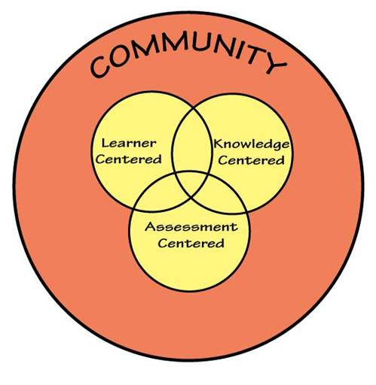
How People Learn (HPL)
HPL Framework
Expertise Implies (Ch. 2):
  a set of cognitive and metacognitive skills
  an organized body of knowledge that is deep and contextualized
  an ability to notice patterns of information in a new situation
  flexibility in retrieving and applying that knowledge to a new problem
Bransford, Brown & Cocking. 1999. How people learn. National Academy Press.

Slide 41

Understanding by Design (UbD)
http://books.google.com/books?id=N2EfKlyUN4QC&printsec=frontcover&source=gbs_v2_summary_r&cad=0#v=onepage&q=&f=false
41
Notes:
41

Slide 42
Understanding by Design Process
What should learners know, understand and be able to do?
Identify the Desired Results
Determine Acceptable Evidence
Learning Activities Aligned
Plan Learning Experience
How will we know if the learners have achieved the desired results?
What will be accepted as evidence of learner’s understanding and proficiency?
What activities will equip learners with the needed knowledge and skills?
What materials and resources will be useful?
Notes:
ADD INSTRUCTOR NOTES

Slide 43
Understanding by Design
Wiggins & McTighe (1997, 2005)
Stage 1. Identify Desired Results
Stage 2. Determine Acceptable Evidence
Stage 3. Plan Learning Experiences
and Instruction
Overall: Are the desired results, assessments, and learning activities ALIGNED?
From: Wiggins, Grant and McTighe, Jay. 1997. Understanding by Design. Alexandria, VA: ASCD
43
Notes:
43

Slide 44
Understanding by Design (UbD) Process
vs. Engineering Design Process
Understanding by Design
Identify the desired results
Determine acceptable evidence
Engineering Design
Determine requirements specifications
Develop or use established metrics to measure against outcomes
Plan learning experiences
Plan and develop process, system, etc. to implement
Think about it…
Why is it important to understand the parallels between these two processes?
Notes:
Ask the class if they can think of some other similarities between the two processes.
ADD INSTRUCTOR NOTES

Slide 45
Understand Big Ideas
HOW PEOPLE LEARN
Notes:
ADD INSTRUCTOR NOTES

Slide 46
Concept: Understanding Big Ideas
LESSON | ACTIVITY
To understand a topic or subject is to use knowledge in sophisticated, flexible ways. Knowledge and skill are necessary elements of understanding, but they are not synonymous with understanding. Matters of understanding require more: Learners need to make conscious sense and apt use of the knowledge they are learning and the principles underlying it. | Break up into pairs. Discuss reasons for why it’s important for students to understand the big ideas. Be prepared to share your top 2 ideas with the class (instructor will document ideas on the large post-it). Using the colored dots, score your top three items. Instructor will tally votes and share out results with the team.
Questions: How do the tallied votes differ from your personal top three? Have your top three reasons changed as a result of this activity? How did this activity help you to better understand the concept of ‘understanding big ideas’?
Notes:
-Understanding by Design,
Wiggins and McTighe (1998)
Since this lesson is critical to the overall course, need to build out instructor notes, so tells a good story. One that students will remember.

Slide 47
Concept: Curricular Priorities
GOOD TO BE FAMILIAR WITH
IMPORTANT TO KNOW
ENDURING OUTCOMES
Things to Consider:
Are the topics enduring and transferable big ideas having value beyond the classroom?
Are the topics big ideas and core processes at the heart of the discipline?
Are the topics abstract, counterintuitive, often misunderstood, or easily misunderstood ideas requiring uncoverage?
Are the topics big ideas embedded in facts, skills and activities?
-Understanding by Design,
Wiggins and McTighe (1998)

Slide 48
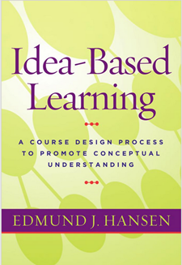
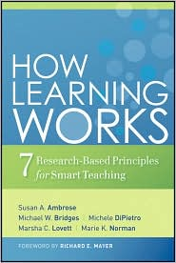
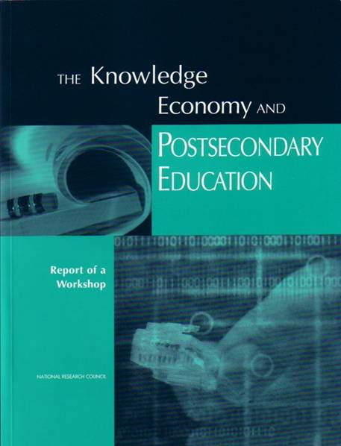
Bransford, Vye and Bateman – Creating High Quality Learning Environments

Slide 49
Students prior knowledge can help or hinder learning
How student organize knowledge influences how they learn and apply what they know
Students’ motivation determines, directs, and sustains what they do to learn
To develop mastery, students must acquire component skills, practice integrating them, and know when to apply what they have learned
Goal-directed practice coupled with targeted feedback enhances the quality of students’ learning
Students’ current level of development interacts with the social, emotional, and intellectual climate of the course to impact learning
To become self-directed learners, students must learn to monitor and adjust their approach to learning

Slide 50
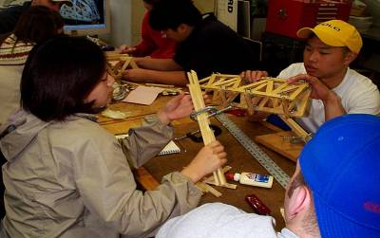
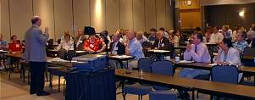
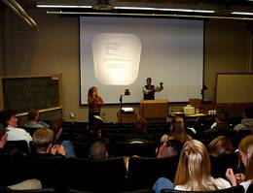
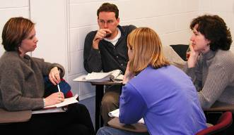
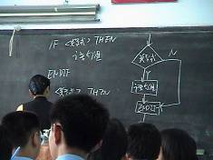
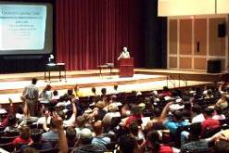
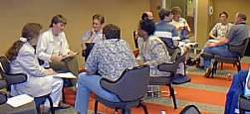
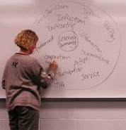
Pedagogies of Engagement (PoE)

Slide 51
Active Learning: Cooperation in the College Classroom
Informal Cooperative Learning Groups
Formal Cooperative Learning Groups
Cooperative Base Groups
Notes: Cooperative Learning
Handout (CL College-912.doc)
www.ce.umn.edu/~smith/docs/CL%20College-912.doc

Slide 52

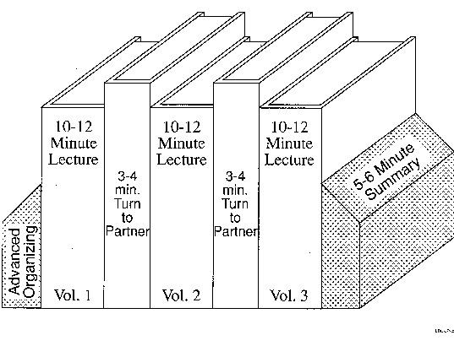
Book Ends on a Class Session
Smith, K.A. 2000. Going deeper: Formal small-group learning in large classes. Energizing large classes: From small groups to learning communities. New Directions for Teaching and Learning, 2000, 81, 25-46. [NDTL81Ch3GoingDeeper.pdf]

Slide 53
Active Learning: Cooperation in the College Classroom
Informal Cooperative Learning Groups
Formal Cooperative Learning Groups
Cooperative Base Groups

Slide 54
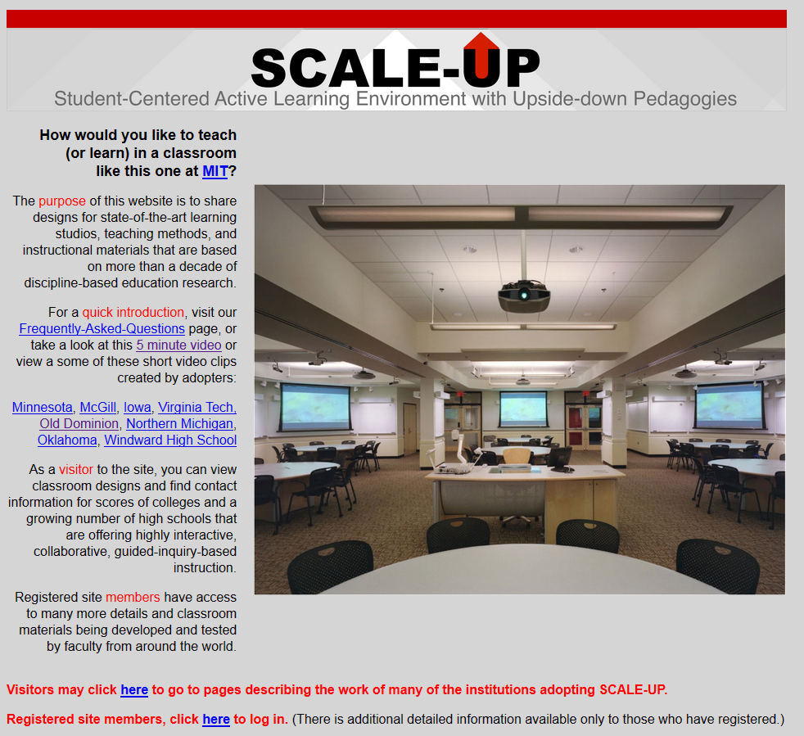
http://scaleup.ncsu.edu/

Slide 55


http://mediamill.cla.umn.edu/mediamill/embed/78755
http://www1.umn.edu/news/news-releases/2010/UR_CONTENT_248261.html
http://www.youtube.com/watch?v=lfT_hoiuY8w
http://youtu.be/lfT_hoiuY8w

Slide 56
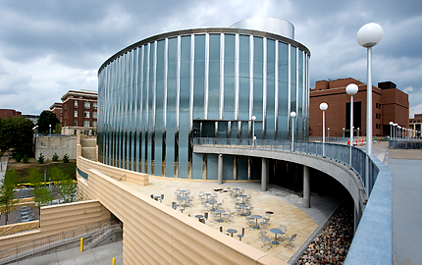
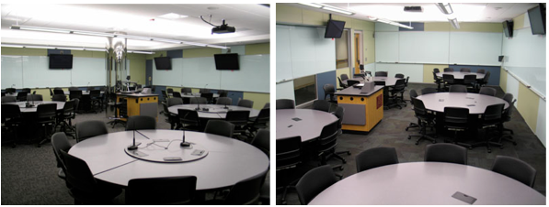
Inside an Active Learning Classroom
STSS in University of Minnesota
http://vimeo.com/andyub/activeclassroom
“I love this space! It makes me feel appreciated as a student, and I feel intellectually invigorated when I work and learn in it.”

Slide 57
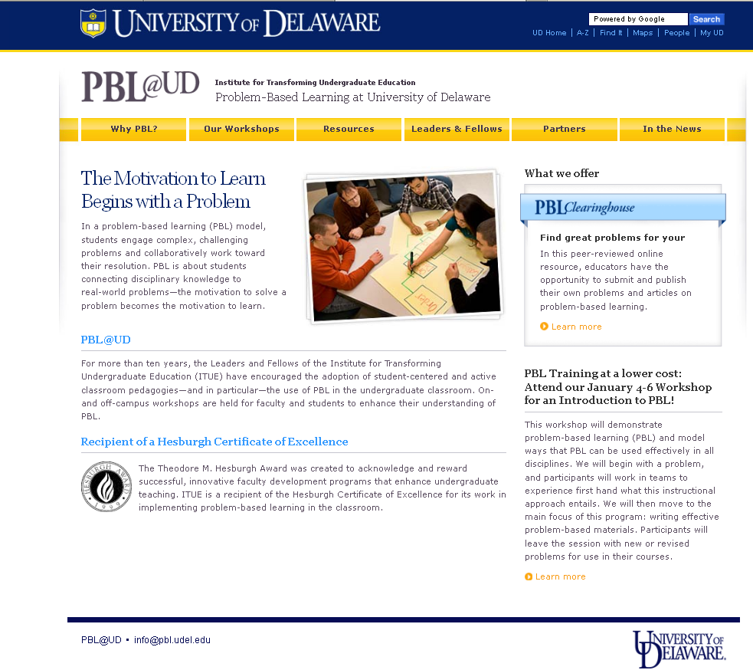
http://www.udel.edu/inst/

Slide 58
PoE Video Examples
Early examples (80s & early 90s)
  Smith
  Derek Bok Center - Harvard
  STEMTEC
Mid 90s
  Felder - NCSU
  U Wisconsin – Chem Concepts
  Jones - Purdue
Recent
  Mazur – Peer Instruction
  University of Minnesota – Active Learning (SCALE-UP)

Slide 59
Session Summary
(Minute Paper)
Reflect on the session:
1. Most interesting, valuable, useful thing you learned.
2. Things that helped you learn.
3. Question, comments, suggestions.
Pace: Too slow 1 . . . . 5 Too fast
Relevance: Little 1 . . . 5 Lots
Instructional Format: Ugh 1 . . . 5 Ah

Slide 60
OSU – Seminar (4-28-14)
Q4 – Pace: Too slow 1 . . . . 5 Too fast (3.0)
Q5 – Relevance: Little 1 . . . 5 Lots (3.9)
Q6 – Format: Ugh 1 . . . 5 Ah (3.7)

