Slide 1
Preparing and Supporting Students to Work in Teams in NTU Learning Environments
Karl A. Smith
Engineering Education – Purdue University
Technological Leadership Institute/ STEM Education Center/ Civil Engineering - University of Minnesota
ksmith@umn.edu - http://www.ce.umn.edu/~smith
Nanyang Business School
Nanyang Technological University
Teaching Strategies for Cooperative Learning Workshop
February – March, 2012

Slide 2
Session Overview
Organizing and Managing Project Teams – Teamwork and Leadership & Leading Learning
Supplemental
  Decision Making in a Team Environment
  Managing Conflict in a Team Environment
  Innovation in a Team Environment

Slide 3
Session Objectives
Strategies for designing high performance teamwork
Strategies for building teamwork skills (task and relationship skills)
Models for processing and monitoring team work
Measures of individual learning in cooperative learning (assurance of learning that demonstrates both individual and group accountability for the task output)

Slide 4
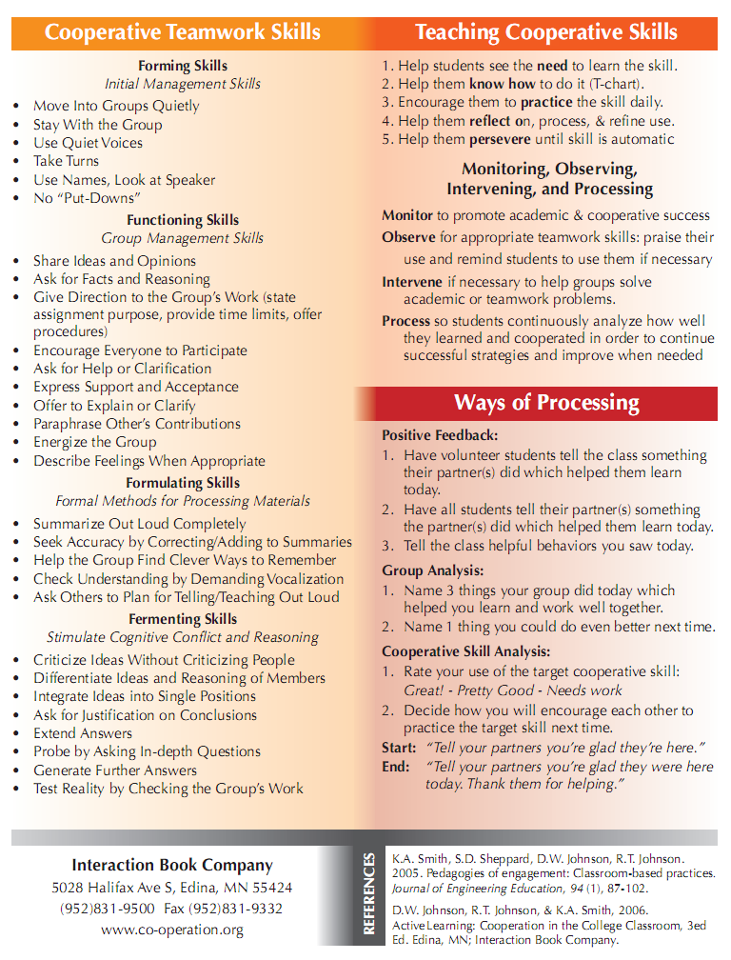
Teamwork Skills
Communication
    Listening and Persuading
Decision Making
Conflict Management
Leadership
Trust and Loyalty

Slide 5
Design team failure is usually due to failed team dynamics
(Leifer, Koseff & Lenshow, 1995).
It’s the soft stuff that’s hard, the hard stuff is easy
(Doug Wilde, quoted in Leifer, 1997)
Professional Skills
(Shuman, L., Besterfield-Sacre, M., and McGourty, J., “The
ABET Professional Skills-Can They Be Taught? Can They Be Assessed?” Journal of Engineering Education, Vo. 94, No. 1, 2005, pp. 41–55.)

Slide 6
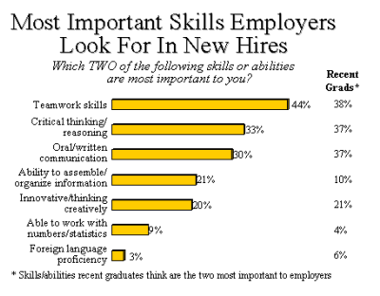
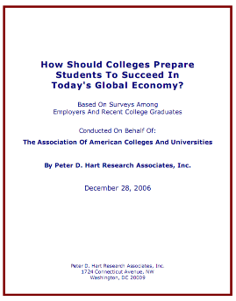
http://www.aacu.org/advocacy/leap/documents/Re8097abcombined.pdf

Slide 7

Top Three Main Engineering Work Activities
Engineering Total
Design – 36%
Computer applications – 31%
Management – 29%
Civil/Architectural
Management – 45%
Design – 39%
Computer applications – 20%
Burton, L., Parker, L, & LeBold, W. 1998. U.S. engineering career trends. ASEE Prism, 7(9), 18-21.

Slide 8
Teamwork

Slide 9
Characteristics of Effective Teams?
?
?

Slide 10
A team is a small number of people with complementary skills who are committed to a common purpose, performance goals, and approach for which they hold themselves mutually accountable
• SMALL NUMBER
• COMPLEMENTARY SKILLS
• COMMON PURPOSE & PERFORMANCE GOALS
• COMMON APPROACH
• MUTUAL ACCOUNTABILITY
--Katzenbach & Smith (1993)
The Wisdom of Teams

Slide 11
Six Basic Principles of Team Discipline
Keep membership small
Ensure that members have complimentary skills
Develop a common purpose
Set common goals
Establish a commonly agreed upon working approach
Integrate mutual and individual accountability
Katzenbach & Smith (2001) The Discipline of Teams

Slide 12

Hackman – Leading Teams
Real Team
Compelling Direction
Enabling Structure
Supportive Organizational Context
Available Expert Coaching
Team Diagnostic Survey (TDS)
https://research.wjh.harvard.edu/TDS/

Slide 13
Real Team
clear boundaries
team members are interdependent for some common purpose, producing a potentially assessable outcome for which members bear collective responsibility
at least moderate stability of membership

Slide 14
Compelling Direction
Good team direction is:
  challenging (which energizes members)
  clear (which orients them to their main purposes)
  consequential (which engages the full range of their talents)

Slide 15
Enabling Structure
Key structural features in fostering competent teamwork
  Task design: The team task should be well aligned with the team’s purpose and have a high standing on “motivating potential.”
  Team composition: The team size should be as small as possible given the work to be accomplished, should include members with ample task and interpersonal skills, and should consist of a good diversity of membership
  Core norms of conduct: Team should have established early in its life clear and explicit specification of the basic norms of conduct for member behavior.

Slide 16
Group Task and Maintenance Roles
Group Task Roles
Group Maintenance Roles
Initiating
Encouraging
Seeking Information
Expressing Feelings
Giving Information
Harmonizing
Seeking Opinions
Compromising
Giving Opinions
Facilitating Communications
Clarifying
Setting Standards or Goals
Elaborating
Testing Agreement
Summarizing
Following

Slide 17
Group Processing
Plus/Delta Format
Plus (+)
Things That Group Did Well
Delta (Δ)
Things Group Could Improve

Slide 18
Team Charter
Team name, membership, and roles
Team Mission Statement
Anticipated results (goals)
Specific tactical objectives
Ground rules/Guiding principles for team participation
Shared expectations/aspirations

Slide 19
Code of Cooperation
•EVERY member is responsible for the team’s progress and success.
•Attend all team meetings and be on time.
•Come prepared.
•Carry out assignments on schedule.
•Listen to and show respect for the contributions of other members; be an active listener.
•CONSTRUCTIVELY criticize ideas, not persons.
•Resolve conflicts constructively,
•Pay attention, avoid disruptive behavior.
•Avoid disruptive side conversations.
•Only one person speaks at a time.
•Everyone participates, no one dominates.
•Be succinct, avoid long anecdotes and examples.
•No rank in the room.
•Respect those not present.
•Ask questions when you do not understand.
•Attend to your personal comfort needs at any time but minimize team disruption.
•HAVE FUN!!
•?
Adapted from Boeing Aircraft Group Team Member Training Manual

Slide 20
Ten Commandments: An Affective Code of Cooperation
• Help each other be right, not wrong.
• Look for ways to make new ideas work, not for reasons they won't.
• If in doubt, check it out! Don't make negative assumptions about each other.
• Help each other win, and take pride in each other's victories.
• Speak positively about each other and about your organization at every opportunity.
• Maintain a positive mental attitude no matter what the circumstances.
• Act with initiative and courage, as if it all depends on you.
• Do everything with enthusiasm; it's contagious.
• Whatever you want; give it away.
• Don't lose faith.
• Have fun
Ford Motor Company

Slide 21
Team Charter Examples & Research
Team Charter – Developed by Vivian Corwin and Marilyn A. Uy for COM 321 (Organizational Behaviour) Gustavson School of Business, University of Victoria
Group Ground Rules Contract Form – Developed by Deborah Allan, University of Delaware
Mathieu, John E. & Rapp, Tammy L. 2009. Laying the foundation for successful team performance trajectories: The role of team charters and performance strategies. Journal of Applied Psychology, 94(1), 90-103

Slide 22
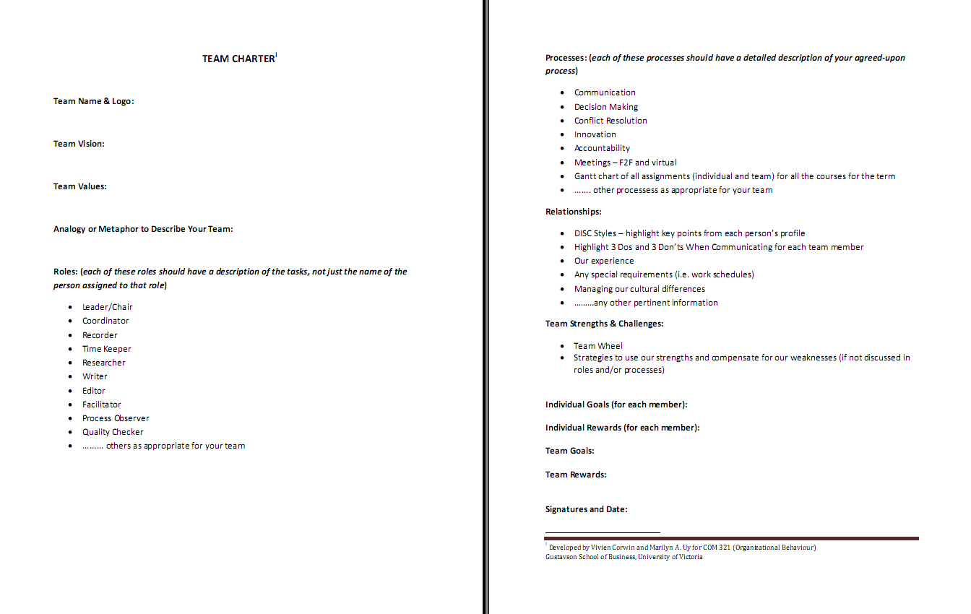

Slide 24
Comparison of Learning Groups
Less Structured (Traditional)
More Structured (Cooperative)
Low interdependence. Members take
High positive interdependence. Members
responsibility only for self. Focus is on
are responsible for own and each other’s
individual performance only.
learning. Focus is on joint performance.
Individual accountability only
Both group and individual accountability.
Members hold self and others accountable
for high quality work.
Assignments are discussed with little
Members promote each other’s success.
commitment to each other’s learning.
The do real work together and help and
support each other’s efforts to learn.
Teamwork skills are ignored. Leader is
Teamwork skills are emphasized. Members
appointed to direct members’ participation.
are taught and expected to use social skills.
All members share leadership
responsibilities.
No group processing of the quality of its
Group processes quality of work and how
work. Individual accomplishments are
effectively members are working together.
rewarded.
rewarded.
Continuous improvement is emphasized.
Continuous improvement is emphasized.
Notes:
Table summarizes my perception of the shift. A version of this table is available in New Paradigms for Engineering Education -- FIE Conf proceedings 97 (avail on the www)
One of the most significant changes that has occurred is the shift from "pouring in knowledge" to "creating a climate where learning flows among students and the professor"

Slide 25
Leadership
Characteristics of Admired Leaders
(people you know and have worked with)
Take 2 minutes and list the characteristics that come to mind for leaders you admire

Slide 26
Characteristics of Admired Leaders (Kouzes & Posner)
Integrity (is truthful, is trustworthy, has character, has convictions)
Competence (is capable, is productive, is efficient)
Leadership (is inspiring, is decisive, provides directions
Based on over 75,000 people around the globe who have completed the “Characteristics of Admired Leaders” survey

Slide 27
Characteristics of Admired Leaders (Percentage of People Selecting Characteristic Over the Years)
Characteristic | 2010 | 2002 | 1987
Honest | 85 | 88 | 83
Forward-looking | 70 | 71 | 62
Inspiring | 69 | 65 | 58
Competent | 64 | 66 | 67
Intelligent | 42 | 47 | 43
Broad-minded | 40 | 40 | 37
Dependable | 37 | 33 | 32
Supportive | 36 | 35 | 32
Fair-minded | 35 | 42 | 40
Straightforward | 31 | 34 | 34
Determined | 28 | 23 | 20
Cooperative | 26 | 28 | 25
Ambitious | 26 | 17 | 21
Courageous | 21 | 20 | 27
Caring | 20 | 20 | 26
Imaginative | 18 | 23 | 34
Loyal | 18 | 14 | 11
Mature | 16 | 21 | 23
Self-controlled | 11 | 8 | 13
Independent | 6 | 6 | 10
Kouzes, J.M. & Posner, B.Z. 2011. Credibility: How leaders gain and lose it and why people demand it. San Francisco: Jossey-Bass

Slide 28
Distributed Actions Approach to Leadership
Leadership is any action that helps a group achieve its goals AND maintain cooperative relationships among members.
Task AND Maintenance

Slide 29
Collins – Level 5 Leadership
Level 5 Level 5 Executive – Builds enduring greatness through a paradoxical combination of personal humility plus professional will
Level 4 Effective Leader – Catalyzes commitment to and vigorous pursuit of a clear and compelling vision; stimulates the group to high performance standards
Level 3 Competent Manager – Organizes people and resource toward the effective and efficient pursuit of predetermined objectives
Level 2 Contributing Team Member
Level 1 Highly Capable Individual

Slide 30
Collins – Good to Great & Built to Last
Check out jimcollins.com for discussion questions to deepen understanding of:
  Level 5 Leadership
  First Who
  Confront the Brutal Facts
  Hedgehog Concept (the Three Circles)
    What it can be best at, How its economics work best, What ignites its people’s passions.
  Culture of Discipline
  Technology Accelerators

Slide 31
Complexity Leadership Theory
Drivers of innovation in adaptive leadership
  Collective identity formation
  Tension
Measuring the space between
  Identifying and bracketing the events, episodes, and interactions of interest
  Capturing these events or interactions as data in a systematic way
  Gathering individual/agent level data that describe interaction cues over time
  Modeling these data in ways that highlight their longitudinal and relational qualities
  Analyzing these data in terms of their relational qualities and longitudinal dynamics
Lichtenstein, et.al., 2006. Complexity leadership theory

Slide 32
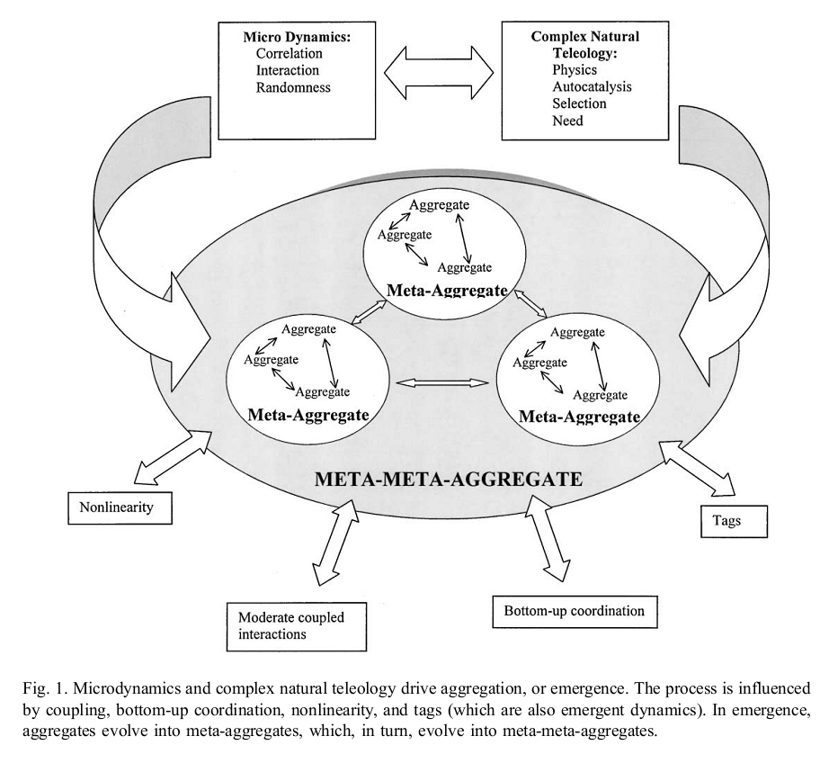
Marion & Uhl-Bien, 2001, Leadership in complex organizations

Slide 33
Nobody in Charge by Harlan Cleveland
Leadership for the Management of Complexity
A lively intellectual curiosity – because everything is related to everything else
A genuine interest in what other people think and why they think that way
A feeling of responsibility for envisioning a future that’s different from straight-line project of the present
A hunch that most risks are there not to be avoided but to be taken
A mindset that crises are normal, tensions can be promising, and complexity is fun
A realization that paranoia and self-pity are reserved for people who don’t want to be leaders
A sense of personal responsibility for the general outcome of your efforts
A quality of “unwarranted optimism”

Slide 34
New Leadership Competencies
The Leader's Handbook (Scholtes, 1998)
1. The ability to think in terms of systems and knowing how to lead systems.
2. The ability to understand the variability of work in planning and problem solving.
3. Understanding how we learn, develop, and improve; leading true learning and improvement.
4. Understanding people and why they behave as they do.
5. Understanding the interaction and interdependence between systems, variability, learning, and human behavior; knowing how each affects the others.
6. Giving vision, meaning, direction, and focus to the organization.

Slide 35
The Ten Commitments of Leadership
(Kouzes & Posner, 1987)
Challenging the Process
1.
Search for Opportunities
2.
Experiment and Take Risks
Inspiring a Shared Vision
3.
Envision the Future
4.
Enlist Others
Enabling Others to Act
5.
Foster Collaboration
6.
Strengthen Others
Modeling the Way
7.
Set the Example
8.
Plan Small Wins
Encouraging the Heart
9.
Recognize Individual Contribution
10.
Celebrate Accomplishments

Slide 36
The Seven Habits of Highly Effective People (Covey, 1989)
Be Pro-Active: Take the initiative and the responsibility to make things happen.
Begin With an End in Mind: Start with a clear destination to understand where you are now, where you're going, and what you value most.
Put First Things First: Manage yourself. Organize and execute around priorities.
Think Win/Win: See life as a cooperative, not a competitive arena where success is not achieved at the expense or exclusion of the success of others.
Seek First to Understand: Understand then be understood to build the skills of empathic listening that inspires openness and trust.
Synergize: Apply the principles of cooperative creativity and value differences.
Renewal: Preserving and enhancing your greatest asset, yourself, by renewing the physical, spiritual, mental and social/emotional dimensions of your nature.

Slide 37
Leading Learning
Key aspects on leading or orchestrating learning for yourself and for others?
  Your experience
  Senge’s ideas?
  Garvin’s ideas?
Rationale for Focusing on Learning?

Slide 38
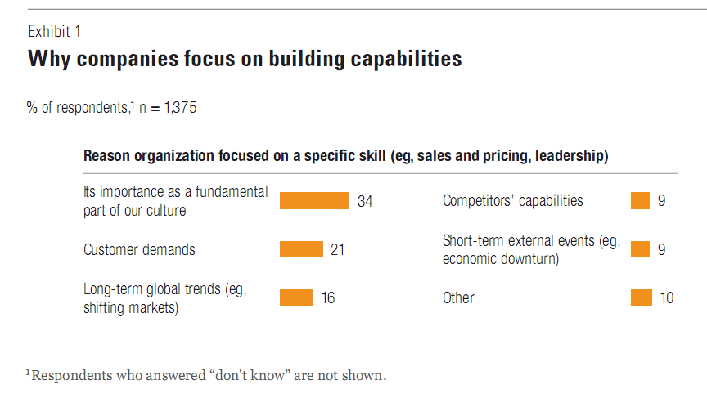
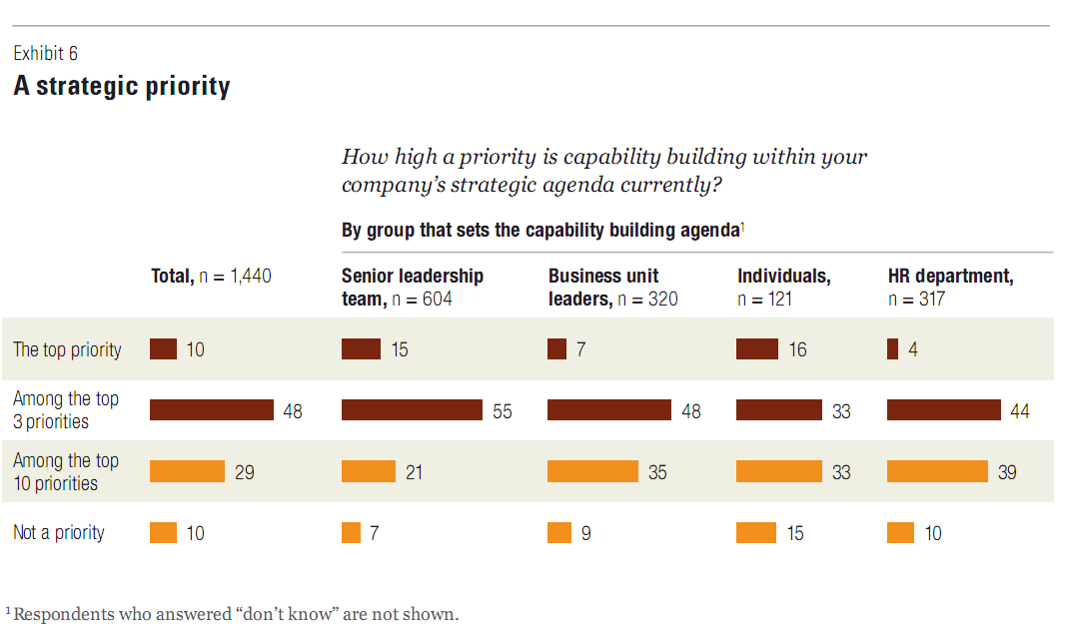
Building Organizational Capabilities
https://www.mckinseyquarterly.com/Organization/Strategic_Organization/Building_organizational_capabilities_McKinsey_Global_Survey_results_2540

Slide 39

Creation Spaces
Creation spaces differ from learning organizations
  They emerge as ecosystems across institutions rather than within a single institution, so they reach a more diverse set of participants
  They are not primarily focused on learning – their goal is to drive more rapid performance improvement, and learning occurs as a byproduct

Slide 40

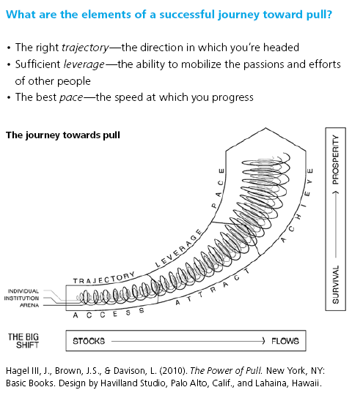
http://www.deloitte.com/assets/Dcom-UnitedStates/Local%20Assets/Documents/TMT_us_tmt/us_tmt_ce_PowerofPull10pages_04132010.pdf

Slide 41
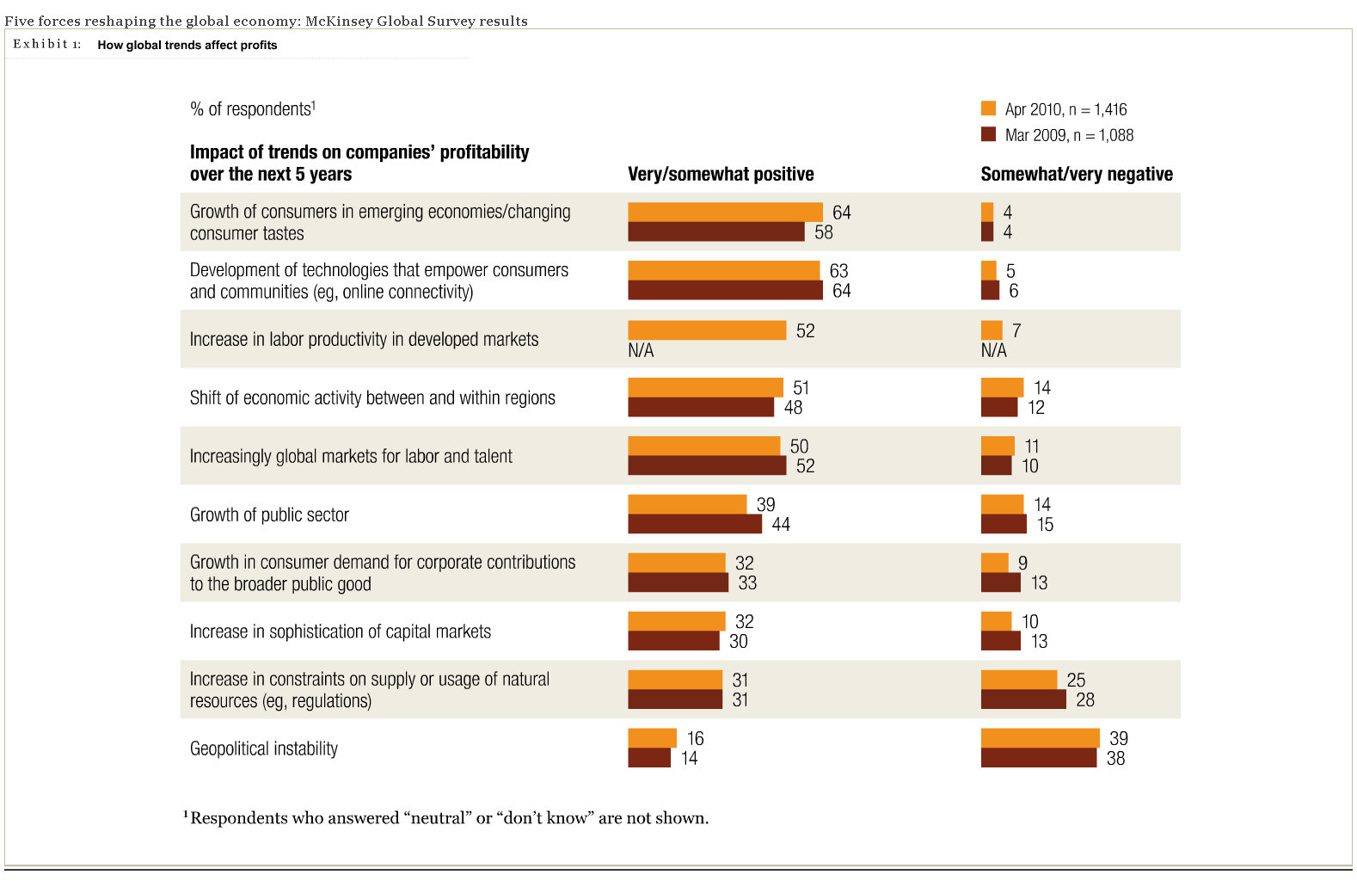
https://www.mckinseyquarterly.com/Strategy/Globalization/Five_forces_reshaping_the_global_economy_McKinsey_Global_Survey_results_2581#1

Slide 42
The Art & Practice of the Learning Organization
Peter Senge (In Ray & Rinzler, 1993)
Building Shared Vision. The idea of building shared vision stresses that you never quite finish it--it's an ongoing process.
Personal Mastery. Learning organizations must be fully committed to the development of each individual's personal mastery--each individual's capacity to create their life the way they truly want.
Mental Models. Our vision of current reality has everything to do with the third discipline--mental models--because what we really have in our lives is constructions, internal pictures that we continually use of interpret and make sense out of the world.
Team Learning. Individual learning, no matter how wonderful it is or how great it makes us feel, if fundamentally irrelevant to organizations, because virtually all important decisions occur in groups. The learning unit of organizations are "teams," groups of people who need one another to act.
Systems Thinking. The last discipline, the one that ties them all together, is systems thinking.
Senge, Peter. 1990. The fifth discipline: The art and practice of the learning organization. New York: Doubleday.
Ray, Michael & Rinzler, Alan. (Eds). 1993. The new paradigm in business: Emerging strategies for leadership and organizational change. Los Angeles: Tarcher/Perigee.

Slide 43
Learning Organization
A learning organization is an organization skilled at creating, acquiring, interpreting, transferring, and retaining knowledge, and at purposefully modifying its behavior to reflect new knowledge and insights – David Garvin
Garvin, David. 2000. Learning in action: A guide to putting the learning organization to work. Cambridge, MA: Harvard Business School Press.

Slide 44
Learning Organization – Litmus Test
Does the organization have a defined learning agenda?
Is the organization open to discordant information?
Does the organization avoid repeated mistakes?
Does the organization lose critical knowledge when key people leave?
Does the organization act on what it knows?
Garvin (2000) p. 15.

Slide 45
Learning Organization – The Learning Process
Stages of learning
  Acquiring Information
  Interpreting Information
  Applying Information
Learning Disabilities
  Biased Information
  Flawed Interpretation – illusory correlation, illusory causation, the illusion of validity, framing effects, categorical bias, availability bias, regression artifacts, hindsight bias
  Inaction
Supportive Learning Environments
  Recognize and Accept Differences
  Provide Timely Feedback
  Stimulate New Ideas
  Tolerate Errors and Mistakes
Garvin (2000) p. 20-43.

Slide 46
Learning Organization – Types of Learning
Intelligence
Gathering Intelligence
Search
Inquiry
Observation
Experience
Reflection and Review
Experiential Learning
Problems that Stimulate Learning
  They are significant (the issues matter to people in the organization)
  They are complex (the solution is not obvious)
  They are multifunctional (participants must work across boundaries(
  They involve difficult people issues (the problems are organizational as well as technical)
  They are action-oriented (the goal is to do something, not simply analyze a situation)
  They are ill-structured (participants must frame and define problems as well as solve them)
  They involve surprises (neither the data nor the results are completely predictable)
Experimentation
Garvin (2000) p. 20-43.

Slide 47
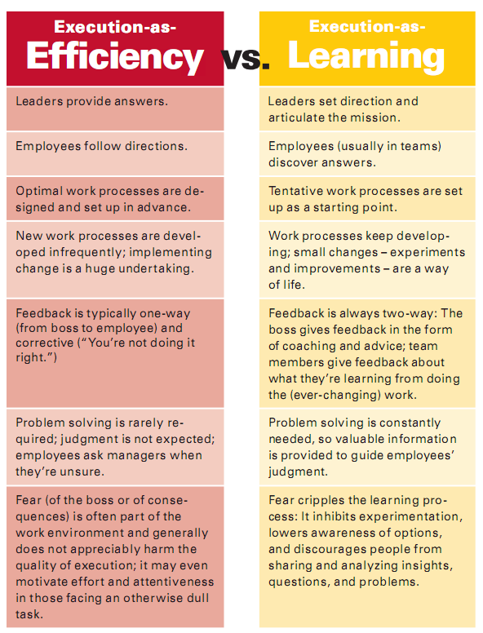
Edmonson-Competitive_Advantage_of_Learning-HBR-2008.pdf

Slide 48
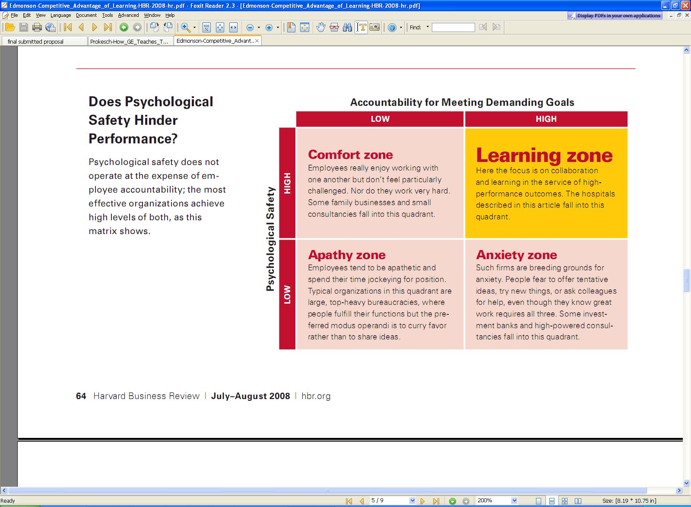
Edmonson-Competitive_Advantage_of_Learning-HBR-2008.pdf

