Slide 1
Pedagogies of Engagement
Cooperative Learning and
Challenge-Based Learning
Karl A. Smith
Engineering Education – Purdue University
Technological Leadership Institute/ STEM Education Center/ Civil Engineering - University of Minnesota
ksmith@umn.edu - http://www.ce.umn.edu/~smith
Nanyang Business School
Nanyang Technological University
Teaching Strategies for Cooperative Learning Workshop
February – March, 2012

Slide 2
Session Layout
Welcome & Overview
Pedagogies of Engagement – Cooperative Learning and Challenge Based Learning
  Informal – Bookends on a Class Session
  Formal Cooperative Learning
Design and Implementation

Slide 3
Workshop Objectives
Participants will be able to
  Explain rationale for Pedagogies of Engagement, especially Cooperative Learning & Challenge Based Learning
  Describe key features of Cooperative Learning
  Apply cooperative learning to classroom practice
  Describe key features of the Understanding by Design and How People Learn
  Identify connections between cooperative learning and desired outcomes of courses and programs

Slide 4
Reflection and Dialogue
Individually reflect on your practice of Pedagogies of Engagement, especially Cooperative Learning and Challenge-Based Learning (Case, Problem, Project). Write for about 1 minute
  Key ideas, insights, applications – Success Stories
  Questions, concerns, challenges
Discuss with your neighbor for about 2 minutes
  Select one Insight, Success Story, Comment, Question, etc. that you would like to present to the whole group if you are randomly selected

Slide 5
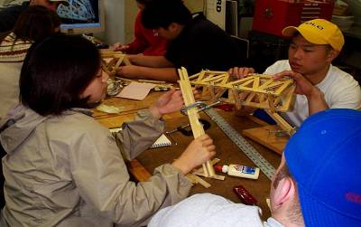
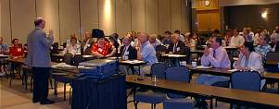
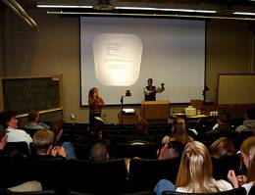
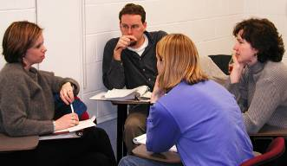
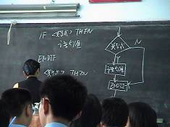
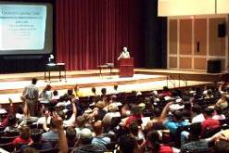
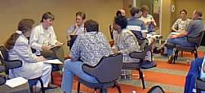
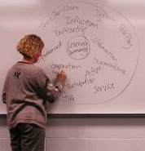
Pedagogies of Engagement

Slide 6
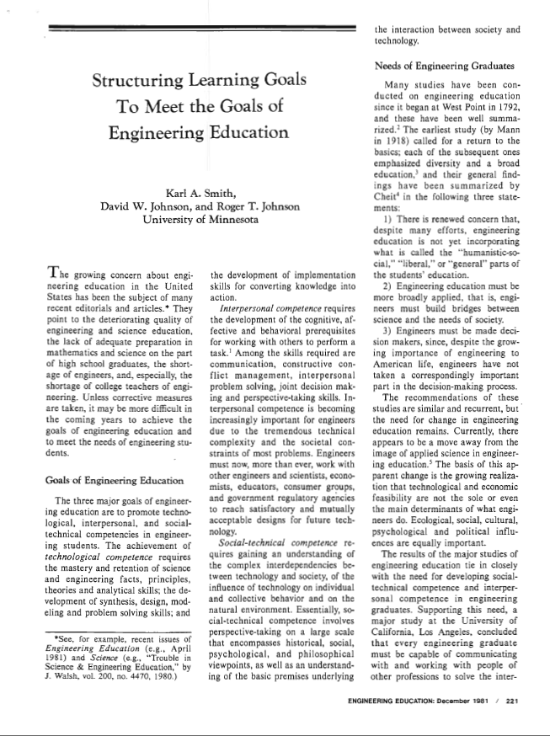
Cooperative Learning Introduced to Engineering – 1981
Smith, K.A., Johnson, D.W. and Johnson, R.T., 1981. The use of cooperative learning groups in engineering education. In L.P. Grayson and J.M. Biedenbach (Eds.), Proceedings Eleventh Annual Frontiers in Education Conference, Rapid City, SD, Washington: IEEE/ASEE, 26‑32.
JEE December 1981

Slide 7
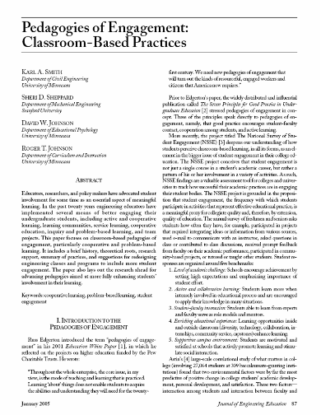
“Throughout the whole enterprise, the core issue, in my view, is the mode of teaching and learning that is practiced. Learning ‘about’ things does not enable students to acquire the abilities and understanding they will need for the twenty-first century. We need new pedagogies of engagement that will turn out the kinds of resourceful, engaged workers and citizens that America now requires.”
Russ Edgerton (reflecting on higher education projects funded by the Pew Memorial Trust)
http://www.asee.org/publications/jee/issueList.cfm?year=2005#January2005

Slide 8
Cooperative Learning Adopted
The American College Teacher:
National Norms for 2007-2008
Methods Used in “All” or “Most” | All – 2005 | All – 2008 | Assistant - 2008
Cooperative Learning | 48 | 59 | 66
Group Projects | 33 | 36 | 61
Grading on a curve | 19 | 17 | 14
Term/research papers | 35 | 44 | 47
http://www.heri.ucla.edu/index.php

Slide 9

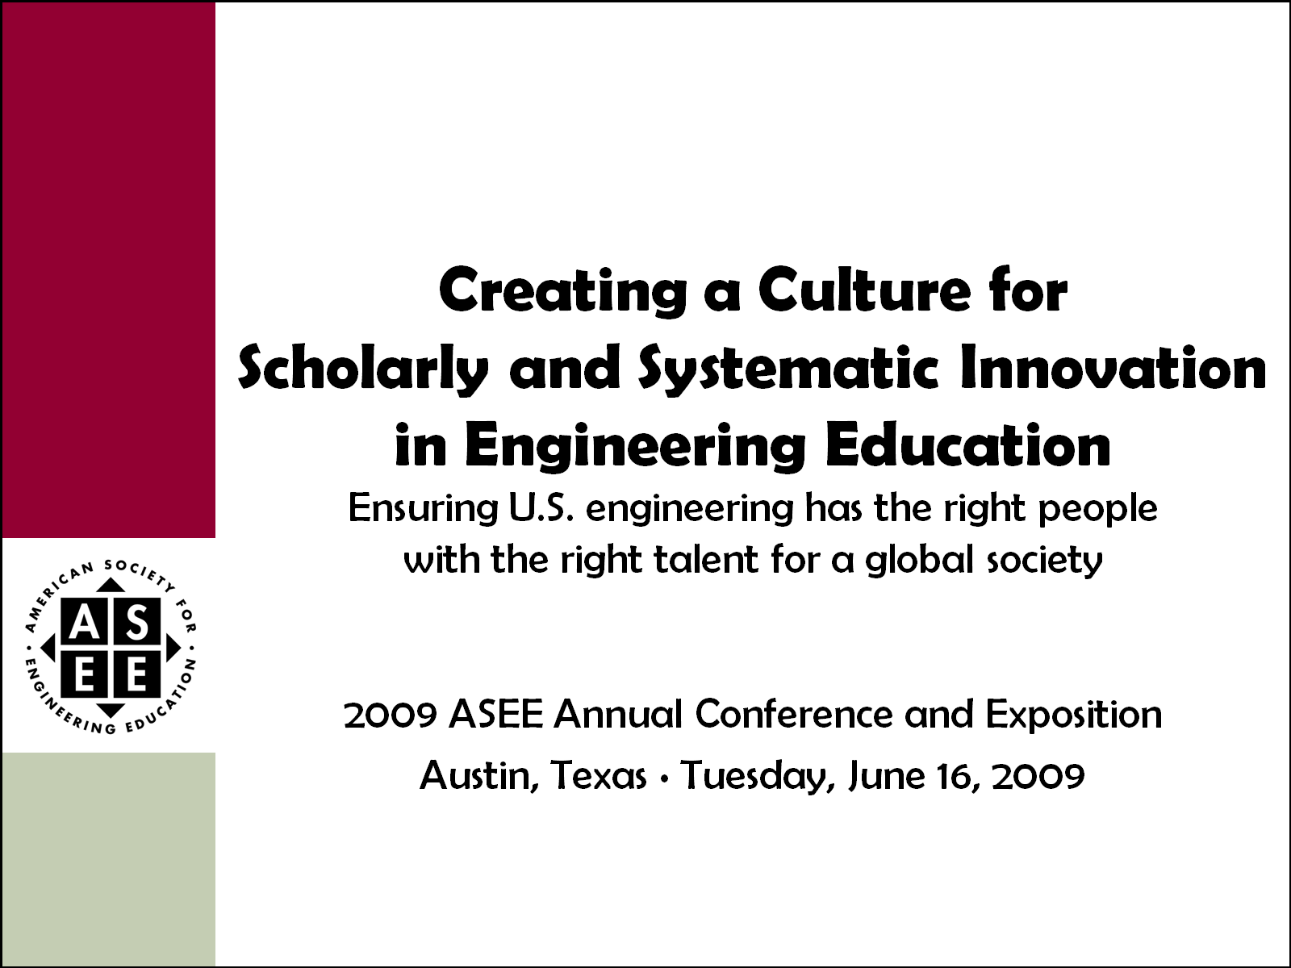
Celebration of Two Major
ASEE Milestones
2011 ASEE Annual Conference and Exposition
Vancouver, British Columbia ∙ Monday, June 27, 2011

Slide 10
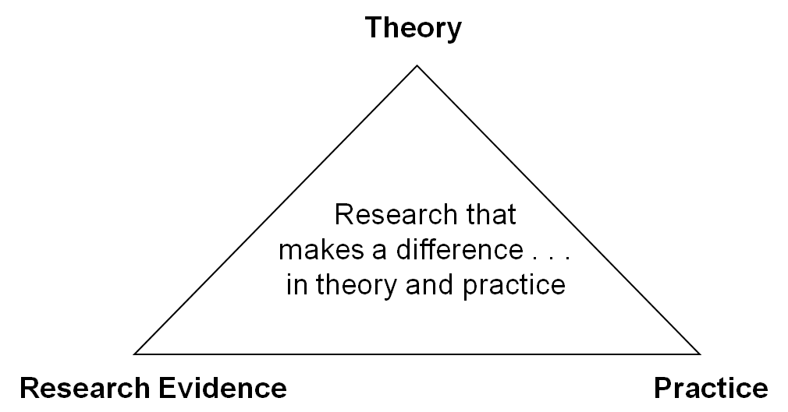
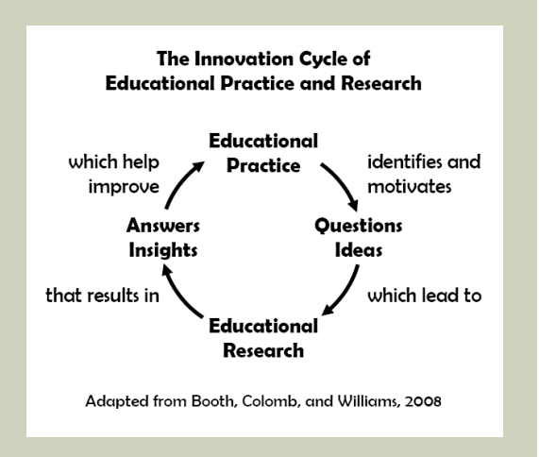

One BIG Idea; Two Perspectives
Jamieson & Lohmann (2009)
Engineering Education Innovation

Slide 11

ASEE Main Plenary, 8:45 a.m. – 10:15 a.m.
Vancouver International Conference Centre, West Ballroom CD
Expected to draw over 2,000 attendees, this year’s plenary features Karl A. Smith, Cooperative Learning Professor of Engineering Education at Purdue University and Morse–Alumni Distinguished Teaching Professor & Professor of Civil Engineering at the University of Minnesota.
Smith has been at the University of Minnesota since 1972 and has been active in ASEE since he became a member in 1973. For the past five years, he has been helping start the engineering education Ph.D. program at Purdue University. He is a Fellow of the American Society for Engineering Education and past Chair of the Educational Research and Methods Division. He has worked with thousands of faculty all over the world on pedagogies of engagement, especially cooperative learning, problem-based learning, and constructive controversy.
On the occasion of the 100th anniversary of the Journal of Engineering Education and the release of ASEE’s Phase II report Creating a Culture for Scholarly and Systematic Innovation in Engineering Education (Jamieson/Lohmann report), the plenary will celebrate these milestones and demonstrate rich, mutual interdependences between practice and inquiry into teaching and learning in engineering education. Depth and range of the plenary will energize the audience and reflects expertise and interests of conference participants. One of ASEE’s premier educators and researchers, Smith will draw upon our roots in scholarship to set the stage and weave the transitions for six highlighted topics selected for their broad appeal across established, evolving, and emerging practices in engineering education.
Video: https://secure.vimeo.com/27147996
Slides: http://www.ce.umn.edu/~smith/links.html
http://www.asee.org/conferences-and-events/conferences/annual-conference/2011/program-schedule/conference-highlights

Slide 12
The Active Learning Continuum
Informal
Group
Activities
Structured
Team
Activities
Problems
Drive the
Course
Make the
lecture active
Instructor
Centered
Student
Centered
Active
Learning
Collaborative
Learning
Cooperative
Learning
Problem-
Based
Learning
Prince, M. (2010). NAE FOEE
My work is situated here – Cooperative
Learning & Challenge-Based Learning

Slide 13
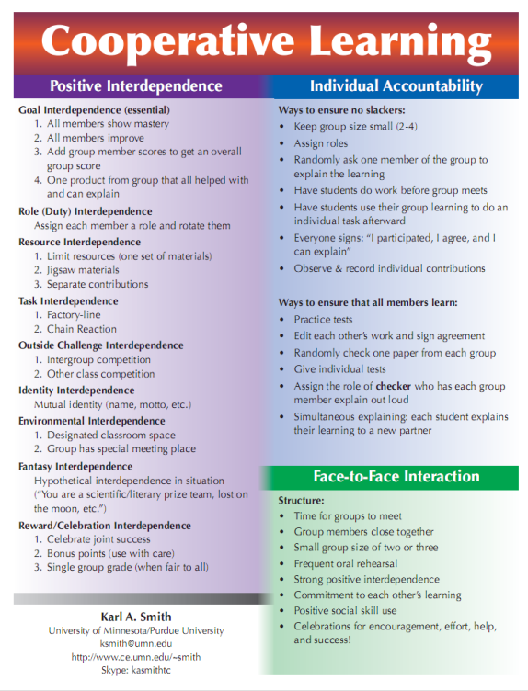
Cooperative Learning is instruction that involves people working in teams to accomplish a common goal, under conditions that involve both positive interdependence (all members must cooperate to complete the task) and individual and group accountability (each member is accountable for the complete final outcome).
Key Concepts
•Positive Interdependence
•Individual and Group Accountability
•Face-to-Face Promotive Interaction
•Teamwork Skills
•Group Processing
http://www.ce.umn.edu/~smith/docs/Smith-CL%20Handout%2008.pdf
Notes:
Table summarizes my perception of the shift. A version of this table is available in New Paradigms for Engineering Education -- FIE Conf proceedings 97 (avail on the www)
One of the most significant changes that has occurred is the shift from "pouring in knowledge" to "creating a climate where learning flows among students and the professor"

Slide 14
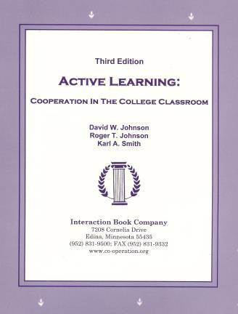
Active Learning: Cooperation in the College Classroom
Informal Cooperative Learning Groups
Formal Cooperative Learning Groups
Cooperative Base Groups
See Cooperative Learning
Handout (CL College-804.doc)

Slide 15
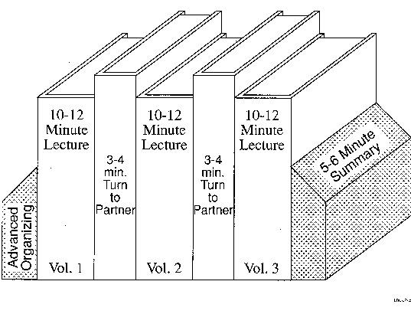
Book Ends on a Class Session
Smith, K.A. 2000. Going deeper: Formal small-group learning in large classes. Energizing large classes: From small groups to learning communities. New Directions for Teaching and Learning, 2000, 81, 25-46. [NDTL81Ch3GoingDeeper.pdf]

Slide 16
Book Ends on a Class Session
Advance Organizer
Formulate-Share-Listen-Create (Turn-to-your-neighbor) -- repeated every 10-12 minutes
Session Summary (Minute Paper)
        What was the most useful or meaningful thing you learned during this session?
        What question(s) remain uppermost in your mind as we end this session?
        What was the “muddiest” point in this session?
Notes:
Table summarizes my perception of the shift. A version of this table is available in New Paradigms for Engineering Education -- FIE Conf proceedings 97 (avail on the www)
One of the most significant changes that has occurred is the shift from "pouring in knowledge" to "creating a climate where learning flows among students and the professor"

Slide 17
Advance Organizer
“The most important single factor influencing learning is what the learner already knows. Ascertain this and teach him accordingly.”
David Ausubel - Educational psychology: A cognitive approach, 1968.

Slide 18
Quick Thinks
Reorder the steps
Paraphrase the idea
Correct the error
Support a statement
Select the response
Johnston, S. & Cooper,J. 1997. Quick thinks: Active- thinking in lecture classes and televised instruction. Cooperative learning and college teaching, 8(1), 2-7.

Slide 19
Formulate-Share-Listen-Create
Informal Cooperative Learning Group
Introductory Pair Discussion of a
FOCUS QUESTION
Formulate your response to the question individually
Share your answer with a partner
Listen carefully to your partner's answer
Work together to Create a new answer through discussion

Slide 20
Minute Paper
What was the most useful or meaningful thing you learned during this session?
What question(s) remain uppermost in your mind as we end this session?
What was the “muddiest” point in this session?
Give an example or application
Explain in your own words . . .
Angelo, T.A. & Cross, K.P. 1993. Classroom assessment techniques: A handbook for college teachers. San Francisco: Jossey Bass.

Slide 21
Session Summary
(Minute Paper)
Reflect on the session:
1. Most interesting, valuable, useful thing you learned.
2. Things that helped you learn.
3. Question, comments, suggestions.
Pace: Too slow 1 . . . . 5 Too fast
Relevance: Little 1 . . . 5 Lots
Instructional Format: Ugh 1 . . . 5 Ah

Slide 22
MOT 8221 – Spring 2012 – Session 1 (1/6/12)
Q4 – Pace: Too slow 1 . . . . 5 Too fast (3.2)
Q5 – Relevance: Little 1 . . . 5 Lots (3.9)
Q6 – Format: Ugh 1 . . . 5 Ah (4.0)

Slide 23
MOT 8221 – Spring 2011 – Session 1 (3/25/11)
Q4 – Pace: Too slow 1 . . . . 5 Too fast (2.9)
Q5 – Relevance: Little 1 . . . 5 Lots (3.9)
Q6 – Format: Ugh 1 . . . 5 Ah (3.7)

Slide 24
Informal CL (Book Ends on a Class Session) with Concept Tests
Physics
Peer Instruction
Eric Mazur - Harvard – http://galileo.harvard.edu
Richard Hake – http://www.physics.indiana.edu/~hake/
Chemistry
Chemistry ConcepTests - UW Madison www.chem.wisc.edu/~concept
Video: Making Lectures Interactive with ConcepTests
ModularChem Consortium – http://mc2.cchem.berkeley.edu/
STEMTEC
Video: How Change Happens: Breaking the “Teach as You Were Taught” Cycle – Films for the Humanities & Sciences – www.films.com
Harvard – Derek Bok Center
Thinking Together & From Questions to Concepts: Interactive Teaching in Physics – www.fas.harvard.edu/~bok_cen/

Slide 25
Richard Hake (Interactive engagement vs traditional methods) http://www.physics.indiana.edu/~hake/
Traditional (lecture)
Interactive (active/cooperative)
<g> = Concept Inventory Gain/Total
Notes:
Barr & Tagg's From teaching to learing is the most often requested article from Change mangazine
Bill Camplbell and I started working on New Paradigms in 1993.

Slide 27
The “Hake” Plot of FCI
35.00
SDI
30.00
UMn-CL+PS
ALS
X
WP
25.00
UMn Cooperative Groups
X
20.00
PI(HU)
15.00
UMn Traditional
ASU(nc)
10.00
WP*
ASU(c)
HU
5.00
0.00
20.00
30.00
40.00
50.00
60.00
70.00
80.00
Pretest (Percent)

Slide 28
Physics (Mechanics) Concepts:
The Force Concept Inventory (FCI)
A 30 item multiple choice test to probe student's understanding of basic concepts in mechanics.
The choice of topics is based on careful thought about what the fundamental issues and concepts are in Newtonian dynamics.
Uses common speech rather than cueing specific physics principles.
The distractors (wrong answers) are
based on students' common inferences.

Slide 29
Informal Cooperative
Learning Groups
Can be used at any time
Can be short term and ad hoc
May be used to break up a long lecture
Provides an opportunity for students to process material they have been listening to (Cognitive Rehearsal)
Are especially effective in large lectures
Include "book ends" procedure
Are not as effective as Formal Cooperative Learning or Cooperative Base Groups
Notes:
Barr & Tagg's From teaching to learing is the most often requested article from Change mangazine
Bill Camplbell and I started working on New Paradigms in 1993.

Slide 30
Strategies for Energizing Large Classes: From Small Groups to
Learning Communities:
Jean MacGregor,
James Cooper,
Karl Smith,
Pamela Robinson
New Directions for Teaching and Learning, No. 81, 2000.
Jossey- Bass
Notes:
Table summarizes my perception of the shift. A version of this table is available in New Paradigms for Engineering Education -- FIE Conf proceedings 97 (avail on the www)
One of the most significant changes that has occurred is the shift from "pouring in knowledge" to "creating a climate where learning flows among students and the professor"

Slide 31
Active Learning: Cooperation in the College Classroom
Informal Cooperative Learning Groups
Formal Cooperative Learning Groups
Cooperative Base Groups
See Cooperative Learning
Handout (CL College-804.doc)

Slide 32
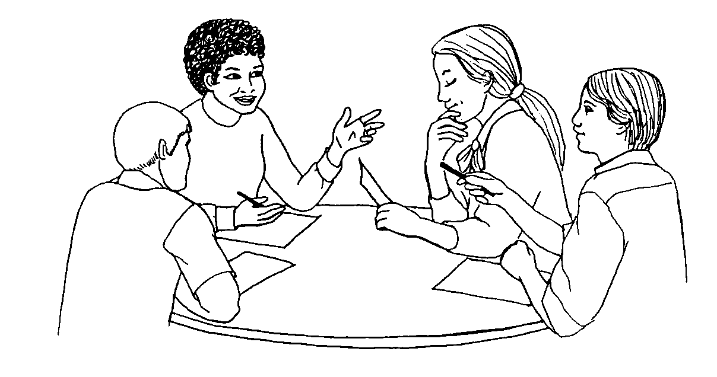
Formal Cooperative Learning Task Groups
Notes:
Barr & Tagg's From teaching to learing is the most often requested article from Change mangazine
Bill Camplbell and I started working on New Paradigms in 1993.

Slide 33
Professor's Role in
Formal Cooperative Learning
Specifying Objectives
Making Decisions
Explaining Task, Positive Interdependence, and Individual Accountability
Monitoring and Intervening to Teach Skills
Evaluating Students' Achievement and Group Effectiveness

Slide 34
Formal Cooperative Learning – Types of Tasks
Jigsaw – Learning new conceptual/procedural material
2. Peer Composition or Editing
3. Reading Comprehension/Interpretation
4. Problem Solving, Project, or Presentation
5. Review/Correct Homework
6. Constructive Academic Controversy
7. Group Tests
Notes:
Table summarizes my perception of the shift. A version of this table is available in New Paradigms for Engineering Education -- FIE Conf proceedings 97 (avail on the www)
One of the most significant changes that has occurred is the shift from "pouring in knowledge" to "creating a climate where learning flows among students and the professor"

Slide 35
Challenge-Based Learning
Problem-based learning
Case-based learning
Project-based learning
Learning by design
Inquiry learning
Anchored instruction
John Bransford, Nancy Vye and Helen Bateman. Creating High-Quality Learning Environments: Guidelines from Research on How People Learn

Slide 36
Challenge-Based Instruction with the Legacy Cycle
The Challenges
Go Public
Generate Ideas
Legacy
Cycle
Test Your Mettle
Multiple Perspectives
Research & Revise
https://repo.vanth.org/portal/public-content/star-legacy-cycle/star-legacy-cycle
36
Notes:
36
We use a learning cycle to assist us in organizing learning activities to meet specific goals. This cycle basically scaffolds the inquiry process necessary to identify potential solutions to a problem, research those opportunities, and revise them over time. However, part of the learning process is monitoring understanding of critical concepts and receiving opportunities to go deeper into specific concepts. Therefore, we use formative assessment methods where students can test their mettle and return to do additional Research & Revise activities which will help to revise their understanding.

Slide 37
Problem-Based Learning
START
Apply it
Problem posed
Learn it
Identify what we
need to know

Slide 38
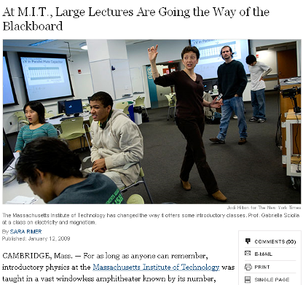
Problem-Based Cooperative Learning
January 13, 2009—New York Times – http://www.nytimes.com/2009/01/13/us/13physics.html?em

Slide 39
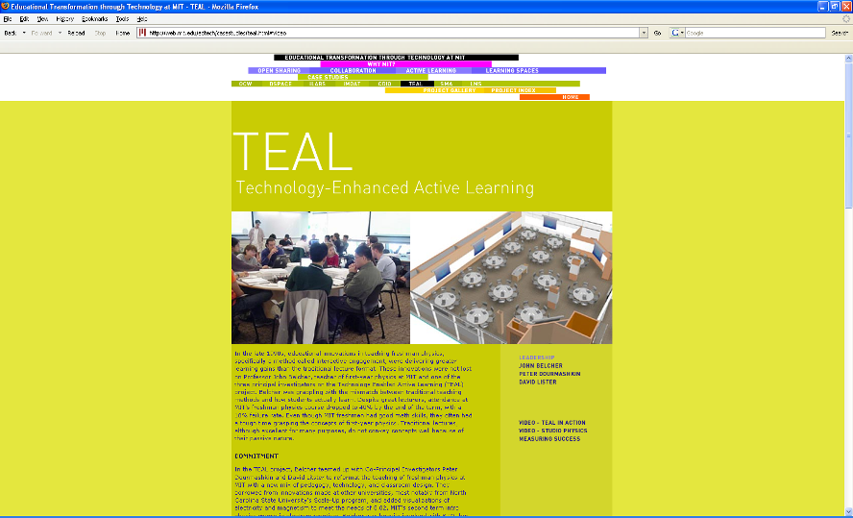
http://web.mit.edu/edtech/casestudies/teal.html#video

Slide 40
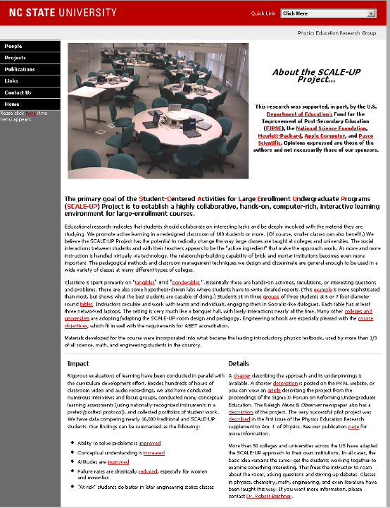
http://www.ncsu.edu/PER/scaleup.html

Slide 41


http://mediamill.cla.umn.edu/mediamill/embed/78755
http://www1.umn.edu/news/news-releases/2010/UR_CONTENT_248261.html
http://www.youtube.com/watch?v=lfT_hoiuY8w
http://youtu.be/lfT_hoiuY8w

Slide 42
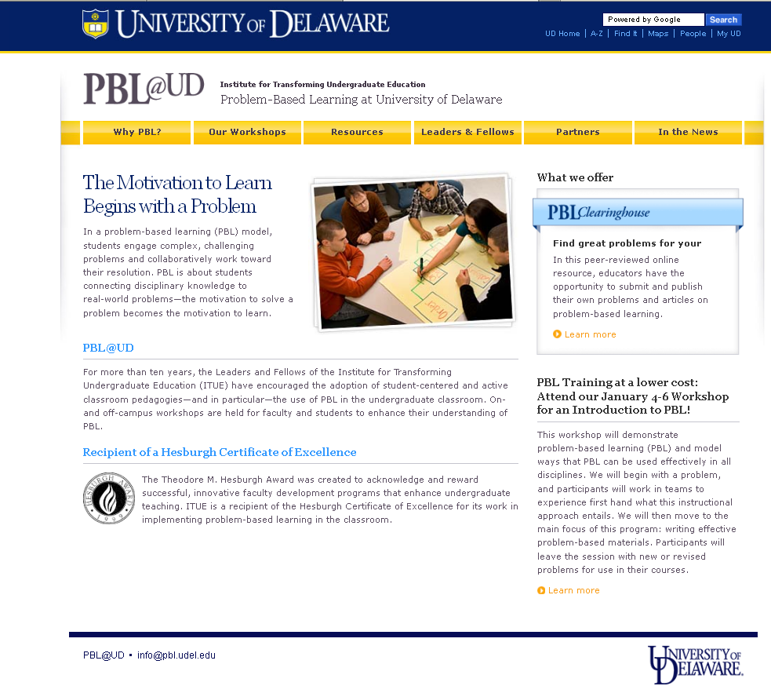
http://www.udel.edu/inst/

Slide 43
Problem-Based Cooperative Learning
Karl A. Smith
Engineering Education – Purdue University
Civil Engineering - University of Minnesota
ksmith@umn.edu
http://www.ce.umn.edu/~smith
Estimation Exercise

Slide 44
First Course Design Experience
UMN – Institute of Technology
Thinking Like an Engineer
Problem Identification
Problem Formulation
Problem Representation
Problem Solving
Problem-Based Learning

Slide 45
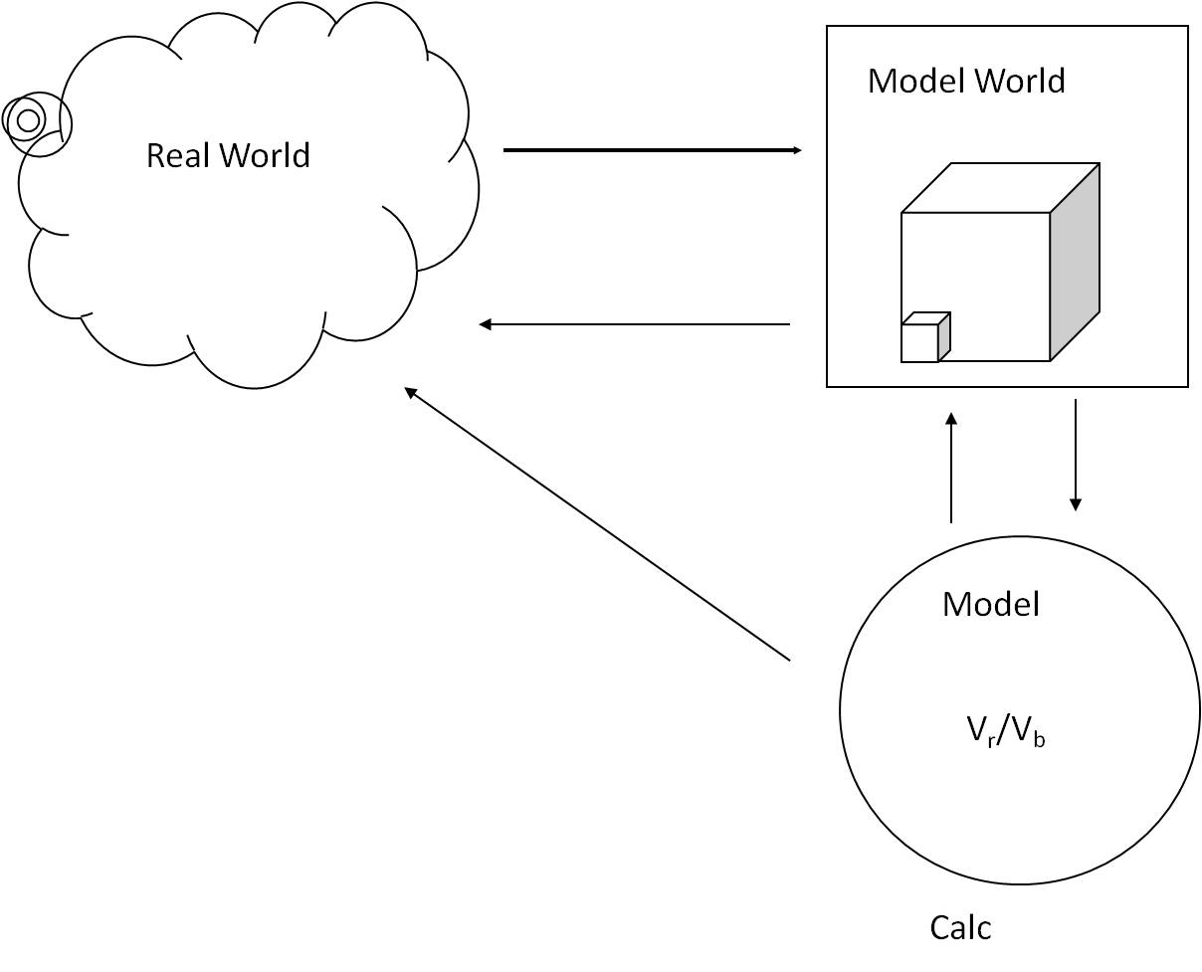
*Based on First Year Engineering course – Problem-based cooperative learning How to Model It published in 1990.

Slide 46
Problem Based Cooperative Learning Format
TASK: Solve the problem(s) or Complete the project.
INDIVIDUAL: Estimate answer. Note strategy.
COOPERATIVE: One set of answers from the group, strive for agreement, make sure everyone is able to explain the strategies used to solve each problem.
EXPECTED CRITERIA FOR SUCCESS: Everyone must be able to explain the strategies used to solve each problem.
EVALUATION: Best answer within available resources or constraints.
INDIVIDUAL ACCOUNTABILITY: One member from your group may be randomly chosen to explain (a) the answer and (b) how to solve each problem.
EXPECTED BEHAVIORS: Active participating, checking, encouraging, and elaborating by all members.
INTERGROUP COOPERATION: Whenever it is helpful, check procedures, answers, and strategies with another group.

Slide 47
Cooperative Base Groups
Are Heterogeneous
Are Long Term (at least one quarter or semester)
Are Small (3-5 members)
Are for support
May meet at the beginning of each session or may meet between sessions
Review for quizzes, tests, etc. together
Share resources, references, etc. for individual projects
Provide a means for covering for absentees

Slide 48
Designing and Implementing Cooperative Learning
Think like a designer
Ground practice in robust theoretical framework
Start small, start early and iterate
Celebrate the successes; problem-solve the failures

Slide 49
The Active Learning Continuum
Informal
Group
Activities
Structured
Team
Activities
Problems
Drive the
Course
Make the
lecture active
Instructor
Centered
Student
Centered
Active
Learning
Collaborative
Learning
Cooperative
Learning
Problem-
Based
Learning
Prince, M. (2010). NAE FOEE
*My work is situated here – Cooperative
Learning & Challenge-Based Learning

Slide 50
Design and Implementation of
Cooperative Learning – Resources
Design Framework – How People Learn (HPL) & Backward Design Process
  Streveler, R.A., Smith, K.A. and Pilotte, M. 2011. Aligning Course Content, Assessment, and Delivery: Creating a Context for Outcome-Based Education – http://www.ce.umn.edu/~smith/links.html
  Bransford, Vye & Bateman. 2002. Creating High Quality Learning Environments -- http://www.nap.edu/openbook/0309082927/html/
  Pellegrino – Rethinking and redesigning curriculum, instruction and assessment: What contemporary research and theory suggests. http://www.skillscommission.org/commissioned.htm
  Smith, K. A., Douglas, T. C., & Cox, M. 2009. Supportive teaching and learning strategies in STEM education. In R. Baldwin, (Ed.). Improving the climate for undergraduate teaching in STEM fields. New Directions for Teaching and Learning, 117, 19-32. San Francisco: Jossey-Bass.
Content Resources
  Donald, Janet. 2002. Learning to think: Disciplinary perspectives. San Francisco: Jossey-Bass.
  Middendorf, Joan and Pace, David. 2004. Decoding the Disciplines: A Model for Helping Students Learn Disciplinary Ways of Thinking. New Directions for Teaching and Learning, 98.
Cooperative Learning - Instructional Format explanation and exercise to model format and to engage workshop participants
  Cooperative Learning (Johnson, Johnson & Smith)
    Smith web site – www.ce.umn.edu/~smith
  Smith (2010) Social nature of learning: From small groups to learning communities. New Directions for Teaching and Learning, 2010, 123, 11-22 [NDTL-123-2-Smith-Social_Basis_of_Learning-.pdf]
  Smith, Sheppard, Johnson & Johnson (2005) Pedagogies of Engagement [Smith-Pedagogies_of_Engagement.pdf]
  Cooperative learning returns to college: What evidence is there that it works? Change, 1998, 30 (4), 26-35. [CLReturnstoCollege.pdf]
Other Resources
  University of Delaware PBL web site – www.udel.edu/pbl
  PKAL – Pedagogies of Engagement – http://www.pkal.org/activities/PedagogiesOfEngagementSummit.cfm
  Fairweather (2008) Linking Evidence and Promising Practices in Science, Technology, Engineering, and Mathematics (STEM) Undergraduate Education - http://www7.nationalacademies.org/bose/Fairweather_CommissionedPaper.pdf

