Slide 1
Introduction to Cooperative Learning and Foundations of Course Design
Karl A. Smith
Engineering Education – Purdue University
Technological Leadership Institute/ STEM Education Center/ Civil Engineering - University of Minnesota
ksmith@umn.edu - http://www.ce.umn.edu/~smith
Nanyang Business School
Nanyang Technological University
Teaching Strategies for Cooperative Learning Workshop
February-March 2012

Slide 2
Session 1 Layout
Welcome & Overview
Cooperative Learning Basics
Course Design Foundations
Design and Implementation

Slide 3
Overall Goal
Build your repertoire of cooperative learning strategies as well as skills and confidence for implementing them

Slide 4
Participant Learning Goals (Objectives)
  Describe key features of Cooperative Learning
  Explain rationale for Pedagogies of Engagement, especially Cooperative Learning & Challenge Based Learning
  Describe key features of the Understanding by Design and How People Learn
  Describe models for processing and monitoring team work
  Apply cooperative learning to classroom practice
  Identify connections between cooperative learning and desired outcomes of courses and programs

Slide 5
Session objectives
Articulate an integrated approach to course design which aligns content, assessment and pedagogy (CAP)
Critically describe the research-based features of CAP
Apply CAP principles to a learning environment (course, module, etc).
Use reflection and discussion to deepen your learning.

Slide 6

Lila M. Smith
Notes:
8:30-9:30?Take copies of Active Lrn, HTMI, New Paradigms,

Slide 7
Engineering Education
Practice – Third-year course in metallurgical reactions – thermodynamics and kinetics
Research – ?
Theory – ?
Theory
Research
Evidence
Practice

Slide 8
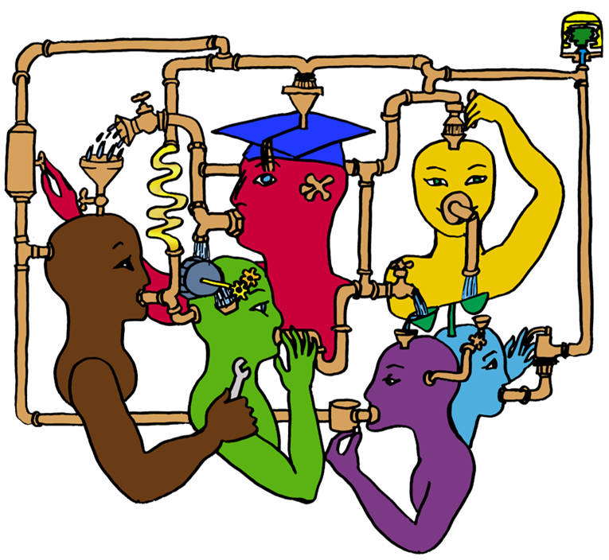
Lila M. Smith
Notes:
8:30-9:30?Take copies of Active Lrn, HTMI, New Paradigms,

Slide 9
Cooperative Learning
Theory – Social Interdependence – Lewin – Deutsch – Johnson & Johnson
Research – Randomized Design Field Experiments
Practice – Formal Teams/Professor’s Role
Theory
Research
Evidence
Practice

Slide 10
Lewin’s Contributions
Founded field of social psychology
Action Research
Force-Field analysis
B = f(P,E)
Social Interdependence Theory
“There is nothing so practical as a good theory”

Slide 11

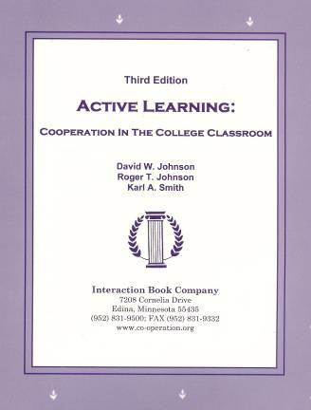
Cooperative Learning
•Positive Interdependence
•Individual and Group Accountability
•Face-to-Face Promotive Interaction
•Teamwork Skills
•Group Processing
[*First edition 1991]

Slide 12


Cooperative Learning Research Support
Johnson, D.W., Johnson, R.T., & Smith, K.A. 1998. Cooperative learning returns to college: What evidence is there that it works? Change, 30 (4), 26-35.
• Over 300 Experimental Studies
• First study conducted in 1924
• High Generalizability
• Multiple Outcomes
Outcomes
1. Achievement and retention
2. Critical thinking and higher-level
reasoning
3. Differentiated views of others
4. Accurate understanding of others' perspectives
5. Liking for classmates and teacher
6. Liking for subject areas
7. Teamwork skills
January 2005
March 2007
Notes:
Table summarizes my perception of the shift. A version of this table is available in New Paradigms for Engineering Education -- FIE Conf proceedings 97 (avail on the www)
One of the most significant changes that has occurred is the shift from "pouring in knowledge" to "creating a climate where learning flows among students and the professor"

Slide 13
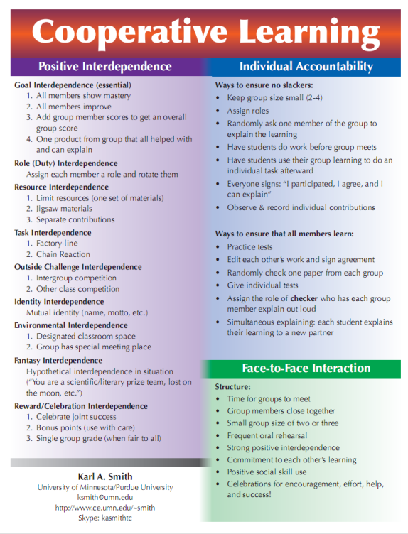
Cooperative Learning is instruction that involves people working in teams to accomplish a common goal, under conditions that involve both positive interdependence (all members must cooperate to complete the task) and individual and group accountability (each member is accountable for the complete final outcome).
Key Concepts
•Positive Interdependence
•Individual and Group Accountability
•Face-to-Face Promotive Interaction
•Teamwork Skills
•Group Processing
http://www.ce.umn.edu/~smith/docs/Smith-CL%20Handout%2008.pdf
Notes:
Table summarizes my perception of the shift. A version of this table is available in New Paradigms for Engineering Education -- FIE Conf proceedings 97 (avail on the www)
One of the most significant changes that has occurred is the shift from "pouring in knowledge" to "creating a climate where learning flows among students and the professor"

Slide 14
Clicker Usage
Never
Occasionally
Frequently
Always
35 of 37

Slide 15
What is your experience with cooperative learning?
Little 1
Between 1&3
Moderate 3
Between 3&5
Extensive 5
35 of 37

Slide 16
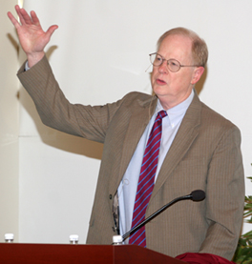
“It could well be that faculty members of the twenty-first century college or university will find it necessary to set aside their roles as teachers and instead become designers of learning experiences, processes, and environments.”
James Duderstadt, 1999
Nuclear Engineering Professor; Dean, Provost and President of the University of Michigan

Slide 17
What do you already know about course design?
[Background Knowledge Survey]

Slide 18
What is your experience with course (re)design?
32
of
37
Little 1
Between 1&3
Moderate 3
Between 3&5
Extensive 5

Slide 19
What is your level familiarity with learning theories (e.g.,HPL) & instruction (e.g., UbD) theories?
32
of
37
Low 1
Between 1&3
Moderate 3
Between 3&5
High 5

Slide 20
What do you already know about course design?
[Background Knowledge Survey]
Short Answer Questions
What do you feel are important considerations about course (re) design?
What are challenges you have faced with course (re) design?

Slide 21

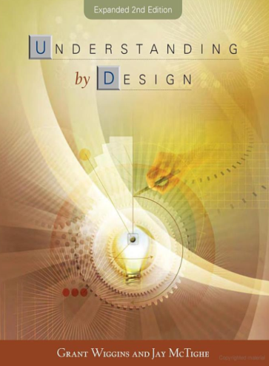
Design Foundations
Science of Instruction (UbD)
 | No | Yes
Yes | Good Theory/ Poor Practice | Good Theory & Good Practice
No |  | Good Practice/ Poor Theory
Science of Learning
(HPL)
Sources: Bransford, Brown & Cocking. 1999. How people learn. National Academy Press.
Wiggins, G. & McTighe, J. 2005. Understanding by design, 2ed. ASCD.
Notes:
Models of how learning works – (1) learning as response strengthening, (2) learning as information acquisition, (3) learning as knowledge construction and (4) learning as social knowledge construction

Slide 22

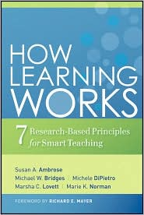

Bransford, Vye and Bateman – Creating High Quality Learning Environments

Slide 23
Students prior knowledge can help or hinder learning
How student organize knowledge influences how they learn and apply what they know
Students’ motivation determines, directs, and sustains what they do to learn
To develop mastery, students must acquire component skills, practice integrating them, and know when to apply what they have learned
Goal-directed practice coupled with targeted feedback enhances the quality of students’ learning
Students’ current level of development interacts with the social, emotional, and intellectual climate of the course to impact learning
To become self-directed learners, students must learn to monitor and adjust their approach to learning

Slide 24
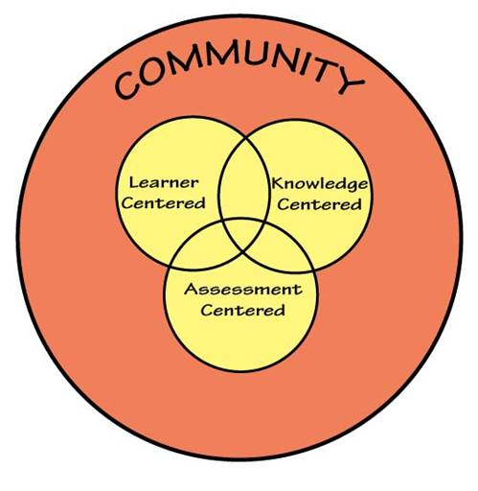
How People Learn (HPL)
HPL Framework
Expertise Implies (Ch. 2):
  a set of cognitive and metacognitive skills
  an organized body of knowledge that is deep and contextualized
  an ability to notice patterns of information in a new situation
  flexibility in retrieving and applying that knowledge to a new problem
Bransford, Brown & Cocking. 1999. How people learn. National Academy Press.

Slide 25
Understanding by Design
Wiggins & McTighe (1997, 2005)
Stage 1. Identify Desired Results
Stage 2. Determine Acceptable Evidence
Stage 3. Plan Learning Experiences
and Instruction
Overall: Are the desired results, assessments, and learning activities ALIGNED?
From: Wiggins, Grant and McTighe, Jay. 1997. Understanding by Design. Alexandria, VA: ASCD
25
Notes:
25

Slide 26
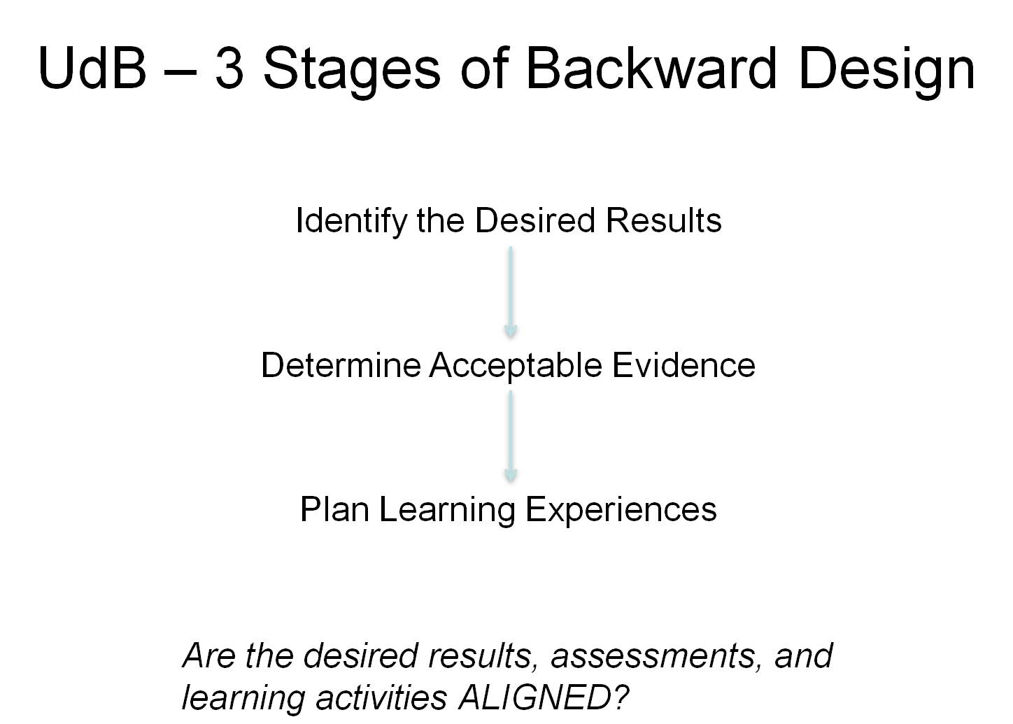
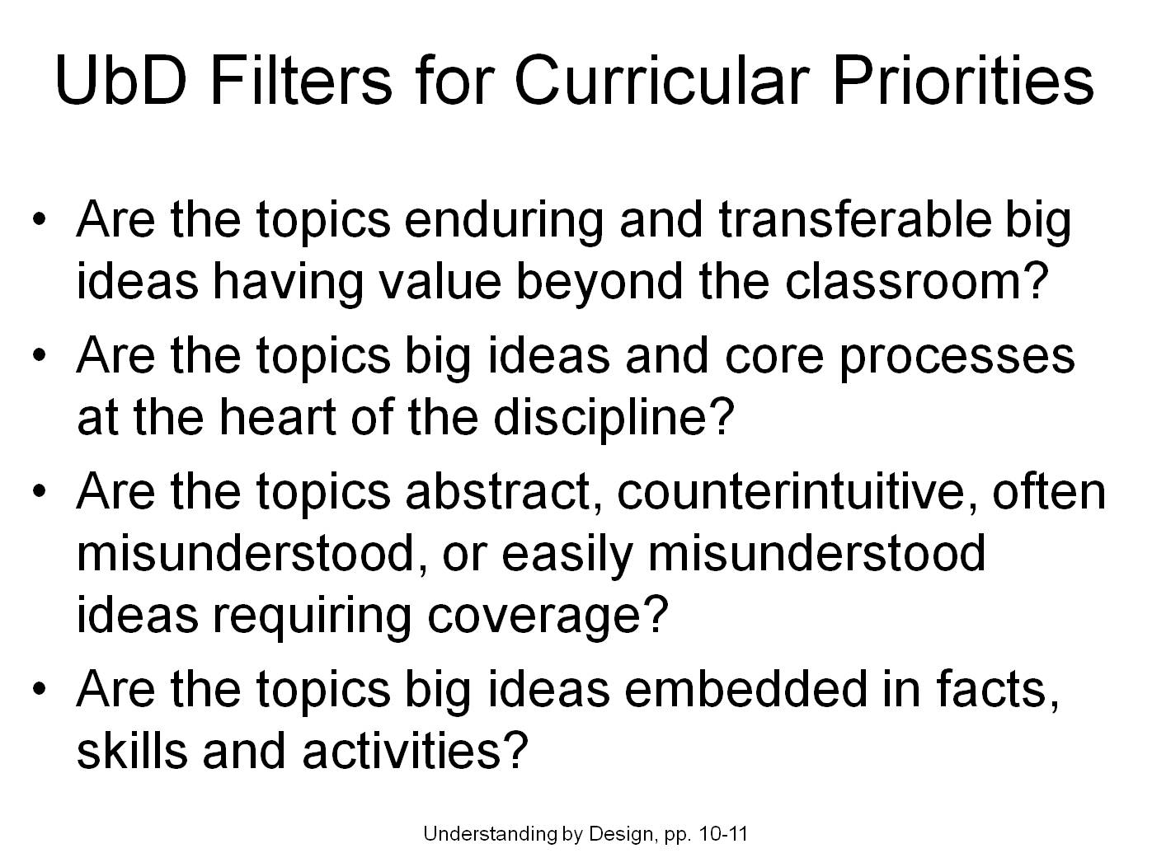
Content-Assessment-Pedagogy (CAP) Design Process Flowchart
Understanding by Design (Wiggins & McTighe, 2005)
Start
Context
Backward Design
Content
Assessment
Pedagogy
No
C & A & P
Alignment?
Yes
End
Streveler, Smith & Pilotte (2011)
Notes:
26

Slide 27

CAP Design Process (Shawn Jordan’s Model)
Start
Context
Content
Cloud of
alignment
Assessment
Pedagogy
Shawn Jordan is a 2010 ENE PhD graduate who is an Assistant Professor at
Arizona State University
End
Notes:
27

Slide 28
Related Integrated Course Design Model
Fink, L.D. 2003. Creating significant learning experiences: An integrated approach to designing college courses. Jossey-Bass
Fink, L.D. 2003. A Self-Directed Guide to Designing Courses for Significant Learning. http://www.deefinkandassociates.com/GuidetoCourseDesignAug05.pdf
28
Notes:
28

Slide 29
A Self-Directed Guide to Designing Courses for Significant Learning
L. Dee Fink. 2003. Creating significant learning experiences. Jossey-Bass.
29
Notes:
29

Slide 30
Your turn
Review your course syllabus
and
Select a topic, class session or learning module you would like to (re)design especially by incorporating cooperative learning

Slide 31
3 Stages of Understanding by Design
Identify the Desired Results
What should students know, understand, and be able to do?
Three categories of learning outcomes:
Enduring understandings
Important to know
Good to be familiar with

Slide 32
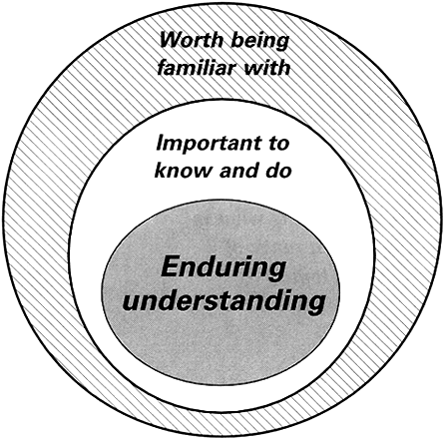
Establishing Curricular Priorities
32

Slide 33
Your turn
What are your intentions for student learning?
  Individually make a list

Slide 34
Filters
Which of these learning outcomes represents the enduring understandings?
  Look at these filters

Slide 35
Understanding Misunderstanding
A Private Universe – 21 minute video available from www.learner.org
Also see Minds of our own (Annenberg/CPB Math and Science Collection – www.learner.org)
Can we believe our eyes?
Lessons from thin air
Under construction

Slide 36
Your turn
Which of these learning outcomes represents the enduring understandings?

Slide 37
Your turn
Share your list with a partner
Discuss each other’s list for enduring understanding.
  Questions?
  Clarifications?

Slide 38
3 Stages of Understanding by Design
Identify the Desired Results
How will we know if the students have achieved the desired results? What will be accepted as evidence of student understanding and proficiency?
Determine Acceptable Evidence

Slide 39
Understanding Understanding
Stage 1. Identify Desired Results
Focus Question: What does it mean to “understand”?
Stage 2. Determine Acceptable Evidence
Focus Questions: “How will we know if students have achieved the desired results and met the standards? What will we accept as evidence of student understanding and proficiency (Wiggins & McTighe)

Slide 40
Taxonomies of Types of Learning
Bloom’s taxonomy of educational objectives: Cognitive Domain (Bloom & Krathwohl, 1956)
A taxonomy for learning, teaching, and assessing: A revision of Bloom’s taxonomy of educational objectives (Anderson & Krathwohl, 2001).
Facets of understanding (Wiggins & McTighe, 1998)
Taxonomy of significant learning (Fink, 2003)
Evaluating the quality of learning: The SOLO taxonomy (Biggs & Collis, 1982)

Slide 41
The Six Major Levels of Bloom's Taxonomy of the Cognitive Domain
(with representative behaviors and sample objectives)
Knowledge. Remembering information Define, identify, label, state, list, match
  Identify the standard peripheral components of a computer
  Write the equation for the Ideal Gas Law
Comprehension. Explaining the meaning of information Describe, generalize, paraphrase, summarize, estimate
  In one sentence explain the main idea of a written passage
  Describe in prose what is shown in graph form
Application. Using abstractions in concrete situations Determine, chart, implement, prepare, solve, use, develop
    Using principles of operant conditioning, train a rate to press a bar
    Derive a kinetic model from experimental data
Analysis. Breaking down a whole into component parts Points out, differentiate, distinguish, discriminate, compare
  Identify supporting evidence to support the interpretation of a literary passage
  Analyze an oscillator circuit and determine the frequency of oscillation
Synthesis. Putting parts together to form a new and integrated whole Create, design, plan, organize, generate, write
  Write a logically organized essay in favor of euthanasia
  Develop an individualized nutrition program for a diabetic patient
Evaluation. Making judgments about the merits of ideas, materials, or phenomena Appraise, critique, judge, weigh, evaluate, select
  Assess the appropriateness of an author's conclusions based on the evidence given
  Select the best proposal for a proposed water treatment plant

Slide 42
The Cognitive Process Dimension
 | Remember | Understand | Apply | Analyze | Evaluate | Create
Factual Knowledge – The basic elements that students must know to be acquainted with a discipline or solve problems in it. a. Knowledge of terminology b. Knowledge of specific details and elements
Conceptual Knowledge – The interrelationships among the basic elements within a larger structure that enable them to function together. a. Knowledge of classifications and categories b. Knowledge of principles and generalizations c. Knowledge of theories, models, and structures
Procedural Knowledge – How to do something; methods of inquiry, and criteria for using skills, algorithms, techniques, and methods. a. Knowledge of subject-specific skills and algorithms b. Knowledge of subject-specific techniques and methods c. Knowledge of criteria for determining when to use appropriate procedures
Metacognitive Knowledge – Knowledge of cognition in general as well as awareness and knowledge of one’s own cognition. a. Strategic knowledge b. Knowledge about cognitive tasks, including appropriate contextual and conditional knowledge c. Self-knowledge
The Knowledge Dimension
(Anderson & Krathwohl, 2001).

Slide 43
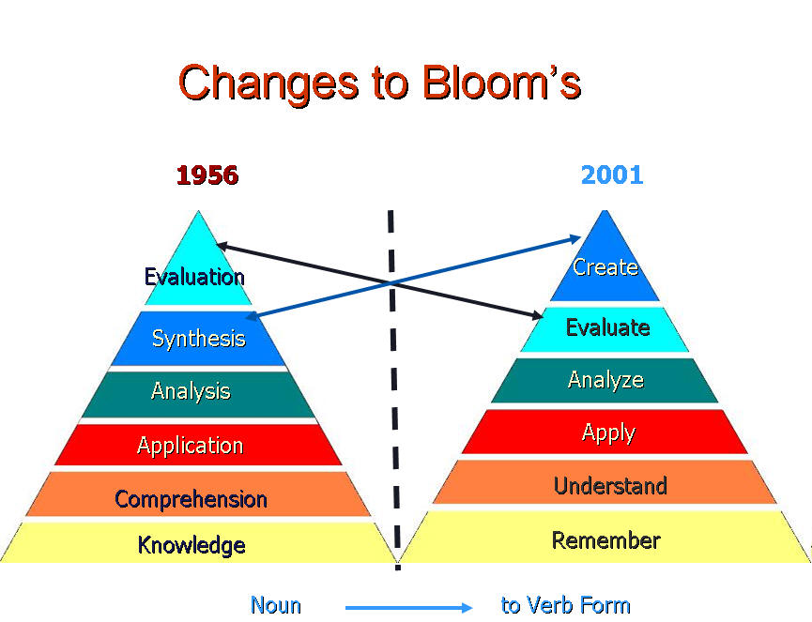
http://www.uwsp.edu/education/lwilson/curric/newtaxonomy.htm

Slide 44
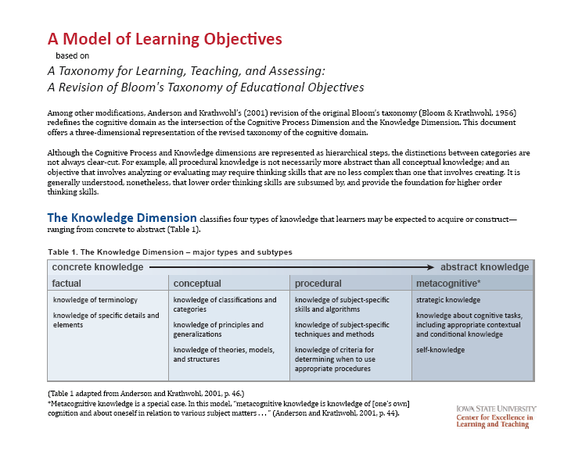
http://www.celt.iastate.edu/pdfs-docs/teaching/RevisedBloomsHandout.pdf

Slide 45
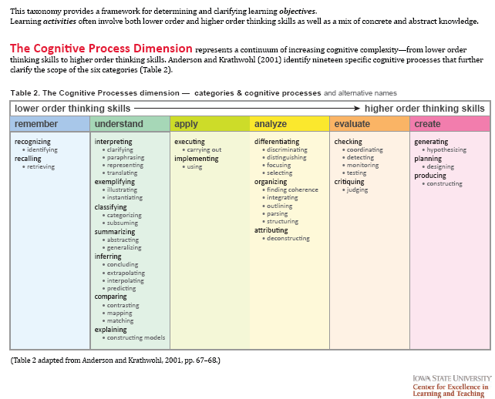

Slide 46
Cognitive
Affective
Me
t
a

Slide 47
SOLO Taxonomy
The Structure of Observed Learning Outcome (SOLO) model consists of 5 levels of understanding
  Pre-structural - The task is not attacked appropriately; the student hasn’t really understood the point and uses too simple a way of going about it.
  Uni-structural - The student's response only focuses on one relevant aspect.
  Multi-structural - The student's response focuses on several relevant aspects but they are treated independently and additively. Assessment of this level is primarily quantitative.
  Relational - The different aspects have become integrated into a coherent whole. This level is what is normally meant by an adequate understanding of some topic.
  Extended abstract - The previous integrated whole may be conceptualised at a higher level of abstraction and generalised to a new topic or area.
http://en.wikipedia.org/wiki/Structure_of_Observed_Learning_Outcome

Slide 48
Teaching Teaching and Understanding Understanding
Biggs SOLO taxonomy
http://video.google.com/videoplay?docid=-5629273206953884671#

Slide 49
Taxonomies of Types of Learning
Bloom’s taxonomy of educational objectives: Cognitive Domain (Bloom & Krathwohl, 1956)
A taxonomy for learning, teaching, and assessing: A revision of Bloom’s taxonomy of educational objectives (Anderson & Krathwohl, 2001).
Facets of understanding (Wiggins & McTighe, 1998)
Taxonomy of significant learning (Fink, 2003)
Evaluating the quality of learning: The SOLO taxonomy (Biggs & Collis, 1982)

Slide 50
Which taxonomy is most appropriate for your course?
Bloom’s taxonomy of educational objectives: Cognitive Domain (Bloom & Krathwohl, 1956)
Bloom’s taxonomy of educational objectives: Revision (Anderson & Krathwohl, 2001)
Taxonomy of significant learning (Fink, 2003)
Evaluating the quality of learning: The SOLO taxonomy (Biggs & Collis, 1982)
32 of 37

Slide 51
Your turn
Are you measuring what is most important?
  Is enduring understanding assessed?
  Are assessment measures appropriate for enduring understanding?

Slide 52
Curricular Priorities and Assessment Methods
Assessment Types
  Traditional quizzes and tests
    Selected-response
  Academic Prompts
    Constructed-response
  Performance tasks and projects
    Open-ended
    Complex
    Authentic
McTighe & Wiggins (1999) Understanding by design handbook. ASCD.

Slide 53
3 Stages of Backward Design
Identify the Desired Results
Determine Acceptable Evidence
What activities will equip students with the needed knowledge and skills?
What materials and resources will be useful?
Plan Learning Experiences
Are the desired results, assessments, and learning activities ALIGNED?

Slide 54
Your turn
How will you help students master the enduring understanding?
What kind of learning opportunity can you design?

Slide 55
Active Learning: Cooperation in the College Classroom
Informal Cooperative Learning Groups
Formal Cooperative Learning Groups
Cooperative Base Groups
See Cooperative Learning
Handout (CL College-804.doc)

Slide 56
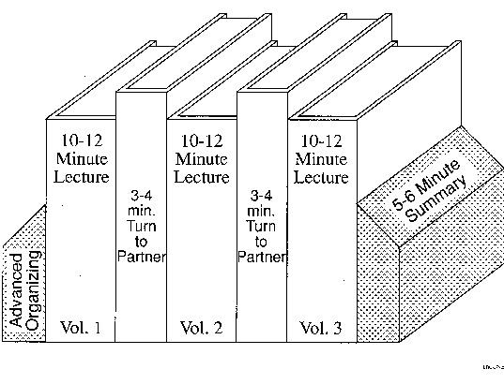
Book Ends on a Class Session
Smith, K.A. 2000. Going deeper: Formal small-group learning in large classes. Energizing large classes: From small groups to learning communities. New Directions for Teaching and Learning, 2000, 81, 25-46. [NDTL81Ch3GoingDeeper.pdf]

Slide 57
Professor's Role in
Formal Cooperative Learning
Specifying Objectives
Making Decisions
Explaining Task, Positive Interdependence, and Individual Accountability
Monitoring and Intervening to Teach Skills
Evaluating Students' Achievement and Group Effectiveness

Slide 58
Formal Cooperative Learning – Types of Tasks
Jigsaw – Learning new conceptual/procedural material
2. Peer Composition or Editing
3. Reading Comprehension/Interpretation
4. Problem Solving, Project, or Presentation
5. Review/Correct Homework
6. Constructive Academic Controversy
7. Group Tests
Notes:
Table summarizes my perception of the shift. A version of this table is available in New Paradigms for Engineering Education -- FIE Conf proceedings 97 (avail on the www)
One of the most significant changes that has occurred is the shift from "pouring in knowledge" to "creating a climate where learning flows among students and the professor"

Slide 59
Clicker Adoption
No
Considering
Probably
Definitely
31 of 37

Slide 60
Session 2 Preview
Pedagogies of Engagement – Cooperative Learning and Challenge Based Learning
  Informal – Bookends on a Class Session
  Formal Cooperative Learning
Preparation for Session 2
  Formal Cooperative Learning – Text Comprehension
    Read Making the case: Professional education for the world of practice by David Garvin
    Discuss in a Formal Cooperative Learning Group

Slide 61
Session Summary
(Minute Paper)
Reflect on the session:
1. Most interesting, valuable, useful thing you learned.
2. Things that helped you learn.
3. Question, comments, suggestions.
Pace: Too slow 1 . . . . 5 Too fast
Relevance: Little 1 . . . 5 Lots
Instructional Format: Ugh 1 . . . 5 Ah

Slide 62
Pace
Too slow
Slow
Ok
Fast
Too fast
0 of 39

Slide 63
Relevance
Very Little
Little
Some
Quite a bit
Lots
0 of 39

Slide 64
Instructional Format
39
Ugh
Huh
Hmm
Yeah
Ah
0

Slide 65
NBS – NTU – Session 1 (22/2/12)
Q4 – Pace: Too slow 1 . . . . 5 Too fast (2.8)
Q5 – Relevance: Little 1 . . . 5 Lots (3.6)
Q6 – Format: Ugh 1 . . . 5 Ah (3.9)

Slide 66
MOT 8221 – Spring 2011 – Session 1 (3/25/11)
Q4 – Pace: Too slow 1 . . . . 5 Too fast (2.9)
Q5 – Relevance: Little 1 . . . 5 Lots (3.9)
Q6 – Format: Ugh 1 . . . 5 Ah (3.7)

