Slide 1
MSPE Engineers Leadership Institute – 11/20/08
Q4 – Pace: Too slow 1 . . . . 5 Too fast (2.9)
Q5 – Relevance: Little 1 . . . 5 Lots (4.6)
Q6 – Format: Ugh 1 . . . 5 Ah (3.9)

Slide 2
Leading Project Teams
Teamwork and Leadership
Karl A. Smith
Purdue University/
University of Minnesota
ksmith@umn.edu
Engineers Leadership Institute
Minnesota Society for
Professional Engineers
November 18, 2011

Slide 3
Design team failure is usually due to failed team dynamics
(Leifer, Koseff & Lenshow, 1995).
It’s the soft stuff that’s hard, the hard stuff is easy
(Doug Wilde, quoted in Leifer, 1997)
Professional Skills
(Shuman, L., Besterfield-Sacre, M., and McGourty, J., “The
ABET Professional Skills-Can They Be Taught? Can They Be Assessed?” Journal of Engineering Education, Vo. 94, No. 1, 2005, pp. 41–55.)

Slide 4
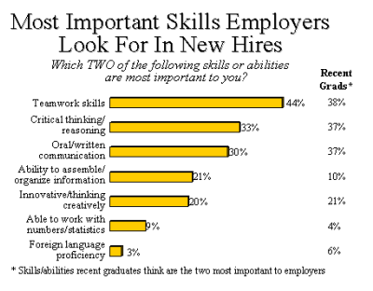

http://www.aacu.org/advocacy/leap/documents/Re8097abcombined.pdf

Slide 5
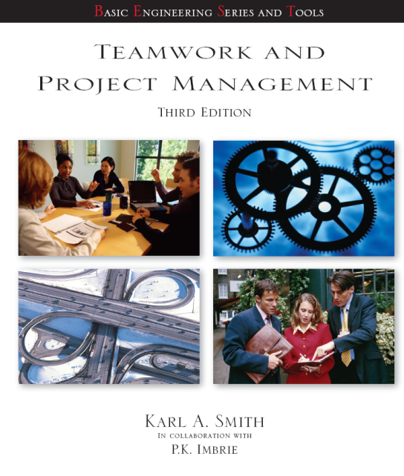
Top Three Main Engineering Work Activities
Engineering Total
Design – 36%
Computer applications – 31%
Management – 29%
Civil/Architectural
Management – 45%
Design – 39%
Computer applications – 20%
Burton, L., Parker, L, & LeBold, W. 1998. U.S. engineering career trends. ASEE Prism, 7(9), 18-21.

Slide 6
Teamwork

Slide 7
Characteristics of Effective Teams?
?
?

Slide 8
A team is a small number of people with complementary skills who are committed to a common purpose, performance goals, and approach for which they hold themselves mutually accountable
• SMALL NUMBER
• COMPLEMENTARY SKILLS
• COMMON PURPOSE & PERFORMANCE GOALS
• COMMON APPROACH
• MUTUAL ACCOUNTABILITY
--Katzenbach & Smith (1993)
The Wisdom of Teams

Slide 10
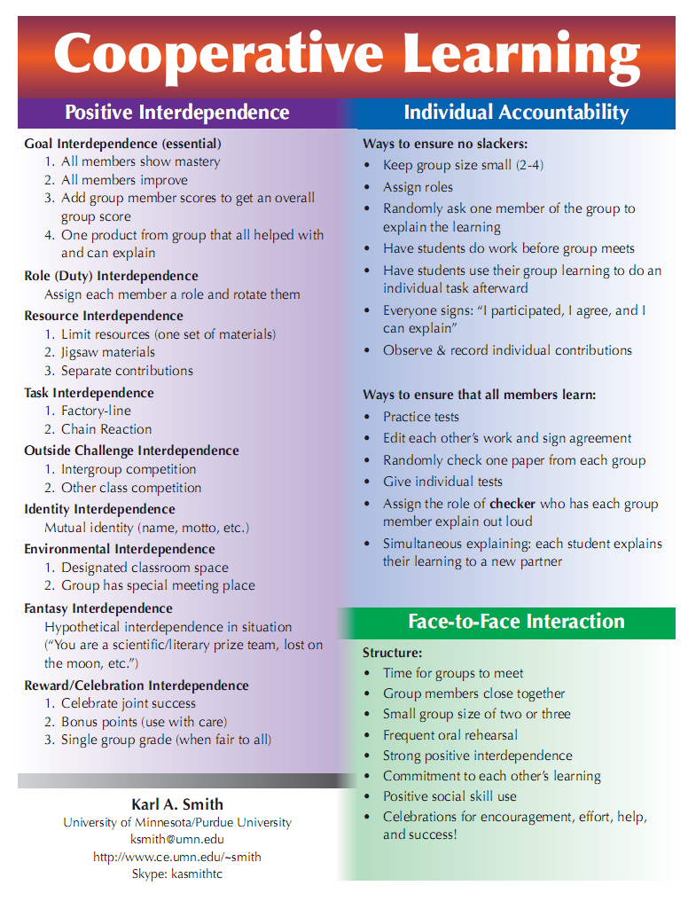
http://www.ce.umn.edu/~smith/docs/Smith-CL%20Handout%2008.pdf

Slide 11
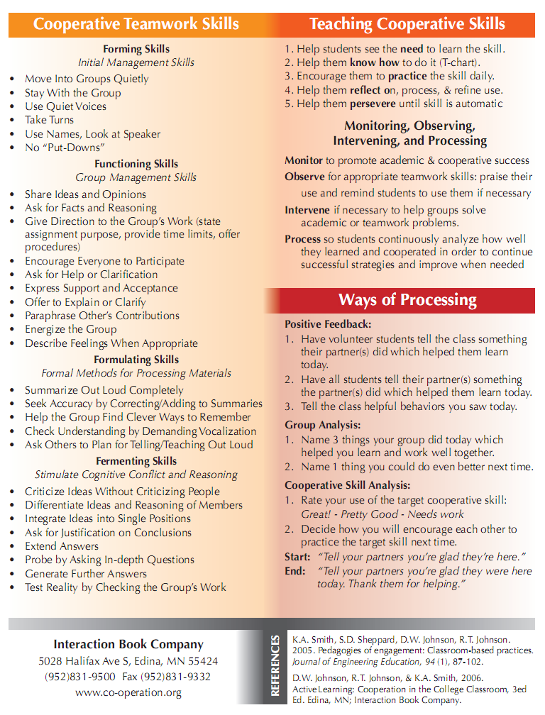
Teamwork Skills
Communication
    Listening and Persuading
Decision Making
Conflict Management
Leadership
Trust and Loyalty

Slide 12
Group Task and Maintenance Roles
Group Task Roles
Group Maintenance Roles
Initiating
Encouraging
Seeking Information
Expressing Feelings
Giving Information
Harmonizing
Seeking Opinions
Compromising
Giving Opinions
Facilitating Communications
Clarifying
Setting Standards or Goals
Elaborating
Testing Agreement
Summarizing
Following

Slide 13
Group Processing
Plus/Delta Format
Plus (+)
Things That Group Did Well
Delta (Δ)
Things Group Could Improve

Slide 14
Team Charter
Team name, membership, and roles
Team Mission Statement
Anticipated results (goals)
Specific tactical objectives
Ground rules/Guiding principles for team participation
Shared expectations/aspirations

Slide 15
Code of Cooperation
•EVERY member is responsible for the team’s progress and success.
•Attend all team meetings and be on time.
•Come prepared.
•Carry out assignments on schedule.
•Listen to and show respect for the contributions of other members; be an active listener.
•CONSTRUCTIVELY criticize ideas, not persons.
•Resolve conflicts constructively,
•Pay attention, avoid disruptive behavior.
•Avoid disruptive side conversations.
•Only one person speaks at a time.
•Everyone participates, no one dominates.
•Be succinct, avoid long anecdotes and examples.
•No rank in the room.
•Respect those not present.
•Ask questions when you do not understand.
•Attend to your personal comfort needs at any time but minimize team disruption.
•HAVE FUN!!
•?
Adapted from Boeing Aircraft Group Team Member Training Manual

Slide 16
Ten Commandments: An Affective Code of Cooperation
• Help each other be right, not wrong.
• Look for ways to make new ideas work, not for reasons they won't.
• If in doubt, check it out! Don't make negative assumptions about each other.
• Help each other win, and take pride in each other's victories.
• Speak positively about each other and about your organization at every opportunity.
• Maintain a positive mental attitude no matter what the circumstances.
• Act with initiative and courage, as if it all depends on you.
• Do everything with enthusiasm; it's contagious.
• Whatever you want; give it away.
• Don't lose faith.
• Have fun
Ford Motor Company

Slide 17
Leadership
Characteristics of Admired Leaders
(people you know and have worked with)
Take 2 minutes and list the characteristics that come to mind for leaders you admire

Slide 18
Characteristics of Admired Leaders
1
1993 U.S.
1987 U.S.
Percentage of
Percentage of
Characteristic
People Selecting
People Selecting
Honest
87
83
Forward-looking
71
62
Inspiring
68
58
Competent
58
67
Fair-minded
49
40
Supportive
46
32
Broad-minded
41
37
Intelligent
38
43
Straightforward
34
34
Courageous
33
27
Dependable
32
32
Cooperative
30
25
Imaginative
28
34
Caring
27
26
James M. Kouzes & Barry Z. Posner. 1993. Credibility: How leaders gain and lose it, why people demand it. San Francisco: Jossey-Bass.
Mature
14
23
Determined
13
20
Ambitious
10
21
Loyal
10
21
Self-controlled
5
13
Independent
5
13

Slide 19
Distributed Actions Approach to Leadership
Leadership is any action that helps a group achieve its goals AND maintain cooperative relationships among members.
Task AND Maintenance

Slide 20
Collins – Level 5 Leadership
Level 5 Level 5 Executive – Builds enduring greatness through a paradoxical combination of personal humility plus professional will
Level 4 Effective Leader – Catalyzes commitment to and vigorous pursuit of a clear and compelling vision; stimulates the group to high performance standards
Level 3 Competent Manager – Organizes people and resource toward the effective and efficient pursuit of predetermined objectives
Level 2 Contributing Team Member
Level 1 Highly Capable Individual

Slide 21
Collins – Good to Great & Built to Last
Check out jimcollins.com for discussion questions to deepen understanding of:
  Level 5 Leadership
  First Who
  Confront the Brutal Facts
  Hedgehog Concept (the Three Circles)
    What it can be best at, How its economics work best, What ignites its people’s passions.
  Culture of Discipline
  Technology Accelerators

Slide 22
Nobody in Charge by Harlan Cleveland
Leadership for the Management of Complexity
A lively intellectual curiosity – because everything is related to everything else
A genuine interest in what other people think and why they think that way
A feeling of responsibility for envisioning a future that’s different from straight-line project of the present
A hunch that most risks are there not to be avoided but to be taken
A mindset that crises are normal, tensions can be promising, and complexity is fun
A realization that paranoia and self-pity are reserved for people who don’t want to be leaders
A sense of personal responsibility for the general outcome of your efforts
A quality of “unwarranted optimism”

Slide 23
New Leadership Competencies
The Leader's Handbook (Scholtes, 1998)
1. The ability to think in terms of systems and knowing how to lead systems.
2. The ability to understand the variability of work in planning and problem solving.
3. Understanding how we learn, develop, and improve; leading true learning and improvement.
4. Understanding people and why they behave as they do.
5. Understanding the interaction and interdependence between systems, variability, learning, and human behavior; knowing how each affects the others.
6. Giving vision, meaning, direction, and focus to the organization.

Slide 24
The Ten Commitments of Leadership
(Kouzes & Posner, 1987)
Challenging the Process
1.
Search for Opportunities
2.
Experiment and Take Risks
Inspiring a Shared Vision
3.
Envision the Future
4.
Enlist Others
Enabling Others to Act
5.
Foster Collaboration
6.
Strengthen Others
Modeling the Way
7.
Set the Example
8.
Plan Small Wins
Encouraging the Heart
9.
Recognize Individual Contribution
10.
Celebrate Accomplishments

Slide 25
The Seven Habits of Highly Effective People (Covey, 1989)
Be Pro-Active: Take the initiative and the responsibility to make things happen.
Begin With an End in Mind: Start with a clear destination to understand where you are now, where you're going, and what you value most.
Put First Things First: Manage yourself. Organize and execute around priorities.
Think Win/Win: See life as a cooperative, not a competitive arena where success is not achieved at the expense or exclusion of the success of others.
Seek First to Understand: Understand then be understood to build the skills of empathic listening that inspires openness and trust.
Synergize: Apply the principles of cooperative creativity and value differences.
Renewal: Preserving and enhancing your greatest asset, yourself, by renewing the physical, spiritual, mental and social/emotional dimensions of your nature.

