Slide 1
Formal Cooperative Learning for
Large Enrollment Classes
Karl A. Smith
STEM Education Center / Technological Leadership Institute / Civil Engineering – University of Minnesota &
Engineering Education – Purdue University
ksmith@umn.edu - http://www.ce.umn.edu/~smith
King Fahd University of Petroleum and Minerals
Design and Implementation of Cooperative Learning
August 19-21, 2013

Slide 2
Session 4 Layout
Welcome and Overview
Reflection on Session 2
Formal Cooperative Learning Rationale and Principles
Formal Cooperative Learning Strategies
  Cooperative Jigsaw
  Cooperative Problem-Based Learning
Aligning outcomes, assessment, and instruction
Design and Implementation

Slide 3
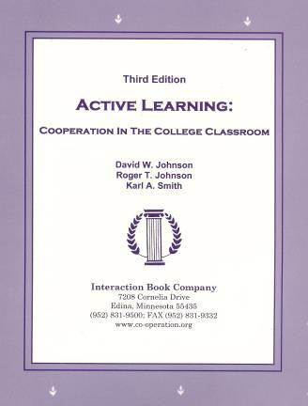
Active Learning: Cooperation in the College Classroom
Informal Cooperative Learning Groups
Formal Cooperative Learning Groups
Cooperative Base Groups
See Cooperative Learning
Handout (CL College-912.doc)

Slide 4
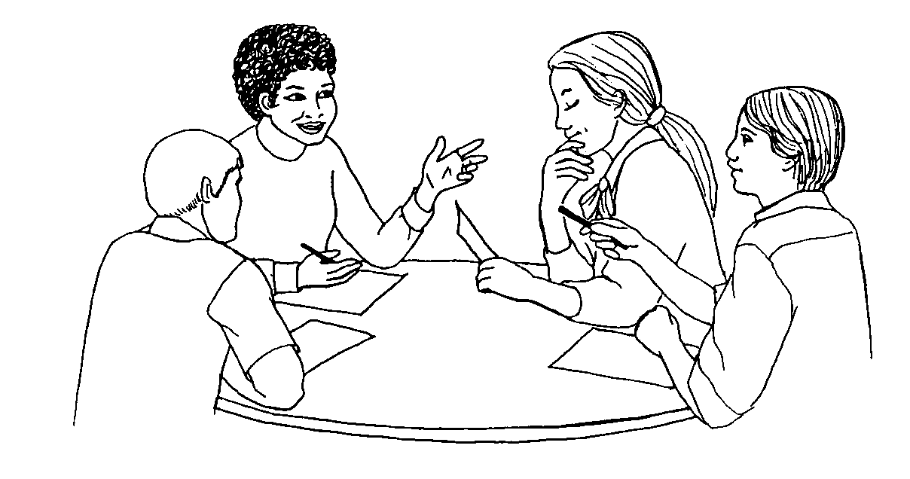
Formal Cooperative Learning Task Groups
Notes:
Barr & Tagg's From teaching to learing is the most often requested article from Change mangazine
Bill Camplbell and I started working on New Paradigms in 1993.

Slide 5
Design team failure is usually due to failed team dynamics
(Leifer, Koseff & Lenshow, 1995).
It’s the soft stuff that’s hard, the hard stuff is easy
(Doug Wilde, quoted in Leifer, 1997)
Professional Skills
(Shuman, L., Besterfield-Sacre, M., and McGourty, J., “The
ABET Professional Skills-Can They Be Taught? Can They Be Assessed?” Journal of Engineering Education, Vo. 94, No. 1, 2005, pp. 41–55.)

Slide 6
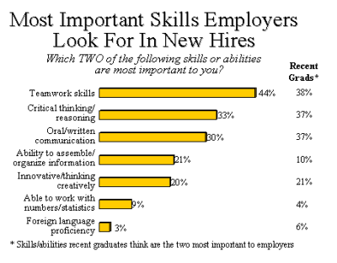

http://www.aacu.org/advocacy/leap/documents/Re8097abcombined.pdf

Slide 7

Top Three Main Engineering Work Activities
Engineering Total
Design – 36%
Computer applications – 31%
Management – 29%
Civil/Architectural
Management – 45%
Design – 39%
Computer applications – 20%
Burton, L., Parker, L, & LeBold, W. 1998. U.S. engineering career trends. ASEE Prism, 7(9), 18-21.

Slide 8
Teamwork

Slide 9
Characteristics of Effective Teams?
?
?

Slide 10
A team is a small number of people with complementary skills who are committed to a common purpose, performance goals, and approach for which they hold themselves mutually accountable
• SMALL NUMBER
• COMPLEMENTARY SKILLS
• COMMON PURPOSE & PERFORMANCE GOALS
• COMMON APPROACH
• MUTUAL ACCOUNTABILITY
--Katzenbach & Smith (1993)
The Wisdom of Teams

Slide 11
Six Basic Principles of Team Discipline
Keep membership small
Ensure that members have complimentary skills
Develop a common purpose
Set common goals
Establish a commonly agreed upon working approach
Integrate mutual and individual accountability
Katzenbach & Smith (2001) The Discipline of Teams

Slide 12
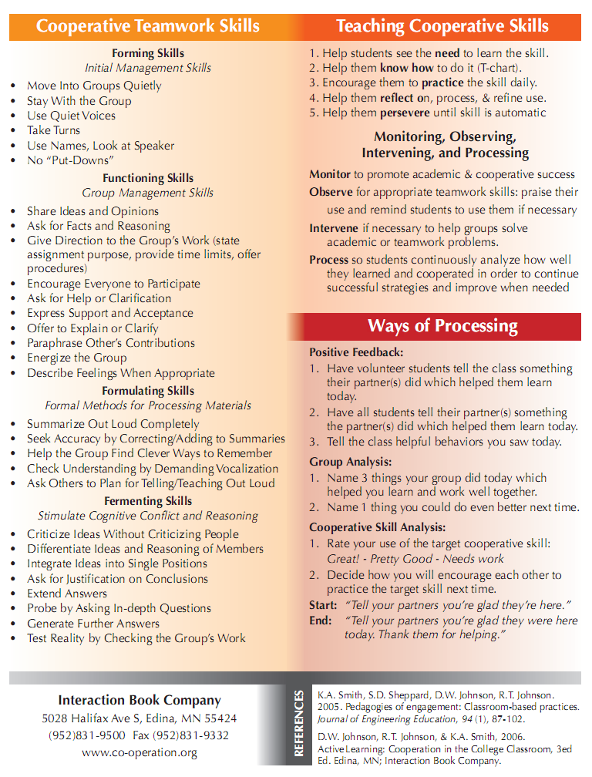
Teamwork Skills
Communication
    Listening and Persuading
Decision Making
Conflict Management
Leadership
Trust and Loyalty

Slide 13
Professor's Role in
Formal Cooperative Learning
Specifying Objectives
Making Decisions
Explaining Task, Positive Interdependence, and Individual Accountability
Monitoring and Intervening to Teach Skills
Evaluating Students' Achievement and Group Effectiveness

Slide 14
Decisions,Decisions
Group size?
Group selection?
Group member roles?
How long to leave groups together?
Arranging the room?
Providing materials?
Time allocation?

Slide 15
Optimal Group Size?
2
3
4
5
6

Slide 16
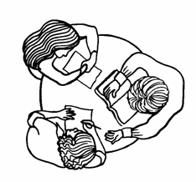
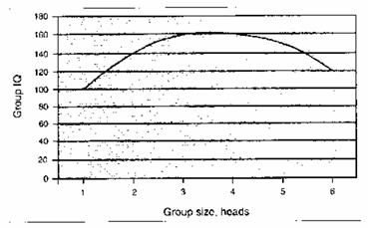
Formal Cooperative Learning Task Groups
Perkins, David. 2003. King Arthur's Round
Table: How collaborative conversations create
smart organizations. NY: Wiley.
Notes:
Barr & Tagg's From teaching to learing is the most often requested article from Change mangazine
Bill Camplbell and I started working on New Paradigms in 1993.

Slide 17
Group Selection?
Self selection
Random selection
Stratified random
Instructor assign
Interest

Slide 18
Formal Cooperative Learning – Types of Tasks
Jigsaw – Learning new conceptual/procedural material
2. Peer Composition or Editing
3. Reading Comprehension/Interpretation
4. Problem Solving, Project, or Presentation
5. Review/Correct Homework
6. Constructive Controversy
7. Group Tests
Notes:
Table summarizes my perception of the shift. A version of this table is available in New Paradigms for Engineering Education -- FIE Conf proceedings 97 (avail on the www)
One of the most significant changes that has occurred is the shift from "pouring in knowledge" to "creating a climate where learning flows among students and the professor"

Slide 19
Three Ways to Structure Cooperative Learning:
Informal-Formal-Base
Karl A. Smith
University of Minnesota
ksmith@umn.edu
Cooperative Jigsaw

Slide 20
JIGSAW SCHEDULE
COOPERATIVE GROUPS
PREPARATION PAIRS
CONSULTING/SHARING PAIRS
TEACHING/LEARNING IN COOPERATIVE GROUPS
WHOLE CLASS REVIEW

Slide 21
Preparation ~ 20 min
Teach & Learn ~ 15 min
Informal ~ 5 min
Formal ~ 5 min
Base ~ 5 min

Slide 22
Cooperative Learning Jigsaw:
Overview – CL Notes p. 8 – All
Informal Cooperative Learning –Notes pp. 9-13 (9-10) – 1
Formal Cooperative Learning – Notes pp. 14-20 (14-15) – 2
Cooperative Base Groups – Notes pp. 21-22 – 3

Slide 23
Cooperative Jigsaw Objectives
Participants will be able to list and describe features of Informal, Formal and Base Cooperative Groups
Participants will be able to elaborate on multiple ways Positive Interdependence and Individual Accountability were structured
Participants will identify features to implement in their own lesson plans

Slide 24
Jigsaw Procedure (Adapted from Johnson, Johnson & Smith, 1998)
When you have information you need to communicate to students, an alternative to lecturing is a procedure for structuring cooperative learning groups called jigsaw (Aronson, 1978).
Task: Think of a reading assignment you will give in the near future. Divide the assignment into multiple (2- 4) parts. Plan how you will use the jigsaw procedure.
Procedure: Positive Interdependence is structured in the jigsaw method through creating resource interdependence. The steps for structuring a "jigsaw" lesson are:
1. Cooperative Groups: Distribute a set of instructions and materials to each group. The set needs to be divisible into the number of members of the group (2, 3, or 4 parts). Give each member one part of the set of materials.
2. Preparation Pairs: Assign students the cooperative task of meeting with someone else in the class who is a member of another learning group and who has the same section of the material to complete two tasks:
a. Learning and becoming an expert on their material.
b. Planning how to teach the material to the other members of their group.
3. Practice Pairs: Assign students the cooperative task of meeting with someone else in the class who is a member of another learning group and who has learned the same material and share ideas as to how the material may best be taught. These "practice pairs" review what each plans to teach their group and how. The best ideas of both are incorporated into each presentation.
4. Cooperative Group: Assign students the cooperative tasks of:
a. Teaching their area of expertise to the other group members.
b. Learning the material being taught by the other members.
5. Evaluation: Assess students' degree of mastery of all the material. Recognize those groups where all members reach the preset criterion of excellence.

Slide 25
Preparation Pairs
TASKS:
a. Master Assigned Material – Skim Chapter
b. Plan How to Teach It To Group
PREPARE TO TEACH:
a. List Major Points You Wish to Teach – 3 – 5 points
b. List Practical Advice Related to Major Points
c. Prepare Visual Aids/Graphical Organizers
d. Prepare Procedure to Make Learners Active, Not Passive
COOPERATIVE: One Teaching Plan From The Two Of You, Both Of You Must Be Ready to Teach

Slide 26
Processing
Please complete the sentence:
One thing you did that helped me learn was . . .

Slide 27
Consulting/Practice Pairs
TASKS:
Find Someone Who Prepared To Teach the Same Section
Prepare Your Teaching Plan
Listen Carefully To Other’s Teaching Plan
Incorporate Other’s Best Ideas Into Your Plan
COOPERATIVE: Ensure Both of You Are Ready to Teach

Slide 28
Teach and Learn Group
TASK: Learn ALL the Material (All three sections)
COOPERATIVE:
Goal: Ensure All Group Members Understand All Sections of Material
Resource: Each Member Has One Part
Roles: Teach, Learn
EXPECTED CRITERIA FOR SUCCESS: Everyone learns and teaches an area of expertise, Everyone learns others' area of expertise, Everyone summarizes and synthesizes
INDIVIDUAL ACCOUNTABILITY:
Professor Monitors Participation of All Learners
Team members check for understanding
Individual implementation
EXPECTED BEHAVIORS: Good Teaching, Excellent Learning, Summarizing, Synthesizing
INTERGROUP COOPERATION: Whenever it is helpful, check procedures, answers, and strategies with another group.

Slide 29
Jigsaw -- Role of Listening Members
Clarify material by asking questions
Suggest creative ways to learn ideas and facts
Relate information to other strategies and elaborate
Present practical applications of information
Keep track of time
Appropriate Humor

Slide 30
JIGSAW SCHEDULE
COOPERATIVE GROUPS
PREPARATION PAIRS
CONSULTING/SHARING PAIRS
TEACHING/LEARNING IN COOPERATIVE GROUPS
WHOLE CLASS REVIEW

Slide 31
Jigsaw Processing
Things We Liked About It
Traps to Watch Out For

Slide 32
Cooperative Learning is instruction that involves people working in teams to accomplish a common goal, under conditions that involve both positive interdependence (all members must cooperate to complete the task) and individual and group accountability (each member is accountable for the complete final outcome).
Key Concepts
•Positive Interdependence
•Individual and Group Accountability
•Face-to-Face Promotive Interaction
•Teamwork Skills
•Group Processing
Notes:
Table summarizes my perception of the shift. A version of this table is available in New Paradigms for Engineering Education -- FIE Conf proceedings 97 (avail on the www)
One of the most significant changes that has occurred is the shift from "pouring in knowledge" to "creating a climate where learning flows among students and the professor"

Slide 33
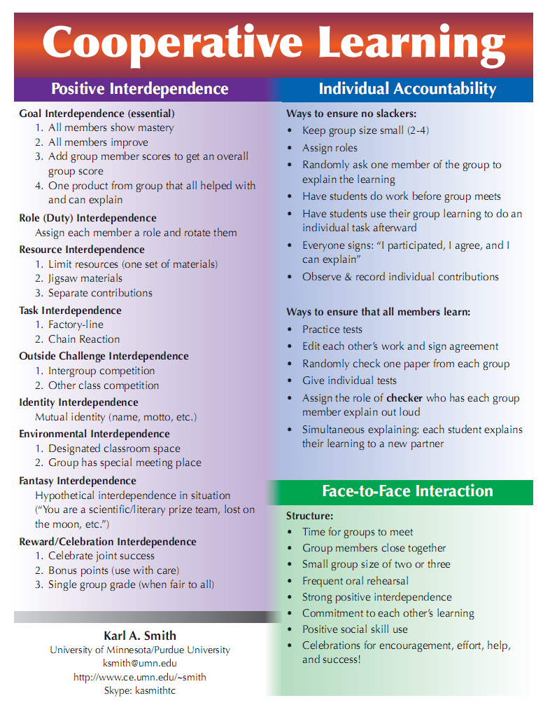
http://www.ce.umn.edu/~smith/docs/Smith-CL%20Handout%2008.pdf

Slide 34
Formal Cooperative Learning – Types of Tasks
Jigsaw – Learning new conceptual/procedural material
2. Peer Composition or Editing
3. Reading Comprehension/Interpretation
4. Problem Solving, Project, or Presentation
5. Review/Correct Homework
6. Constructive Controversy
7. Group Tests
Notes:
Table summarizes my perception of the shift. A version of this table is available in New Paradigms for Engineering Education -- FIE Conf proceedings 97 (avail on the www)
One of the most significant changes that has occurred is the shift from "pouring in knowledge" to "creating a climate where learning flows among students and the professor"

Slide 35
Challenge-Based Learning
Problem-based learning
Case-based learning
Project-based learning
Learning by design
Inquiry learning
Anchored instruction
John Bransford, Nancy Vye and Helen Bateman. Creating High-Quality Learning Environments: Guidelines from Research on How People Learn

Slide 36
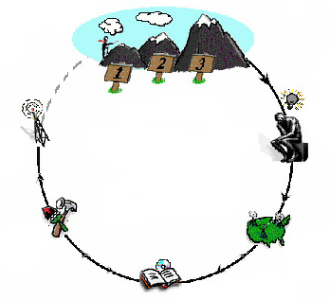
Challenge-Based Instruction with the Legacy Cycle
The Challenges
Go Public
Generate Ideas
Legacy
Cycle
Test Your Mettle
Multiple Perspectives
Research & Revise
https://repo.vanth.org/portal/public-content/star-legacy-cycle/star-legacy-cycle
36
Notes:
36
We use a learning cycle to assist us in organizing learning activities to meet specific goals. This cycle basically scaffolds the inquiry process necessary to identify potential solutions to a problem, research those opportunities, and revise them over time. However, part of the learning process is monitoring understanding of critical concepts and receiving opportunities to go deeper into specific concepts. Therefore, we use formative assessment methods where students can test their mettle and return to do additional Research & Revise activities which will help to revise their understanding.

Slide 37
Problem-Based Learning
START
Apply it
Problem posed
Learn it
Identify what we
need to know

Slide 38
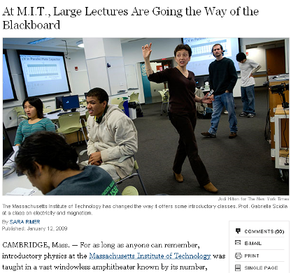
Problem-Based Cooperative Learning
January 13, 2009—New York Times – http://www.nytimes.com/2009/01/13/us/13physics.html?em

Slide 39
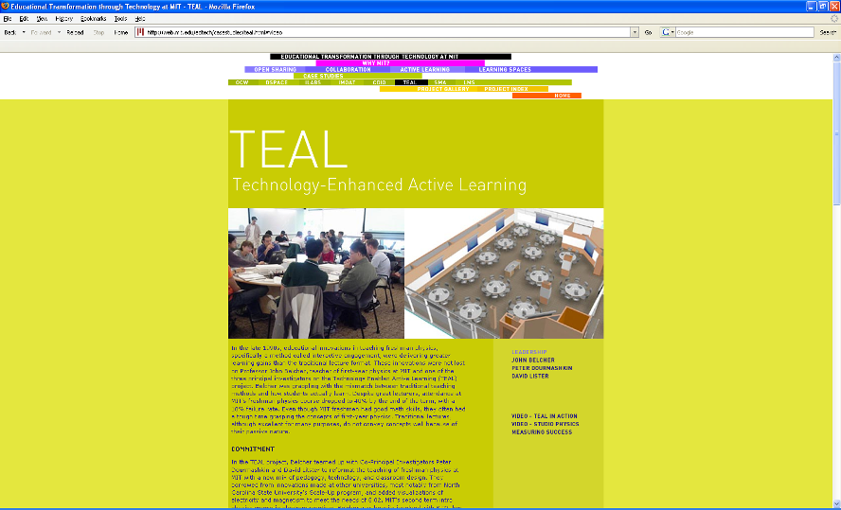
http://web.mit.edu/edtech/casestudies/teal.html#video

Slide 40
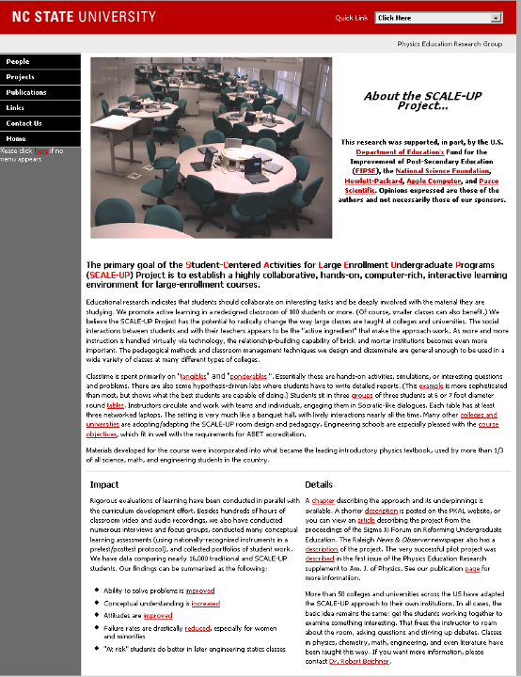
http://www.ncsu.edu/PER/scaleup.html

Slide 41


http://mediamill.cla.umn.edu/mediamill/embed/78755
http://www1.umn.edu/news/news-releases/2010/UR_CONTENT_248261.html
http://www.youtube.com/watch?v=lfT_hoiuY8w
http://youtu.be/lfT_hoiuY8w

Slide 42

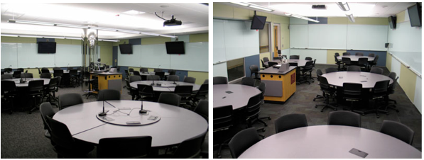
Inside an Active Learning Classroom
STSS in University of Minnesota
http://vimeo.com/andyub/activeclassroom
“I love this space! It makes me feel appreciated as a student, and I feel intellectually invigorated when I work and learn in it.”

Slide 43
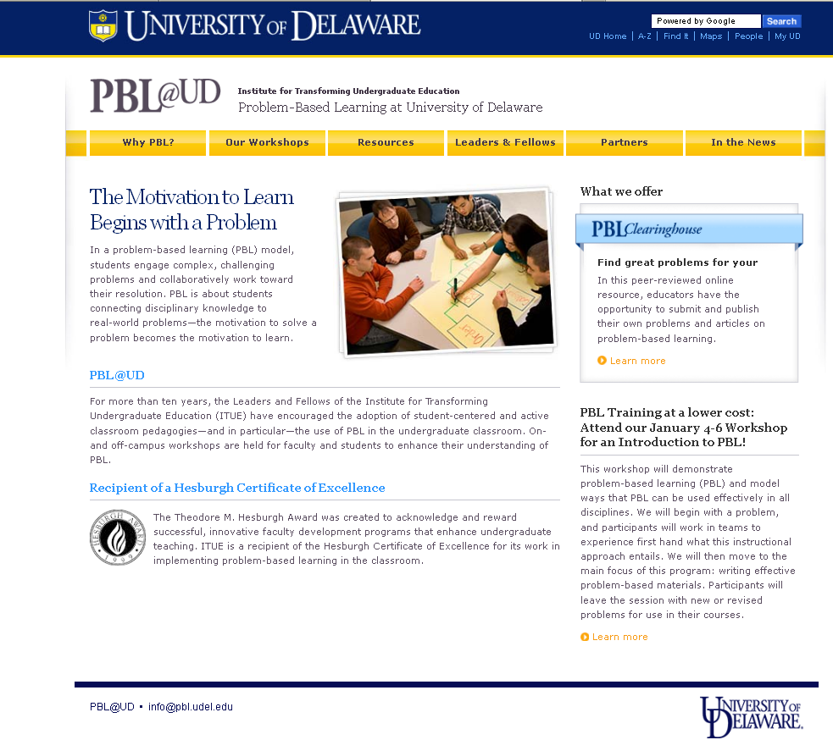
http://www.udel.edu/inst/

Slide 44
Problem-Based Cooperative Learning
Karl A. Smith
Engineering Education – Purdue University
Civil Engineering - University of Minnesota
ksmith@umn.edu
http://www.ce.umn.edu/~smith
Estimation Exercise

Slide 45
First Course Design Experience
UMN – Institute of Technology
Thinking Like an Engineer
Problem Identification
Problem Formulation
Problem Representation
Problem Solving
Problem-Based Learning

Slide 46
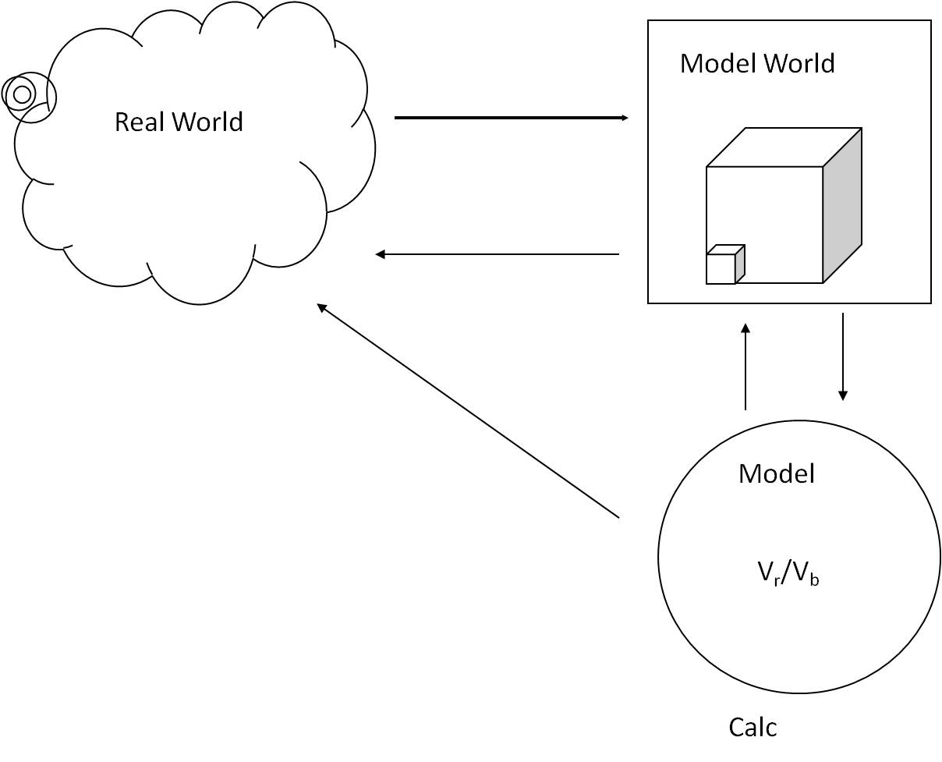
*Based on First Year Engineering course – Problem-based cooperative learning How to Model It published in 1990.

Slide 47
Problem Based Cooperative Learning Format
TASK: Solve the problem(s) or Complete the project.
INDIVIDUAL: Estimate answer. Note strategy.
COOPERATIVE: One set of answers from the group, strive for agreement, make sure everyone is able to explain the strategies used to solve each problem.
EXPECTED CRITERIA FOR SUCCESS: Everyone must be able to explain the strategies used to solve each problem.
EVALUATION: Best answer within available resources or constraints.
INDIVIDUAL ACCOUNTABILITY: One member from your group may be randomly chosen to explain (a) the answer and (b) how to solve each problem.
EXPECTED BEHAVIORS: Active participating, checking, encouraging, and elaborating by all members.
INTERGROUP COOPERATION: Whenever it is helpful, check procedures, answers, and strategies with another group.

Slide 48
Active Learning: Cooperation in the College Classroom
Informal Cooperative Learning Groups
Formal Cooperative Learning Groups
Cooperative Base Groups
See Cooperative Learning
Handout (CL College-912.doc)

Slide 49
Cooperative Base Groups
Are Heterogeneous
Are Long Term (at least one quarter or semester)
Are Small (3-5 members)
Are for support
May meet at the beginning of each session or may meet between sessions
Review for quizzes, tests, etc. together
Share resources, references, etc. for individual projects
Provide a means for covering for absentees

Slide 50
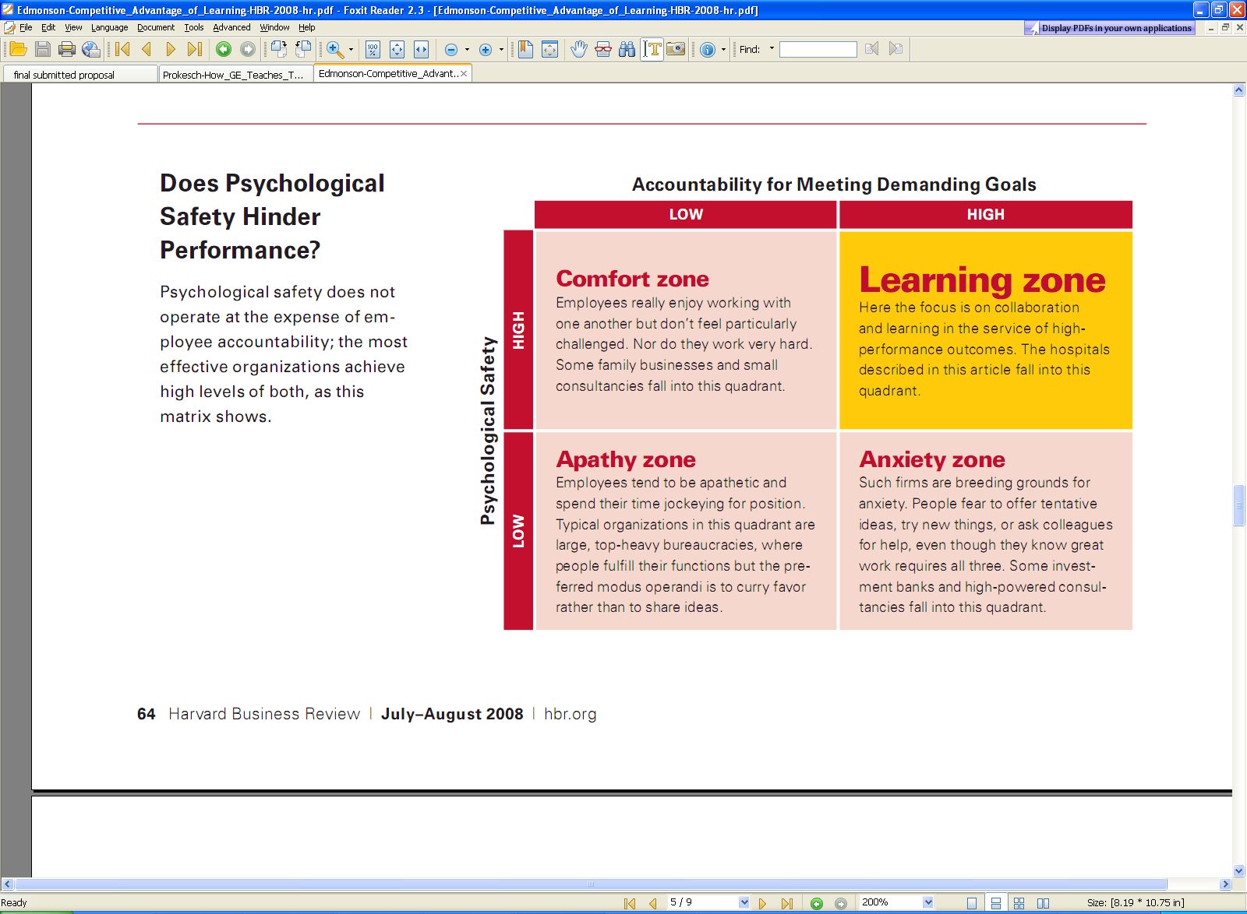
Edmonson-Competitive_Advantage_of_Learning-HBR-2008.pdf

Slide 52
Designing and Implementing Cooperative Learning
Think like a designer
Ground practice in robust theoretical framework
Start small, start early and iterate
Celebrate the successes; problem-solve the failures

Slide 53
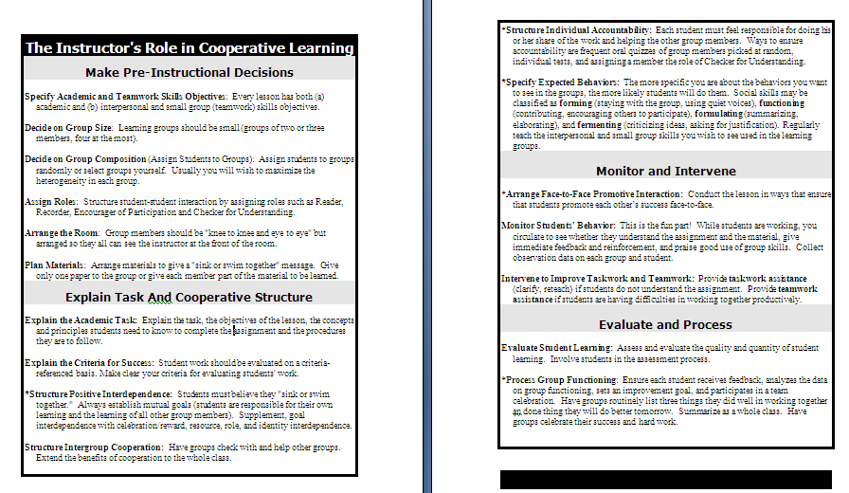

Slide 54
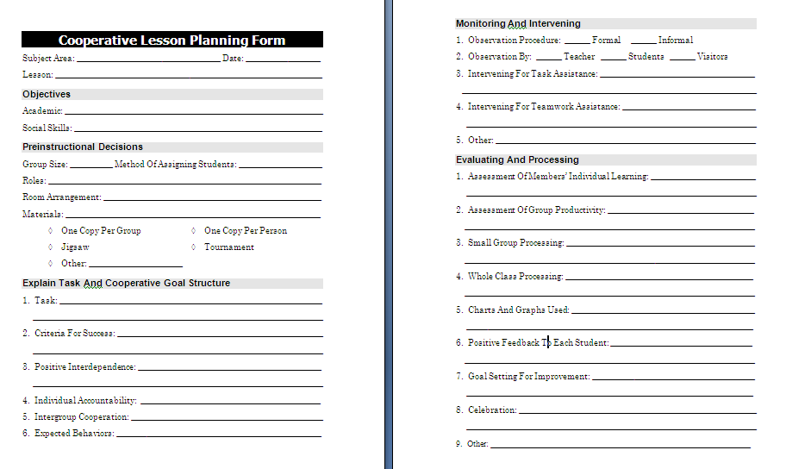

Slide 55
Resources
Design Framework – How People Learn (HPL) & Understanding by Design (UdB) Process
  Ambrose, S., et.al. 2010. How learning works: 7 research based principles for smart teaching. Jossey-Bass
  Bransford, John, Vye, Nancy, and Bateman, Helen. 2002. Creating High-Quality Learning Environments: Guidelines from Research on How People Learn. The Knowledge Economy and Postsecondary Education: Report of a Workshop. National Research Council. Committee on the Impact of the Changing Economy of the Education System. P.A. Graham and N.G. Stacey (Eds.). Center for Education. Washington, DC: National Academy Press. http://www.nap.edu/openbook/0309082927/html/
  Pellegrino, J. 2006. Rethinking and redesigning curriculum, instruction and assessment: What contemporary research and theory suggests. http://www.skillscommission.org/commissioned.htm
  Smith, K. A., Douglas, T. C., & Cox, M. 2009. Supportive teaching and learning strategies in STEM education. In R. Baldwin, (Ed.). Improving the climate for undergraduate teaching in STEM fields. New Directions for Teaching and Learning, 117, 19-32. San Francisco: Jossey-Bass.
  Streveler, R.A., Smith, K.A. and Pilotte, M. 2012. Content, Assessment and Pedagogy (CAP): An Integrated Engineering Design Approach. In Dr. Khairiyah Mohd Yusof, Dr. Shahrin Mohammad, Dr. Naziha Ahmad Azli, Dr. Mohamed Noor Hassan, Dr. Azlina Kosnin and Dr. Sharifah Kamilah Syed Yusof (Eds.). Outcome-Based Education and Engineering Curriculum: Evaluation, Assessment and Accreditation, Universiti Teknologi Malaysia, Malaysia [Streveler-Smith-Pilotte_OBE_Chapter-CAP-v11.pdf]
  Wiggins, G. & McTighe, J. 2005. Understanding by Design: Expanded Second Edition. Prentice Hall.
Content Resources
  Donald, Janet. 2002. Learning to think: Disciplinary perspectives. San Francisco: Jossey-Bass.
  Middendorf, Joan and Pace, David. 2004. Decoding the Disciplines: A Model for Helping Students Learn Disciplinary Ways of Thinking. New Directions for Teaching and Learning, 98.
Cooperative Learning
  Cooperative Learning (Johnson, Johnson & Smith) - Smith web site – www.ce.umn.edu/~smith
  Smith (2010) Social nature of learning: From small groups to learning communities. New Directions for Teaching and Learning, 2010, 123, 11-22 [NDTL-123-2-Smith-Social_Basis_of_Learning-.pdf]
  Smith, Sheppard, Johnson & Johnson (2005) Pedagogies of Engagement [Smith-Pedagogies_of_Engagement.pdf]
  Johnson, Johnson & Smith. 1998. Cooperative learning returns to college: What evidence is there that it works? Change, 1998, 30 (4), 26-35. [CLReturnstoCollege.pdf]
Other Resources
  University of Delaware PBL web site – www.udel.edu/pbl
  PKAL – Pedagogies of Engagement – http://www.pkal.org/activities/PedagogiesOfEngagementSummit.cfm
  Fairweather (2008) Linking Evidence and Promising Practices in Science, Technology, Engineering, and Mathematics (STEM) Undergraduate Education - http://www7.nationalacademies.org/bose/Fairweather_CommissionedPaper.pdf

