Slide 1
Evidence-Based Practices for
Innovative Education
Karl A. Smith
Engineering Education – Purdue University
STEM Education Center/Civil Eng – University of Minnesota
ksmith@umn.edu - http://www.ce.umn.edu/~smith/
Frontiers of Engineering Education –
Educational Innovation Seminar Series
(FOEE–EISS)
Worcester Polytechnic Institute
September 7, 2011

Slide 2
Reflection and Dialogue
Individually reflect on your mental image of an innovative teacher. Write for about 1 minute.
  Jot down words or phrases
  Construct a figure or diagram
Discuss with your neighbor for about 2 minutes
  Describe your mental image and talk about similarities and differences
  Select one Element, Image, Comment, Story, etc. that you would like to present to the whole group if you are randomly selected
Whole group discussion

Slide 3
Teacher Mental Images About Teaching - Axelrod (1973)
Mental Image | Motto | Characteristics | Disciplines
Content | I teach what I know | Pour it in, Lecture | Science, Math
Instructor | I teach what I am | Modeling, Demonstration | Many
Student – Cognitive Development | I train minds | Active Learning, Discussion | English, Humanities
Student – Development of Whole Person | I work with students as people | Motivation, Self-esteem | Basic Skills Teachers
Axelrod, J. The University Teacher as Artist. San Francisco: Jossey-Bass, 1973.

Slide 4
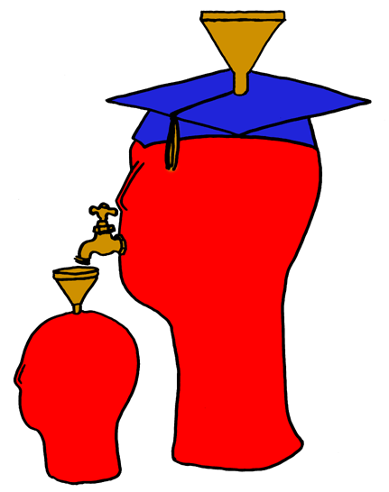
Lila M. Smith
Notes:
8:30-9:30?Take copies of Active Lrn, HTMI, New Paradigms,

Slide 5
Engineering Education: Advancing the Practice Karl Smith
Research
Process Metallurgy 1970 -1992
Learning ~1974
Design ~1995
Engineering Education Research & Innovation ~ 2000
Innovation – Cooperative Learning
Need identified ~1974
Introduced ~1976
FIE conference 1981
JEE paper 1981
Research book 1991
Practice handbook 1991
Change paper 1998
Teamwork and project management 2000
JEE paper 2005
National Academy of Engineering - Frontiers of Engineering Education Symposium - December 13-16, 2010 - Slides PDF [Smith-NAE-FOEE-HPL-UbD-12-10-v8.pdf]
Notes:
In this seminar I plan to provide links between my experience as a researcher and an innovation that I’m associated with. I’m using Denning and Dunhams (2010) definition of innovation as the adoption of a new practice in a community. Several researchers argue that a principal aspect of innovation is novel combinations, and I will highlight this aspect, too. Individual reflection – what link between research and innovation are you or would you like to be know for?

Slide 6
Process Metallurgy
Dissolution Kinetics – liquid-solid interface
Iron Ore Desliming – solid-solid interface
Metal-oxide reduction roasting – gas-solid interface
Notes:
My process metallurgy experience was at interfaces, which I think helped position me for work at the engineering and education interface

Slide 7
Dissolution Kinetics
Theory – Governing Equation for Mass Transport
Research – rotating disk
Practice – leaching of silver bearing metallic copper

Slide 8
Iron Ore Desliming
Theory – DLVO [V(h) = V_{A}(h) + V_{R}(h)]
Research – streaming potential
Practice – recovery of iron from low-grade Fe₂O₃ ores (Selective removal of silicates)

Slide 9
Metal Oxide Reduction Roasting
Theory – catalyzed gas-solid reactions
Boudouard Reaction [CO₂ + C = 2CO]
Research method – thermogravimetric analysis
Practice – extraction of Ti from FeTiO₃, Al from Al₂O₃ – bearing minerals

Slide 10
First Teaching Experience
Practice – Third-year course in metallurgical reactions – thermodynamics and kinetics

Slide 11
Lila M. Smith
Notes:
8:30-9:30?Take copies of Active Lrn, HTMI, New Paradigms,

Slide 12
Engineering Education
Practice – Third-year course in metallurgical reactions – thermodynamics and kinetics
Research – ?
Theory – ?
Theory
Research
Evidence
Practice

Slide 13
University of Minnesota College of Education
Social, Psychological and Philosophical Foundations of Education
Statistics, Measurement, Research Methodology
Assessment and Evaluation
Learning and Cognitive Psychology
Knowledge Acquisition, Artificial Intelligence, Expert Systems
Social psychology of learning – student – student interaction

Slide 14
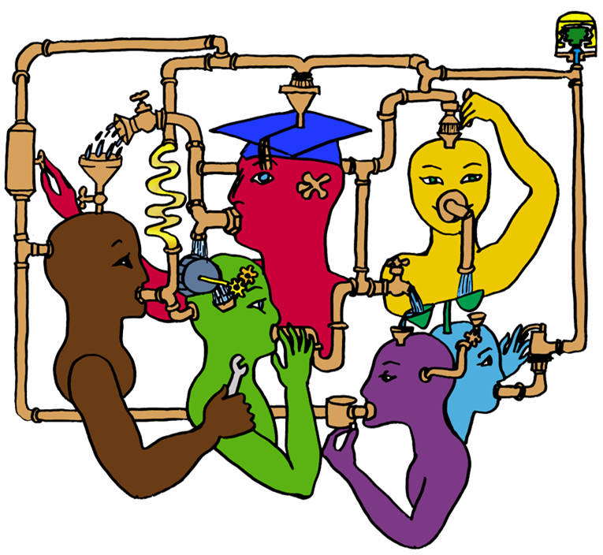
Lila M. Smith
Notes:
8:30-9:30?Take copies of Active Lrn, HTMI, New Paradigms,

Slide 15
Pedago-pathologies
Amnesia
Fantasia
Inertia
Lee Shulman – MSU Med School – PBL Approach (late 60s – early 70s), President Emeritus of the Carnegie Foundation for the Advancement of College Teaching
Shulman, Lee S. 1999. Taking learning seriously. Change, 31 (4), 11-17.
Notes:
8:30-9:30?Take copies of Active Lrn, HTMI, New Paradigms,

Slide 16
What do we do about these pathologies?
Activity – Engage learners in meaningful and purposeful activities
Reflection – Provide opportunities
Collaboration – Design interaction
Passion – Connect with things learners care about
Shulman, Lee S. 1999. Taking learning seriously. Change, 31 (4), 11-17.

Slide 17
Seven Principles for Good Practice in Undergraduate Education
Good practice in undergraduate education:
  Encourages student-faculty contact
  Encourages cooperation among students
  Encourages active learning
  Gives prompt feedback
  Emphasizes time on task
  Communicates high expectations
  Respects diverse talents and ways of learning
Chickering & Gamson, June, 1987

Slide 18
Student Engagement Research Evidence
Perhaps the strongest conclusion that can be made is the least surprising. Simply put, the greater the student’s involvement or engagement in academic work or in the academic experience of college, the greater his or her level of knowledge acquisition and general cognitive development …(Pascarella and Terenzini, 2005).
Active and collaborative instruction coupled with various means to encourage student engagement invariably lead to better student learning outcomes irrespective of academic discipline (Kuh et al., 2005, 2007).
See Smith, et.al, 2005 and Fairweather, 2008, Linking Evidence and Promising Practices in Science, Technology, Engineering, and Mathematics (STEM) Undergraduate Education - http://www7.nationalacademies.org/bose/Fairweather_CommissionedPaper.pdf

Slide 19
Robert Barr & John Tagg. From teaching to learning: A new paradigm for undergraduate education. Change, 27(6), 1995.
Wm. Campbell & Karl Smith. New Paradigms for College Teaching. Interaction Books, 1997.
Notes:
8:30-9:30?Take copies of Active Lrn, HTMI, New Paradigms,

Slide 20
Comparison of Old and New Paradigm of Teaching (Johnson, Johnson & Smith, 1991)
 | Old Paradigm | New Paradigm
Knowledge | Transferred from Faculty to Students | Jointly Constructed by Students and Faculty
Students | Passive Vessel to be Filled by Faculty's Knowledge | Active Constructor, Discoverer, Transformer of Knowledge
Faculty Purpose | Classify and Sort Students | Develop Students' Competencies and Talents
Relationships | Impersonal Relationship Among Students and Between Faculty and Students | Personal Transaction Among Students and Between Faculty and Students
Context | Competitive/Individualistic | Cooperative Learning in Classroom and Cooperative Teams Among Faculty
Teaching Assumption | Any Expert can Teach | Teaching is Complex and Requires Considerable Training
Johnson, D.W., Johnson, R.T., and Smith, K.A. Active Learning: Cooperation in the College Classroom (1st ed.). Edina, MN: Interaction Book Company, 1991.

Slide 21
 | Old Paradigm | New Paradigm
Knowledge | Transferred from Faculty to Students | Jointly Constructed by Students and Faculty
Students | Passive Vessel to be Filled by Faculty's Knowledge | Active Constructor, Discoverer, Transformer of Knowledge
Mode of Learning | Memorizing | Relating
Faculty Purpose | Classify and Sort Students | Develop Students' Competencies and Talents
Student Goals | Complete Requirements, Achieve Certification within a Discipline | Grow, Focus on Continual Lifelong Learning within a Broader System
Relationships | Impersonal Relationship Among Students and Between Faculty and Students | Personal Transaction Among Students and Between Faculty and Students
Context | Competitive/Individualistic | Cooperative Learning in Classroom and Cooperative Teams Among Faculty
Climate | Conformity/Cultural Uniformity | Diversity and Personal Esteem/ Cultural Diversity and Commonality
Power | Faculty Holds and Exercises Power, Authority, and Control | Students are Empowered; Power is Shared Among Students and Between Students and Faculty
Assessment | Norm-Referenced (i.e., Graded "On the Curve"); Typically Multiple Choice Items; Student rating of instruction at end of course | Criterion-Referenced; Typically Performances and Portfolios; Continual Assessment of Instruction
Ways of Knowing | Logico-Scientific | Narrative
Technology Use | Drill and Practice; Textbook Substitute; Chalk and Talk Substitute | Problem Solving, Communication, Collaboration, Information Access, Expression
Teaching Assumption | Any Expert can Teach | Teaching is Complex and Requires Considerable Training

Slide 22
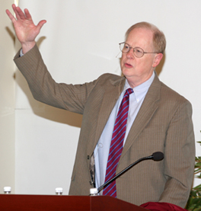
It could well be that faculty members of the twenty-first century college or university will find it necessary to set aside their roles as teachers and instead become designers of learning experiences, processes, and environments.
James Duderstadt, 1999 [Nuclear Engineering Professor; Dean, Provost and President of the University of Michigan]

Slide 23
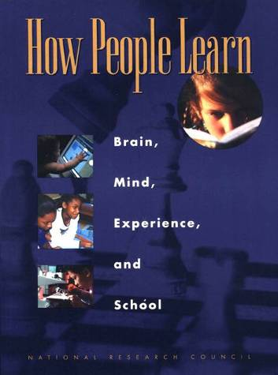
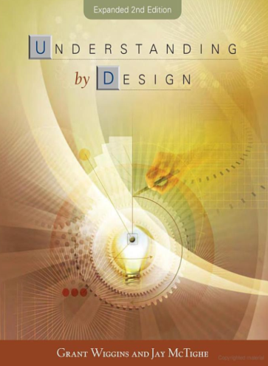
Design Foundations
Science of Instruction (UbD)
 | No | Yes
Yes | Good Theory/ Poor Practice | Good Theory & Good Practice
No |  | Good Practice/ Poor Theory
Science of Learning
(HPL)
Sources: Bransford, Brown & Cocking. 1999. How people learn. National Academy Press.
Wiggins, G. & McTighe, J. 2005. Understanding by design, 2ed. ASCD.
Notes:
Models of how learning works – (1) learning as response strengthening, (2) learning as information acquisition, (3) learning as knowledge construction and (4) learning as social knowledge construction

Slide 24
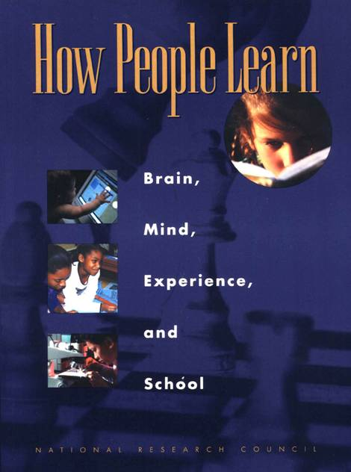
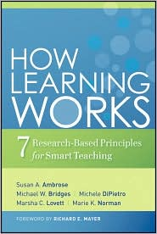
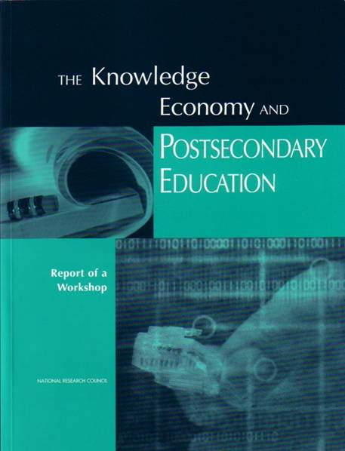
Bransford, Vye and Bateman – Creating High Quality Learning Environments

Slide 25
Students prior knowledge can help or hinder learning
How student organize knowledge influences how they learn and apply what they know
Students’ motivation determines, directs, and sustains what they do to learn
To develop mastery, students must acquire component skills, practice integrating them, and know when to apply what they have learned
Goal-directed practice coupled with targeted feedback enhances the quality of students’ learning
Students’ current level of development interacts with the social, emotional, and intellectual climate of the course to impact learning
To become self-directed learners, students must learn to monitor and adjust their approach to learning

Slide 26
Understanding by Design
Wiggins & McTighe (1997, 2005)
Stage 1. Identify Desired Results
Enduring understanding
Important to know and do
Worth being familiar with
Stage 2. Determine Acceptable Evidence
Stage 3. Plan Learning Experiences
and Instruction
Overall: Are the desired results, assessments, and learning activities ALIGNED?
From: Wiggins, Grant and McTighe, Jay. 1997. Understanding by Design. Alexandria, VA: ASCD
26
Notes:
26

Slide 27
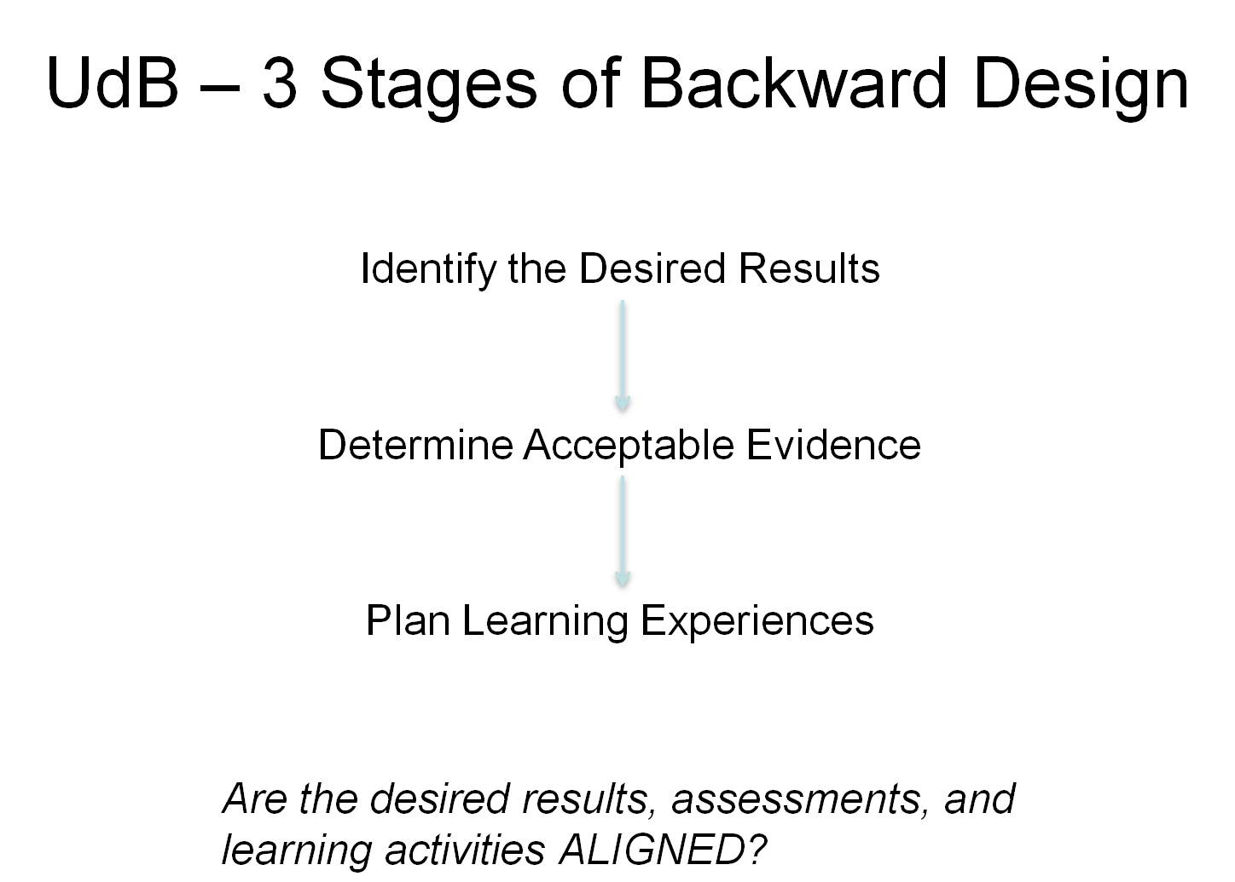
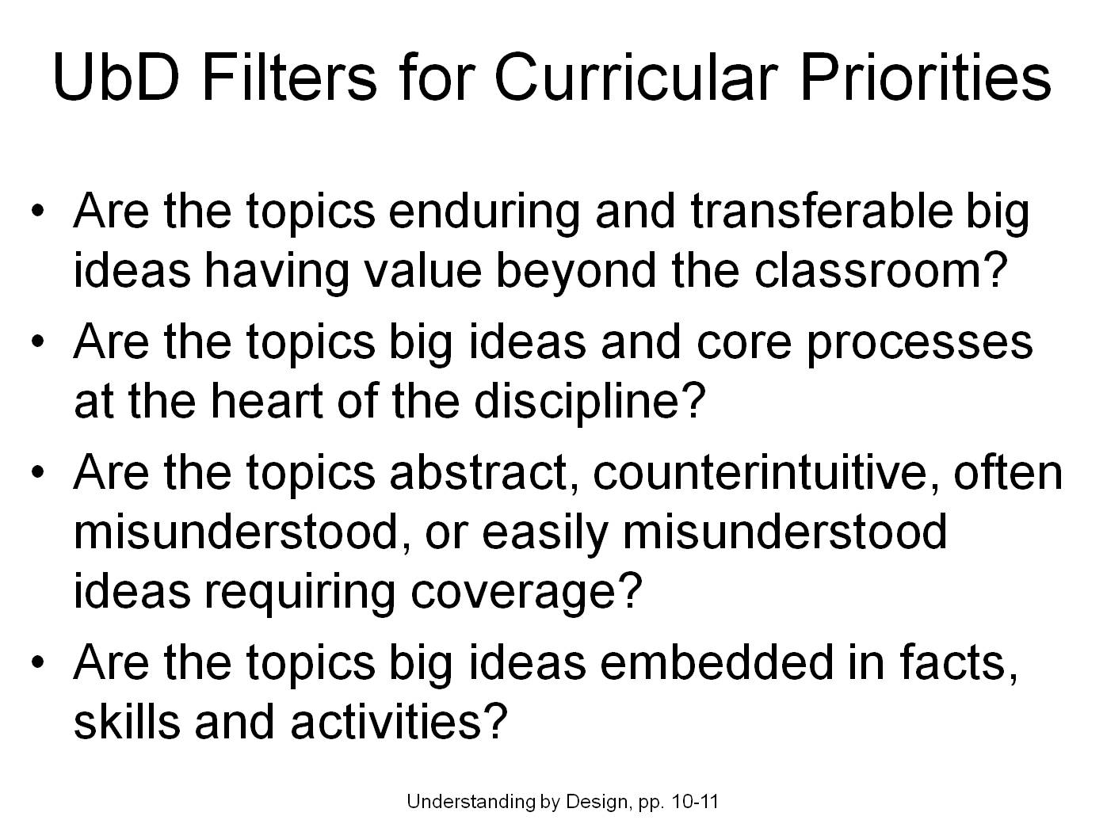
Content-Assessment-Pedagogy (CAP) Design Process Flowchart
Understanding by Design (Wiggins & McTighe, 2005)
Start
Context
Backward Design
Content
Assessment
Pedagogy
No
C & A & P
Alignment?
Yes
End
Streveler, Smith & Pilotte (2011)
Notes:
27

Slide 28
Lila M. Smith
Notes:
8:30-9:30?Take copies of Active Lrn, HTMI, New Paradigms,

Slide 29
Cooperative Learning
Theory – Social Interdependence – Lewin – Deutsch – Johnson & Johnson
Research – Randomized Design Field Experiments
Practice – Formal Teams/Professor’s Role
Theory
Research
Evidence
Practice

Slide 30
Lewin’s Contributions
Founded field of social psychology
Action Research
Force-Field analysis
B = f(P,E)
Social Interdependence Theory
“There is nothing so practical as a good theory”

Slide 31

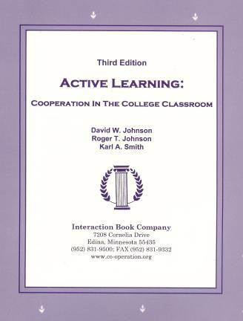
Cooperative Learning
•Positive Interdependence
•Individual and Group Accountability
•Face-to-Face Promotive Interaction
•Teamwork Skills
•Group Processing
[*First edition 1991]

Slide 32
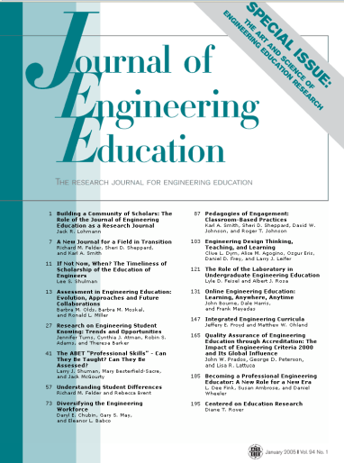

Cooperative Learning Research Support
Johnson, D.W., Johnson, R.T., & Smith, K.A. 1998. Cooperative learning returns to college: What evidence is there that it works? Change, 30 (4), 26-35.
• Over 300 Experimental Studies
• First study conducted in 1924
• High Generalizability
• Multiple Outcomes
Outcomes
1. Achievement and retention
2. Critical thinking and higher-level
reasoning
3. Differentiated views of others
4. Accurate understanding of others' perspectives
5. Liking for classmates and teacher
6. Liking for subject areas
7. Teamwork skills
January 2005
March 2007
Notes:
Table summarizes my perception of the shift. A version of this table is available in New Paradigms for Engineering Education -- FIE Conf proceedings 97 (avail on the www)
One of the most significant changes that has occurred is the shift from "pouring in knowledge" to "creating a climate where learning flows among students and the professor"

Slide 33
Small-Group Learning: Meta-analysis
Springer, L., Stanne, M. E., & Donovan, S. 1999. Effects of small-group learning on undergraduates in science, mathematics, engineering, and technology: A meta-analysis. Review of Educational Research, 69(1), 21-52.
Small-group (predominantly cooperative) learning in postsecondary science, mathematics, engineering, and technology (SMET). 383 reports from 1980 or later, 39 of which met the rigorous inclusion criteria for meta-analysis.
The main effect of small-group learning on achievement, persistence, and attitudes among undergraduates in SMET was significant and positive. Mean effect sizes for achievement, persistence, and attitudes were 0.51, 0.46, and 0.55, respectively.
Notes:
Table summarizes my perception of the shift. A version of this table is available in New Paradigms for Engineering Education -- FIE Conf proceedings 97 (avail on the www)
One of the most significant changes that has occurred is the shift from "pouring in knowledge" to "creating a climate where learning flows among students and the professor"

Slide 34
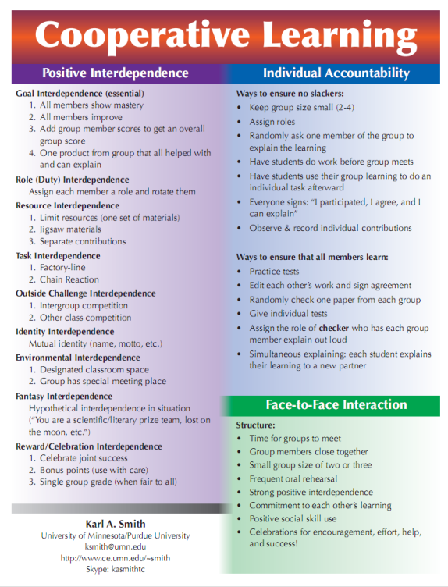
Cooperative Learning is instruction that involves people working in teams to accomplish a common goal, under conditions that involve both positive interdependence (all members must cooperate to complete the task) and individual and group accountability (each member is accountable for the complete final outcome).
Key Concepts
•Positive Interdependence
•Individual and Group Accountability
•Face-to-Face Promotive Interaction
•Teamwork Skills
•Group Processing
http://www.ce.umn.edu/~smith/docs/Smith-CL%20Handout%2008.pdf
Notes:
Table summarizes my perception of the shift. A version of this table is available in New Paradigms for Engineering Education -- FIE Conf proceedings 97 (avail on the www)
One of the most significant changes that has occurred is the shift from "pouring in knowledge" to "creating a climate where learning flows among students and the professor"

Slide 35
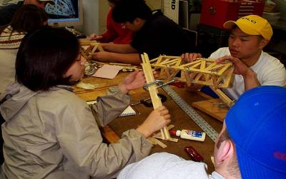
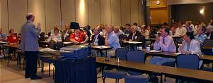
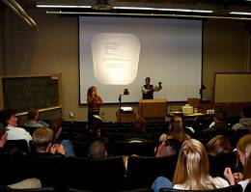
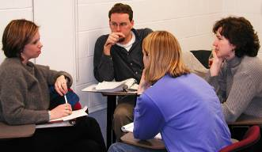
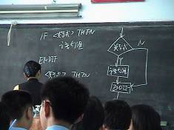
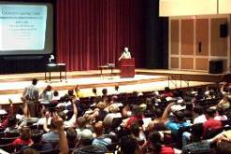
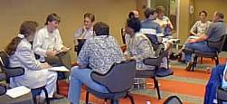
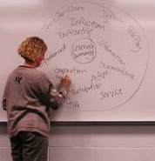
Pedagogies of Engagement

Slide 36
The Active Learning Continuum
Informal
Group
Activities
Structured
Team
Activities
Problems
Drive the
Course
Make the
lecture active
Instructor
Centered
Student
Centered
Active
Learning
Collaborative
Learning
Cooperative
Learning
Problem-
Based
Learning
Prince, M. (2010). NAE FOEE
My work is situated here – Cooperative
Learning & Challenge-Based Learning

Slide 37
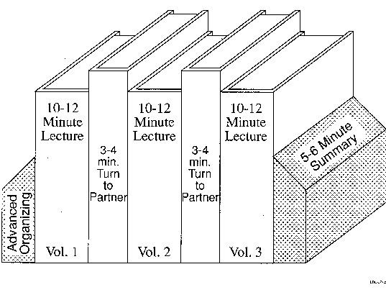
Book Ends on a Class Session

Slide 38
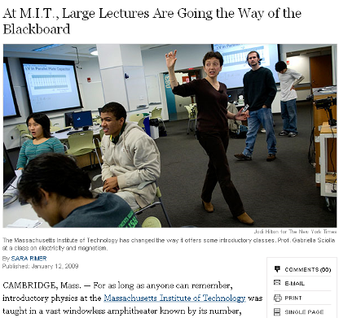
Problem-Based Cooperative Learning
January 13, 2009—New York Times – http://www.nytimes.com/2009/01/13/us/13physics.html?em

Slide 39
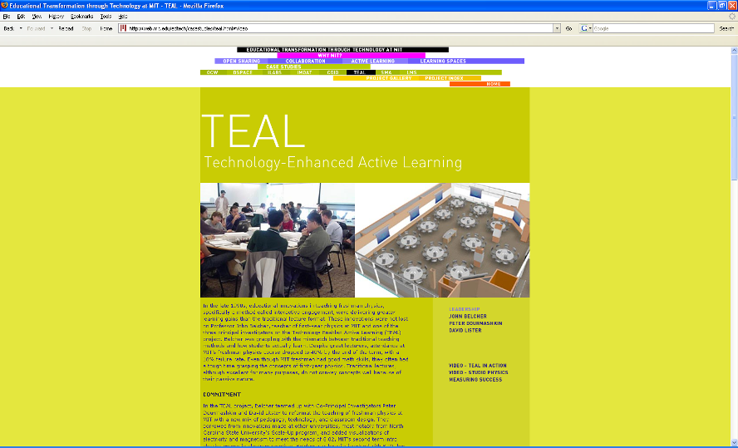
http://web.mit.edu/edtech/casestudies/teal.html#video

Slide 40
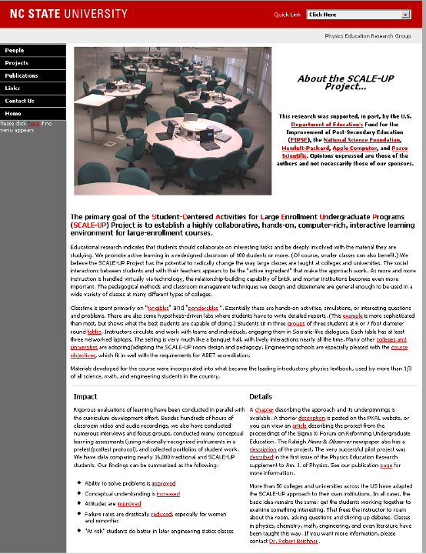
http://www.ncsu.edu/PER/scaleup.html

Slide 41

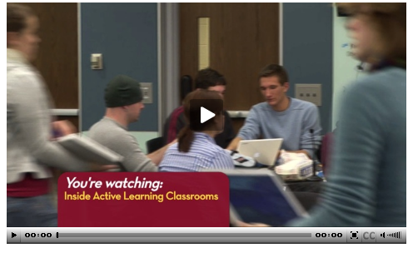
http://mediamill.cla.umn.edu/mediamill/embed/78755
http://www1.umn.edu/news/news-releases/2010/UR_CONTENT_248261.html
http://www.youtube.com/watch?v=lfT_hoiuY8w
http://youtu.be/lfT_hoiuY8w

Slide 42
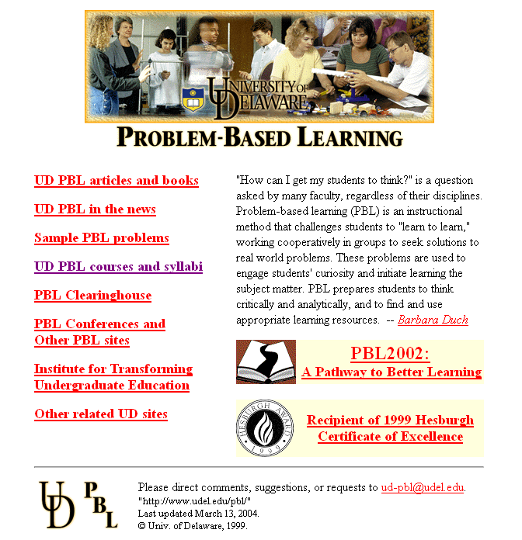
http://www.udel.edu/pbl/

Slide 43
Cooperative Learning Adopted
The American College Teacher:
National Norms for 2007-2008
Methods Used in “All” or “Most” | All – 2005 | All – 2008 | Assistant - 2008
Cooperative Learning | 48 | 59 | 66
Group Projects | 33 | 36 | 61
Grading on a curve | 19 | 17 | 14
Term/research papers | 35 | 44 | 47
http://www.heri.ucla.edu/index.php

Slide 44

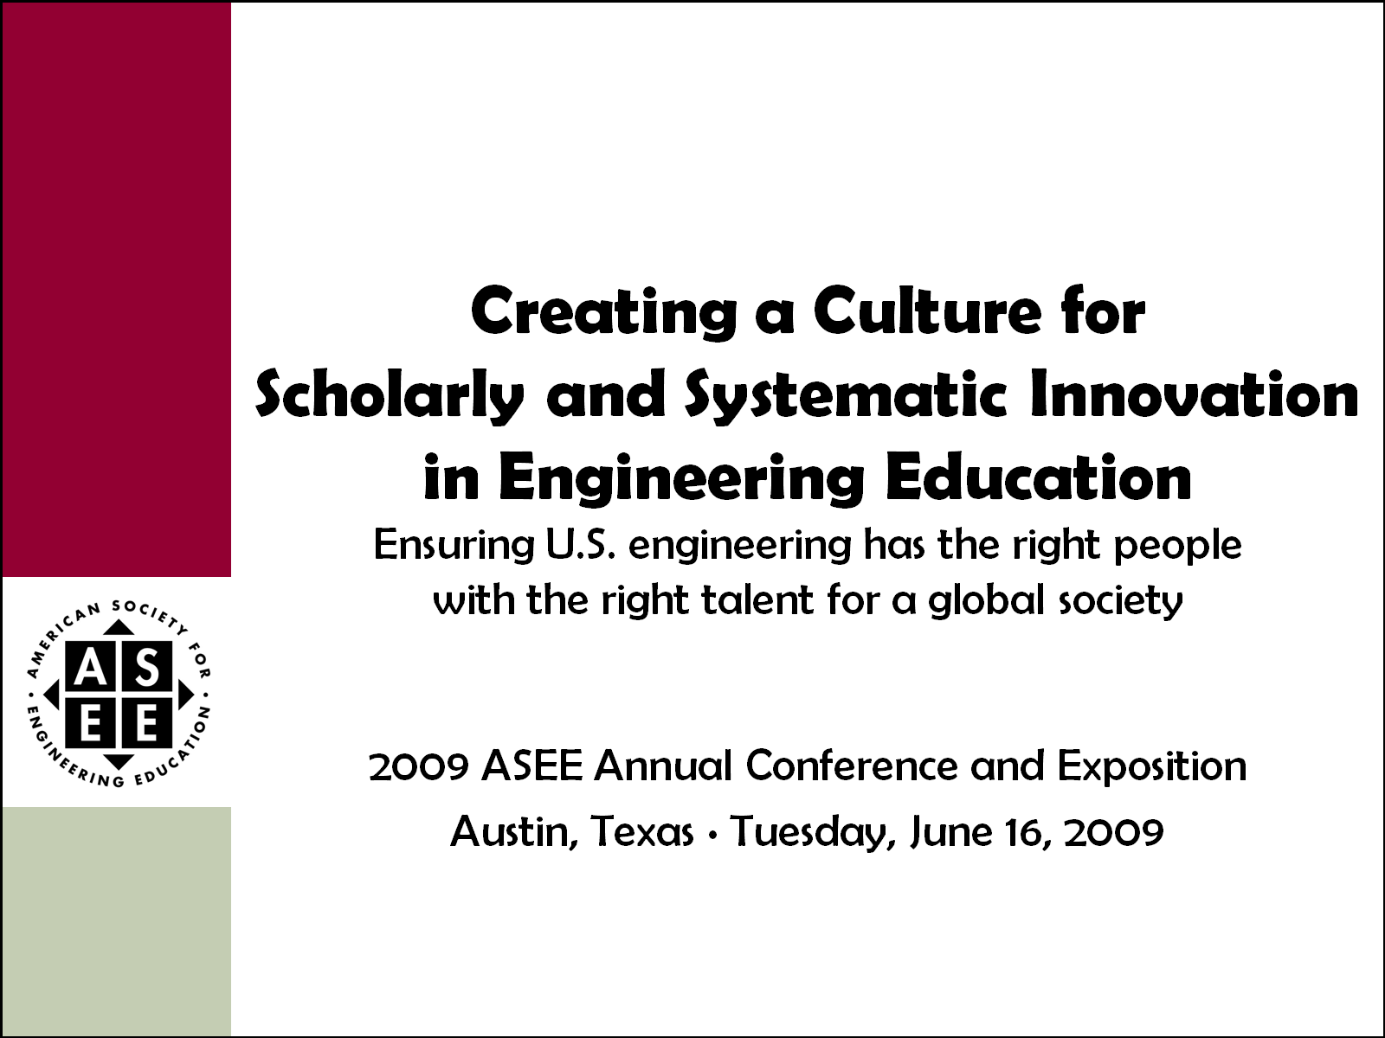
Celebration of Two Major
ASEE Milestones
2011 ASEE Annual Conference and Exposition
Vancouver, British Columbia ∙ Monday, June 27, 2011

Slide 45
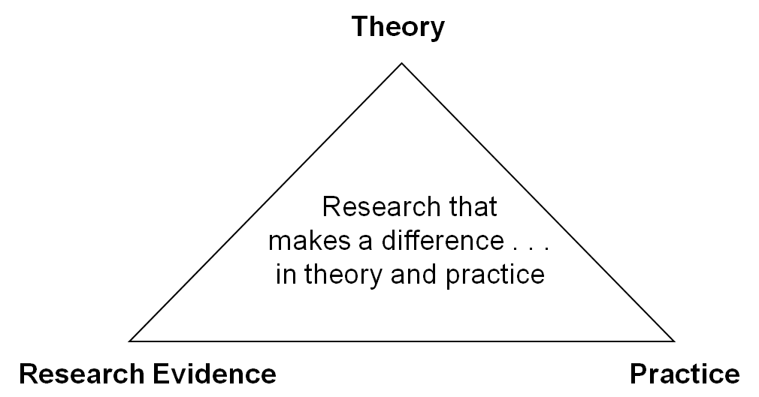
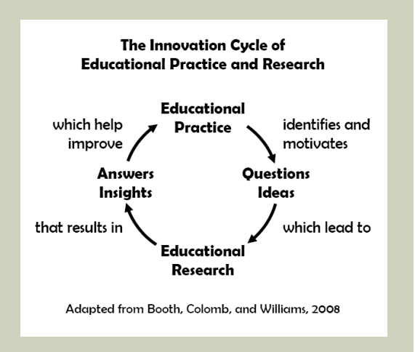

One BIG Idea; Two Perspectives
Jamieson & Lohmann (2009)
Engineering Education Innovation

Slide 46
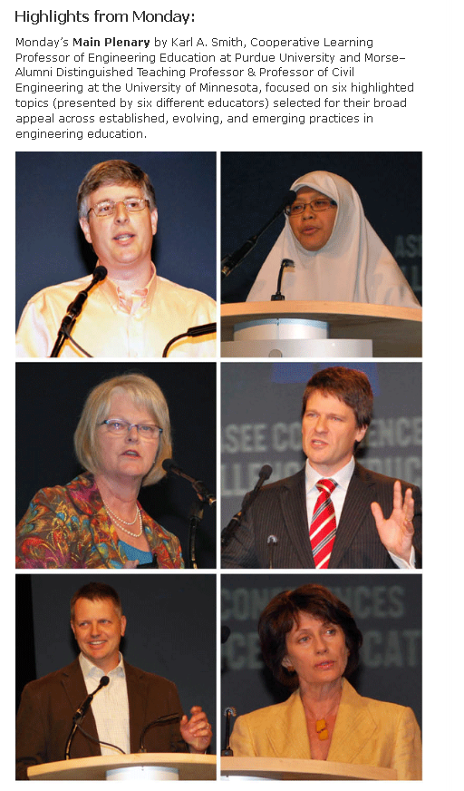
ASEE Main Plenary, 8:45 a.m. – 10:15 a.m.
Vancouver International Conference Centre, West Ballroom CD
Expected to draw over 2,000 attendees, this year’s plenary features Karl A. Smith, Cooperative Learning Professor of Engineering Education at Purdue University and Morse–Alumni Distinguished Teaching Professor & Professor of Civil Engineering at the University of Minnesota.
Smith has been at the University of Minnesota since 1972 and has been active in ASEE since he became a member in 1973. For the past five years, he has been helping start the engineering education Ph.D. program at Purdue University. He is a Fellow of the American Society for Engineering Education and past Chair of the Educational Research and Methods Division. He has worked with thousands of faculty all over the world on pedagogies of engagement, especially cooperative learning, problem-based learning, and constructive controversy.
On the occasion of the 100th anniversary of the Journal of Engineering Education and the release of ASEE’s Phase II report Creating a Culture for Scholarly and Systematic Innovation in Engineering Education (Jamieson/Lohmann report), the plenary will celebrate these milestones and demonstrate rich, mutual interdependences between practice and inquiry into teaching and learning in engineering education. Depth and range of the plenary will energize the audience and reflects expertise and interests of conference participants. One of ASEE’s premier educators and researchers, Smith will draw upon our roots in scholarship to set the stage and weave the transitions for six highlighted topics selected for their broad appeal across established, evolving, and emerging practices in engineering education.
Video: https://secure.vimeo.com/27147996
Slides: http://www.ce.umn.edu/~smith/links.html
http://www.asee.org/conferences-and-events/conferences/annual-conference/2011/program-schedule/conference-highlights

Slide 47


Innovation is the adoption
of a new practice in a community
- Denning & Dunham (2010)

Slide 48
*Education Innovation
Stories supported by evidence are essential for adoption of new practices
  Good ideas and/or insightful connections
  Supported by evidence
  Spread the word
  Patience and persistence
Cooperative learning took over 25 years to become widely practiced in higher education
We can’t wait 25 years for YOUR innovations to become widely practiced!

Slide 49
Reflection and Dialogue
Individually reflect on your Education Innovation. Write for about 1 minute
  Are the student learning outcomes clearly articulated?
    Are they BIG ideas at the heart of the discipline?
  Are the assessments aligned with the outcomes?
  Is the pedagogy aligned with the outcomes & assessment?
Discuss with your neighbor for about 2 minutes
  Select Design Example, Comment, Insight, etc. that you would like to present to the whole group if you are randomly selected

Slide 50
Good teaching comes from the identity and integrity of the teacher.
Good teachers possess a capacity for connectedness.
Parker J. Palmer in The courage to teach: Exploring the inner landscape of a teacher=s life. Jossey-Bass, 1998.
Notes:
Table summarizes my perception of the shift. A version of this table is available in New Paradigms for Engineering Education -- FIE Conf proceedings 97 (avail on the www)
One of the most significant changes that has occurred is the shift from "pouring in knowledge" to "creating a climate where learning flows among students and the professor"

Slide 51
College Teaching:
What do we know about it?
Five assertions about what we know about college teaching
  Good teaching makes a difference
  Teachers vary markedly
  Some characteristics/methods are present in all good teaching
  Teaching can be evaluated and rewarded
  There is ample room for improvement.
K. Patricia Cross, 1991 ASEE ERM Distinguished Lecture

Slide 52
Four factors in good teaching, based on student ratings*:
  Skill. Communicates in an exciting way.
  Rapport. Understands and emphasizes with students.
  Structure. Provides guidance to course and material.
  Load. Requires moderate work load.
*Student ratings of teaching are consistent (with other measures), unbiased, and useful. Students agree on good teaching and their views are consistent with faculty.
Notes:
Effective learning depends on the performance of the students, not the teacher. It is an evocative process, not a performance.
New information results in meaningful learning when it connects with what is already known. Ausubel said, "find out what a student knows and then teach accordingly."

Slide 53
The biggest and most long-lasting reforms of undergraduate education will come when individual faculty or small groups of instructors adopt the view of themselves as reformers within their immediate sphere of influence, the classes they teach every day.
K. Patricia Cross

Slide 54
The biggest and most long-lasting reforms of undergraduate education will come when individual faculty or small groups of instructors adopt the view of themselves as reformers within their immediate sphere of influence, the classes they teach every day.
K. Patricia Cross

Slide 55
Resources
Design Framework – How People Learn (HPL) & Understanding by Design (UdB) Process
  Bransford, John, Vye, Nancy, and Bateman, Helen. 2002. Creating High-Quality Learning Environments: Guidelines from Research on How People Learn. The Knowledge Economy and Postsecondary Education: Report of a Workshop. National Research Council. Committee on the Impact of the Changing Economy of the Education System. P.A. Graham and N.G. Stacey (Eds.). Center for Education. Washington, DC: National Academy Press. http://www.nap.edu/openbook/0309082927/html/
  Mayer, R. E. 2010. Applying the science of learning. Upper Saddle River, NJ: Pearson.
  Pellegrino – Rethinking and redesigning curriculum, instruction and assessment: What contemporary research and theory suggests. http://www.skillscommission.org/commissioned.htm
  Smith, K. A., Douglas, T. C., & Cox, M. 2009. Supportive teaching and learning strategies in STEM education. In R. Baldwin, (Ed.). Improving the climate for undergraduate teaching in STEM fields. New Directions for Teaching and Learning, 117, 19-32. San Francisco: Jossey-Bass.
  Wiggins, G. & McTighe, J. 2005. Understanding by Design: Expanded Second Edition. Prentice Hall.
Content Resources
  Donald, Janet. 2002. Learning to think: Disciplinary perspectives. San Francisco: Jossey-Bass.
  Middendorf, Joan and Pace, David. 2004. Decoding the Disciplines: A Model for Helping Students Learn Disciplinary Ways of Thinking. New Directions for Teaching and Learning, 98.
Cooperative Learning
  Cooperative Learning (Johnson, Johnson & Smith) - Smith web site – www.ce.umn.edu/~smith
  Smith (2010) Social nature of learning: From small groups to learning communities. New Directions for Teaching and Learning, 2010, 123, 11-22 [NDTL-123-2-Smith-Social_Basis_of_Learning-.pdf]
  Smith, Sheppard, Johnson & Johnson (2005) Pedagogies of Engagement [Smith-Pedagogies_of_Engagement.pdf]
  Johnson, Johnson & Smith. 1998. Cooperative learning returns to college: What evidence is there that it works? Change, 1998, 30 (4), 26-35. [CLReturnstoCollege.pdf]
Other Resources
  University of Delaware PBL web site – www.udel.edu/pbl
  PKAL – Pedagogies of Engagement – http://www.pkal.org/activities/PedagogiesOfEngagementSummit.cfm
  Fairweather (2008) Linking Evidence and Promising Practices in Science, Technology, Engineering, and Mathematics (STEM) Undergraduate Education - http://www7.nationalacademies.org/bose/Fairweather_CommissionedPaper.pdf

Slide 56
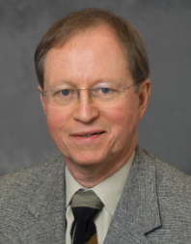
Thank you!
An e-copy of this presentation is posted to:
http://www.ce.umn.edu/~smith/links.html
Worcester Polytechnic Technology – September 7, 2011
ksmith@umn.edu

