Slide 1
Evidence-Based Practices for
Innovative Education
Karl A. Smith
STEM Education Center / Technological Leadership Institute / Civil Engineering – University of Minnesota &
Engineering Education – Purdue University
ksmith@umn.edu http://personal.cege.umn.edu/~smith/links.html
FaCIT Workshop
Central Michigan University
October 10, 2014

Slide 2
Session Layout
Welcome & Overview
Evidence-Based Practices
  Rationale
Pedagogies of Engagement, Cooperative Learning & Challenge-Based Learning
  Rationale
  Key Elements
Course Design Foundations
  How People Learn
  Understanding by Design
Applications of Pedagogies of Engagement

Slide 3
Overall Goal
Build your knowledge of Evidence-Based Practices and your implementation repertoire

Slide 4
Workshop Objectives
Participants will be able to :
  Describe key features of evidence-based instruction and effective, interactive strategies for facilitating learning
  Summarize key elements of Course Design Foundations
    How People Learn (HPL)
    Understanding by Design (UbD) process – Content (outcomes) – Assessment – Pedagogy
  Explain key features of and rationale for Pedagogies of Engagement – Cooperative Learning and Challenge-Based learning
  Identify connections between cooperative learning and desired outcomes of courses and programs
Participants will begin applying key elements to the design on a course, class session or learning module

Slide 5
Reflection and Dialogue
Individually reflect on your favorite rationale for Evidence-Based Practices. Write for about 1 minute
  Context/Audience? Who is the focus, e.g., students?
  Claim? What is the nature of the rationale?
  Evidence? Support for your claim
Discuss with your neighbor for about 2 minutes
  Select/create a response to present to the whole group if you are randomly selected

Slide 6
Seven Principles for Good Practice in Undergraduate Education
Good practice in undergraduate education:
  Encourages student-faculty contact
  Encourages cooperation among students
  Encourages active learning
  Gives prompt feedback
  Emphasizes time on task
  Communicates high expectations
  Respects diverse talents and ways of learning
Chickering & Gamson, June, 1987
http://learningcommons.evergreen.edu/pdf/fall1987.pdf

Slide 7
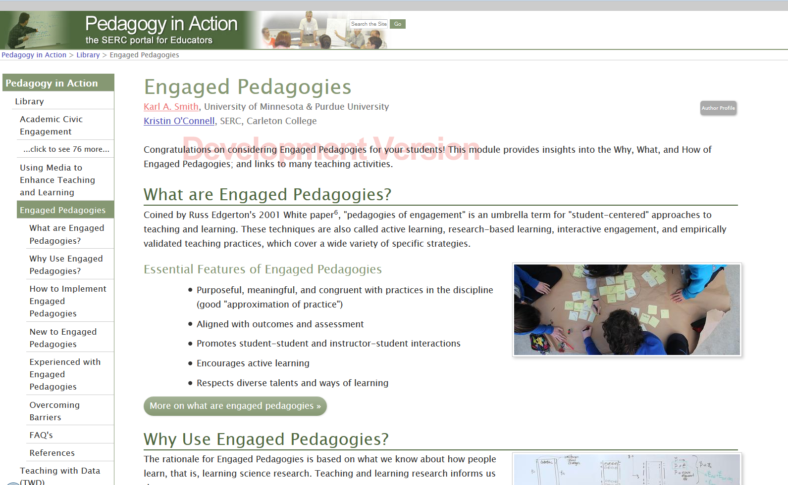
http://serc.carleton.edu/index.html

Slide 8
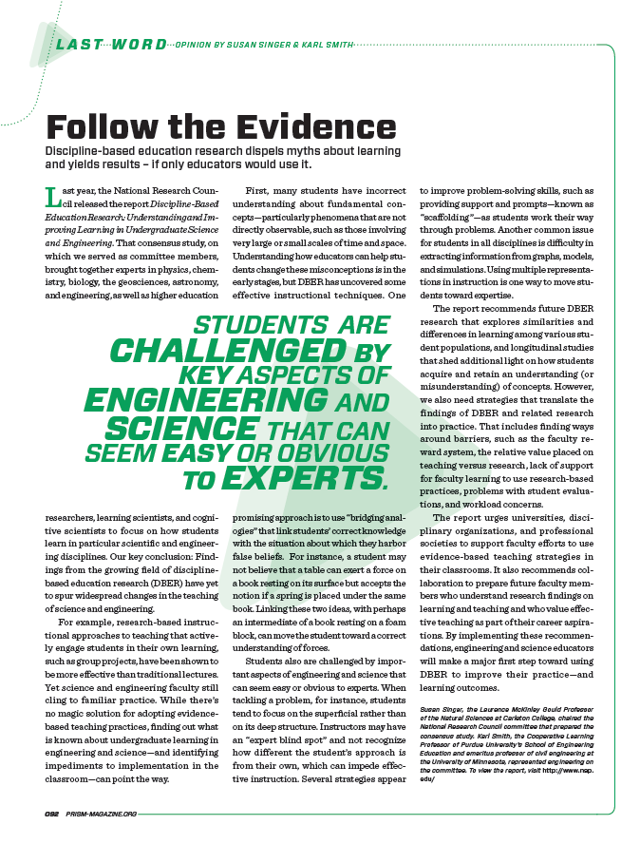
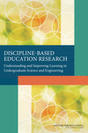
Discipline-Based Education Research (DBER) Report Update
Discipline-Based
Education Research
Practitioner Guide
In Preparation
Coming 2014
“Reaching Students: What Research Says About Effective Instruction in Undergraduate Science and Engineering”
ASEE Prism Summer 2013
National Research Council
Summer 2012 – http://www.nap.edu/
catalog.php?record_id=13362
Journal of Engineering Education
Editorial – October, 2013

Slide 9
Student Engagement Research Evidence
Perhaps the strongest conclusion that can be made is the least surprising. Simply put, the greater the student’s involvement or engagement in academic work or in the academic experience of college, the greater his or her level of knowledge acquisition and general cognitive development …(Pascarella and Terenzini, 2005).
Active and collaborative instruction coupled with various means to encourage student engagement invariably lead to better student learning outcomes irrespective of academic discipline (Kuh et al., 2005, 2007).
See Smith, et.al, 2005 and Fairweather, 2008, Linking Evidence and Promising Practices in Science, Technology, Engineering, and Mathematics (STEM) Undergraduate Education - http://www7.nationalacademies.org/bose/Fairweather_CommissionedPaper.pdf

Slide 10
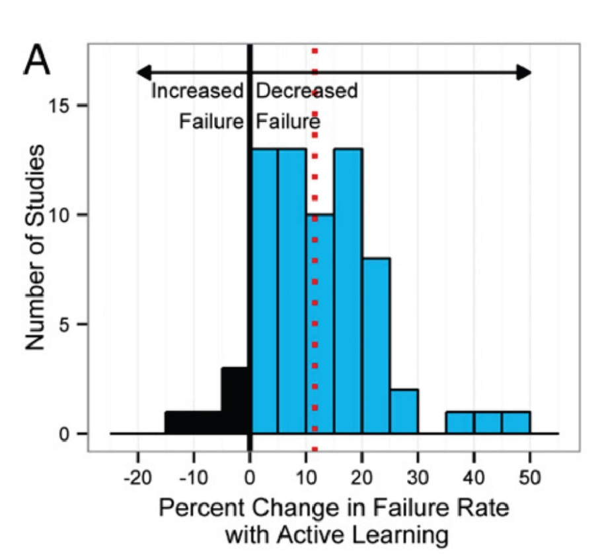
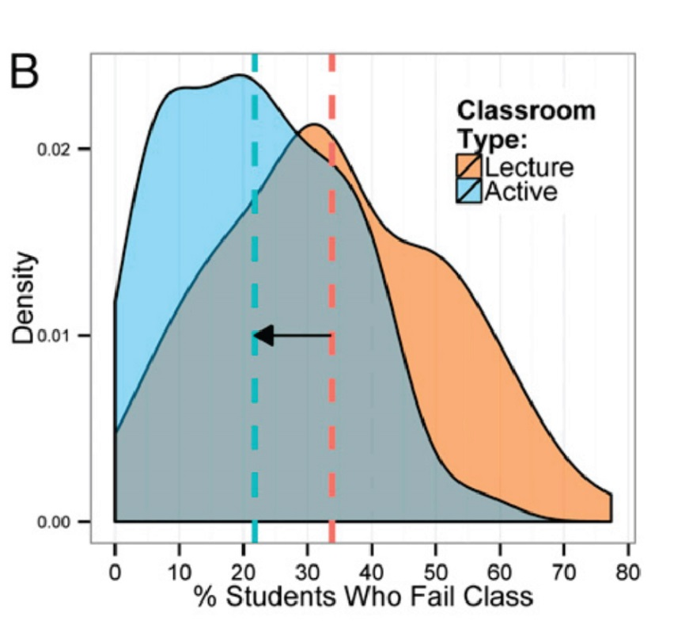
Engaged Pedagogies = Reduced Failure Rates
Evidence-based research on learning indicates that when students are actively involved in their education they are more successful and less likely to fail. A new PNAS report by Freeman et al., shows a significant decrease of failure rate in active learning classroom compared to traditional lecture
Freeman, Scott; Eddy, Sarah L.; McDonough, Miles; Smith, Michelle K.; Okoroafor, Nnadozie; Jordt, Hannah; Wenderoth, Mary Pat; Active learning increases student performance in science, engineering, and mathematics, 2014, Proc. Natl. Acad. Sci.

Slide 11
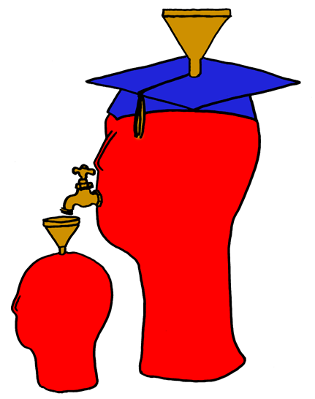
Lila M. Smith
Notes:
8:30-9:30?Take copies of Active Lrn, HTMI, New Paradigms,

Slide 12
Process Metallurgy
Dissolution Kinetics – liquid-solid interface
Iron Ore Desliming – solid-solid interface
Metal-oxide reduction roasting – gas-solid interface
Notes:
My process metallurgy experience was at interfaces, which I think helped position me for work at the engineering and education interface

Slide 13
Dissolution Kinetics
Theory – Governing Equation for Mass Transport
Research – rotating disk
Practice – leaching of silver bearing metallic copper & printed circuit-board waste

Slide 14
First Teaching Experience
Practice – Third-year course in metallurgical reactions – thermodynamics and kinetics

Slide 15
Engineering Education
Practice – Third-year course in metallurgical reactions – thermodynamics and kinetics
Research – ?
Theory – ?
Theory
Research
Evidence
Practice

Slide 16
University of Minnesota College of Education
Social, Psychological and Philosophical Foundations of Education
Statistics, Measurement, Research Methodology
Assessment and Evaluation
Learning and Cognitive Psychology
Knowledge Acquisition, Artificial Intelligence, Expert Systems
Development Theories
Motivation Theories
Social psychology of learning – student – student interaction

Slide 17
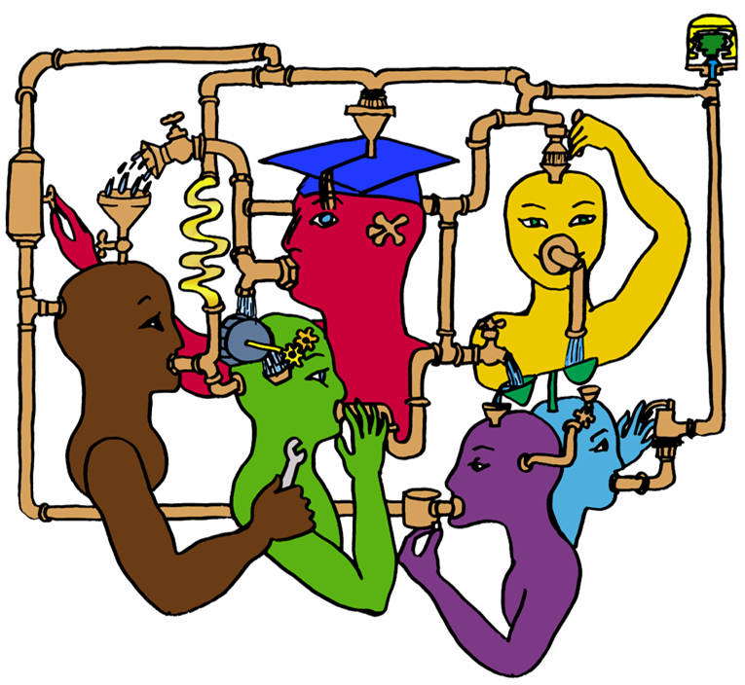
Lila M. Smith
Notes:
8:30-9:30?Take copies of Active Lrn, HTMI, New Paradigms,

Slide 18
Cooperative Learning
Theory – Social Interdependence – Lewin – Deutsch – Johnson & Johnson
Research – Randomized Design Field Experiments
Practice – Formal Teams/Professor’s Role
Theory
Research
Evidence
Practice

Slide 19
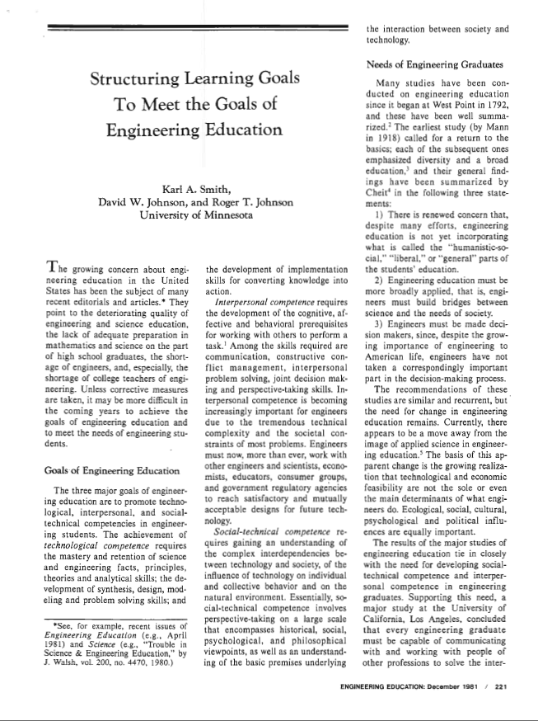
Cooperative Learning Introduced to Engineering – 1981
Smith, K.A., Johnson, D.W. and Johnson, R.T., 1981. The use of cooperative learning groups in engineering education. In L.P. Grayson and J.M. Biedenbach (Eds.), Proceedings Eleventh Annual Frontiers in Education Conference, Rapid City, SD, Washington: IEEE/ASEE, 26‑32.
JEE December 1981

Slide 20
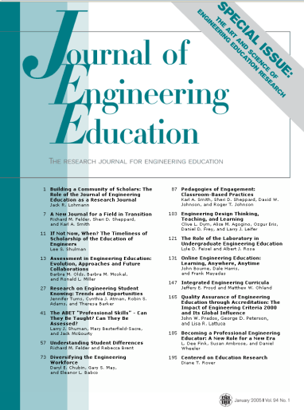

Cooperative Learning Research Support
Johnson, D.W., Johnson, R.T., & Smith, K.A. 1998. Cooperative learning returns to college: What evidence is there that it works? Change, 30 (4), 26-35.
• Over 300 Experimental Studies
• First study conducted in 1924
• High Generalizability
• Multiple Outcomes
Outcomes
1. Achievement and retention
2. Critical thinking and higher-level
reasoning
3. Differentiated views of others
4. Accurate understanding of others' perspectives
5. Liking for classmates and teacher
6. Liking for subject areas
7. Teamwork skills
Johnson, D. W., Johnson, R. T., & Smith, K. A. (2014). Cooperative learning: Improving university instruction by basing practice on validated theory. Journal on Excellence in College Teaching, 25(3&4)
January 2005
March 2007
Notes:
Table summarizes my perception of the shift. A version of this table is available in New Paradigms for Engineering Education -- FIE Conf proceedings 97 (avail on the www)
One of the most significant changes that has occurred is the shift from "pouring in knowledge" to "creating a climate where learning flows among students and the professor"

Slide 21
Small-Group Learning: Meta-analysis
Springer, L., Stanne, M. E., & Donovan, S. 1999. Effects of small-group learning on undergraduates in science, mathematics, engineering, and technology: A meta-analysis. Review of Educational Research, 69(1), 21-52.
Small-group (predominantly cooperative) learning in postsecondary science, mathematics, engineering, and technology (SMET). 383 reports from 1980 or later, 39 of which met the rigorous inclusion criteria for meta-analysis.
The main effect of small-group learning on achievement, persistence, and attitudes among undergraduates in SMET was significant and positive. Mean effect sizes for achievement, persistence, and attitudes were 0.51, 0.46, and 0.55, respectively.
Notes:
Table summarizes my perception of the shift. A version of this table is available in New Paradigms for Engineering Education -- FIE Conf proceedings 97 (avail on the www)
One of the most significant changes that has occurred is the shift from "pouring in knowledge" to "creating a climate where learning flows among students and the professor"

Slide 22
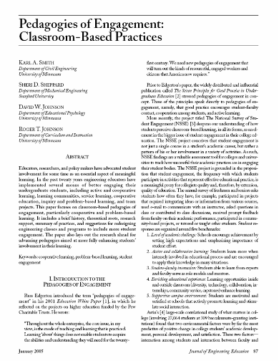
“Throughout the whole enterprise, the core issue, in my view, is the mode of teaching and learning that is practiced. Learning ‘about’ things does not enable students to acquire the abilities and understanding they will need for the twenty-first century. We need new pedagogies of engagement that will turn out the kinds of resourceful, engaged workers and citizens that America now requires.”
Russ Edgerton (reflecting on higher education projects funded by the Pew Memorial Trust)
http://www.asee.org/publications/jee/issueList.cfm?year=2005#January2005

Slide 23
Reflection and Dialogue
Individually reflect on your mental image of an effective teacher. Write for about 1 minute.
  Jot down words or phrases
  Construct a figure or diagram
Discuss with your neighbor for about 2 minutes
  Describe your mental image and talk about similarities and differences
  Select one Element, Image, Comment, Story, etc. that you would like to present to the whole group if you are randomly selected
Whole group discussion

Slide 24
Teacher Mental Images About Teaching - Axelrod (1973)
Mental Image | Motto | Characteristics | Disciplines
Content | I teach what I know | Pour it in, Lecture | Science, Math
Instructor | I teach what I am | Modeling, Demonstration | Many
Student – Cognitive Development | I train minds | Active Learning, Discussion | English, Humanities
Student – Development of Whole Person | I work with students as people | Motivation, Self-esteem | Basic Skills Teachers
Axelrod, J. The University Teacher as Artist. San Francisco: Jossey-Bass, 1973.

Slide 25
Good teaching comes from the identity and integrity of the teacher.
Good teachers possess a capacity for connectedness.
Parker J. Palmer in The courage to teach: Exploring the inner landscape of a teacher=s life. Jossey-Bass, 1998.
Notes:
Table summarizes my perception of the shift. A version of this table is available in New Paradigms for Engineering Education -- FIE Conf proceedings 97 (avail on the www)
One of the most significant changes that has occurred is the shift from "pouring in knowledge" to "creating a climate where learning flows among students and the professor"

Slide 26
College Teaching:
What do we know about it?
Five assertions about what we know about college teaching
  Good teaching makes a difference
  Teachers vary markedly
  Some characteristics/methods are present in all good teaching
  Teaching can be evaluated and rewarded
  There is ample room for improvement.
K. Patricia Cross, 1991 ASEE ERM Distinguished Lecture

Slide 27
Four factors in good teaching, based on student ratings*:
  Skill. Communicates in an exciting way.
  Rapport. Understands and emphasizes with students.
  Structure. Provides guidance to course and material.
  Load. Requires moderate work load.
*Student ratings of teaching are consistent (with other measures), unbiased, and useful. Students agree on good teaching and their views are consistent with faculty.
Notes:
Effective learning depends on the performance of the students, not the teacher. It is an evocative process, not a performance.
New information results in meaningful learning when it connects with what is already known. Ausubel said, "find out what a student knows and then teach accordingly."

Slide 28
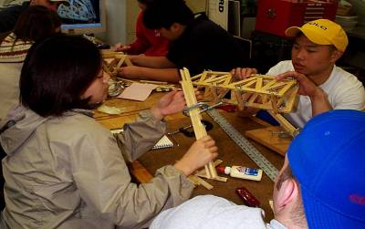
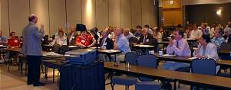
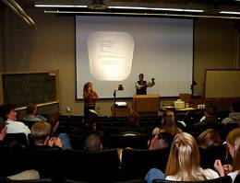
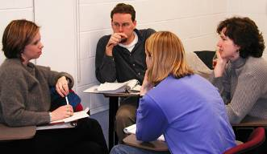
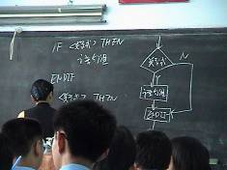
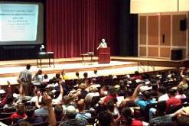
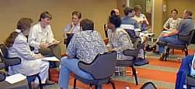
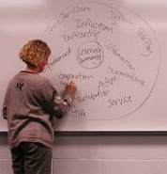
Pedagogies of Engagement

Slide 29
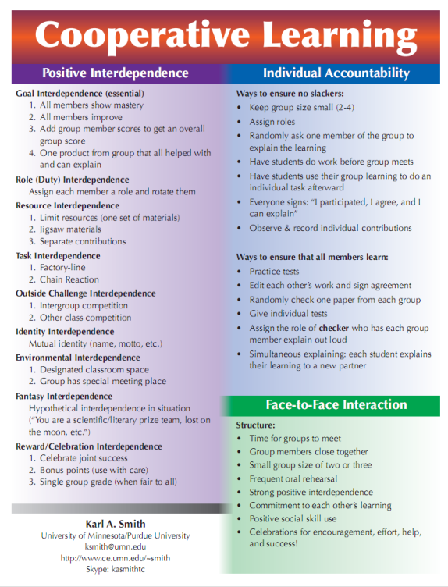
Cooperative Learning is instruction that involves people working in teams to accomplish a common goal, under conditions that involve both positive interdependence (all members must cooperate to complete the task) and individual and group accountability (each member is accountable for the complete final outcome).
Key Concepts
•Positive Interdependence
•Individual and Group Accountability
•Face-to-Face Promotive Interaction
•Teamwork Skills
•Group Processing
http://www.ce.umn.edu/~smith/docs/Smith-CL%20Handout%2008.pdf
Notes:
Table summarizes my perception of the shift. A version of this table is available in New Paradigms for Engineering Education -- FIE Conf proceedings 97 (avail on the www)
One of the most significant changes that has occurred is the shift from "pouring in knowledge" to "creating a climate where learning flows among students and the professor"

Slide 30
The American College Teacher:
National Norms for 2007-2008
Methods Used in “All” or “Most” | All – 2005 | All – 2008 | Assistant - 2008
Cooperative Learning | 48 | 59 | 66
Group Projects | 33 | 36 | 61
Grading on a curve | 19 | 17 | 14
Term/research papers | 35 | 44 | 47
http://www.heri.ucla.edu/index.php

Slide 31
Undergraduate Teaching Faculty, 2011*
Methods Used in “All” or “Most” | STEM women | STEM men | All other women | All other men
Cooperative learning | 60% | 41% | 72% | 53%
Group projects | 36% | 27% | 38% | 29%
Grading on a curve | 17% | 31% | 10% | 16%
Student inquiry | 43% | 33% | 54% | 47%
Extensive lecturing | 50% | 70% | 29% | 44%
*Undergraduate Teaching Faculty. National Norms for the
2010-2011 HERI Faculty Survey, www.heri.ucla.edu/index.php
Notes:
Karl

Slide 32
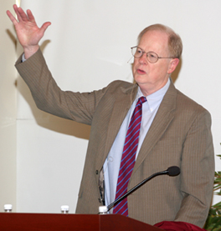
“It could well be that faculty members of the twenty-first century college or university will find it necessary to set aside their roles as teachers and instead become designers of learning experiences, processes, and environments.”
James Duderstadt, 1999
Nuclear Engineering Professor; Former Dean, Provost and President of the University of Michigan

Slide 33
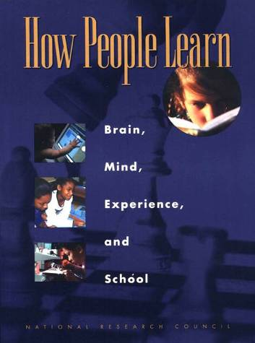
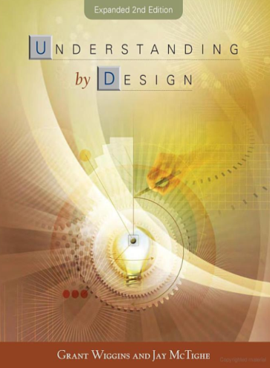
Course Design Foundations
Science of Instruction (UbD)
 | No | Yes
Yes | Good Theory/ Poor Practice | Good Theory & Good Practice
No |  | Good Practice/ Poor Theory
Science of Learning
(HPL)
Bransford, Brown & Cocking. 1999. How People Learn. National Academy Press.
Wiggins & McTighe, 2005. Understanding by Design, 2ed. ASCD.
Notes:
Karl
Models of how learning works – (1) learning as response strengthening, (2) learning as information acquisition, (3) learning as knowledge construction and (4) learning as social knowledge construction

Slide 34
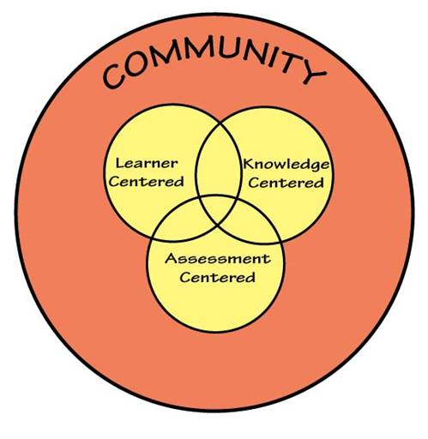
How People Learn (HPL)
HPL Framework
Expertise implies (Ch. 2):
  a set of cognitive and metacognitive skills
  an organized body of knowledge that is deep and contextualized
  an ability to notice patterns of information in a new situation
  flexibility in retrieving and applying that knowledge to a new problem
Bransford, Brown & Cocking. 1999. How people learn. National Academy Press.
Notes:
Karl

Slide 35
Understanding by Design
Stage 1. Identify Desired Results
  Enduring understanding (enduring outcomes)
  Important to know and do
  Worth being familiar with
Stage 2. Determine Acceptable Evidence
Stage 3. Plan Learning Experiences and Instruction
Overall: Are the desired results, assessments, and learning activities ALIGNED?
Wiggins & McTighe, 1997, 2005. Understanding by Design. Alexandria, VA: ASCD.
Notes:
35
Karl

Slide 36

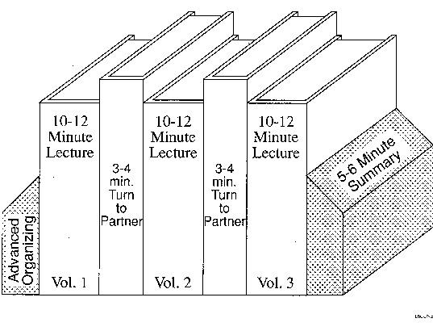
Book Ends on a Class Session
Smith, K.A. 2000. Going deeper: Formal small-group learning in large classes. Energizing large classes: From small groups to learning communities. New Directions for Teaching and Learning, 2000, 81, 25-46. [NDTL81Ch3GoingDeeper.pdf]

Slide 37
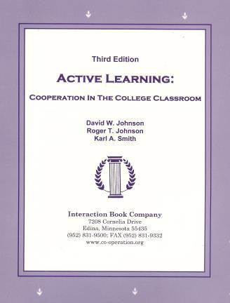
Active Learning: Cooperation in the College Classroom
Informal Cooperative Learning Groups
Formal Cooperative Learning Groups
Cooperative Base Groups
Notes: Cooperative Learning
Handout (CL-College-814.doc)

Slide 38
Book Ends on a Class Session
Advance Organizer
Formulate-Share-Listen-Create (Turn-to-your-neighbor) -- repeated every 10-12 minutes
Session Summary (Minute Paper)
        What was the most useful or meaningful thing you learned during this session?
        What question(s) remain uppermost in your mind as we end this session?
        What was the “muddiest” point in this session?
Notes:
Table summarizes my perception of the shift. A version of this table is available in New Paradigms for Engineering Education -- FIE Conf proceedings 97 (avail on the www)
One of the most significant changes that has occurred is the shift from "pouring in knowledge" to "creating a climate where learning flows among students and the professor"

Slide 39
Formulate-Share-Listen-Create
Informal Cooperative Learning Group
Introductory Pair Discussion of a
FOCUS QUESTION
Formulate your response to the question individually
Share your answer with a partner
Listen carefully to your partner's answer
Work together to Create a new answer through discussion

Slide 40
Informal CL (Book Ends on a Class Session) with Concept Tests
Physics
Eric Mazur - Harvard – http://galileo.harvard.edu
Peer Instruction – http://mazur.harvard.edu/research/detailspage.php?rowid=8
Richard Hake – http://www.physics.indiana.edu/~hake/
Chemistry
Chemistry ConcepTests - UW Madison - http://chemcollective.org/tests
Video: Making Lectures Interactive with ConcepTests
http://www.wcer.wisc.edu/archive/cl1/flag/cat/contests/contests7.htm
ModularChem Consortium – http://chemconnections.org/
STEMTEC - http://k12s.phast.umass.edu/stemtec/
Video: How Change Happens: Breaking the “Teach as You Were Taught” Cycle – Films for the Humanities & Sciences – www.films.com
Harvard – Derek Bok Center
Thinking Together & From Questions to Concepts: Interactive Teaching in Physics – http://bokcenter.harvard.edu/

Slide 41
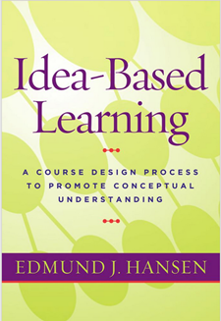
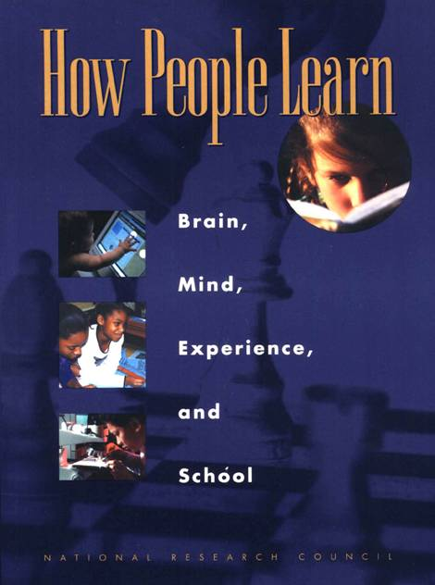
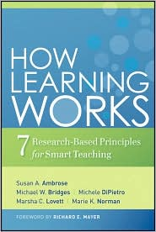
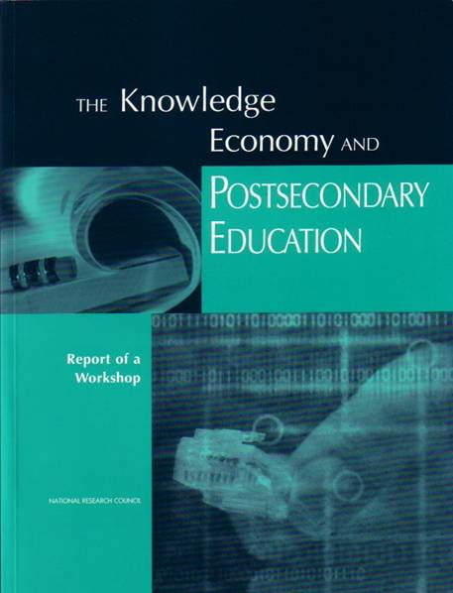
Bransford, Vye and Bateman – Creating High Quality Learning Environments
Notes:
Karl

Slide 42
Students prior knowledge can help or hinder learning
How student organize knowledge influences how they learn and apply what they know
Students’ motivation determines, directs, and sustains what they do to learn
To develop mastery, students must acquire component skills, practice integrating them, and know when to apply what they have learned
Goal-directed practice coupled with targeted feedback enhances the quality of students’ learning
Students’ current level of development interacts with the social, emotional, and intellectual climate of the course to impact learning
To become self-directed learners, students must learn to monitor and adjust their approach to learning

Slide 43
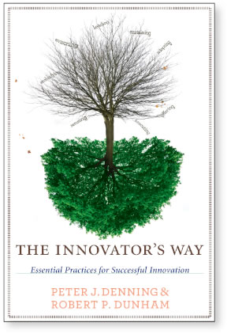

Innovative Education
Innovation is the adoption
of a new practice in a community
- Denning & Dunham (2010)

Slide 44
*Education Innovation
Stories supported by evidence are essential for adoption of new practices
  Good ideas and/or insightful connections
  Supported by evidence
  Spread the word
  Patience and persistence
Cooperative learning took over 25 years to become widely practiced in higher education
We can’t wait 25 years for YOUR innovations to become widely practiced!

Slide 45

Workshop: I-Corps for Learning (I-Corps L):
A Pilot Initiative to Propagate & Scale Educational Innovations
(NSF DUE)
Give the I-Corps-L team an experiential learning opportunity to help determine the readiness of their innovation for sustainable scalability. Sustainable scalability involves a self-supported entity that is sustainable and systematically promotes the adoption of the educational innovation and enables and facilitates its use.
Enable the team to develop a clear go/no go decision regarding sustainable scalability of the innovation.
Develop a transition plan and actionable tasks to move the innovation forward to sustainable scalability, if the team decides to do so.
Instructor Team: Karl Smith (PI), Ann McKenna
& Chris Swan

Slide 46
The biggest and most long-lasting reforms of undergraduate education will come when individual faculty or small groups of instructors adopt the view of themselves as reformers within their immediate sphere of influence, the classes they teach every day.
K. Patricia Cross

Slide 47
Session Summary
(Minute Paper)
Reflect on the session:
1. Most interesting, valuable, useful thing you learned.
2. Things that helped you learn.
3. Question, comments, suggestions.
Pace: Too slow 1 . . . . 5 Too fast
Relevance: Little 1 . . . 5 Lots
Instructional Format: Ugh 1 . . . 5 Ah

Slide 48
Active Learning: Cooperation in the College Classroom
Informal Cooperative Learning Groups
Formal Cooperative Learning Groups
Cooperative Base Groups
Notes: Cooperative Learning
Handout (CL-College-814.doc)

Slide 49
Book Ends on a Class Session
Smith, K.A. 2000. Going deeper: Formal small-group learning in large classes. Energizing large classes: From small groups to learning communities. New Directions for Teaching and Learning, 2000, 81, 25-46. [NDTL81Ch3GoingDeeper.pdf]

Slide 50
Book Ends on a Class Session
Advance Organizer
Formulate-Share-Listen-Create (Turn-to-your-neighbor) -- repeated every 10-12 minutes
Session Summary (Minute Paper)
        What was the most useful or meaningful thing you learned during this session?
        What question(s) remain uppermost in your mind as we end this session?
        What was the “muddiest” point in this session?
Notes:
Table summarizes my perception of the shift. A version of this table is available in New Paradigms for Engineering Education -- FIE Conf proceedings 97 (avail on the www)
One of the most significant changes that has occurred is the shift from "pouring in knowledge" to "creating a climate where learning flows among students and the professor"

Slide 51
Formulate-Share-Listen-Create
Informal Cooperative Learning Group
Introductory Pair Discussion of a
FOCUS QUESTION
Formulate your response to the question individually
Share your answer with a partner
Listen carefully to your partner's answer
Work together to Create a new answer through discussion

Slide 52
Informal CL (Book Ends on a Class Session) with Concept Tests
Physics
Eric Mazur - Harvard – http://galileo.harvard.edu
Peer Instruction – http://mazur.harvard.edu/research/detailspage.php?rowid=8
Richard Hake – http://www.physics.indiana.edu/~hake/
Chemistry
Chemistry ConcepTests - UW Madison - http://chemcollective.org/tests
Video: Making Lectures Interactive with ConcepTests
http://www.wcer.wisc.edu/archive/cl1/flag/cat/contests/contests7.htm
ModularChem Consortium – http://chemconnections.org/
STEMTEC - http://k12s.phast.umass.edu/stemtec/
Video: How Change Happens: Breaking the “Teach as You Were Taught” Cycle – Films for the Humanities & Sciences – www.films.com
Harvard – Derek Bok Center
Thinking Together & From Questions to Concepts: Interactive Teaching in Physics – http://bokcenter.harvard.edu/

Slide 53
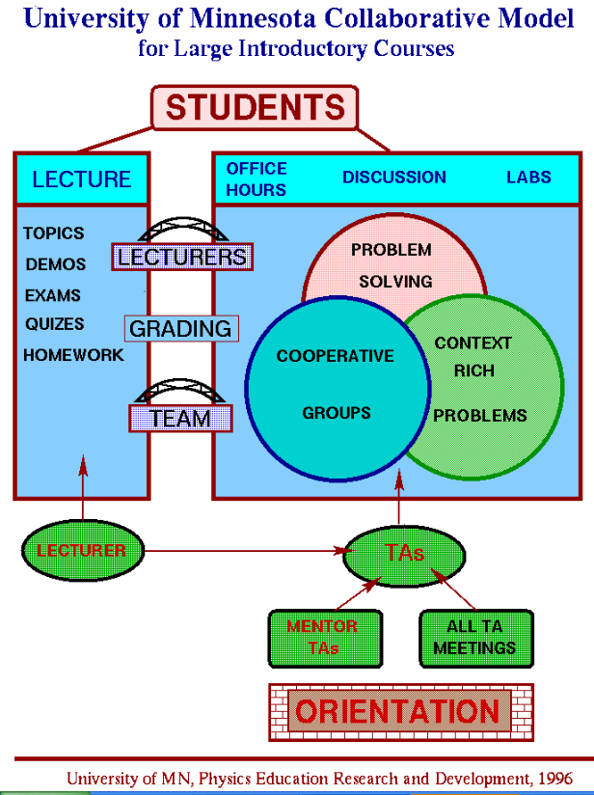
http://groups.physics.umn.edu/physed/Research/MNModel/Model.html

Slide 54
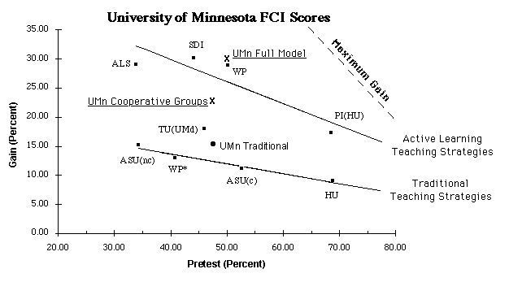
Conceptual Understanding
http://groups.physics.umn.edu/physed/Research/MNModel/FCI.html

Slide 55
Physics (Mechanics) Concepts:
The Force Concept Inventory (FCI)
A 30 item multiple choice test to probe student's understanding of basic concepts in mechanics.
The choice of topics is based on careful thought about what the fundamental issues and concepts are in Newtonian dynamics.
Uses common speech rather than cueing specific physics principles.
The distractors (wrong answers) are
based on students' common inferences.

Slide 56
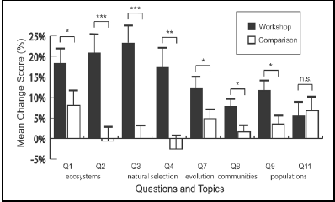
Workshop Biology
Traditional passive lecture vs. “Workshop biology”
Source: Udovic et al. 2002

Slide 57
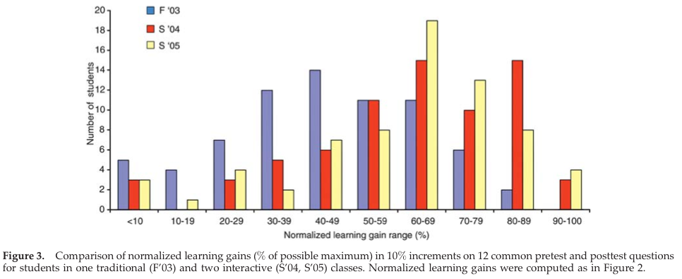
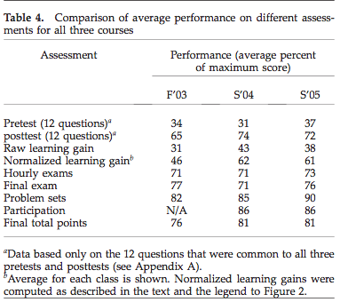
Biology
Source: Knight, J. and Wood, W. (2005). Teaching more by lecturing less. Cell Biol Educ. 4(4): 298–310.

Slide 58
Informal Cooperative
Learning Groups
Can be used at any time
Can be short term and ad hoc
May be used to break up a long lecture
Provides an opportunity for students to process material they have been listening to (Cognitive Rehearsal)
Are especially effective in large lectures
Include "book ends" procedure
Are not as effective as Formal Cooperative Learning or Cooperative Base Groups
Notes:
Barr & Tagg's From teaching to learing is the most often requested article from Change mangazine
Bill Camplbell and I started working on New Paradigms in 1993.

Slide 59
Strategies for Energizing Large Classes: From Small Groups to
Learning Communities:
Jean MacGregor,
James Cooper,
Karl Smith,
Pamela Robinson
New Directions for Teaching and Learning, No. 81, 2000.
Jossey- Bass
Notes:
Table summarizes my perception of the shift. A version of this table is available in New Paradigms for Engineering Education -- FIE Conf proceedings 97 (avail on the www)
One of the most significant changes that has occurred is the shift from "pouring in knowledge" to "creating a climate where learning flows among students and the professor"

Slide 60
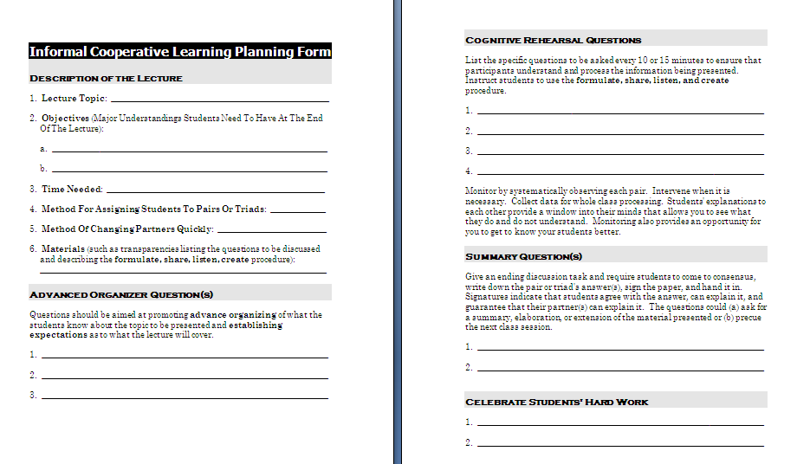

Slide 61
Session Summary
(Minute Paper)
Reflect on the session:
1. Most interesting, valuable, useful thing you learned.
2. Things that helped you learn.
3. Question, comments, suggestions.
Pace: Too slow 1 . . . . 5 Too fast
Relevance: Little 1 . . . 5 Lots
Instructional Format: Ugh 1 . . . 5 Ah

Slide 62
OSU – Seminar (4-28-14)
Q4 – Pace: Too slow 1 . . . . 5 Too fast (3.0)
Q5 – Relevance: Little 1 . . . 5 Lots (3.9)
Q6 – Format: Ugh 1 . . . 5 Ah (3.7)

Slide 63
Resources
Design Framework – How People Learn (HPL) & Understanding by Design (UdB) Process
  Ambrose, S., et.al. 2010. How learning works: 7 research based principles for smart teaching. Jossey-Bass
  Bransford, John, Vye, Nancy, and Bateman, Helen. 2002. Creating High-Quality Learning Environments: Guidelines from Research on How People Learn. The Knowledge Economy and Postsecondary Education: Report of a Workshop. National Research Council. Committee on the Impact of the Changing Economy of the Education System. P.A. Graham and N.G. Stacey (Eds.). Center for Education. Washington, DC: National Academy Press. http://www.nap.edu/openbook/0309082927/html/
  Pellegrino, J. 2006. Rethinking and redesigning curriculum, instruction and assessment: What contemporary research and theory suggests. http://www.skillscommission.org/commissioned.htm
  Smith, K. A., Douglas, T. C., & Cox, M. 2009. Supportive teaching and learning strategies in STEM education. In R. Baldwin, (Ed.). Improving the climate for undergraduate teaching in STEM fields. New Directions for Teaching and Learning, 117, 19-32. San Francisco: Jossey-Bass.
  Streveler, R.A., Smith, K.A. and Pilotte, M. 2012. Content, Assessment and Pedagogy (CAP): An Integrated Engineering Design Approach. In Dr. Khairiyah Mohd Yusof, Dr. Shahrin Mohammad, Dr. Naziha Ahmad Azli, Dr. Mohamed Noor Hassan, Dr. Azlina Kosnin and Dr. Sharifah Kamilah Syed Yusof (Eds.). Outcome-Based Education and Engineering Curriculum: Evaluation, Assessment and Accreditation, Universiti Teknologi Malaysia, Malaysia [Streveler-Smith-Pilotte_OBE_Chapter-CAP-v11.pdf]
  Wiggins, G. & McTighe, J. 2005. Understanding by Design: Expanded Second Edition. Prentice Hall.
Content Resources
  Donald, Janet. 2002. Learning to think: Disciplinary perspectives. San Francisco: Jossey-Bass.
  Middendorf, Joan and Pace, David. 2004. Decoding the Disciplines: A Model for Helping Students Learn Disciplinary Ways of Thinking. New Directions for Teaching and Learning, 98.
Cooperative Learning
  Cooperative Learning (Johnson, Johnson & Smith) - Smith web site – www.ce.umn.edu/~smith
  Smith (2010) Social nature of learning: From small groups to learning communities. New Directions for Teaching and Learning, 2010, 123, 11-22 [NDTL-123-2-Smith-Social_Basis_of_Learning-.pdf]
  Smith, Sheppard, Johnson & Johnson (2005) Pedagogies of Engagement [Smith-Pedagogies_of_Engagement.pdf]
  Johnson, Johnson & Smith. 1998. Cooperative learning returns to college: What evidence is there that it works? Change, 1998, 30 (4), 26-35. [CLReturnstoCollege.pdf]
Other Resources
  University of Delaware PBL web site – www.udel.edu/pbl
  PKAL – Pedagogies of Engagement – http://www.pkal.org/activities/PedagogiesOfEngagementSummit.cfm
  Fairweather (2008) Linking Evidence and Promising Practices in Science, Technology, Engineering, and Mathematics (STEM) Undergraduate Education - http://www7.nationalacademies.org/bose/Fairweather_CommissionedPaper.pdf

