Slide 1

Design and Implementation of Pedagogies of Engagement
Cooperative Learning and Problem-Based Learning
Karl A. Smith
STEM Education Center / Civil Engineering – University of Minnesota &
Engineering Education
– Purdue University
ksmith@umn.edu http://personal.cege.umn.edu/~smith/links.htm
Ball State University – Scientific Teaching Program
November 17, 2015

Slide 2
Session Layout
Welcome & Overview
Rationale for Evidence-Based Practices
Course Design Foundations
  How Learning Works
  How People Learn
  Understanding by Design
Pedagogies of Engagement: Cooperative Learning & Problem-based Learning
  Key Elements
  Instructor’s Role
Applications of Pedagogies of Engagement

Slide 3
Overall Goal
Build your knowledge of evidence-based practices for engaging students and your implementation repertoire.

Slide 4
Workshop Objectives
Participants will be able to:
  Describe key features of evidence-based instruction and effective, interactive strategies for facilitating learning
  Summarize key elements of Course Design Foundations
    How Learning Works and How People Learn (HPL)
    Understanding by Design (UbD) process – Content (outcomes) – Assessment – Pedagogy
  Explain key features of and instructor’s role for Pedagogies of Engagement – Cooperative Learning and Problem-Based learning
  Identify connections between cooperative learning and desired outcomes of courses and programs
Participants will begin applying key elements to the design on a course, class session or learning module

Slide 5
Reflection and Dialogue
Individually reflect on your favorite rationale for Engaging Students. Write for about 1 minute.
  Context/Audience? E.g., First Year Engineering
  Why engaging students is important?
  What support do you have for your rationale?
Discuss with your neighbor for about 2 minutes
  Select/create a response to present to the whole group if you are randomly selected
Notes:
Randomly call on 2-3 pairs
1. Here are some examples of reasons from the literature….
2. Personal stories

Slide 6
Seven Principles for Good Practice in Undergraduate Education
Good practice in undergraduate education:
  Encourages student-faculty contact
  Encourages cooperation among students
  Encourages active learning
  Gives prompt feedback
  Emphasizes time on task
  Communicates high expectations
  Respects diverse talents and ways of learning
Chickering & Gamson. (1987). http://learningcommons.evergreen.edu/pdf/fall1987.pdf

Slide 7

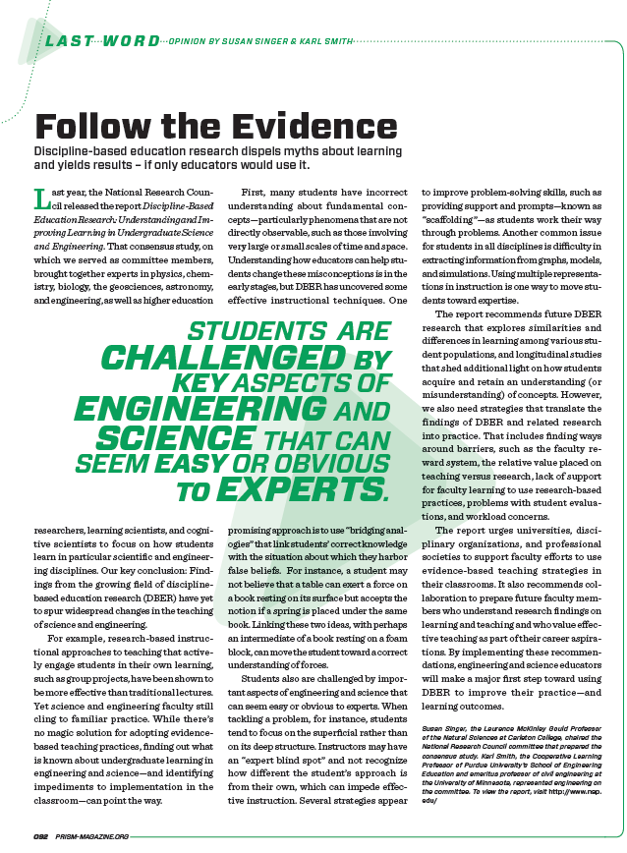

Discipline-Based Education Research (DBER) Report
National Research Council
Summer 2012 – http://www.nap.edu/catalog.php?record_id=13362
ASEE Prism Summer 2013
National Research Council – 2015 http://www.nap.edu/catalog/18687/reaching-students-what-research-says-about-effective-instruction-in-undergraduate
Journal of Engineering Education – October, 2013

Slide 8
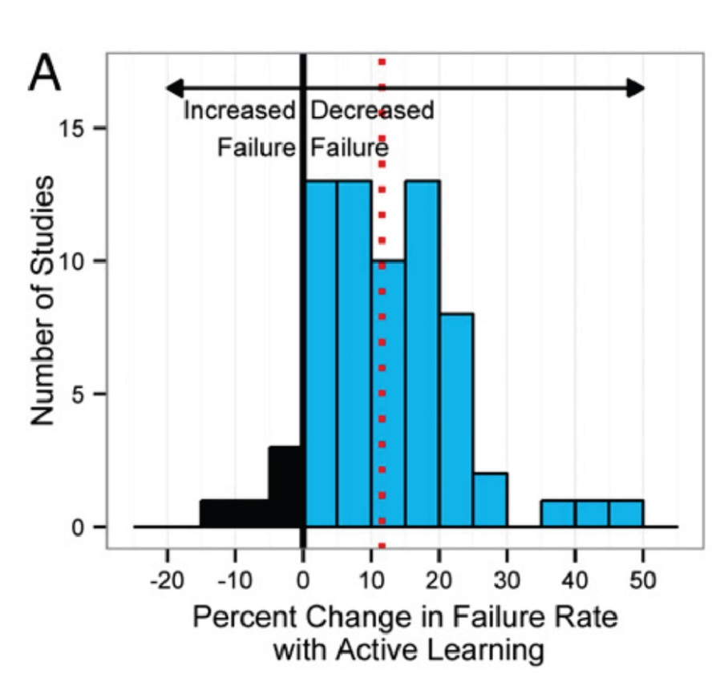
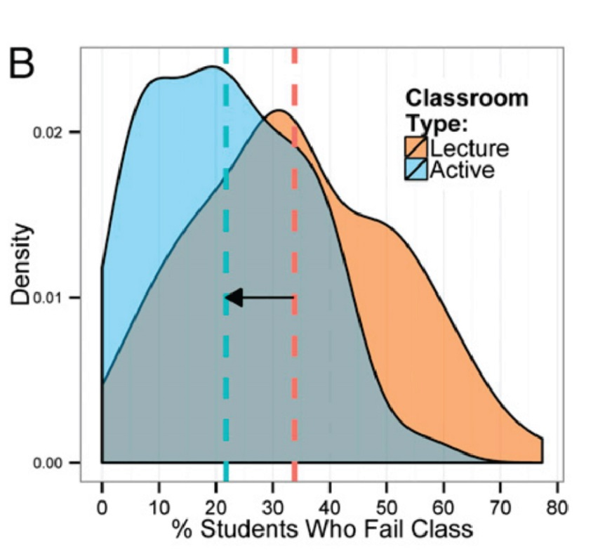
Engaged Pedagogies = Reduced Failure Rates
Evidence-based research on learning indicates that when students are actively involved in their education they are more successful and less likely to fail. A new PNAS report by Freeman et al., shows a significant decrease of failure rate in active learning classroom compared to traditional lecture
Freeman, Scott; Eddy, Sarah L.; McDonough, Miles; Smith, Michelle K.; Okoroafor, Nnadozie; Jordt, Hannah; Wenderoth, Mary Pat; Active learning increases student performance in science, engineering, and mathematics, 2014, Proc. Natl. Acad. Sci.

Slide 9
Karl’s Rationale
First Teaching Experience – Third-year course in metallurgical reactions – thermodynamics and kinetics

Slide 10
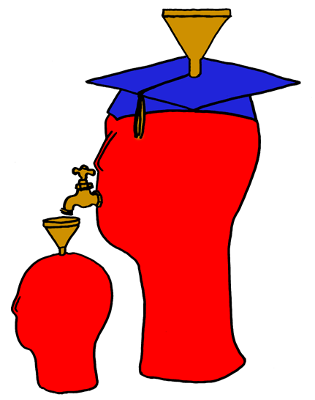
Lila M. Smith
Notes:
8:30-9:30?Take copies of Active Lrn, HTMI, New Paradigms,

Slide 11
Engineering Education
Practice – Third-year course in metallurgical reactions – thermodynamics and kinetics
Research – ?
Theory – ?
Theory
Research
Evidence
Practice

Slide 12
University of Minnesota College of Education
Social, Psychological and Philosophical Foundations of Education
Learning and Cognitive Psychology
Social psychology of learning: Student – student interaction
Statistics, Measurement, Research Methodology
Assessment and Evaluation
Knowledge Acquisition, Artificial Intelligence, Expert Systems
Development Theories
Motivation Theories

Slide 13
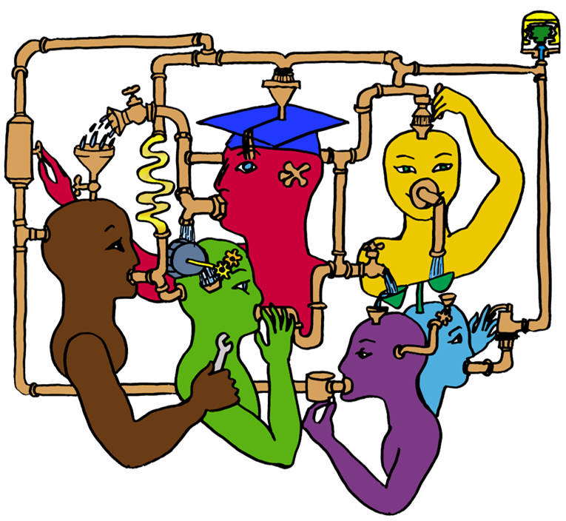
Lila M. Smith
Notes:
8:30-9:30?Take copies of Active Lrn, HTMI, New Paradigms,

Slide 14
Cooperative Learning
Theory – Social Interdependence – Lewin – Deutsch – Johnson & Johnson
Research – Randomized Design Field Experiments
Practice – Formal Teams/Professor’s Role
Theory
Research
Evidence
Practice

Slide 15
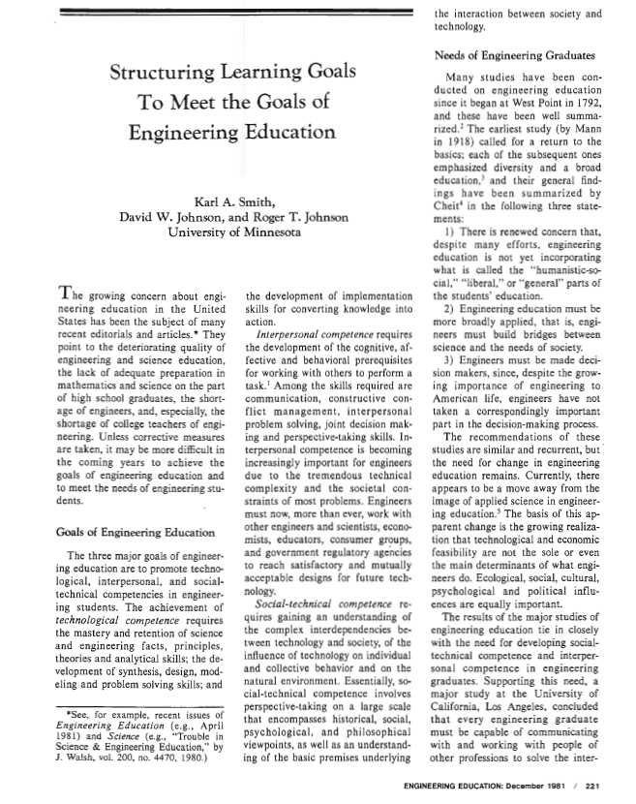
Cooperative Learning Introduced to Engineering – 1981
Smith, K.A., Johnson, D.W. and Johnson, R.T., 1981. The use of cooperative learning groups in engineering education. In L.P. Grayson and J.M. Biedenbach (Eds.), Proceedings Eleventh Annual Frontiers in Education Conference, Rapid City, SD, Washington: IEEE/ASEE, 26‑32.
JEE December 1981

Slide 16
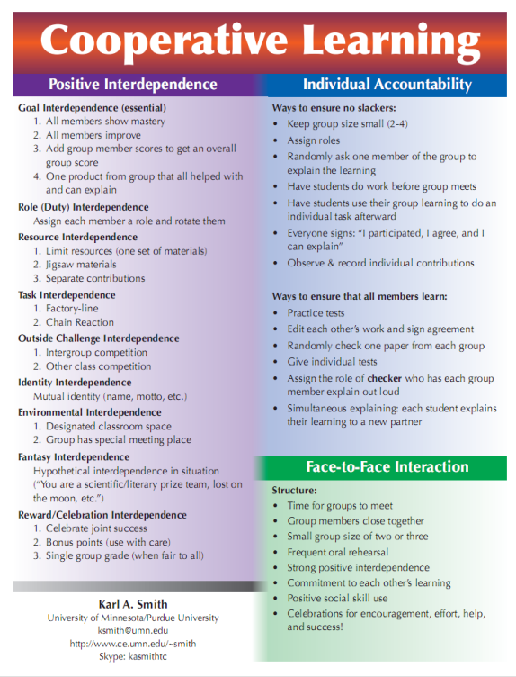
Cooperative Learning is instruction that involves people working in teams to accomplish a common goal, under conditions that involve both positive interdependence (all members must cooperate to complete the task) and individual and group accountability (each member is accountable for the complete final outcome).
Key Concepts
•Positive Interdependence
•Individual and Group Accountability
•Face-to-Face Promotive Interaction
•Teamwork Skills
•Group Processing
http://personal.cege.umn.edu/~smith/links.html
Notes:
Table summarizes my perception of the shift. A version of this table is available in New Paradigms for Engineering Education -- FIE Conf proceedings 97 (avail on the www)
One of the most significant changes that has occurred is the shift from "pouring in knowledge" to "creating a climate where learning flows among students and the professor"

Slide 17
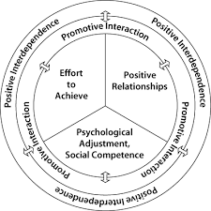
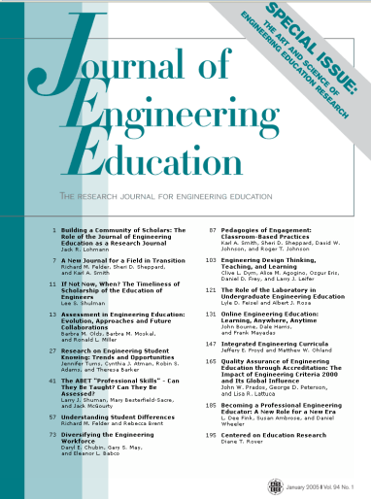

Cooperative Learning Research Support
Johnson, D.W., Johnson, R.T., & Smith, K.A. 1998. Cooperative learning returns to college: What evidence is there that it works? Change, 30 (4), 26-35.
• Over 300 Experimental Studies
• First study conducted in 1924
• High Generalizability
• Multiple Outcomes
Outcomes
1. Achievement and retention
2. Critical thinking and higher-level
reasoning
3. Differentiated views of others
4. Accurate understanding of others' perspectives
5. Liking for classmates and teacher
6. Liking for subject areas
7. Teamwork skills
Johnson, D. W., Johnson, R. T., & Smith, K. A. (2014). Cooperative learning: Improving university instruction by basing practice on validated theory. Journal on Excellence in College Teaching, 25(3&4)
January 2005
March 2007
Notes:
Table summarizes my perception of the shift. A version of this table is available in New Paradigms for Engineering Education -- FIE Conf proceedings 97 (avail on the www)
One of the most significant changes that has occurred is the shift from "pouring in knowledge" to "creating a climate where learning flows among students and the professor"

Slide 18
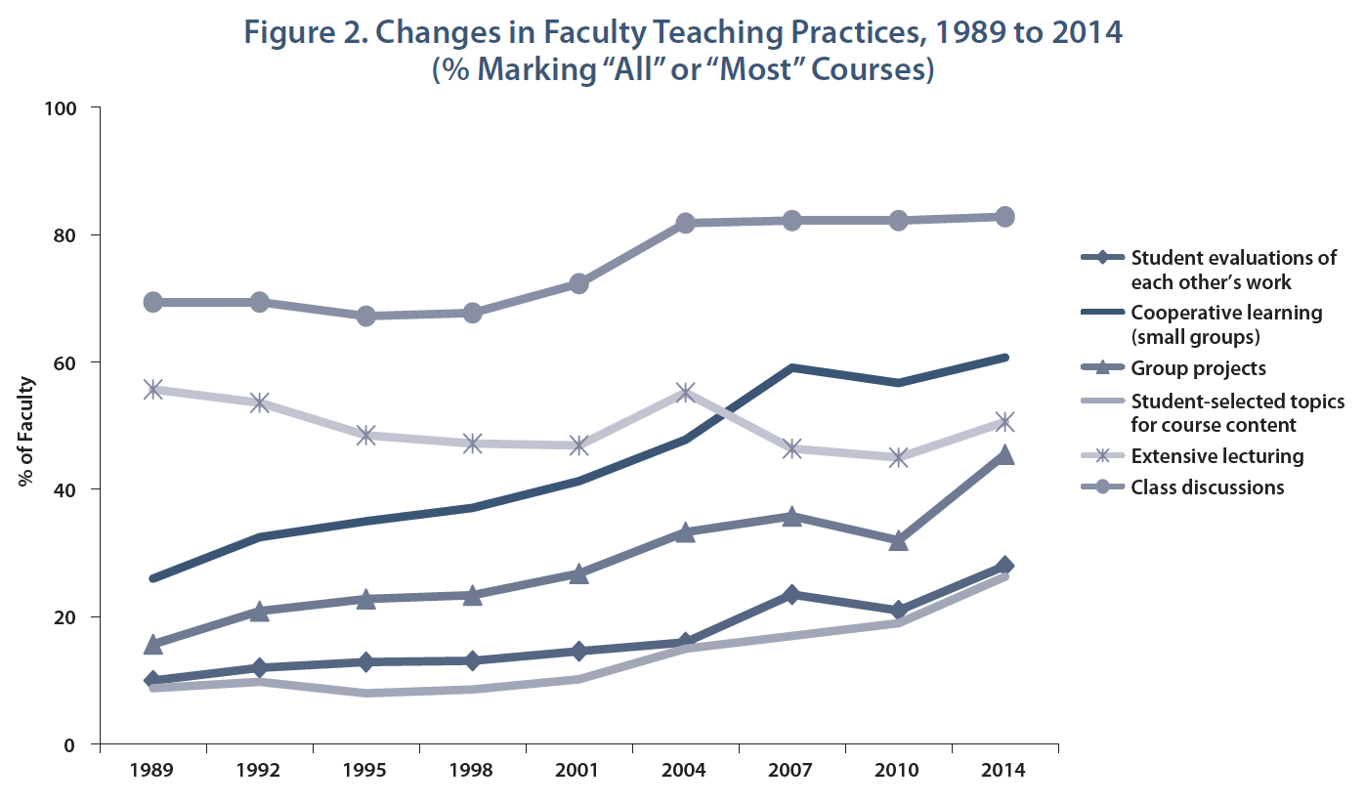
Undergraduate Teaching Faculty: The 2013–2014 HERI Faculty Survey
http://heri.ucla.edu/monographs/HERI-FAC2014-monograph.pdf

Slide 19
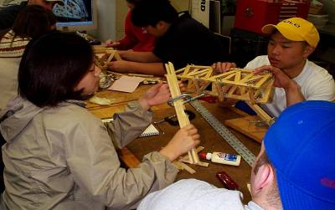
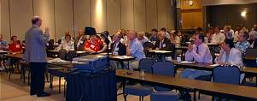
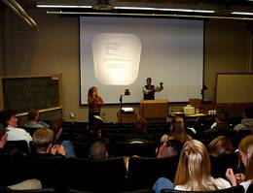
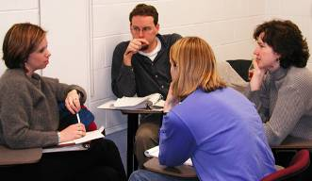
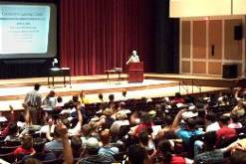
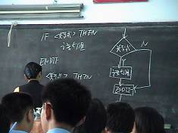
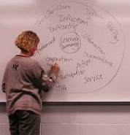
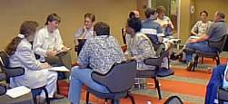
Pedagogies of Engagement

Slide 20
Reflection and Dialogue
Individually reflect on your story. How did you become interested in engaging students? Write for about 1 minute.
Discuss with your neighbor for about 2 minutes
  Select/create a response to present to the whole group if you are randomly selected
Notes:
Randomly call on 2-3 pairs
Encourage them to learn about others’ stories outside the workshop

Slide 21
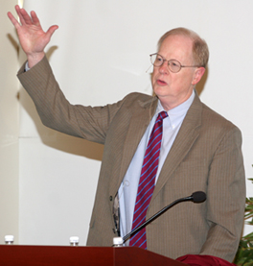
“It could well be that faculty members of the twenty-first century college or university will find it necessary to set aside their roles as teachers and instead become designers of learning experiences, processes, and environments.”
James Duderstadt, 1999
Nuclear Engineering Professor; Former Dean, Provost and President of the University of Michigan

Slide 22
What is your experience with course (re)design?
Little 1
Between 1&3
Moderate 3
Between 3&5
Extensive 5
Record your response (1, 2, 3, 4 or 5) on a Post-It note and add it to the histogram

Slide 23
What do you already know about course design?
Short Answer Questions
What do you feel are important considerations about course (re)design?
What are challenges you have faced with course (re)design?

Slide 24

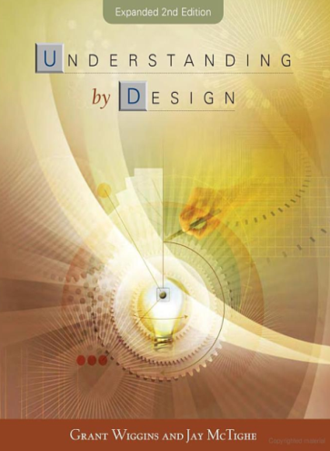
Course Design Foundations
Science of Instruction (UbD)
 | No | Yes
Yes | Good Theory/ Poor Practice | Good Theory & Good Practice
No |  | Good Practice/ Poor Theory
Science of Learning
(HPL)
Bransford, Brown & Cocking. 1999. How People Learn. National Academy Press.
Wiggins & McTighe, 2005. Understanding by Design, 2ed. ASCD.
Notes:
Karl
Models of how learning works – (1) learning as response strengthening, (2) learning as information acquisition, (3) learning as knowledge construction and (4) learning as social knowledge construction

Slide 25
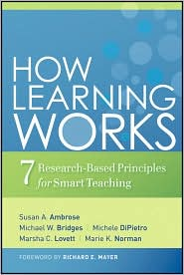

The Big Picture (Good Learning Theory and Good Instructional Practice)
Understanding By Design
How People Learn
How Learning Works

Slide 26
Students prior knowledge can help or hinder learning
How student organize knowledge influences how they learn and apply what they know
Students’ motivation determines, directs, and sustains what they do to learn
To develop mastery, students must acquire component skills, practice integrating them, and know when to apply what they have learned
Goal-directed practice coupled with targeted feedback enhances the quality of students’ learning
Students’ current level of development interacts with the social, emotional, and intellectual climate of the course to impact learning
To become self-directed learners, students must learn to monitor and adjust their approach to learning

Slide 27
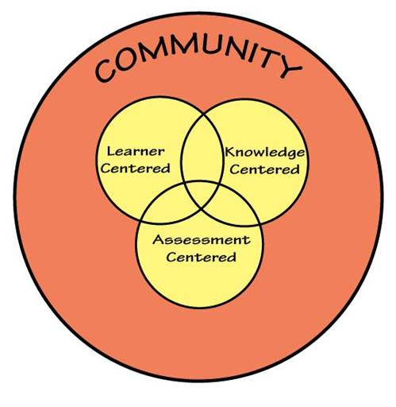
How People Learn
HPL Framework
Expertise implies (Ch. 2):
  a set of cognitive and metacognitive skills
  an organized body of knowledge that is deep and contextualized
  an ability to notice patterns of information in a new situation
  flexibility in retrieving and applying that knowledge to a new problem
Bransford, Brown & Cocking. 1999. How people learn. National Academy Press.
Notes:
Karl

Slide 28
Understanding by Design Process
What should learners know, understand and be able to do?
Identify the Desired Results
Determine Acceptable Evidence
Learning Activities Aligned
Plan Learning Experience
How will we know if the learners have achieved the desired results?
What will be accepted as evidence of Learners’ understanding and proficiency?
What activities will equip learners with the needed knowledge and skills?
What materials and resources will be useful?

Slide 29

Understanding by Design Process
vs. Engineering Design Process
Understanding by Design
Identify the desired results
Determine acceptable evidence
Engineering Design
Determine requirements specifications
Develop or use established metrics to measure against outcomes
Plan learning experiences
Plan and develop process, system, etc. to implement
Streveler, R.A, Smith, K.A., & Pilotte, M. 2012. Aligning course content, assessment, and delivery: Creating a context for outcomes-based education. In Khairiyah Mohd Yusof, Shahrin Mohammad, Naziha Ahmad Azli, Mohamed Noor Hassan, Azlina Kosnin & Sharifah Kamilah Syed Yusof (Eds.). Outcome-based science, technology, engineering and mathematics: Innovative Practices. (pp. 1 – 26). Hersey, PA: IGI Global.

Slide 30
Concept: Curricular Priorities
GOOD TO BE FAMILIAR WITH
IMPORTANT TO KNOW
ENDURING OUTCOMES
Things to Consider:
Are the topics enduring and transferable big ideas having value beyond the classroom?
Are the topics big ideas and core processes at the heart of the discipline?
Are the topics abstract, counterintuitive, often misunderstood, or easily misunderstood ideas requiring uncoverage?
Are the topics big ideas embedded in facts, skills and activities?
Understanding by Design, Wiggins and McTighe (1998)

Slide 31
Identifying Big Ideas - Exercise
Individually identify 2-3 big ideas in a course you are designing or re-designing. Write them down.
Break into pairs to discuss

Slide 32
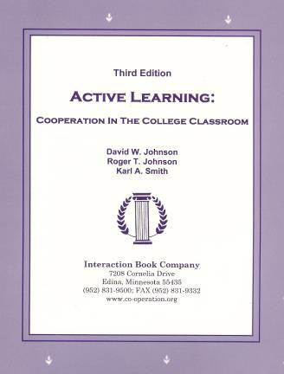
Active Learning: Cooperation in the College Classroom
Informal Cooperative Learning Groups
Formal Cooperative Learning Groups
Cooperative Base Groups
Notes: Cooperative Learning
Handout (CL-College-814.doc)
[CL-College-814.doc]

Slide 33
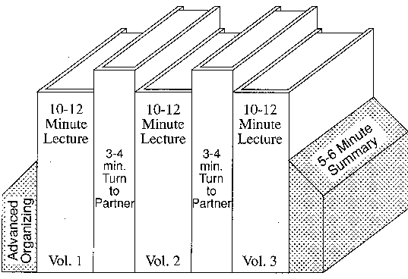

Book Ends on a Class Session
Smith, K.A. 2000. Going deeper: Formal small-group learning in large classes. Energizing large classes: From small groups to learning communities. New Directions for Teaching and Learning, 2000, 81, 25-46. [NDTL81Ch3GoingDeeper.pdf]
Notes:
Karl will show two videos

Slide 34
Book Ends on a Class Session
Advance Organizer
Formulate-Share-Listen-Create (Turn-to-your-neighbor) -- repeated every 10-12 minutes
Session Summary (Minute Paper)
        What was the most useful or meaningful thing you learned during this session?
        What question(s) remain uppermost in your mind as we end this session?
        What was the “muddiest” point in this session?
Notes:
Table summarizes my perception of the shift. A version of this table is available in New Paradigms for Engineering Education -- FIE Conf proceedings 97 (avail on the www)
One of the most significant changes that has occurred is the shift from "pouring in knowledge" to "creating a climate where learning flows among students and the professor"

Slide 35
Formulate-Share-Listen-Create
Informal Cooperative Learning Group
Introductory Pair Discussion of a
FOCUS QUESTION
Formulate your response to the question individually
Share your answer with a partner
Listen carefully to your partner's answer
Work together to Create a new answer through discussion

Slide 36
Informal CL (Book Ends on a Class Session) with Concept Tests
Physics
  Eric Mazur - Harvard – http://galileo.harvard.edu
  Peer Instruction – http://mazur.harvard.edu/research/detailspage.php?rowid=8
  Richard Hake – http://www.physics.indiana.edu/~hake/
Chemistry
  Chemistry ConcepTests - UW Madison - http://chemcollective.org/tests
    Video: Making Lectures Interactive with ConcepTests http://www.wcer.wisc.edu/archive/cl1/flag/cat/contests/contests7.htm
  ModularChem Consortium – http://chemconnections.org/
STEMTEC - http://k12s.phast.umass.edu/stemtec/
  Video: How Change Happens: Breaking the “Teach as You Were Taught” Cycle – Films for the Humanities & Sciences – www.films.com
Harvard – Derek Bok Center
  Thinking Together & From Questions to Concepts: Interactive Teaching in Physics – http://bokcenter.harvard.edu/
Notes:
Links to additional videos

Slide 37
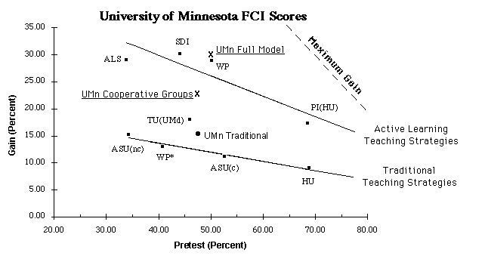
Conceptual Understanding
http://groups.physics.umn.edu/physed/Research/MNModel/FCI.html

Slide 38
Physics (Mechanics) Concepts:
The Force Concept Inventory (FCI)
A 30 item multiple choice test to probe student's understanding of basic concepts in mechanics.
The choice of topics is based on careful thought about what the fundamental issues and concepts are in Newtonian dynamics.
Uses common speech rather than cueing specific physics principles.
The distractors (wrong answers) are
based on students' common inferences.

Slide 39
Informal Cooperative Learning Groups
Can be used at any time
Can be short term and ad hoc
May be used to break up a long lecture
Provides an opportunity for students to process material they have been listening to (Cognitive Rehearsal)
Are especially effective in large lectures
Include "book ends" procedure
Are not as effective as Formal Cooperative Learning or Cooperative Base Groups
Notes:
Barr & Tagg's From teaching to learing is the most often requested article from Change mangazine
Bill Camplbell and I started working on New Paradigms in 1993.

Slide 40
Strategies for Energizing Large Classes: From Small Groups to
Learning Communities:
Jean MacGregor,
James Cooper,
Karl Smith,
Pamela Robinson
New Directions for Teaching and Learning, No. 81, 2000.
Jossey- Bass
Notes:
Table summarizes my perception of the shift. A version of this table is available in New Paradigms for Engineering Education -- FIE Conf proceedings 97 (avail on the www)
One of the most significant changes that has occurred is the shift from "pouring in knowledge" to "creating a climate where learning flows among students and the professor"

Slide 41
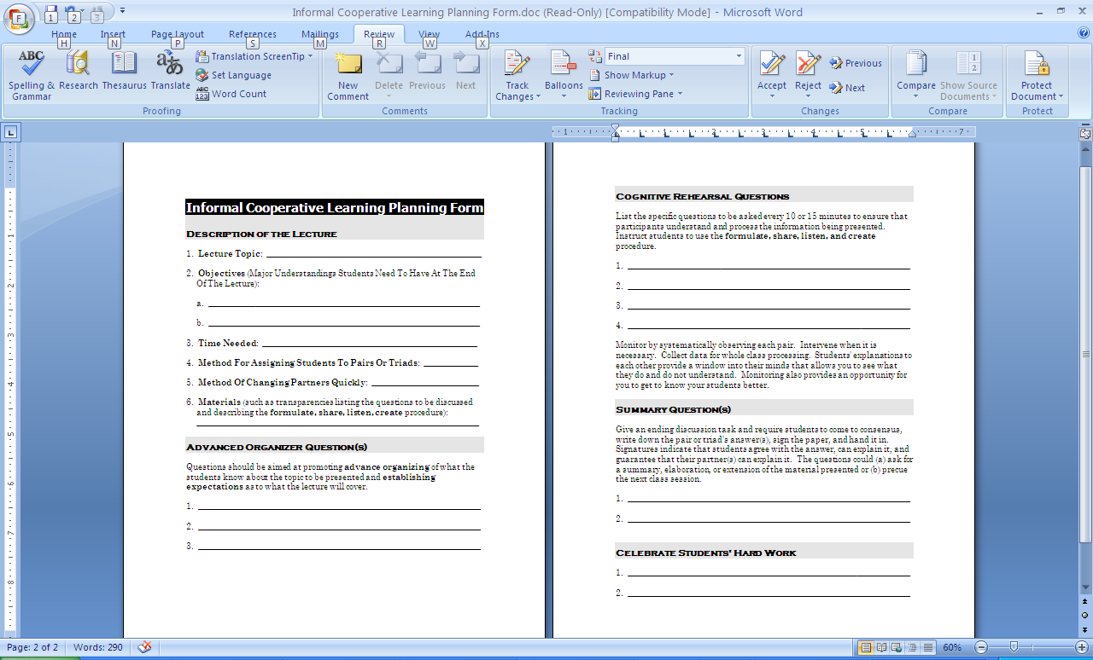
http://personal.cege.umn.edu/~smith/

Slide 42
Session Summary (Minute Paper)
Reflect on the session
Most interesting, valuable, useful thing you learned.
Things that helped you learn.
Question, comments, suggestions.
Pace: Too slow 1 2 3 4 5 Too fast
Relevance: Little 1 2 3 4 5 Lots
Instructional Format: Ugh 1 2 3 4 5 Ah
Notes:
Formative feedback… use index cards.

Slide 43
Active Learning: Cooperation in the College Classroom
Informal Cooperative Learning Groups
Formal Cooperative Learning Groups
Cooperative Base Groups
Notes: Cooperative Learning
Handout (CL-College-814.doc)
[CL-College-814.doc]

Slide 44
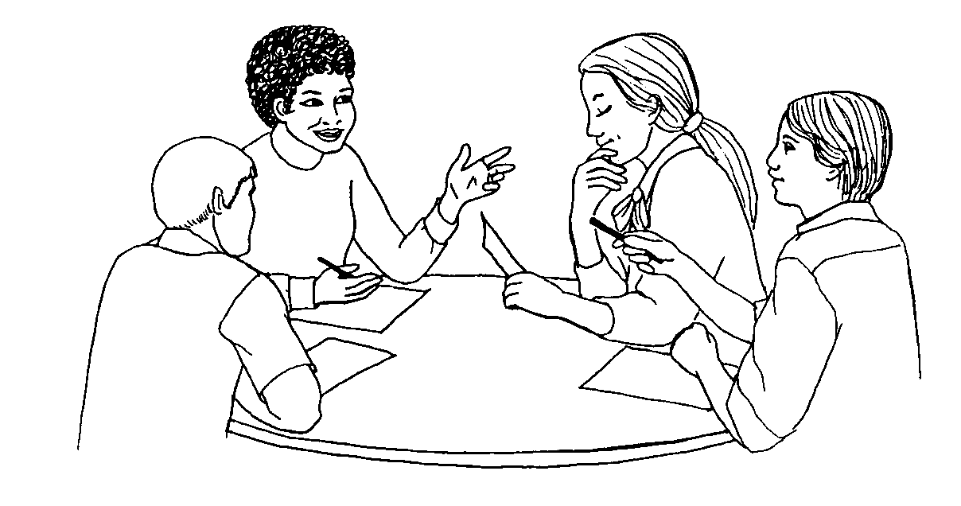
Structuring Teamwork in the Classroom
Formal Cooperative Learning Task Groups
Notes:
Barr & Tagg's From teaching to learing is the most often requested article from Change mangazine
Bill Camplbell and I started working on New Paradigms in 1993.

Slide 45
Teamwork

Slide 46
Reflection and Dialogue
Individually reflect on the Characteristics of High Performing Teams. Think/Write for about 1 minute
  Base on your experience on high performing teams,
  Or your facilitation of high performing teams in your classes, or
  Or your imagination
Discuss with your team for about 3 minutes and record a list

Slide 47
Characteristics of High Performing Teams
?
?

Slide 48
A team is a small number of people with complementary skills who are committed to a common purpose, performance goals, and approach for which they hold themselves mutually accountable:
SMALL NUMBER
COMPLEMENTARY SKILLS
COMMON PURPOSE & PERFORMANCE GOALS
COMMON APPROACH
MUTUAL ACCOUNTABILITY
--Katzenbach & Smith (1993)
The Wisdom of Teams

Slide 49
Six Basic Principles of Team Discipline
Keep membership small
Ensure that members have complimentary skills
Develop a common purpose
Set common goals
Establish a commonly agreed upon working approach
Integrate mutual and individual accountability
Katzenbach & Smith (2001) The Discipline of Teams

Slide 50


Hackman – Leading Teams
Real Team
Compelling Direction
Enabling Structure
Supportive Organizational Context
Available Expert Coaching
Team Diagnostic Survey (TDS)
https://research.wjh.harvard.edu/TDS/

Slide 51
Real Team
clear boundaries
team members are interdependent for some common purpose, producing a potentially assessable outcome for which members bear collective responsibility
at least moderate stability of membership

Slide 52
Compelling Direction
Good team direction is:
  challenging (which energizes members)
  clear (which orients them to their main purposes)
  consequential (which engages the full range of their talents)

Slide 53
Enabling Structure
Key structural features in fostering competent teamwork
  Task design: The team task should be well aligned with the team’s purpose and have a high standing on “motivating potential.”
  Team composition: The team size should be as small as possible given the work to be accomplished, should include members with ample task and interpersonal skills, and should consist of a good diversity of membership
  Core norms of conduct: Team should have established early in its life clear and explicit specification of the basic norms of conduct for member behavior.

Slide 54
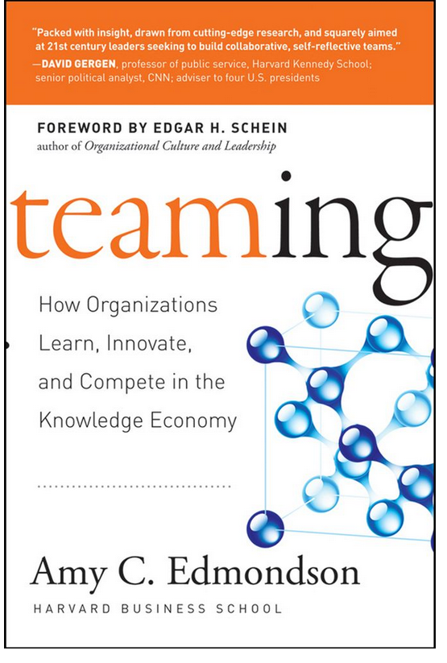
Edmondson - Teaming
Learning to team, teaming to learn
Teaming process (bottom-up)
  Teaming mindset adopted
  Reflection/feedback
  Interdependent action unfolds
  Coordination of steps and hand-offs
  Individuals communicate
  Recognize need for teaming
Four pillars of effective teaming
  Speaking up
  Collaboration
  Experimentation
  Reflection
"Teaming is the engine of organizational learning."

Slide 55

Teamwork on the Fly
Speak Up
Listen intensely
Integrate different facts and points of view
Experiment interactively
Reflect on your ideas and actions
https://www.youtube.com/watch?v=pV15JvPwOOE

Slide 56
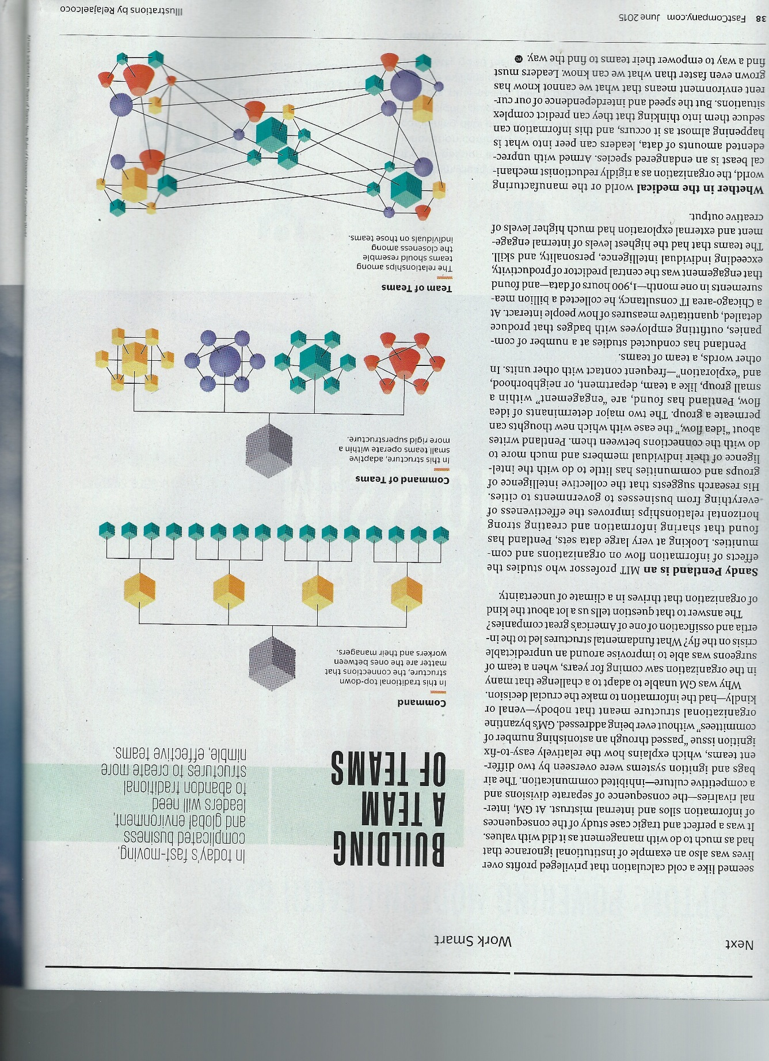
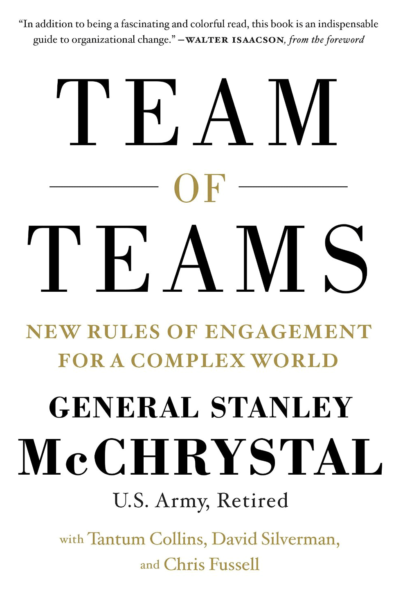
Goodbye org chart
Team of Teams author General
Stanley McChrystal and Co-authors explain why adaptability trumps hierarchy
Work Smart – Fast Company
June 2015 http://www.fastcompany.com/3045477/work-smart/goodbye-org-chart

Slide 57
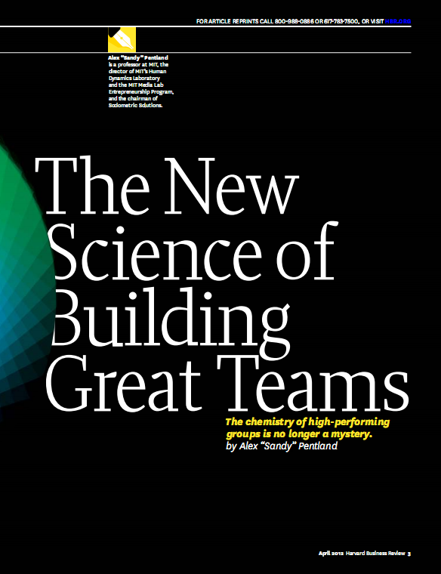
Successful teams share several defining characteristics:
Everyone on the team talks and listens in roughly equal measure, keeping communication short and sweet.
Members face one another, and their conversations and gestures are energetic.
Members connect directly with one another – not just with the team leader
Members carry on back-channel or side conversations.
Members periodically break, go exploring outside the team, and bring information back.
The most valuable form of communication is face-to-face. E-mail and texting are least valuable. Pentland (2012)
https://hbr.org/2012/04/the-new-science-of-building-great-teams

Slide 58
Cooperative Learning is instruction that involves people working in teams to accomplish a common goal, under conditions that involve both positive interdependence (all members must cooperate to complete the task) and individual and group accountability (each member is accountable for the complete final outcome).
Key Concepts
Positive Interdependence
Individual and Group Accountability
Face-to-Face Promotive Interaction
Teamwork Skills
Group Processing
http://personal.cege.umn.edu/~smith/docs/Smith-CL%20Handout%2008.pdf
Notes:
Table summarizes my perception of the shift. A version of this table is available in New Paradigms for Engineering Education -- FIE Conf proceedings 97 (avail on the www)
One of the most significant changes that has occurred is the shift from "pouring in knowledge" to "creating a climate where learning flows among students and the professor"

Slide 59
Instructor’s Role in Formal Cooperative Learning
Specifying Objectives (Academic and Social/Teamwork)
Making Decisions
Explaining Task, Positive Interdependence, and Individual Accountability
Monitoring and Intervening to Teach Skills
Evaluating Students' Achievement and Group Effectiveness

Slide 60
Concept: Curricular Priorities
GOOD TO BE FAMILIAR WITH
IMPORTANT TO KNOW
ENDURING OUTCOMES
Things to Consider:
Are the topics enduring and transferable big ideas having value beyond the classroom?
Are the topics big ideas and core processes at the heart of the discipline?
Are the topics abstract, counterintuitive, often misunderstood, or easily misunderstood ideas requiring uncoverage?
Are the topics big ideas embedded in facts, skills and activities?
Understanding by Design, Wiggins and McTighe (1998)

Slide 61
Understanding by Design Process
What should learners know, understand and be able to do?
Identify the Desired Results
Determine Acceptable Evidence
Learning Activities Aligned
Plan Learning Experience
How will we know if the learners have achieved the desired results?
What will be accepted as evidence of Learners’ understanding and proficiency?
What activities will equip learners with the needed knowledge and skills?
What materials and resources will be useful?

Slide 62
Decisions, Decisions…
Group size?
Group selection?
Group member roles?
How long to leave groups together?
Arranging the room?
Providing materials?
Time allocation?

Slide 63
Optimal Group Size?
2
3
4
5
6

Slide 64
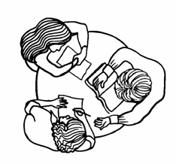

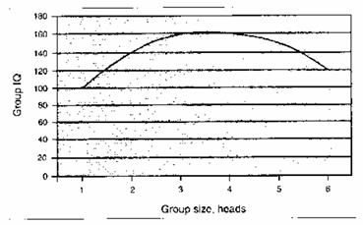
Formal Cooperative Learning Task Groups
Page 48
Perkins, David. 2003. King Arthur's Round
Table: How collaborative conversations create
smart organizations. NY: Wiley.
Notes:
Barr & Tagg's From teaching to learing is the most often requested article from Change mangazine
Bill Camplbell and I started working on New Paradigms in 1993.

Slide 65
Group Selection?
Self selection
Random selection
Stratified random
Instructor assign
Other

Slide 66
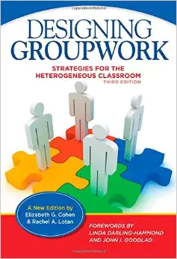
Assigning Roles
Chapter 8: Group Roles and Responsibilities
  Roles
    Facilitator
    Checker
    Set-Up
    Materials Manager
    Safety Officer
    Reporter
  Dividing the labor

Slide 67
Group Processing
Plus/Delta Format
Plus (+)
Things That Group Did Well
Delta (Δ)
Things Group Could Improve

Slide 68
Formal Cooperative Learning – Types of Tasks
Problem Solving, Project, or Presentation
Jigsaw – Learning new conceptual/procedural material
Group Tests
Review/Correct Homework
Peer Composition or Editing
Reading Comprehension/Interpretation
Constructive Controversy
Notes:
Table summarizes my perception of the shift. A version of this table is available in New Paradigms for Engineering Education -- FIE Conf proceedings 97 (avail on the www)
One of the most significant changes that has occurred is the shift from "pouring in knowledge" to "creating a climate where learning flows among students and the professor"

Slide 69
Challenge-Based Learning
Problem-based learning
Case-based learning
Project-based learning
Learning by design
Inquiry learning
Anchored instruction
John Bransford, Nancy Vye and Helen Bateman. Creating High-Quality Learning Environments: Guidelines from Research on How People Learn
http://books.nap.edu/openbook.php?record_id=10239&page=159

Slide 70
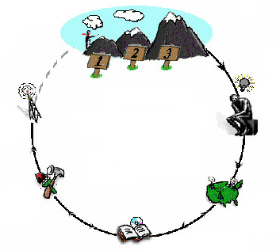
Challenge-Based Learning
The Challenges
Go Public
Generate Ideas
Test Your Mettle
Multiple Perspectives
Research & Revise
http://eecs.vanderbilt.edu/courses/ee213/challenge-based_Lab_design_concept.htm
Notes:
70
We use a learning cycle to assist us in organizing learning activities to meet specific goals. This cycle basically scaffolds the inquiry process necessary to identify potential solutions to a problem, research those opportunities, and revise them over time. However, part of the learning process is monitoring understanding of critical concepts and receiving opportunities to go deeper into specific concepts. Therefore, we use formative assessment methods where students can test their mettle and return to do additional Research & Revise activities which will help to revise their understanding.

Slide 71
Cooperative Problem-Based Learning Format
TASK: Solve the problem(s) or Complete the project.
INDIVIDUAL: Develop ideas, Initial Model, Estimate, etc. Note strategy.
COOPERATIVE: One set of answers from the group, strive for agreement, make sure everyone is able to explain the strategies used to solve each problem.
EXPECTED CRITERIA FOR SUCCESS: Everyone must be able to explain the model and strategies used to solve each problem.
EVALUATION: Best answer within available resources or constraints.
INDIVIDUAL ACCOUNTABILITY: One member from your group may be randomly chosen to explain (a) the answer and (b) how to solve each problem.
EXPECTED BEHAVIORS: Active participating, checking, encouraging, and elaborating by all members.
INTERGROUP COOPERATION: Whenever it is helpful, check procedures, answers, and strategies with another group.

Slide 72
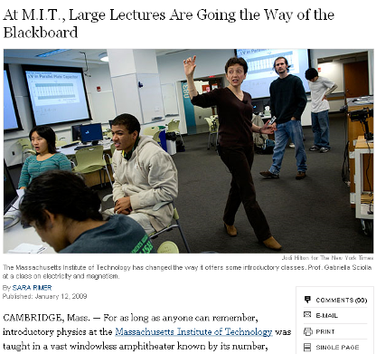
Cooperative Problem-based Learning
January 13, 2009—New York Times – http://www.nytimes.com/2009/01/13/us/13physics.html?em

Slide 73
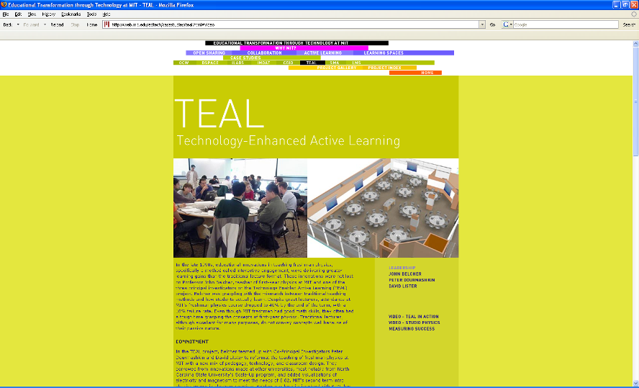
http://web.mit.edu/edtech/casestudies/teal.html#video

Slide 74
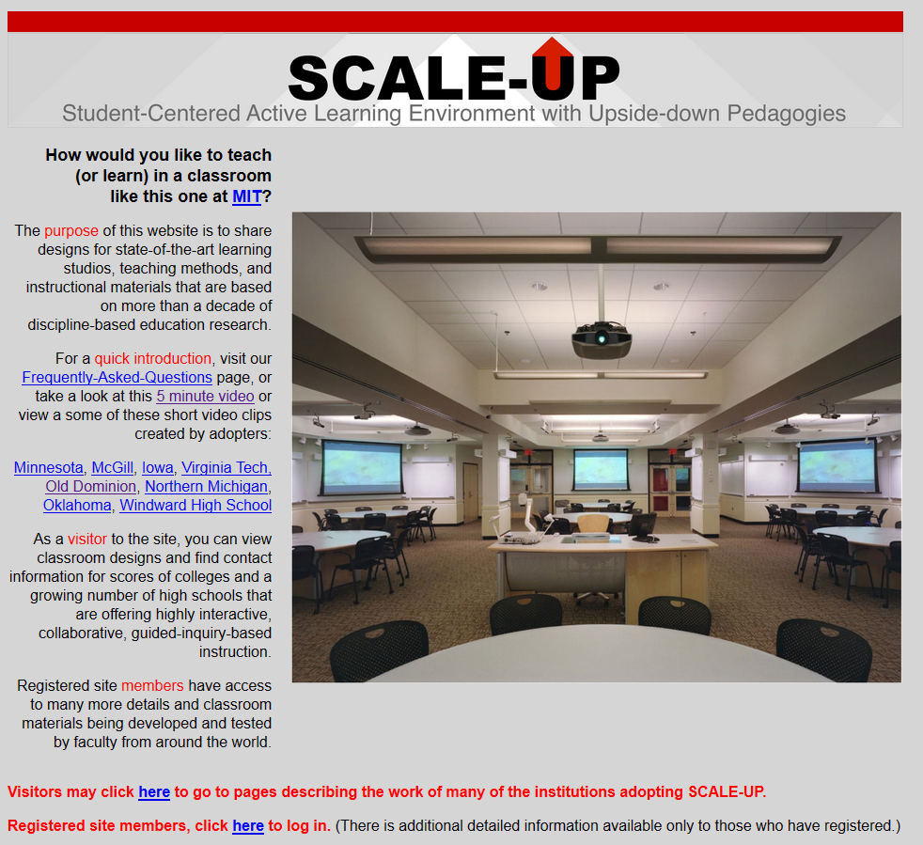
http://scaleup.ncsu.edu/

Slide 75
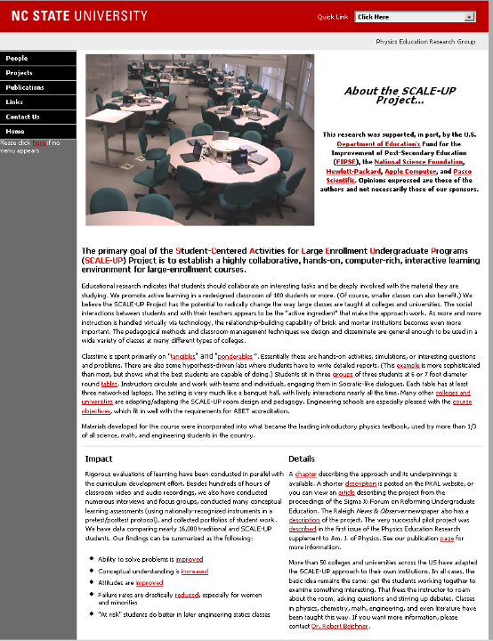
http://www.ncsu.edu/PER/scaleup.html

Slide 76


http://mediamill.cla.umn.edu/mediamill/embed/78755
http://www1.umn.edu/news/news-releases/2010/UR_CONTENT_248261.html
http://www.youtube.com/watch?v=lfT_hoiuY8w
http://youtu.be/lfT_hoiuY8w

Slide 77
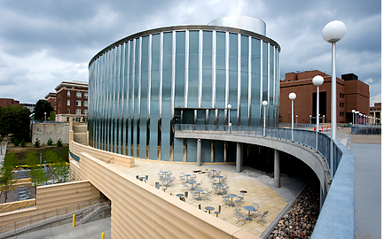
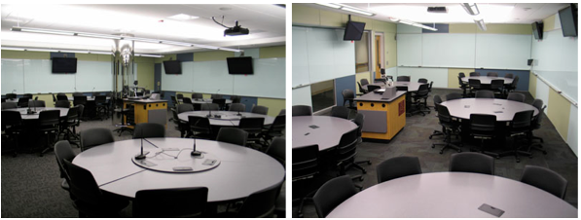
Inside an Active Learning Classroom
STSS at the University of Minnesota
http://vimeo.com/andyub/activeclassroom
“I love this space! It makes me feel appreciated as a student, and I feel intellectually invigorated when I work and learn in it.”

Slide 78
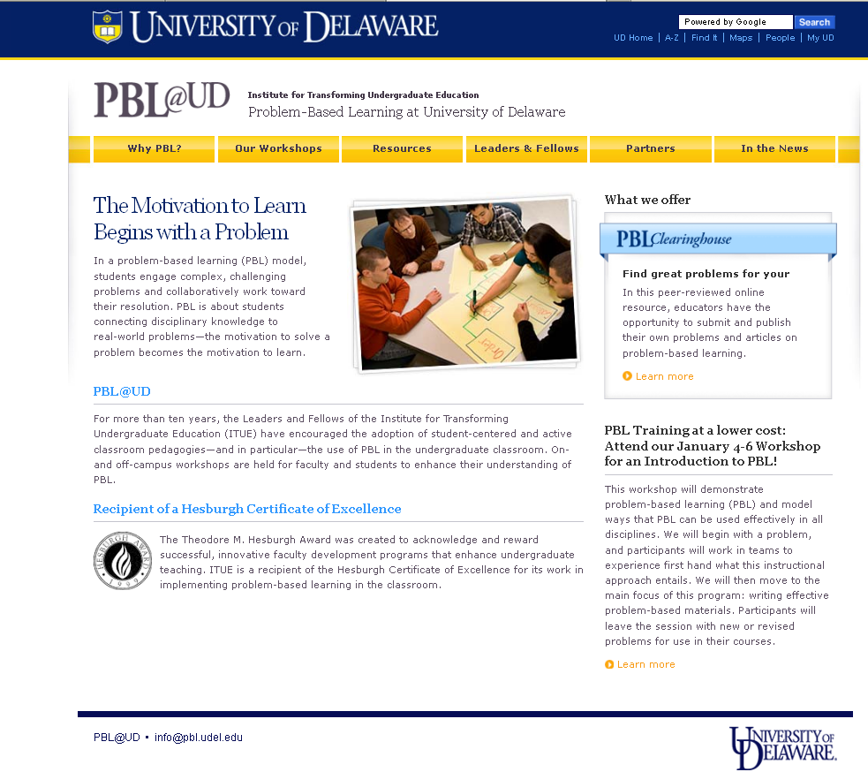
http://www.udel.edu/inst/

Slide 79
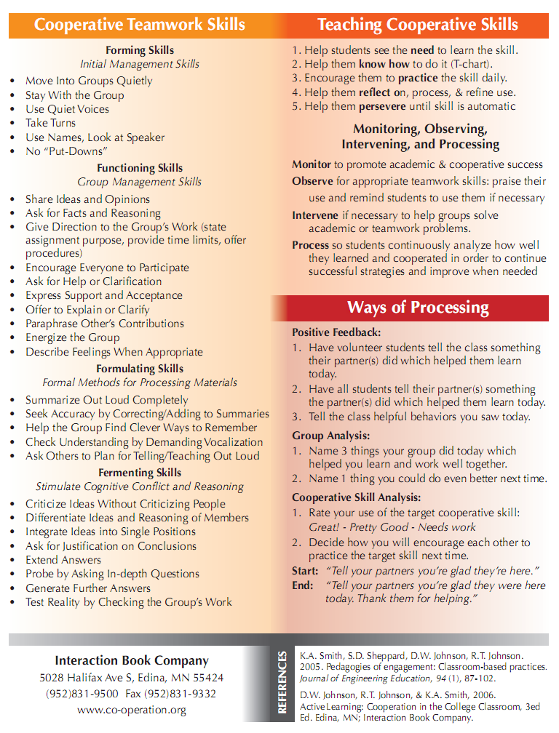
Teamwork Skills
Communication
  Listening and Persuading
Decision Making
Conflict Management
Leadership
Trust and Loyalty
Chapters 3, 4, 5 & 6

Slide 80
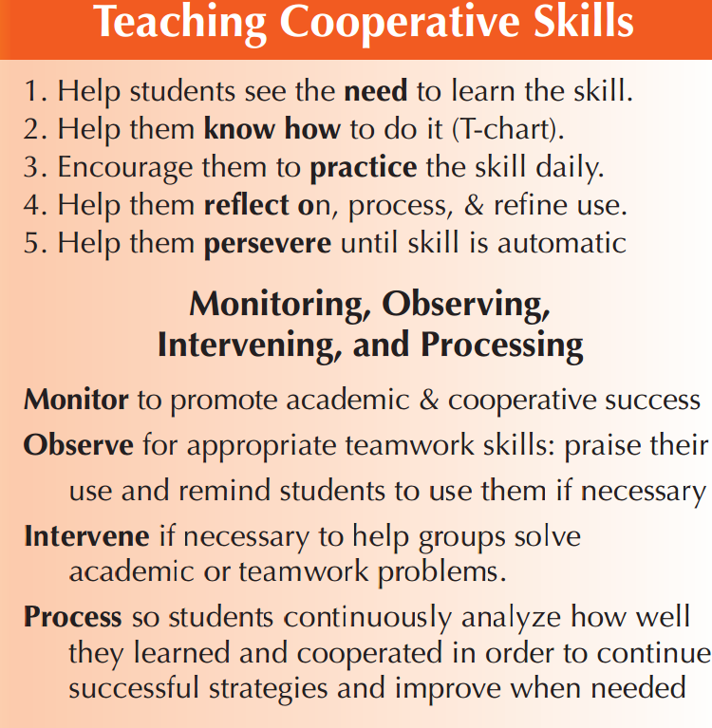
TEAMWORK

Slide 81
Team Charter
Team name, membership, and roles
Team mission
Anticipated results (goal)
Specific tactical objectives
Ground rules/ Guiding principles for team participation
Shared expectations/aspirations
pp. 60-61, 204-205

Slide 82
Code of Cooperation
•EVERY member is responsible for the team’s progress and success.
•Attend all team meetings and be on time.
•Come prepared.
•Carry out assignments on schedule.
•Listen to and show respect for the contributions of other members; be an active listener.
•CONSTRUCTIVELY criticize ideas, not persons.
•Resolve conflicts constructively,
•Pay attention, avoid disruptive behavior.
•Avoid disruptive side conversations.
•Only one person speaks at a time.
•Everyone participates, no one dominates.
•Be succinct, avoid long anecdotes and examples.
•No rank in the room.
•Respect those not present.
•Ask questions when you do not understand.
•Attend to your personal comfort needs at any time but minimize team disruption.
•HAVE FUN!!
•?
Adapted from Boeing Aircraft Group Team Member Training Manual

Slide 83
Team Charter Examples & Research
Team Charter – Developed by Vivian Corwin and Marilyn A. Uy for COM 321 (Organizational Behaviour) Gustavson School of Business, University of Victoria
Mathieu, John E. & Rapp, Tammy L. 2009. Laying the foundation for successful team performance trajectories: The role of team charters and performance strategies. Journal of Applied Psychology, 94(1), 90-103
Group Ground Rules Contract Form – Developed by Deborah Allan, University of Delaware (Recommend using with student teams)
Many more examples available online

Slide 84
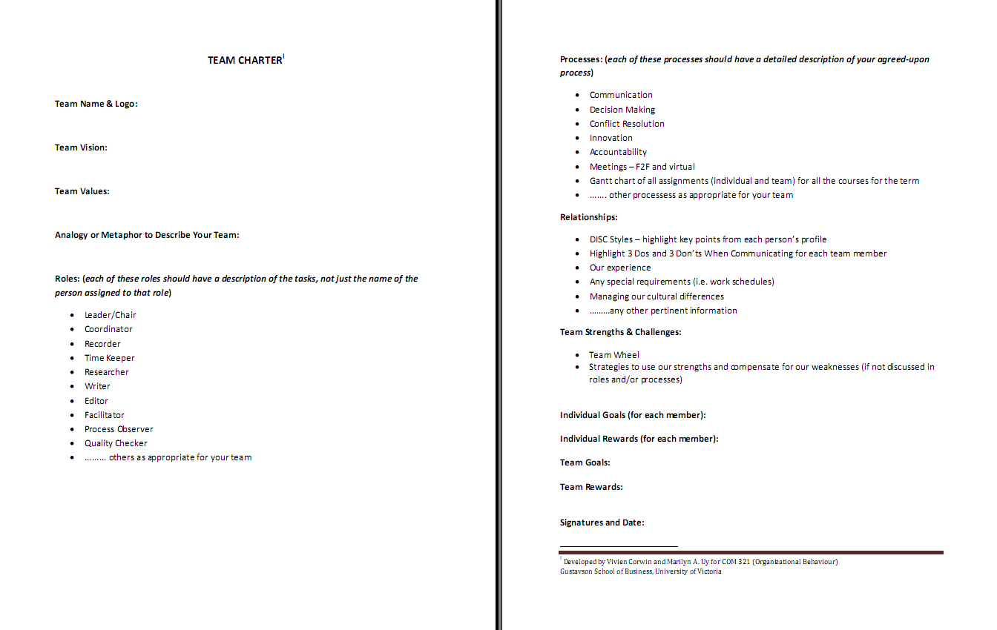

Slide 85
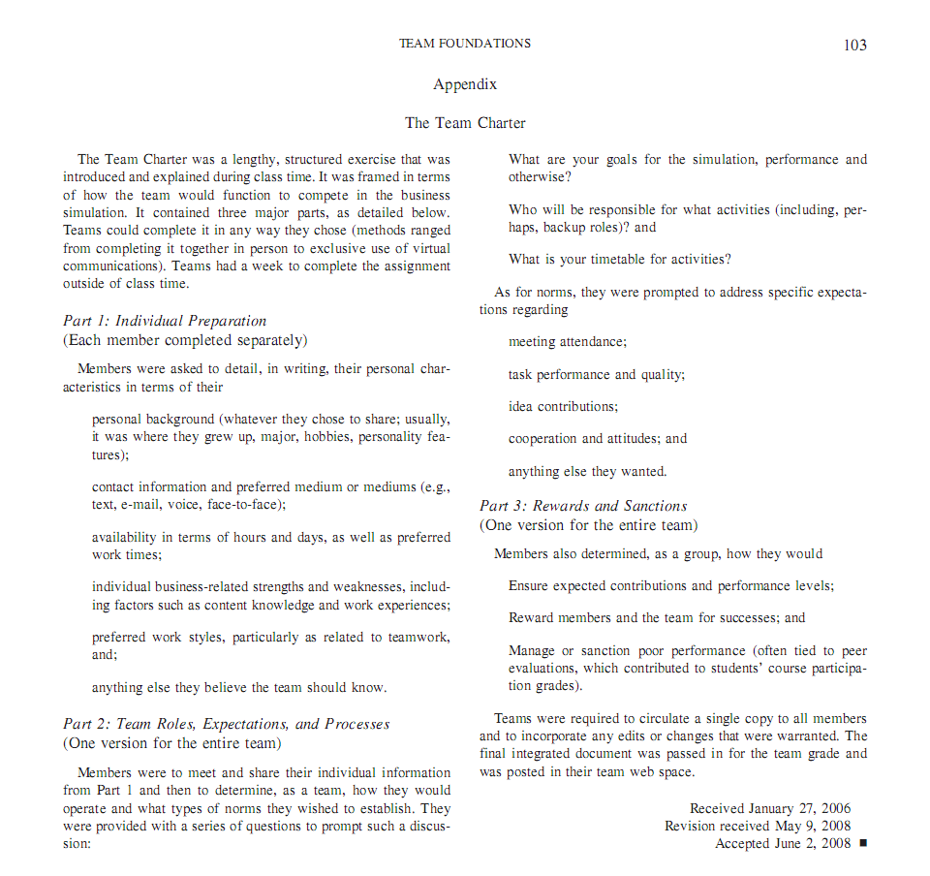
Mathieu, John E. & Rapp, Tammy L. 2009. Laying the foundation for successful team performance trajectories: The role of team charters and performance strategies. Journal of Applied Psychology, 94(1), 90-103

Slide 87
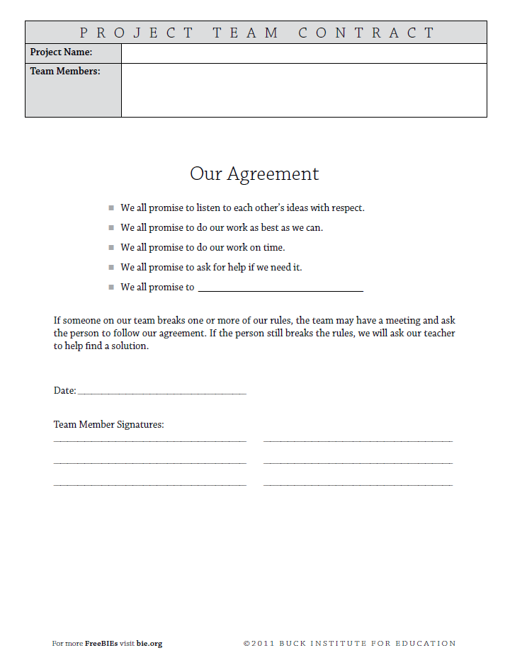

Slide 88
Designing and Implementing Cooperative Learning
Think like a designer
Ground practice in robust theoretical framework
Start small, start early and iterate
Celebrate the successes; problem-solve the failures

Slide 89
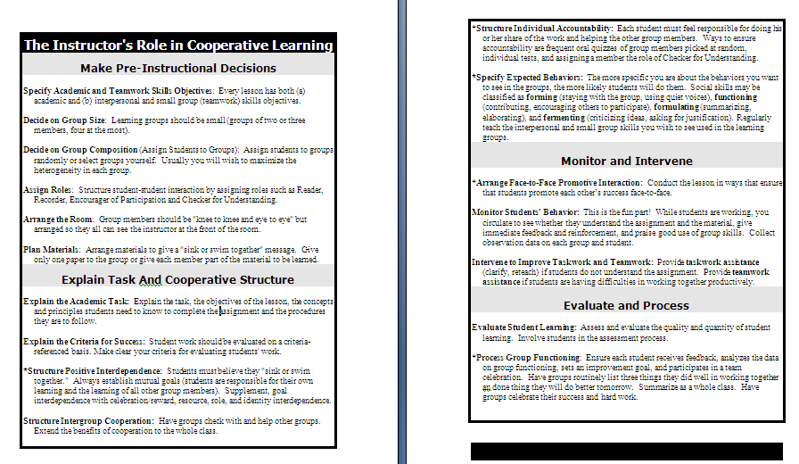

Slide 90
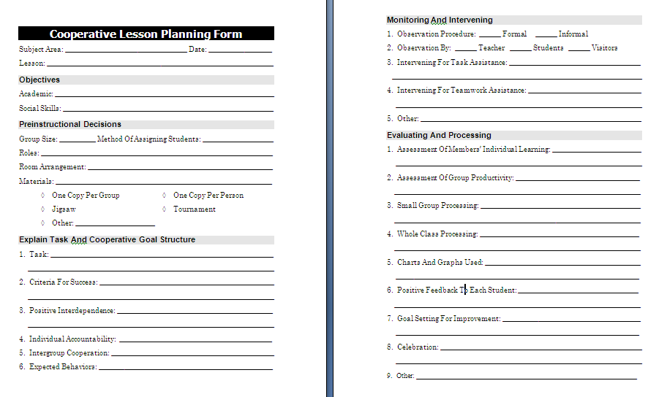

Slide 91
Design and Implementation of Pedagogies of Engagement
Cooperative Learning and Problem-Based Learning
Karl A. Smith
STEM Education Center / Civil Engineering – University of Minnesota &
Engineering Education
– Purdue University
ksmith@umn.edu http://personal.cege.umn.edu/~smith/links.htm
THANK YOU!

Slide 92
UIAPR Bayamon - Workshop (3-20-15)
Q4 – Pace: Too slow 1 . . . . 5 Too fast (3.3)
Q5 – Relevance: Little 1 . . . 5 Lots (4.6)
Q6 – Format: Ugh 1 . . . 5 Ah (4.5)

