Slide 1
Essential Elements of Effective Teaching
Karl A. Smith
Engineering Education – Purdue University
Civil Engineering - University of Minnesota
ksmith@umn.edu
http://www.ce.umn.edu/~smith
Effective Teaching: Moving Away from a Teacher-Centered Paradigm
Plenary for the Associated
Colleges of the St. Lawrence Valley
November 6, 2010

Slide 2
Reflection and Dialogue
Individually reflect on your mental image of effective teaching. Write for about 1 minute.
  Jot down words or phrases
  Construct a figure or diagram
Discuss with your neighbor for about 3 minutes
  Describe your mental image and talk about similarities and differences
  Select one Element, Image, Comment, Story, etc. that you would like to present to the whole group if you are randomly selected
Whole group discussion

Slide 3
Teacher Mental Images About Teaching - Axelrod (1973)
Mental Image | Motto | Characteristics | Disciplines
Content | I teach what I know | Pour it in, Lecture | Science, Math
Instructor | I teach what I am | Modeling, Demonstration | Many
Student – Cognitive Development | I train minds | Active Learning, Discussion | English, Humanities
Student – Development of Whole Person | I work with students as people | Motivation, Self-esteem | Basic Skills Teachers
Axelrod, J. The University Teacher as Artist. San Francisco: Jossey-Bass, 1973.

Slide 4
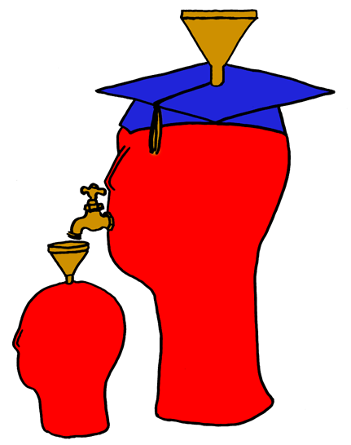
Lila M. Smith
Notes:
8:30-9:30?Take copies of Active Lrn, HTMI, New Paradigms,

Slide 5
Pedago-pathologies
Amnesia
Fantasia
Inertia
Lee Shulman – MSU Med School – PBL Approach (late 60s – early 70s), President Emeritus of the Carnegie Foundation for the Advancement of College Teaching
Shulman, Lee S. 1999. Taking learning seriously. Change, 31 (4), 11-17.
Notes:
8:30-9:30?Take copies of Active Lrn, HTMI, New Paradigms,

Slide 6
What do we do about these pathologies?
Activity – Engage learners in meaningful and purposeful activities
Reflection – Provide opportunities
Collaboration – Design interaction
Passion – Connect with things learners care about
Shulman, Lee S. 1999. Taking learning seriously. Change, 31 (4), 11-17.

Slide 7
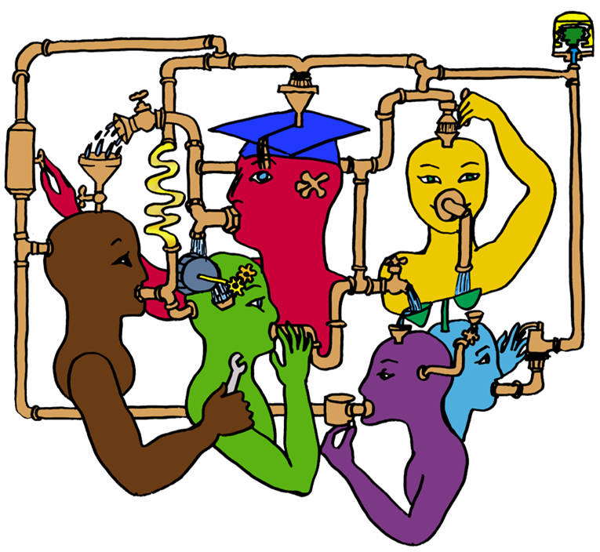
Lila M. Smith
Notes:
8:30-9:30?Take copies of Active Lrn, HTMI, New Paradigms,

Slide 8
Seven Principles for Good Practice in Undergraduate Education
Good practice in undergraduate education:
  Encourages student-faculty contact
  Encourages cooperation among students
  Encourages active learning
  Gives prompt feedback
  Emphasizes time on task
  Communicates high expectations
  Respects diverse talents and ways of learning
Chickering & Gamson, June, 1987

Slide 9
Formulate-Share-Listen-Create (Think-Pair-Share)
Individually read the quote “To teach is to engage students in learning. . .”
Underline/Highlight words and/or phrases that stand out for you
Turn to the person next to you and talk about words and/or phrases that stood out
Report out

Slide 10
To teach is to engage students in learning; thus teaching consists of getting students involved in the active construction of knowledge. . .The aim of teaching is not only to transmit information, but also to transform students from passive recipients of other people's knowledge into active constructors of their own and others' knowledge. . .Teaching is fundamentally about creating the pedagogical, social, and ethical conditions under which students agree to take charge of their own learning, individually and collectively
Education for judgment: The artistry of discussion leadership. Edited by C. Roland Christensen, David A. Garvin, and Ann Sweet. Cambridge, MA: Harvard Business School, 1991.
Notes:
8:30-9:30?Take copies of Active Lrn, HTMI, New Paradigms,

Slide 11
Comparison of Old and New Paradigm of Teaching (Johnson, Johnson & Smith, 1991)
 | Old Paradigm | New Paradigm
Knowledge | Transferred from Faculty to Students | Jointly Constructed by Students and Faculty
Students | Passive Vessel to be Filled by Faculty's Knowledge | Active Constructor, Discoverer, Transformer of Knowledge
Faculty Purpose | Classify and Sort Students | Develop Students' Competencies and Talents
Relationships | Impersonal Relationship Among Students and Between Faculty and Students | Personal Transaction Among Students and Between Faculty and Students
Context | Competitive/Individualistic | Cooperative Learning in Classroom and Cooperative Teams Among Faculty
Teaching Assumption | Any Expert can Teach | Teaching is Complex and Requires Considerable Training
Johnson, D.W., Johnson, R.T., and Smith, K.A. Active Learning: Cooperation in the College Classroom (1st ed.). Edina, MN: Interaction Book Company, 1991.

Slide 12
Robert Barr & John Tagg. From teaching to learning: A new paradigm for undergraduate education. Change, 27(6), 1995.
Wm. Campbell & Karl Smith. New Paradigms for College Teaching. Interaction Books, 1997.
Notes:
8:30-9:30?Take copies of Active Lrn, HTMI, New Paradigms,

Slide 13
 | Old Paradigm | New Paradigm
Knowledge | Transferred from Faculty to Students | Jointly Constructed by Students and Faculty
Students | Passive Vessel to be Filled by Faculty's Knowledge | Active Constructor, Discoverer, Transformer of Knowledge
Mode of Learning | Memorizing | Relating
Faculty Purpose | Classify and Sort Students | Develop Students' Competencies and Talents
Student Goals | Complete Requirements, Achieve Certification within a Discipline | Grow, Focus on Continual Lifelong Learning within a Broader System
Relationships | Impersonal Relationship Among Students and Between Faculty and Students | Personal Transaction Among Students and Between Faculty and Students
Context | Competitive/Individualistic | Cooperative Learning in Classroom and Cooperative Teams Among Faculty
Climate | Conformity/Cultural Uniformity | Diversity and Personal Esteem/ Cultural Diversity and Commonality
Power | Faculty Holds and Exercises Power, Authority, and Control | Students are Empowered; Power is Shared Among Students and Between Students and Faculty
Assessment | Norm-Referenced (i.e., Graded "On the Curve"); Typically Multiple Choice Items; Student rating of instruction at end of course | Criterion-Referenced; Typically Performances and Portfolios; Continual Assessment of Instruction
Ways of Knowing | Logico-Scientific | Narrative
Technology Use | Drill and Practice; Textbook Substitute; Chalk and Talk Substitute | Problem Solving, Communication, Collaboration, Information Access, Expression
Teaching Assumption | Any Expert can Teach | Teaching is Complex and Requires Considerable Training

Slide 14
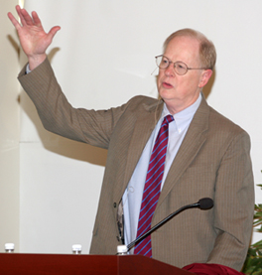
It could well be that faculty members of the twenty-first century college or university will find it necessary to set aside their roles as teachers and instead become designers of learning experiences, processes, and environments.
James Duderstadt, 1999 [Nuclear Engineering Professor; Dean, Provost and President of the University of Michigan]

Slide 15
Content-Assessment-Pedagogy (CAP) Design Process Flowchart
Integrated Course Design (Fink, 2003)
Initial Design Phase
Start
Context
1. Situational Factors
Backward Design
Content
2. Learning Goals
Assessment
3. Feedback and Assessment
Pedagogy
4. Teaching/Learning Activities
No
C & A & P
Alignment?
5. Integration
Yes
End
Notes:
15

Slide 16
College Teaching:
What do we know about it?
Five assertions about what we know about college teaching
  Good teaching makes a difference
  Teachers vary markedly
  Some characteristics/methods are present in all good teaching
  Teaching can be evaluated and rewarded
  There is ample room for improvement.
K. Patricia Cross, 1991 ASEE ERM Distinguished Lecture

Slide 17
Four factors in good teaching, based on student ratings*:
  Skill. Communicates in an exciting way.
  Rapport. Understands and emphasizes with students.
  Structure. Provides guidance to course and material.
  Load. Requires moderate work load.
*Student ratings of teaching are consistent (with other measures), unbiased, and useful. Students agree on good teaching and their views are consistent with faculty.
Notes:
Effective learning depends on the performance of the students, not the teacher. It is an evocative process, not a performance.
New information results in meaningful learning when it connects with what is already known. Ausubel said, "find out what a student knows and then teach accordingly."

Slide 18
Student Engagement Research Evidence
Perhaps the strongest conclusion that can be made is the least surprising. Simply put, the greater the student’s involvement or engagement in academic work or in the academic experience of college, the greater his or her level of knowledge acquisition and general cognitive development …(Pascarella and Terenzini, 2005).
Active and collaborative instruction coupled with various means to encourage student engagement invariably lead to better student learning outcomes irrespective of academic discipline (Kuh et al., 2005, 2007).
See Smith, et.al, 2005 and Fairweather, 2008, Linking Evidence and Promising Practices in Science, Technology, Engineering, and Mathematics (STEM) Undergraduate Education - http://www7.nationalacademies.org/bose/Fairweather_CommissionedPaper.pdf

Slide 19
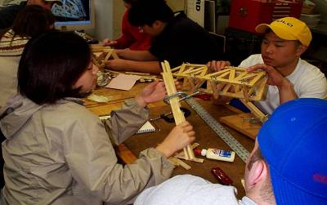
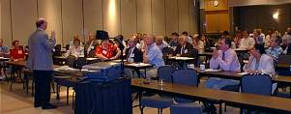
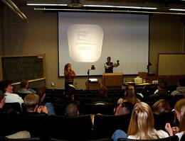
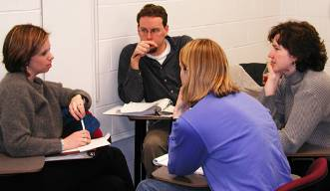
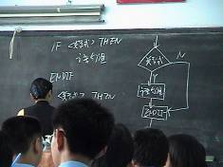
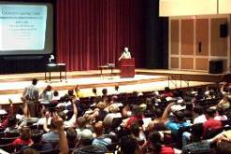
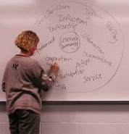
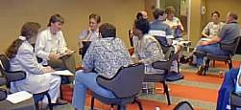
Pedagogies of Engagement

Slide 20
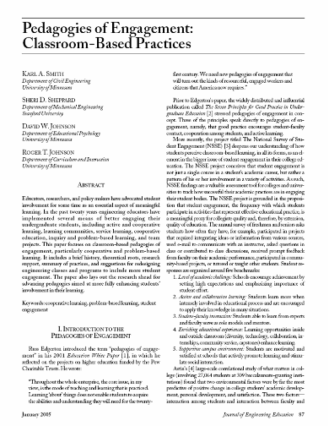
“Throughout the whole enterprise, the core issue, in my view, is the mode of teaching and learning that is practiced. Learning ‘about’ things does not enable students to acquire the abilities and understanding they will need for the twenty-first century. We need new pedagogies of engagement that will turn out the kinds of resourceful, engaged workers and citizens that America now requires.”
Russ Edgerton (reflecting on higher education projects funded by the Pew Memorial Trust)

Slide 21
Cooperative Learning
Theory – Social Interdependence – Lewin – Deutsch – Johnson & Johnson
Research – Randomized Design Field Experiments
Practice – Formal Teams/Professor’s Role
Theory
Research
Practice

Slide 22

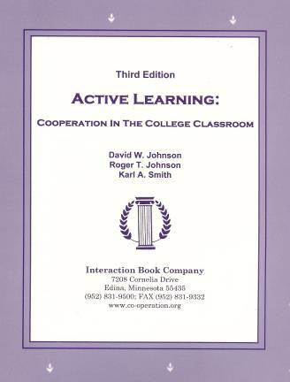
Cooperative Learning
•Positive Interdependence
•Individual and Group Accountability
•Face-to-Face Promotive Interaction
•Teamwork Skills
•Group Processing

Slide 23
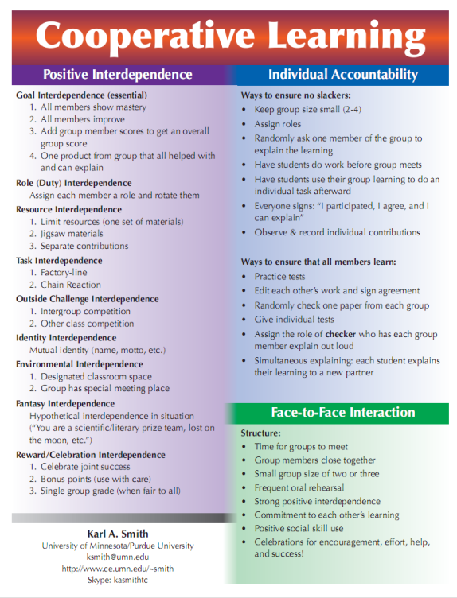
Cooperative Learning is instruction that involves people working in teams to accomplish a common goal, under conditions that involve both positive interdependence (all members must cooperate to complete the task) and individual and group accountability (each member is accountable for the complete final outcome).
Key Concepts
•Positive Interdependence
•Individual and Group Accountability
•Face-to-Face Promotive Interaction
•Teamwork Skills
•Group Processing
Notes:
Table summarizes my perception of the shift. A version of this table is available in New Paradigms for Engineering Education -- FIE Conf proceedings 97 (avail on the www)
One of the most significant changes that has occurred is the shift from "pouring in knowledge" to "creating a climate where learning flows among students and the professor"

Slide 24
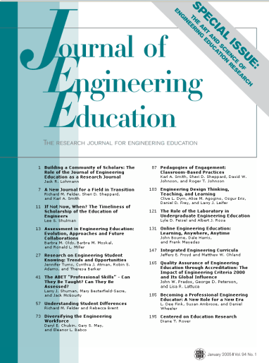

Cooperative Learning Research Support
Johnson, D.W., Johnson, R.T., & Smith, K.A. 1998. Cooperative learning returns to college: What evidence is there that it works? Change, 30 (4), 26-35.
• Over 300 Experimental Studies
• First study conducted in 1924
• High Generalizability
• Multiple Outcomes
Outcomes
1. Achievement and retention
2. Critical thinking and higher-level
reasoning
3. Differentiated views of others
4. Accurate understanding of others' perspectives
5. Liking for classmates and teacher
6. Liking for subject areas
7. Teamwork skills
January 2005
March 2007
Notes:
Table summarizes my perception of the shift. A version of this table is available in New Paradigms for Engineering Education -- FIE Conf proceedings 97 (avail on the www)
One of the most significant changes that has occurred is the shift from "pouring in knowledge" to "creating a climate where learning flows among students and the professor"

Slide 25
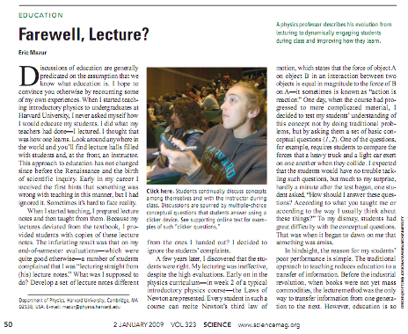
Active and Cooperative Learning
January 2, 2009—Science, Vol. 323 – www.sciencemag.org
Calls for evidence-based promising practices

Slide 26
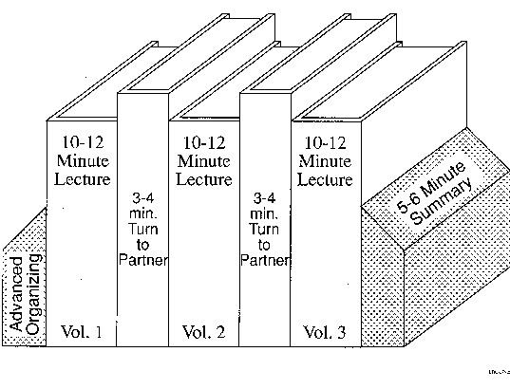
Book Ends on a Class Session
Thinking Together: Collaborative Learning in the Sciences – Harvard University – Derek Bok Center – www.fas.harvard.edu/~bok_cen/

Slide 27
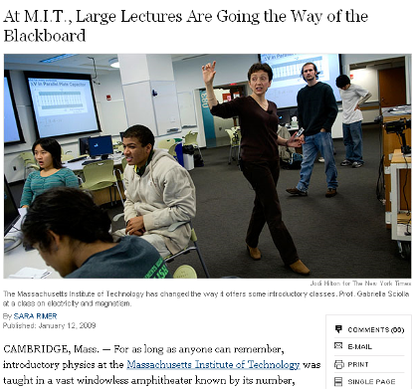
Cooperative Learning
January 13, 2009—New York Times – http://www.nytimes.com/2009/01/13/us/13physics.html?em

Slide 28
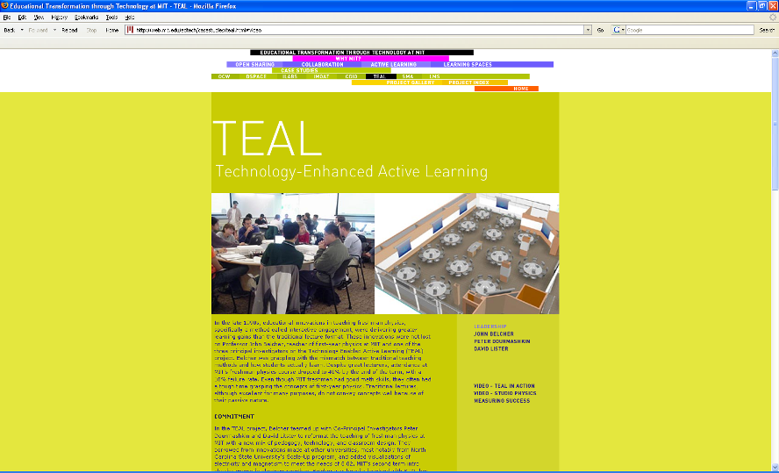
http://web.mit.edu/edtech/casestudies/teal.html#video

Slide 29
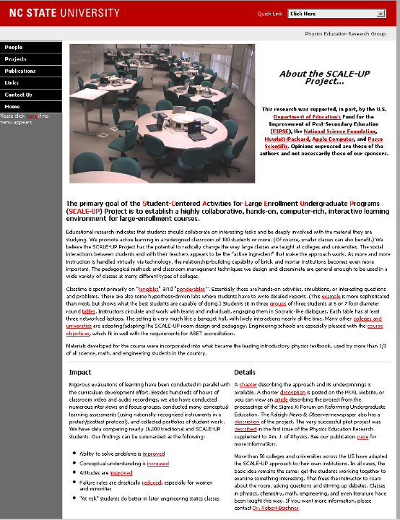
http://www.ncsu.edu/PER/scaleup.html

Slide 30
The American College Teacher:
National Norms for 2007-2008
Methods Used in “All” or “Most” | All – 2005 | All – 2008 | Assistant - 2008
Cooperative Learning | 48 | 59 | 66
Group Projects | 33 | 36 | 61
Grading on a curve | 19 | 17 | 14
Term/research papers | 35 | 44 | 47
http://www.heri.ucla.edu/index.php

Slide 31
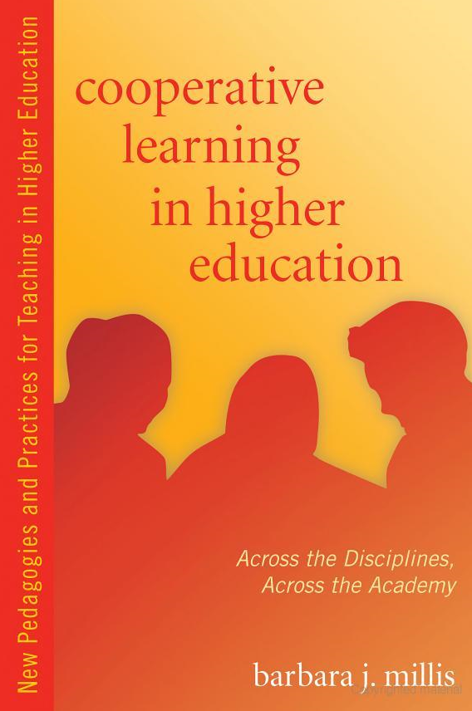


Slide 32
Good teaching comes from the identity and integrity of the teacher.
Good teachers possess a capacity for connectedness.
Parker J. Palmer in The courage to teach: Exploring the inner landscape of a teacher=s life. Jossey-Bass, 1998.
Notes:
Table summarizes my perception of the shift. A version of this table is available in New Paradigms for Engineering Education -- FIE Conf proceedings 97 (avail on the www)
One of the most significant changes that has occurred is the shift from "pouring in knowledge" to "creating a climate where learning flows among students and the professor"

Slide 33
The biggest and most long-lasting reforms of undergraduate education will come when individual faculty or small groups of instructors adopt the view of themselves as reformers within their immediate sphere of influence, the classes they teach every day.
K. Patricia Cross

Slide 34
Resources
Design Framework – How People Learn (HPL) & Backward Design Process
  Creating High Quality Learning Environments (Bransford, Vye & Bateman) -- http://www.nap.edu/openbook/0309082927/html/
  Pellegrino – Rethinking and redesigning curriculum, instruction and assessment: What contemporary research and theory suggests. http://www.skillscommission.org/commissioned.htm
  Smith, K. A., Douglas, T. C., & Cox, M. 2009. Supportive teaching and learning strategies in STEM education. In R. Baldwin, (Ed.). Improving the climate for undergraduate teaching in STEM fields. New Directions for Teaching and Learning, 117, 19-32. San Francisco: Jossey-Bass.
Content Resources
  Donald, Janet. 2002. Learning to think: Disciplinary perspectives. San Francisco: Jossey-Bass.
  Middendorf, Joan and Pace, David. 2004. Decoding the Disciplines: A Model for Helping Students Learn Disciplinary Ways of Thinking. New Directions for Teaching and Learning, 98.
Cooperative Learning - Instructional Format explanation and exercise to model format and to engage workshop participants
  Cooperative Learning (Johnson, Johnson & Smith)
    Smith web site – www.ce.umn.edu/~smith
  Smith (2010) Social nature of learning: From small groups to learning communities. New Directions for Teaching and Learning, 2010, 123, 11-22 [NDTL-123-2-Smith-Social_Basis_of_Learning-.pdf]
  Smith, Sheppard, Johnson & Johnson (2005) Pedagogies of Engagement [Smith-Pedagogies_of_Engagement.pdf]
  Cooperative learning returns to college: What evidence is there that it works? Change, 1998, 30 (4), 26-35. [CLReturnstoCollege.pdf]
Other Resources
  University of Delaware PBL web site – www.udel.edu/pbl
  PKAL – Pedagogies of Engagement – http://www.pkal.org/activities/PedagogiesOfEngagementSummit.cfm
  Fairweather (2008) Linking Evidence and Promising Practices in Science, Technology, Engineering, and Mathematics (STEM) Undergraduate Education - http://www7.nationalacademies.org/bose/Fairweather_CommissionedPaper.pdf

