Slide 1
Leveraging Your Engineering
Education Innovation
Karl A. Smith
Engineering Education – Purdue University
STEM Education Center/Civil Eng – University of Minnesota
ksmith@umn.edu - http://www.ce.umn.edu/~smith/
Mary Besterfield-Sacre
Industrial Engineering/Engineering Education Research Center – University of Pittsburgh
mbsacre@pitt.edu – http://www.engineering.pitt.edu/EERC
National Academy of Engineering
Frontiers of Engineering Education Symposium
October, 2012

Slide 2
Participant Learning Goals (Objectives)
Describe key features of recent engineering education innovation and research reports
  Explain rationale for national and international emphasis on engineering education innovation and research
  Apply findings and/or recommendations to your engineering education innovation
  Identify connections between national reports and how to leverage key aspects to advance your innovation.

Slide 3





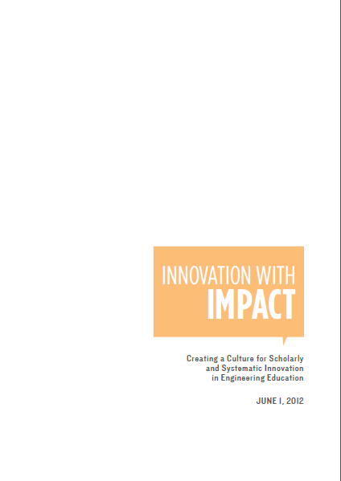




Global Calls
for Reform
Research-based Transformation
K-12 Engineering

Slide 4
Reflection and Dialogue
Individually reflect on findings that would help support/leverage your engineering education innovation. Write for about 1 minute.
  Recall reports you have reviewed or
  Speculate on areas of emphasis that would help support your innovation
Discuss with your neighbor for about 2 minutes
  Describe your lists and talk about similarities and differences
Whole group discussion

Slide 5
Summary of President’s Council of Advisors on Science and Technology (PCAST) Report Dated February 2012
James M. Tien, PhD, DEng (h.c.), NAE
Distinguished Professor and Dean

Slide 6
Report’s Foci
Mission: Producing 1M Additional STEM Graduates
Vision: Engaging Students, Faculty and Government
Approach:
  Increasing Retention Rate From 40% to 50% (Would Yield Additional 0.75M Graduates!)
  Requiring Faculty To Better Inspire and Motivate Students
  Adopting Empirically Validated Teaching Practices
  Replacing Standard Lab Courses With Discovery-Based Research Courses
  Launching Postsecondary Mathematics Education To Address Math Gap
  Encouraging Partnership Among Stakeholders
  Creating A Presidential Council on STEM Education

Slide 7



The State of
Engineering Education Culture
Highlights of Phase 1 and 2 Reports with Takeaways
Mary Besterfield-Sacre
National Academy of Engineering
Frontiers of Engineering Education
14 - 17 October 2012
Phase 1&2
Innovation with Impact
Creating a Culture for Scholarly
and Systematic Innovation in
Engineering Education

Slide 8


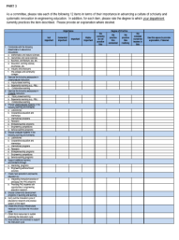
U.S. engineering education for the 21st century
“How could/should ASEE contribute?’
Jack Lohmann
Leah Jamieson
2004
2005
2006
2007
2008
2009
2010
2012
Discussion
and planning
“Year of Dialogue”
Phase 1: “Creating a Culture for Scholarly and Systematic Innovation in Engineering Education”
Two Phase
Project
Survey of Faculty, Chairs & Deans
Community Feedback
Synthesis of Results
Phase 2: “Innovation with Impact”

Slide 9

a universal and fundamental question…
…and the report’s major recommendation
Q: “How can we create an environment in which many exciting, engaging, and empowering engineering educational innovations can flourish and make a significant difference in educating future engineers?”
A: “Create and sustain a vibrant engineering academic culture for scholarly and systematic educational innovation — just as we have for technological innovation — to ensure that the U.S. engineering profession has the right people with the right talent for a global society.”
Notes:
Leah - 30 seconds

Slide 10
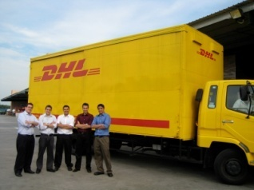

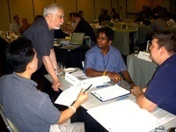
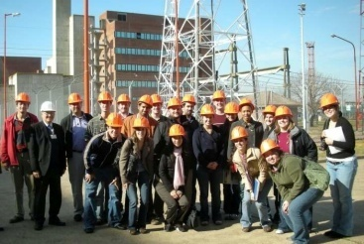

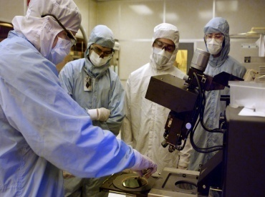
“who” should drive change?
engineering education depends on many stakeholders, but…
…engineering faculty and administrators are key
They determine the content of the program, decide how it is delivered, and shape the environment in which it is offered
We need to –
  strengthen career-long professional development
  create supportive environments
  form broader collaborations
Notes:
Jack - 30 seconds

Slide 11



“what” change is needed?
integrate what we know about engineering with what we know about learning
High-quality learning environments are the result of attention to both content and how people learn
There is ample evidence that our engineering programs need to be more –
engaging
relevant
welcoming

Slide 12
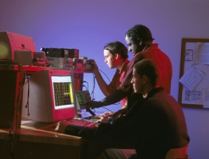
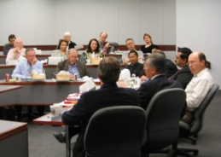
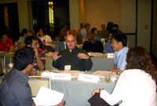
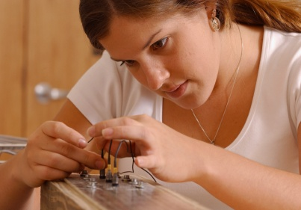
“how” to drive change
connecting communities
  Engineering education innovation depends on a vibrant community of scholars and practitioners
  working in collaboration
  to advance the frontiers of
  knowledge and practice…and it also depends on support –
  Adequate fiscal resources
  Appropriate facilities
  Reputable journals
  Highly-regarded conferences
  Prestigious recognitions
Notes:
Leah - 1 minute

Slide 13
Phase 2 – feedback and a baseline study
heart of the feedback — two samples of engineering programs
Research Team
Mary Besterfield-Sacre
University of Pittsburgh
Maura J. Borrego
Virginia Tech
Monica F. Cox
Purdue University
Barbara M. Olds
Colorado School of Mines
NSF
156 Engineering Schools invited
Random Sample 100 colleges and 200 designated departments selected randomly
Focused Sample 73 “Top 20” colleges and ∼140 undesignated departments by selected attributes (e.g., size, degrees, diversity)
Carnegie Classification
26 Bachelors
40 Masters
90 PhD
46%
Response
Rate

Slide 14
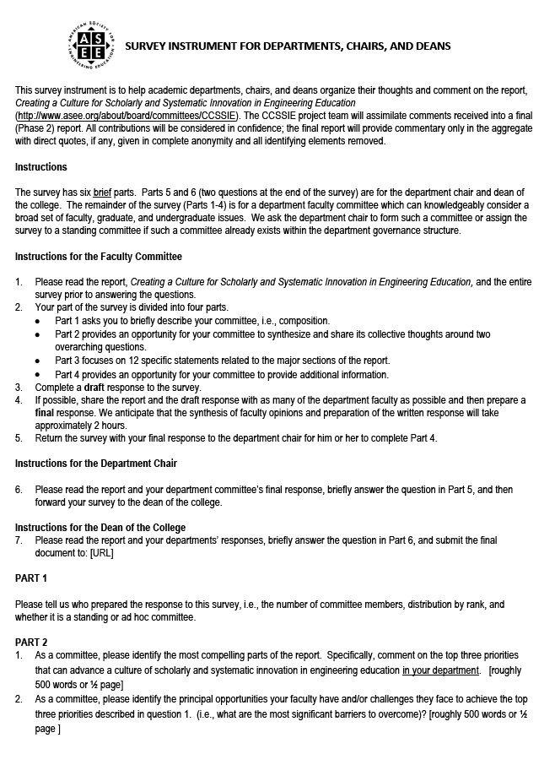
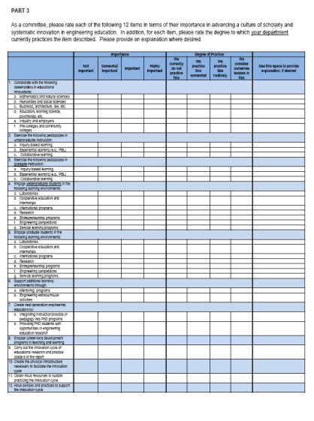
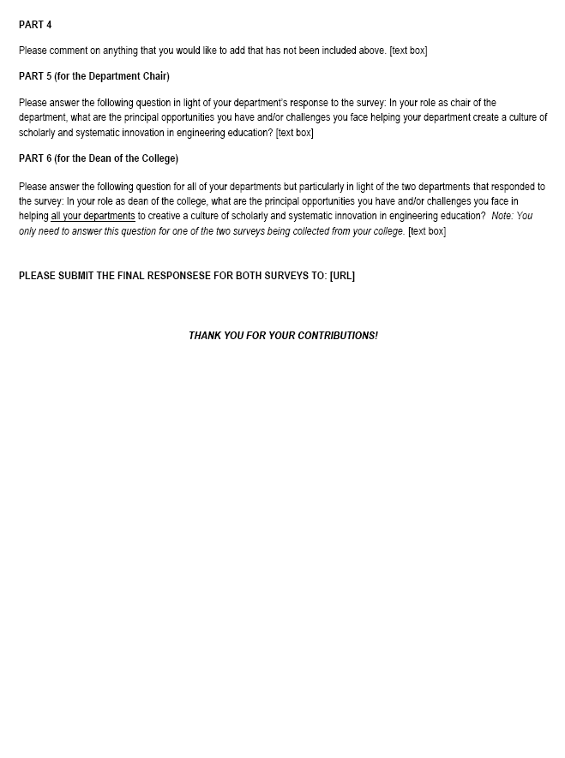
a three-part survey
faculty, chairs, deans
Faculty Committee
Q1: Most compelling parts of the report, specifically, top three priorities?
Q2: Principal opportunities/challenges to achieve priorities?
Quantitative: 12 “check the box” statements
Chairs/Heads & Deans
Q: Principal opportunities/challenges to help create a culture for scholarly and systematic educational innovation in…
… your department? (chair)
… your college? (dean)

Slide 15
classifying faculty committee results
we’re
leaders
practice
routinely
practice
somewhat
don’t
practice
Data collected by and displayed here as
→
we’re
leaders
practice
routinely
practice
somewhat
don’t
practice
**
→
→
→
→
*
Degree of Practice
Degree of Practice
→
→
↑
↑
↑
↑
not important
somewhat highly
→
→
not important
somewhat highly
Degree of Importance
Practices that are:
valued and routinely practiced
valued but not routinely practiced
not valued nor practiced much
Degree of Importance

Slide 16
preparing new and future faculty by . . .
who
* Encouraging industry experience for faculty and future faculty
we’re
leaders
practice
routinely
practice
somewhat
don’t
practice
→
* Engaging in career-long development programs in teaching and learning
→
Degree of Practice
→
* Integrating instruction/practice of pedagogy into graduate programs
→
↑
↑
↑
↑
not important
somewhat highly
Degree of Importance

Slide 17
form broader collaborations with . . .
who
* Education, learning sciences, psychology, etc.
we’re
leaders
practice
routinely
practice
somewhat
don’t
practice
→
* Mathematics and natural sciences
→
* * Industry and employers
Degree of Practice
→
Business, architecture, law, etc.
Pre-colleges and community colleges
→
Humanities and social sciences
!?
↑
↑
↑
↑
not important
somewhat highly
At odds with national reports
Degree of Importance

Slide 18
broaden pedagogical approaches to include . . .
(undergraduate shown, have graduate data, too)
what
we’re
leaders
practice
routinely
practice
somewhat
don’t
practice
→
* * Collaborative learning
→
* * Experiential learning
Degree of Practice
→
* Inquiry-based learning
→
↑
↑
↑
↑
not important
somewhat highly
Degree of Importance

Slide 19
engage in educational environments such as . . .
what
** Research
we’re
leaders
practice
routinely
practice
somewhat
don’t
practice
→
** Laboratories
→
** Co-op and internships
Degree of Practice
→
International programs
Entrepreneurship programs
Service learning programs
→
↑
↑
↑
↑
!?
not important
somewhat highly
Again, at odds with national reports
Degree of Importance

Slide 20
supporting communities in innovation
how
we’re
leaders
practice
routinely
practice
somewhat
don’t
practice
→
→
* Obtain fiscal resources
Degree of Practice
→
* Have supportive policies and practices
* Create physical infrastructure
→
↑
↑
↑
↑
Carry out the innovation cycle
not important
somewhat highly
Provide grad students opportunities
Degree of Importance

Slide 21
…top 5 challenges and opportunities…

Slide 22
a path forward…7 recommendations
who
Grow professional development in teaching and learning
  Career-long PD programs in teaching, learning, and education innovation for faculty and administrators
  Begin to prepare future faculty
Expand collaborations
  Disciplinary programs relevant to engineers
  Support the pre-professional, professional, and continuing education of engineers

Slide 23
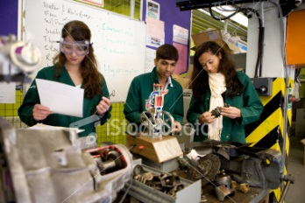
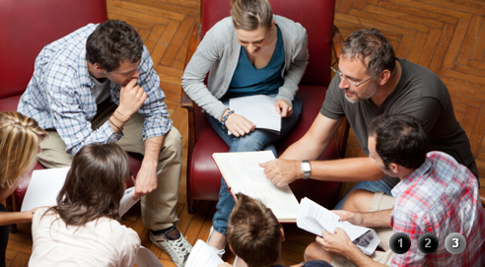
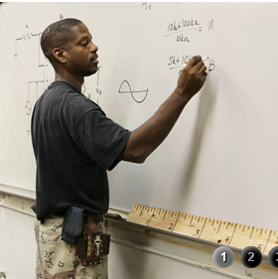
a path forward…7 recommendations
what
Expand efforts to make engineering programs more: engaging, relevant, &
welcoming
  Pedagogy embraced,
  but changing landscape
  New learning
  environments
  to explore

Slide 24
a path forward…7 recommendations
how
Resources
  Increase, leverage, and diversify for engineering teaching, learning, and innovation
Raise awareness
  Proven practices
  Scholarship in engineering education

Slide 25
Create a Better
Culture!
a path forward…7 recommendations
Measure progress in implementing policies, practices, and infrastructure in support of scholarly and systematic innovation in engineering education:
Push our individual institutions
  Vision, shared values, clear goals, careful planning, and commitment to follow through
  It is up to us to make it happen
National capacity for innovation
  “A seat at the table” as a peer with engineering research

Slide 26
Thank you! www.asee.org > Member Resources> Reports
Notes:
Jack
Intro + slides 1-6: 10 minutes

Slide 27
Reflect
Which of the 7 recommendations do you feel is most salient to your innovation. Why?
What role do you see engineering education research play in your innovation?

Slide 28
Who
Grow professional development in teaching and learning.
Expand collaborations.
What
3. Expand efforts to make engineering more engaging, relevant, and welcoming.
How
4. Increase, leverage, and diversify resources for engineering teaching, learning, and innovation.
Raise awareness of proven practices and of scholarship in engineering education.
Creating a Better Culture
To measure progress in implementing policies, practices, and infrastructure in support of scholarly and systematic innovation in engineering education:
Conduct periodic self-assessments in our individual institutions.
Conduct periodic community-wide self-assessments.
Notes:
28
+ countless research accomplishments

Slide 29
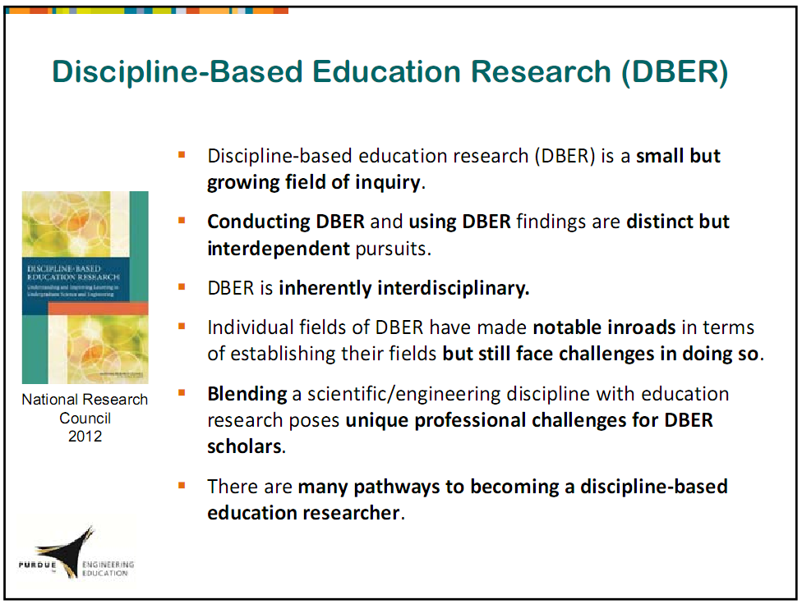

Slide 30
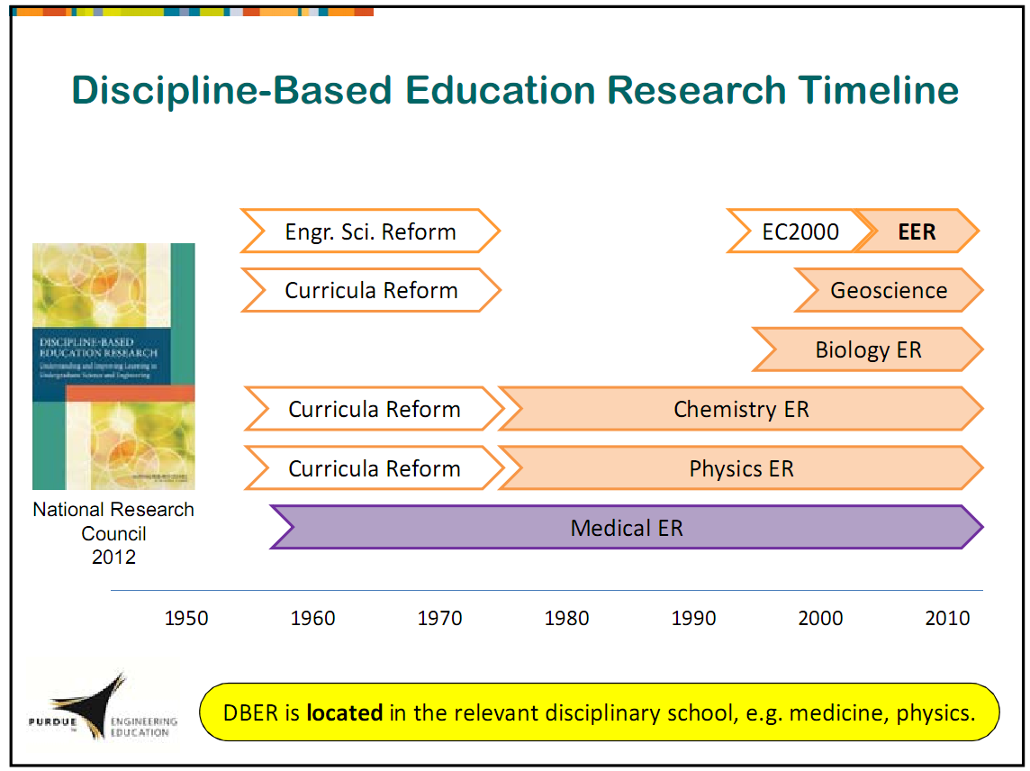

Slide 31

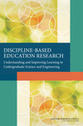
Discipline-Based Education Research (DBER)
Understanding and Improving Learning in Undergraduate Science and Engineering
http://www.nap.edu/catalog.php?record_id=13362

Slide 32


Undergraduate Science and Engineering Education: Goals
Provide all students with foundational knowledge and skills
Motivate some students to complete degrees in science or engineering
Support students who wish to pursue careers in science or engineering
Notes:
Context for DBER and for this study, which addresses undergraduate education. Move through Slides 1-3 relatively quickly.

Slide 33
Undergraduate Science and Engineering Education: Challenges and Opportunities
Retaining students in courses and majors
Increasing diversity
Improving the quality of instruction

Slide 34
What is Discipline-Based
Education Research?
Emerging from various parent disciplines
Investigates teaching and learning in a given discipline
Informed by and complementary to general research on human learning and cognition
Notes:
DBER is one piece of the puzzle in efforts to improve undergraduate science and engineering education. DBER overlaps with cognitive science, educational psychology, and K-12 education research while uniquely contributing to areas where a deep disciplinary knowledge is essential and extending findings from other areas into undergraduate education.
Defining characteristic is deep disciplinary knowledge.

Slide 35
Study Charge
Synthesize empirical research on undergraduate teaching and learning in physics, chemistry, engineering, biology, the geosciences, and astronomy.
Examine the extent to which this research currently influences undergraduate science instruction.
Describe the intellectual and material resources that are required to further develop DBER.
Notes:
DBER had been emerging in various disciplines for nearly two decades, with little effort to synthesize the research. NSF and BOSE recognized a critical opportunity to synthesize the literature at a time of increasing calls for improved undergraduate science and engineering education.
Make sure to list the disciplines covered by the study.

Slide 36
Committee on the Status, Contributions, and Future Directions of Discipline-Based Education Research
SUSAN SINGER (Chair), Carleton College
ROBERT BEICHNER, North Carolina State University
STACEY LOWERY BRETZ, Miami University
MELANIE COOPER, Clemson University
SEAN DECATUR, Oberlin College
JAMES FAIRWEATHER, Michigan State University
KENNETH HELLER, University of Minnesota
KIM KASTENS, Columbia University
MICHAEL MARTINEZ, University of California, Irvine
DAVID MOGK, Montana State University
LAURA R. NOVICK, Vanderbilt University
MARCY OSGOOD, University of New Mexico
TIMOTHY F. SLATER, University of Wyoming
KARL A. SMITH, University of Minnesota and Purdue University
WILLIAM B. WOOD, University of Colorado
Notes:
The NRC carries out all of its work through expert volunteers. Every study has a committee of expert volunteers who are selected specifically for that study. Each committee is carefully constructed to include a diverse range of expertise and perspectives and to be balanced along many other dimensions, such as gender, geography, ethnicity, and previous NRC committee service.
The Committee on the Status, Contributions, and Future Directions of Discipline-Based Education Research contained a mix of DBER scholars in physics, chemistry, engineering, biology, the geosciences, and astronomy; Cognitive scientists and educational psychologists; and higher-education policy and organization scholars.
Because this was a consensus study, the committee was required to come to consensus about the evidence related to each element of the study charge. The report that I am discussing today is the result of those deliberations, and was jointly authored by the committee.
Acknowledge Michael Martinez.

Slide 37
Structure of the Report
Section I. Status of Discipline-Based Education Research
Section II. Contributions of Discipline-Based Education Research
Section III. Future Directions for Discipline-Based Education Research
Notes:
Mention that the rest of the presentation will point out some of the report’s major messages. The conclusions and recommendations are paraphrased on the following slides, so the listeners should be aware that the language on the PowerPoint does not necessarily reflect the exact language of the report.

Slide 38
Section I. Status of Discipline-Based Education Research

Slide 39
Status of DBER: Goals
Understand how people learn the concepts, practices, and ways of thinking of science and engineering.
Understand the nature and development of expertise in a discipline.
Help to identify and measure appropriate learning objectives and instructional approaches that advance students toward those objectives.
Contribute to the knowledge base in a way that can guide the translation of DBER findings to classroom practice.
Identify approaches to make science and engineering education broad and inclusive.

Slide 40
Status of DBER: Types of
Knowledge Required To Conduct DBER
Deep disciplinary knowledge
The nature of human thinking and learning as they relate to a discipline
Students’ motivation to understand and apply findings of a discipline
Research methods for investigating human thinking, motivation, and learning
Notes:
The expertise needed in DBER can, but need not, reside in a single DBER scholar; it can also be strategically distributed across multidisciplinary collaborative teams.

Slide 41
Status of DBER: Conclusions
DBER is a collection of related research fields rather than a single, unified field. (Conclusion 1)
High-quality DBER combines expert knowledge of:
  a science or engineering discipline,
  learning and teaching in that discipline, and
  the science of learning and teaching more generally.
  (Conclusion 4)
Notes:
DBER is a collection of related research fields rather than a single, unified field. Most efforts to develop and advance DBER are taking place at the level of individual fields of DBER.

Slide 42
Section II. Contributions of Discipline-Based Education Research

Slide 43
Contributions of DBER: Conceptual Understanding and Conceptual Change
In all disciplines, undergraduate students have incorrect ideas and beliefs about fundamental concepts. (Conclusion 6)
Students have particular difficulties with concepts that involve very large or very small temporal or spatial scales. (Conclusion 6)
Several types of instructional strategies have been shown to promote conceptual change.
Notes:
Acknowledge overlap with cognitive science, educational psychology, and K-12 science education research. DBER extends some of these findings into undergraduate education. (see chapter 3).
For second and third bullets, list some of the specifics (see supporting text of conclusion 6). Give some specific examples (Chapter 4, chapter 9).

Slide 44
Contributions of DBER: Problem Solving and the Use of Representations
As novices in a domain, students are challenged by important aspects of the domain that can seem easy or obvious to experts. (Conclusion 7)
Students can be taught more expert-like problem-solving skills and strategies to improve their understanding of representations.
Notes:
Cognitive science has provided the theoretical frame in which DBER on problem solving and the use of representations is situated.
Read Conclusion 7 (italicized part) in its entirety.
As novices in a domain, students are challenged by important aspects of the domain that can seem easy or obvious to experts, such as complex problem solving and domain-specific representations like graphs, models, and simulations. These challenges pose serious impediments to learning in science and engineering, especially if instructors are not aware of them.
EXPERT BLINDSPOT and implications for teaching.
Under bullet 1: Students’ problem solving strategies differ from experts in consistent and identifiable ways (focus on superficial aspects, working backward)
Students also have difficulties interpreting representations in their own right, and seeing similarities among different representations of the same phenomenon).
Bullet 2: list specific strategies: scaffolding (steps and prompts to guide students), use of multiple representations. Be sure to qualify the evidence.
This is not an area discovered by DBER scholars, but they have advanced it. The value of DBER is the deep disciplinary knowledge essential for identifying which problems or representations are most important to address and how to both analyze problems and representations and understand sticking spots for students.

Slide 45
Contributions of DBER:
Research on Effective Instruction
Effective instruction includes a range of well-implemented, research-based approaches. (Conclusion 8)
Involving students actively in the learning process can enhance learning more effectively than lecturing.
Notes:
Effective instruction includes a range of well-implemented, research-based approaches. Improving undergraduate science and engineering education involves integrating proven strategies for general instruction with strategies designed to explicitly target challenges that are unique to science and engineering or a specific discipline.
Examples of Research based strategies –Physics tutorials, POGIL (process oriented guided inquiry learning) PLTL (peer led team learning), Project SCALE-UP
Active learning – not discovered by DBER, goes back to the 1970s and what would become cognitive psychology
Interactive lectures, Think pair share, solving authentic problems, use formative assessment, promote metacognition.

Slide 46
Section III. Future Directions for Discipline-Based Education Research

Slide 47
Future Directions for DBER: Translating DBER into Practice
Available evidence suggests that DBER and related research have not yet prompted widespread changes in teaching practice among science and engineering faculty. (Conclusion 12)
Efforts to translate DBER and related research into practice are more likely to succeed if they:
  are consistent with research on motivating adult learners,
  include a deliberate focus on changing faculty conceptions about teaching and learning,
  recognize the cultural and organizational norms of the department and institution, and
  work to address those norms that pose barriers to change in teaching practice. (Conclusion 13)
Notes:
Available evidence suggests that DBER and related research have not yet prompted widespread changes in teaching practice among science and engineering faculty. Strategies are needed to more effectively promote the translation of findings from DBER into practice.
Barriers – Limited data at a national level of faculty instructional practices. Faculty behavior is influenced by many factors beyond the evidence – rewards, relative valuing of teaching and research, institutional emphasis on bringing in research dollars. National survey data does show that science and engineering faculty are the least likely to use any form of student-centered or collaborative instruction.
It’s really a conceptual change issue for faculty – similar to what we report on for students and conceptual change.

Slide 48
Future Directions for DBER: Recommendations for Translating DBER Into Practice
RECOMMENDATION: With support from institutions, disciplinary departments, and professional societies, faculty should adopt evidence-based teaching practices.
RECOMMENDATION: Institutions, disciplinary departments, and professional societies should work together to prepare current and future faculty to apply the findings of DBER and related research, and then include teaching effectiveness in evaluation processes and reward systems throughout faculty members’ careers. (Paraphrased)
Notes:
Second bullet is a paraphrased combination of two recommendations (See chapter 9).

Slide 49
Future Directions for DBER: Advancing DBER through Collaborations
Collaborations among the fields of DBER, and among DBER scholars and scholars from related disciplines, although relatively limited, have enhanced the quality of DBER. (Conclusion 15)
Notes:
This bullet is about collaborations among the fields of DBER, and collaborations among DBER scholars and scholars from other disciplines.
Provide examples (see chapters 2 and 9).

Slide 50
Future Directions for DBER:
Research Infrastructure
Advancing DBER requires a robust infrastructure for research. (Conclusion 16 )
RECOMMENDATION: Science and engineering departments, professional societies, journal editors, funding agencies, and institutional leaders should:
  clarify expectations for DBER faculty positions,
  emphasize high-quality DBER work,
  provide mentoring for new DBER scholars, and
  support venues for DBER scholars to share their research findings
Notes:
Advancing DBER requires a robust infrastructure for research that includes adequate and sustained funding for research and training, venues for peer-reviewed publication, recognition and support within professional societies, and professional conferences.
The recommendation is designed to encourage various stakeholders to build that infrastructure.

Slide 51
Future Directions for DBER: Some Key Elements of a Research Agenda
Studies of similarities and differences among different groups of students
Longitudinal studies
Additional basic research in DBER
Interdisciplinary studies of cross-cutting concepts and cognitive processes
Additional research on the translational role of DBER
Notes:
For each bullet, give examples of important questions or studies that DBER can answer.
Different groups –important as the demographics of the US shifts and very little DBER exists on them. In addition to race, ethnicity, and gender, age should also be considered.
Longitudinal studies – conceptual change takes a long long time, need to see if effects are lasting
Basic DBER – what are the sources of robust misconceptions? Folk science, instructionally induced
Interdisciplinary – e.g. energy in bio chem physics
Translational role of DBER
Additional details for the last bullet (from chapter 9):
Conclusion 11: Determining the extent to which DBER findings have been translated into instructional practice requires more nuanced, multi-faceted investigations than are currently available.
Future research and development of change initiatives in DBER should:
o Include systematic national surveys or studies of science and engineering teaching practice in each of the disciplines.
o Build on DBER and also on the related fields of faculty development (including the Scholarship of Teaching and Learning), higher education studies, and organizational change.
o Develop and test a range of initiatives aligned with different theories of change.
o Provide empirical data to support claims of success.
o Address a strategic gap in the research by studying new recognition and reward systems designed to encourage research-based improvements in teaching.

Slide 52
Acknowledgements
National Science Foundation, Division of Undergraduate Education (Grant No. 0934453)
Various volunteers:
  Committee
  Fifteen reviewers
  Report Review Monitor (Susan Hanson, Clark University) and Coordinator (Adam Gamoran, University of Wisconsin-Madison)
  Commissioned paper authors
  NRC staff (Natalie Nielsen, Heidi Schweingruber, Margaret Hilton)

Slide 53
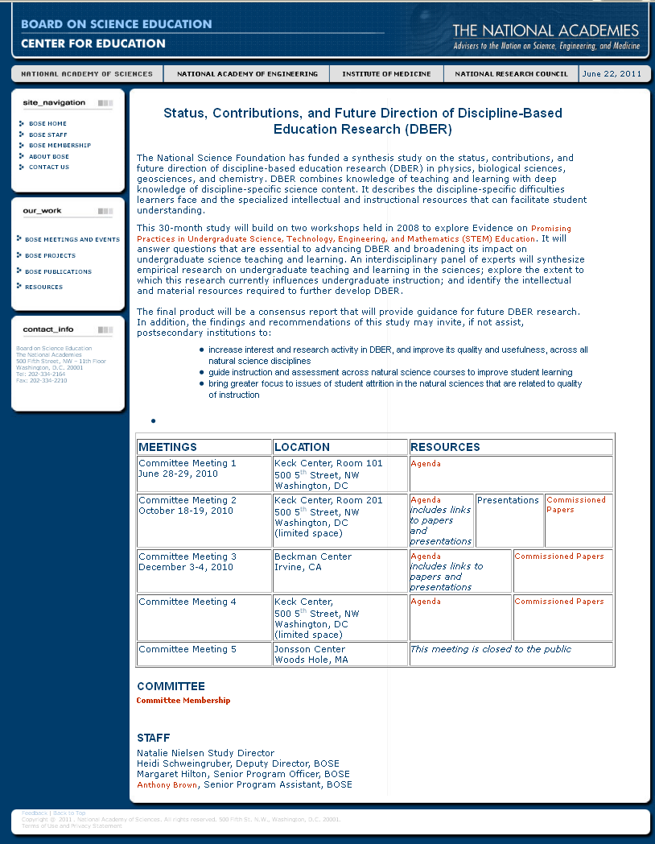
http://www7.nationalacademies.org/bose/DBER_Homepage.html

Slide 54
Reflection and Dialogue
Add to your reflection, your additional insights and connections gained from the DBER. Write for about 1 minute.
  List supporting points
  Articulate connections that would help leverage and/or support your innovation
Discuss with your neighbor for about 2 minutes
  Describe your lists and talk about similarities and differences
Whole group discussion

Slide 55
Recent Reports/Initiatives
National Research Council Discipline-Based Education Research (DBER)
  http://www.nap.edu/catalog.php?record_id=13362
ASEE Innovation with Impact report
  http://www.asee.org/about-us/the-organization/advisory-committees/Innovation-with-Impact
Froyd, J.E., Wankat, P.C. & Smith, K.A. (2012). Five major shifts in 100 years of engineering education. Proceedings of the IEEE
  http://ieeexplore.ieee.org/stamp/stamp.jsp?arnumber=06185632

