Slide 1

ASEE Main Plenary, 8:45 a.m. – 10:15 a.m.
Vancouver International Conference Centre, West Ballroom CD
Expected to draw over 2,000 attendees, this year’s plenary features Karl A. Smith, Cooperative Learning Professor of Engineering Education at Purdue University and Morse–Alumni Distinguished Teaching Professor & Professor of Civil Engineering at the University of Minnesota.
Smith has been at the University of Minnesota since 1972 and has been active in ASEE since he became a member in 1973. For the past five years, he has been helping start the engineering education Ph.D. program at Purdue University. He is a Fellow of the American Society for Engineering Education and past Chair of the Educational Research and Methods Division. He has worked with thousands of faculty all over the world on pedagogies of engagement, especially cooperative learning, problem-based learning, and constructive controversy.
On the occasion of the 100th anniversary of the Journal of Engineering Education and the release of ASEE’s Phase II report Creating a Culture for Scholarly and Systematic Innovation in Engineering Education (Jamieson/Lohmann report), the plenary will celebrate these milestones and demonstrate rich, mutual interdependences between practice and inquiry into teaching and learning in engineering education. Depth and range of the plenary will energize the audience and reflects expertise and interests of conference participants. One of ASEE’s premier educators and researchers, Smith will draw upon our roots in scholarship to set the stage and weave the transitions for six highlighted topics selected for their broad appeal across established, evolving, and emerging practices in engineering education.

Slide 2

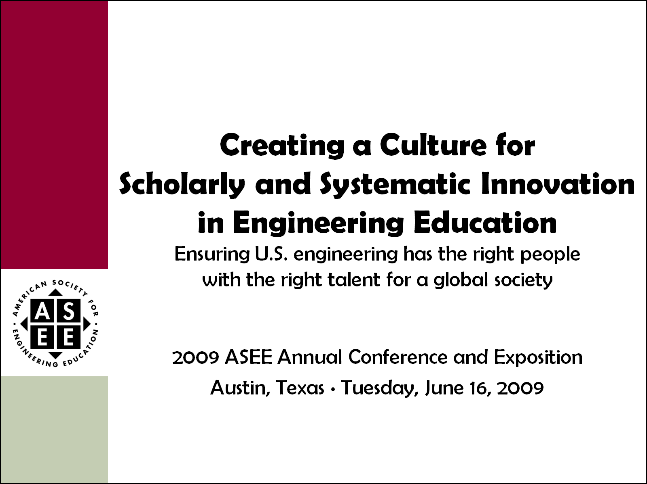
Celebration of Two Major
ASEE Milestones
2011 ASEE Annual Conference and Exposition
Vancouver, British Columbia ∙ Monday, June 27, 2011

Slide 3
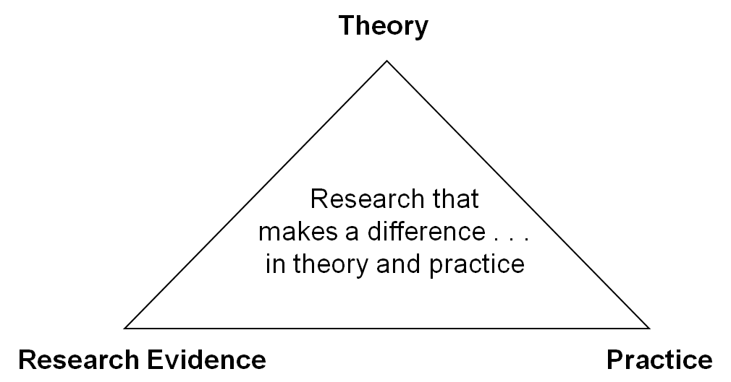
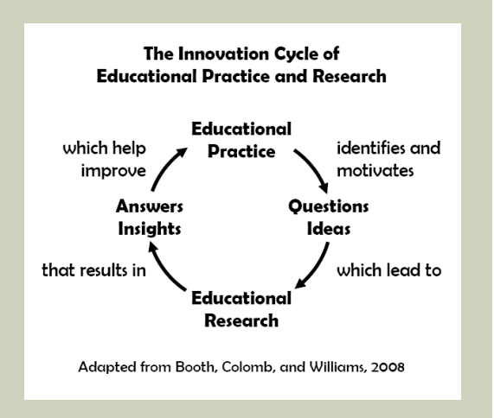

One BIG Idea; Two Perspectives
Jamieson & Lohmann (2009)
Engineering Education Innovation

Slide 4
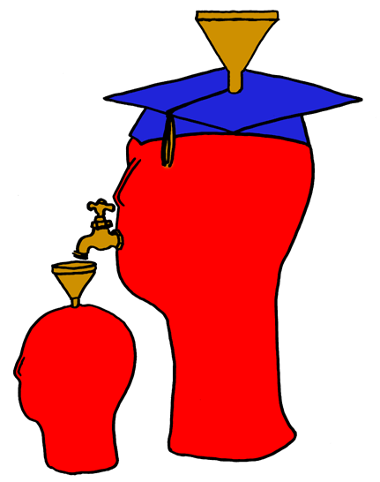
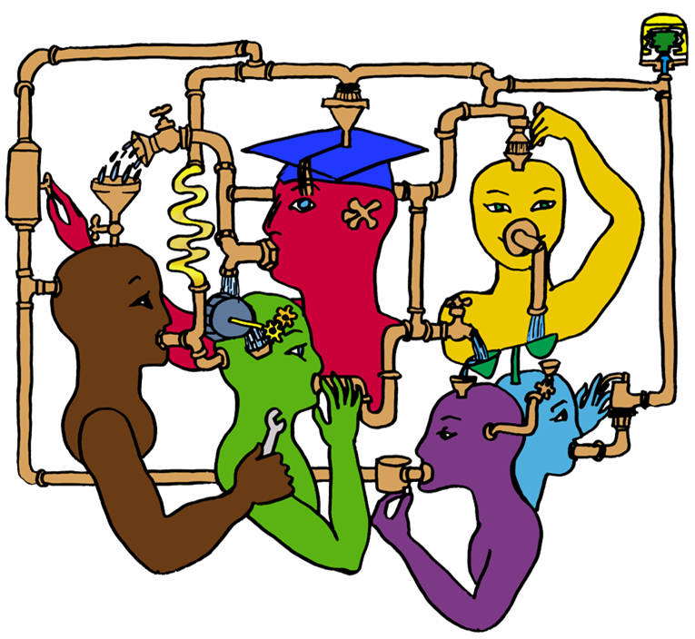
Karl Smith’s Innovation Story:
Cooperative Learning
Illustrations by Lila M. Smith, ca. 1975

Slide 5
Agenda
Introduction, Purpose, and Overview
  Karl Smith, Purdue University/ University of Minnesota
Assessment of Conceptual Understanding
  David Darmofal, MIT
Systematic Formative Assessment
  Anna Dollár, Miami University
Reflection (~1 minute)
Active/Cooperative Learning
  Michael Prince, Bucknell University
Service/Problem-based Learning
  Khairiyah Mohd Yusof, Universiti Teknologi Malaysia
Reflection (~ 1 minute)
Close – Follow Up Sessions
  Monday, 6 PM, Engineering Education Research Community
  Wednesday, 10:30 AM, – Jamieson/Lohmann Report
First-year Engineering Design Courses
  Jacquelyn Sullivan, University of Colorado, Boulder
Interdisciplinary Capstone Courses
  Arnold Pears, Uppsala University
Reflection (~1 minute)

Slide 6
Active/Cooperative Learning
Michael Prince
Professor of Chemical Engineering
Bucknell University

Slide 7
The Active Learning Continuum
Informal
Group
Activities
Structured
Team
Activities
Problems
Drive the
Course
Make the
lecture active
Instructor
Centered
Student
Centered
Active
Learning
Collaborative
Learning
Cooperative
Learning
Problem-
Based
Learning

Slide 8
Effectiveness of Short Activities:
Less Can Be More
 | With Pause | Without Pause
Short term recall | 108 correct facts recalled after lecture | 80 correct facts recalled after lecture
Long term recall | Average exam score = 84.9 | Average exam score = 76.7
Ruhl et al., Using the Pause Procedure to Enhance Lecture Recall”, Teacher Education and Special Education, Vol. 10, Winter 1987

Slide 9
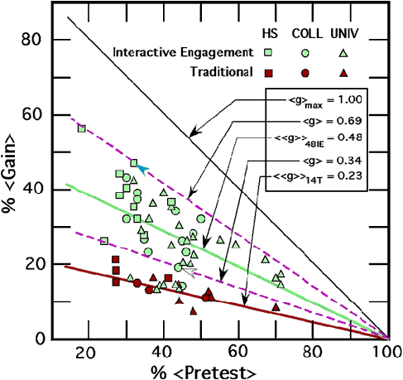
Active Learning:
Twice As Effective as Lecturing
Hake, R., “Interactive Engagement vs. Traditional Methods”, Am. J. of Physics, 1998.

Slide 10
Incorporating Active Learning:
Variations on How We Ask Questions

Slide 11

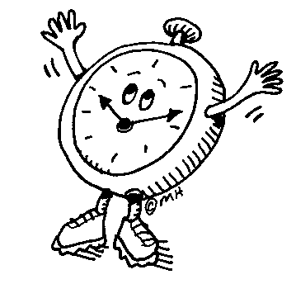
Common Faculty Questions
Can I still cover the syllabus?
How much time does it take to prepare?
Often very little
YES!!

Slide 12

Active Learning and Teams
  Consider the Following Scenario
  You assign 4 homework problems to teams of 4 students
  Students pick teams
  One solution handed in
  Same grade for all
What could go wrong?

Slide 13
CL Criteria:
Structures to Improve Teams
Regular self-assessment
of group functioning
Face-to-face
interaction
Appropriate use of
interpersonal skills
Positive
interdependence
Individual
accountability

Slide 14

Does Cooperative Learning Work?
Achievement:
Retention:
Student Attitudes
50
70
Springer et al., “Effects of small-group learning on undergraduates in science , mathematics, engineering, and technology: A meta-analysis”. Review of Educational Research, 1999

Slide 15
Problem-based learning (PBL)
Khairiyah Mohd Yusof, PhD
Director,
Regional Centre for Engineering Education (RCEE)
Universiti Teknologi Malaysia (UTM)

Slide 16
Traditional Teaching and Learning (T&L) Model
Told what to learn
Learn
Give exercises for illustration
Deductive T&L
Service/Problem-Based Learning Model
Identify what to learn
Learn
Apply
Inductive T&L

Slide 17
Critical Elements in
Problem-Based Learning (PBL)
Realistic
Problem
Instructorsas
Designer & Coach / Facilitator
Student as
Problem Solver
O. S. Tan (2003)
Notes:
There are 3 critical elements in implementing PBL. They are:
1. A realistic, if not real, Problem. The problem provides context and is crafted to ensure attainment of learning outcomes, which can be in the form of content, skills and attitude outcomes.
2. The instructors is the designer of the learning environment & facilitator. Facilitation skills are required to make thinking visible – a term known as cognitive coaching. Proper assessment must also be made on both content and process. Need TRAINING!
3. Students do not readily have the skills for PBL – must be prepared, supported and motivated by instructors

Slide 18
Why PBL?
Effective outcomes based on research
Knowledge retention
Skills
Positive attitude
Deep learning
Meta-cognitive skills
Strobel & Barneveld, 2009
Prince & Felder, 2006
Woods et al, 2000
Notes:
Why should we go the extra mile to do PBL? Well, there’s been lots of research that studied the impact of PBL.
When compared to traditional instruction, students taught with PBL retain knowledge for a longer period of time, although in the short term, students may acquire more knowledge in the short term through conventional instruction.
There’s overwhelming evidence on skills development, both for immediate and delayed assessment
PBL also results in developing students’ positive attitude towards learning. Students become motivated to learn when they understand the context and importance of the knowledge that they are learning
In addition, the emphasis in PBL is to learn functioning knowledge - students have to use the knowledge learned to solve the problem, which consequently push them into deep learning.
Metacognition = thinking about thinking. 2 characteristics of meta-cognition: a. Knowledge about how thoughts are applied, and b. knowledge about how much can be learned and strategies to use. By emphasizing on functioning knowledge and incorporating reflection, PBL has been shown to promote thinking. This is actually a difficult skill to develop in traditional learning environments.

Slide 19
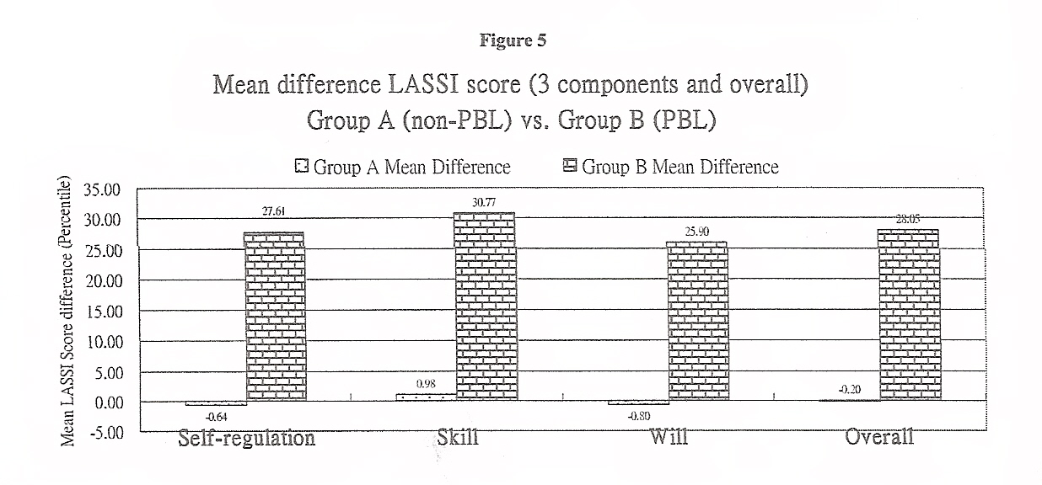
Why PBL?
- a sample research finding
Learning And Studying Strategy Inventory
Downing 2007, 2010
p < 0.01 for all components
Notes:
Study conducted on 1st year students from the building discipline at the University of Hong Kong.
A = degree students underwent traditional approach, focusing more on declarative and procedural knowledge, B = associate degree students (entry results lower than A, LASSI score at entry level lower than A), underwent PBL approach, focusing more on functioning knowledge.
Graph shows the difference in LASSI score after 15 months
Skill: learning strategies, skills and thought process related to learning
Will: diligence, self-discipline, attitude and willingness to exert effort in learning
Self-regulation: manage and control learning process through effective time management, focus & concentration, checking for understanding, using available study support

Slide 20
The PBL Process
Meet the problem
Self-directed
learning
Phase 1
Problem identification
& analysis
Synthesis &
application
Phase 2
Presentation
& reflection
Phase 3
Closure
Notes:
In a typical PBL cycle, students are presented with a problem first. Students first understand and analyze the problem, where they identify what are the new knowledge, called the learning issues, that they have to learn to solve the problem. They synthesize the knowledge and apply them on the problem. Therefore, the outcome of the problem is always in terms of functioning knowledge, rather than declarative. Finally, after presenting the soln, there’s closure and reflection. Reflection very imp to help students internalize experience and knowledge. It also trains students to develop meta-cognitive skills.

Slide 21
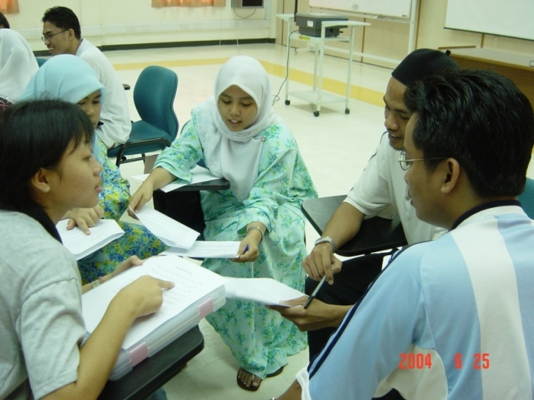

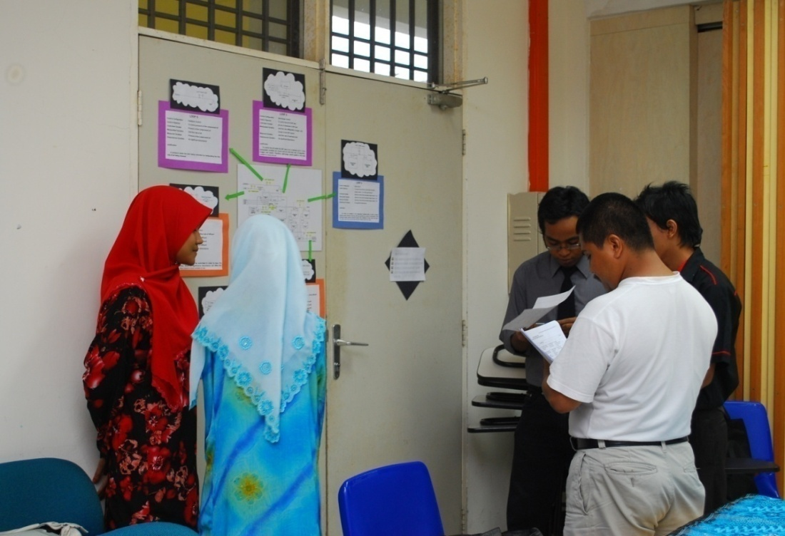
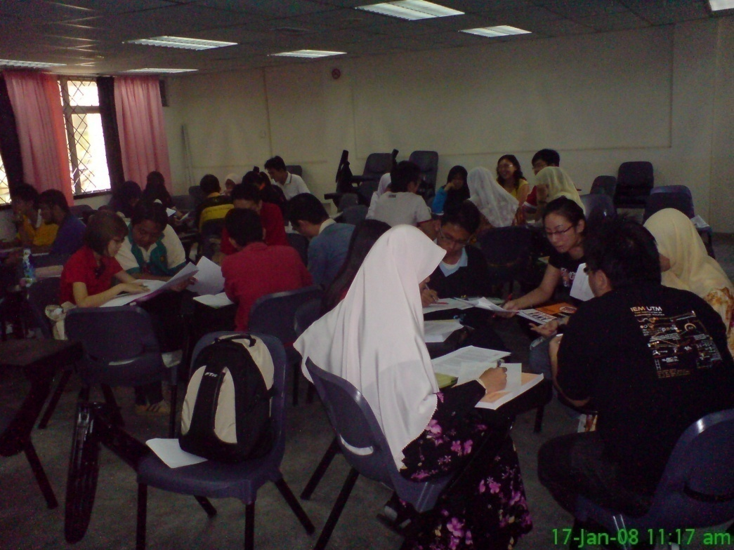
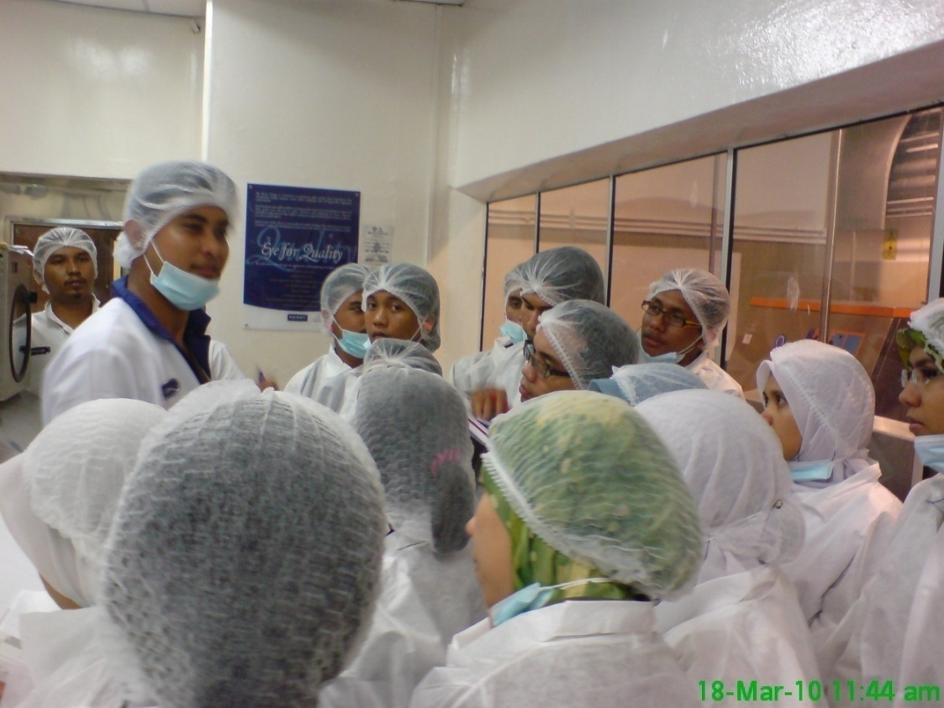
PBL in a Typical Engineering Course…
Notes:
Just to show a sample on using industrial problems in PBL…

Slide 22
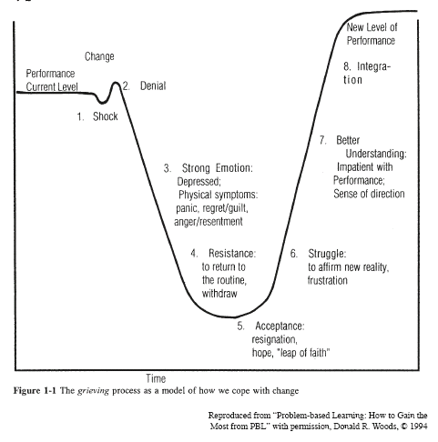
Coping with change – need to explain and rationalize => MOTIVATE!!
Woods, 1994
Notes:
Students facing PBL for the first time do not willingly accept it. This diagram shows the grieving process that students typically go through because of the drastically different learning environment and requirements. This grieving process is similar to what psychologist observe what we go through when we go through drastic changes in our life.
Shock (oh my! What on earth is this PBL?)
Denial (This can’t be happening…)
Strong emotion (This is unfair! How can anyone expect me to learn on my own? The profs are not doing their job!)
Resistance (No way! I’m not going to waste my time with this)
Acceptance (Oh well, it’s here to stay. So I need to do it…)
Struggle (This is not easy, but I’ll give it a try…)
Better understanding (Hey, this is not so bad after all…)
Integration (I’m getting the hang of this – infact, I’m actually good at it!!)
Understanding at which state students are is important for us to help them through their grieving process – so have patience!

Slide 23
Gradual move towards PBL…
  If unfamiliar with active learning techniques, start gradually
Challenge of PBL
Macro PBL
Getting a taste
Micro PBL
Team-
working
Formal CL
AL warm-up
Informal CL
  Go for training & read – embrace lifelong learning!

Slide 24
Reflection
Take a moment to think about the ideas, strategies, evidence and experiences presented
Identify practices that resonate
Start thinking about follow up

Slide 25

First Year Engineering Design
  Jacquelyn Sullivan
  Associate Dean
  College of Engineering and Applied Science
  University of Colorado Boulder
  jacquelyn.sullivan@colorado.edu

Slide 26
Engineering Design
Design Education
What engineers do…
Design within constraints
Systematic
Thoughtful
People centered
Focused on students
Knowledge and professional practice
Social activity… with people, for people
Ambiguity
See work of Dym, Sheppard

Slide 27
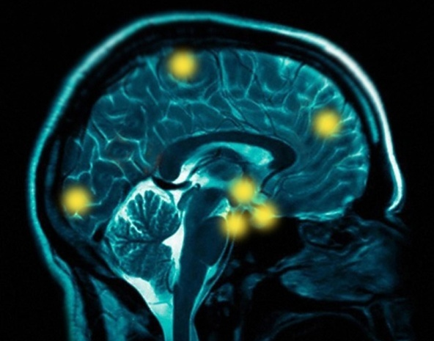

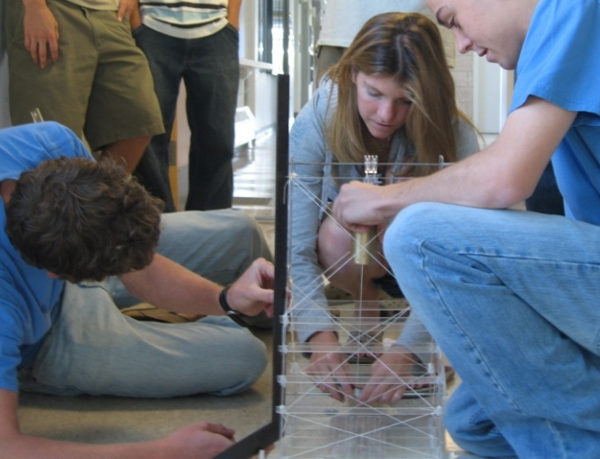
Evolution of First Year Design
Early –mid 1990’s
The leap: science & math → engineering
Acquire facts; organize knowledge
Connect to existing knowledge
Multidisciplinary
Synthesis
Hopeful
outcomes
See work of Froyd and Ohland

Slide 28
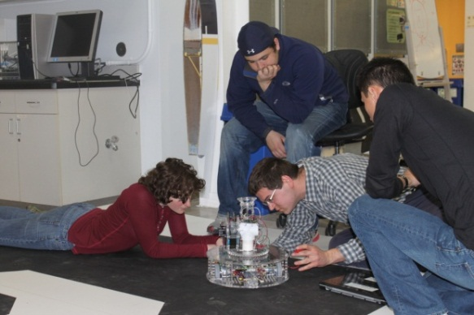
Start Early: First Year Design
Not so common…
ASEE and CASEE benchmarking
9% (10/113) – generalize to ~35 nationally?
Early design → reflection → success
Self efficacy research enticing for First Year Design
  Engineering experiences
  shape confidence
  Importance of mastery
  experiences
See survey summary by Brannan,
research by Stevens and Hutchinson-Green

Slide 29

Learning Happens Between People
Technical vs social
Engineering is about people
Neglectful relationship to people?
Socio-technical work
Implications of outsourcing
the First Year
First Year Design
Engineering
People
See research of Stevens

Slide 30


Engaging
Learning requires feedback
Solving a problem →connections
Entwinement
  Learning and engaging
  Mind and heart
  Social and technical
Context for engineering design challenges…
  Gender differences in patterns of intellectual development
  Is to engineer in context particularly
  important for women?
Design!
See research of Adams, Kilgore

Slide 31

The Fuzzy Stuff - Self Efficacy
Confidence in one’s ability to perform tasks to achieve success in the engineering environment
Relevance to First Year design education
  Mastery experiences
  Working in teams
  Getting help
  Mastery experiences (again)
  Design!
See research of Hutchinson-Green

Slide 32
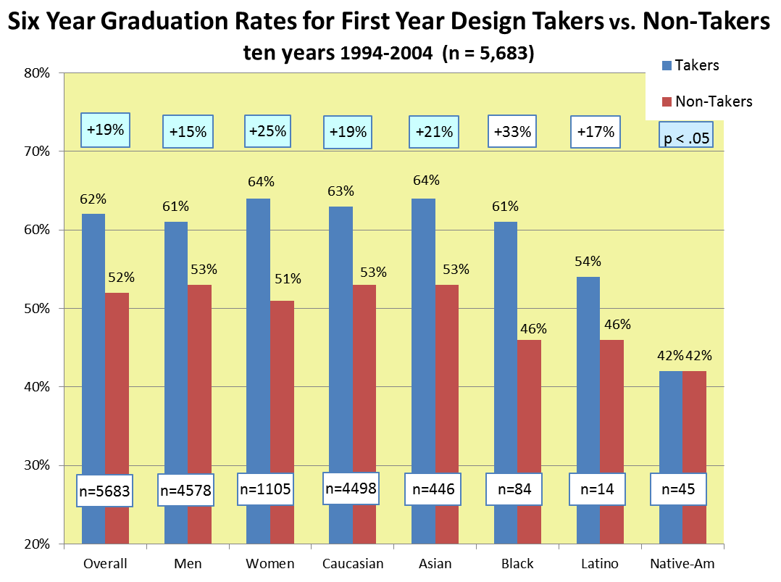
Self-efficacy and Persistence
Increased persistence, achievement and interest
Gender differences
Relevance to First
Year design
  Experiencing
  Confirming
  mastery
See Fortenberry et al

Slide 33
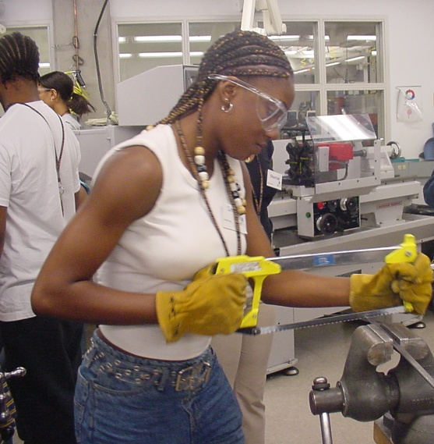

So…What Might You Ponder or Act Upon?
Engineering
People
  Jacquelyn Sullivan
  College of Engineering & Applied Science
  University of Colorado Boulder

Slide 34


Interdisciplinary Capstones
Arnold Pears
Uppsala Universitet

Slide 35
Engineering the future
To develop the increasingly
complex systems
which support our
technological society,
and meet user expectations for flexible and usable systems,
development teams
are necessarily increasingly
interdisciplinary and intercultural
in nature.
www.CeTUSS.se

Slide 36
Why interdisciplinary projects?
  Skills for a global workplace
  Competitiveness and employability
  Recent developments
    NSF's report "Educating Engineers as Global Citizens: A Call for Action"
    Global Engineering Excellence Initiative - Global Eng. Internship Program
    Online Journal for Global Eng. Education
  European dimension of engineering education
www.CeTUSS.se
Notes:
Note that in Sweden and Europe in general there is a desire to create a niche for our engineers
Calls for engineers with interdisciplinary and intercultural skill basis

Slide 37

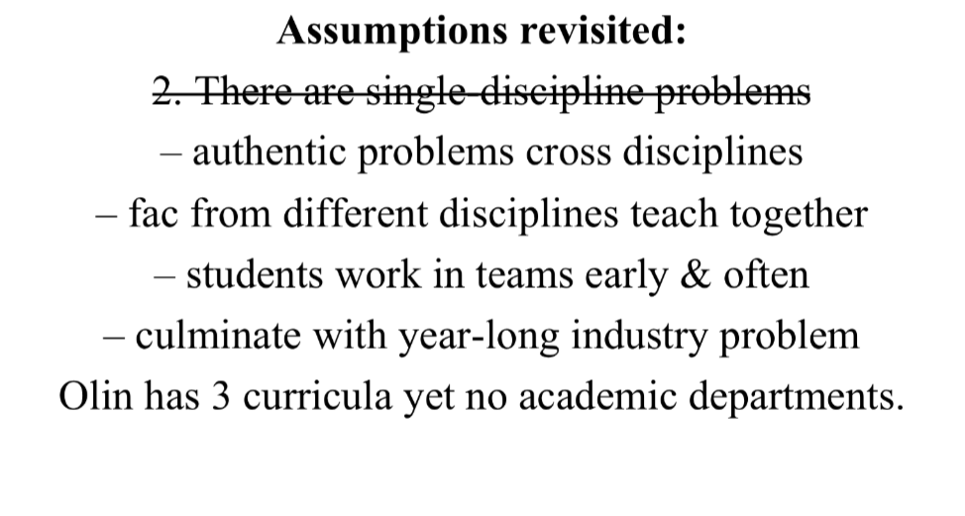
A quote from Sherra Kerns,
Olin College
www.CeTUSS.se

Slide 38
Integrated Approaches
  Holistic PBL, e.g. Roskilde and Aalborg University, Denmark
  Interdisciplinary integrated curriculum, e.g. Olin College, USA.
Holistic approaches require high level policy support!
www.CeTUSS.se

Slide 39
Capstone/Project designs
Using integrative projects is a more achievable model for many institutions
    Open Ended Group Projects (OEGP)
(Daniels et al. 2010)
    Course level PBL
      (A/E/C Global Teamwork)
      (Pears and Daniels 2010)
      (Bannerot et al. 2010)
www.CeTUSS.se

Slide 40
Challenges
  courses that involve students from several degree programs in an interdisciplinary context are quite hard to establish
(Bannerot 2010)
  grading non-technical aspects is complex, and schemes vary widely
(Dutson et al. 1997)
  interdisciplinary work practices and solution formulation are not highly regarded or appreciated
(Pears 2009)
www.CeTUSS.se
Notes:
Many students perceive these workplace challenges as uncharacteristic of future workplace practice.

Slide 41
A successful interdisciplinary project
    Integrates knowledge and skills from participants
    Builds additional competence in
        project management
        virtual development teamwork
        cultural and interdisciplinary teamwork
    Allows student to experience a full project cycle from conception to delivery
    Provides opportunities to learn professional skills with close mentorship in a secure setting
www.CeTUSS.se

Slide 42
Take home messages
  Students with a strong technical focus in their studies have a tendency to under-rate the potential contribution of other key skill areas and disciplines.
  The value of skills from other disciplines are often first acknowledged after the project, during debriefing.
www.CeTUSS.se

Slide 43
Conclusions
  There are well established models for developing interdisciplinary teamwork skills
  Devising appropriate grading strategies is crucial
  Students need to experience interdisciplinary work at least twice during their education, since it seems that many need to experience partial failure in order to understand the value of skills with which they are unfamiliar, and have traditionally undervalued.
www.CeTUSS.se

Slide 44
Reflection
Take a moment to think about the ideas, strategies, evidence and experiences presented
Identify practices that resonate
Start thinking about follow up

Slide 45
Assessment of Conceptual Understanding
2011 ASEE Annual Conference and Exposition
Vancouver, British Columbia
Monday, June 27, 2011
David L. Darmofal
Aeronautics & Astronautics
Massachusetts Institute of Technology

Slide 46
Conceptual Knowledge
Conceptual knowledge: “understanding of principles governing a domain and the interrelations between units of knowledge in a domain” (Perkins, 2006)
Organization of conceptual knowledge: (Ozdemir & Clark, 2007)
  Knowledge as theory
  Knowledge as elements
Misconceptions, misconceptions, misconceptions…
"It’s not what you don’t know that hurts you.
It’s what you know that ain’t so!”
Mark Twain

Slide 47
Concept Inventories
First developed in physics to assess conceptual understanding of force and motion
  Mechanics Diagnostic (Halloun & Hestenes, 1985)
  Force Concept Inventory (Hestenes et al 1992)
“Conventional physics instruction produces little change in [common sense misconceptions about mechanics] … independent of the instructor and the mode of instruction”
(Hestenes et al 1992)
Since the Force Concept Inventory, concept inventories have been developed in a wide-range of topics: statics, thermal & transport sciences, circuits, statistics, material science, …
Recent work has also suggested several ways to improve the usage of concept inventories (e.g. Steif & Hansen 2007)

Slide 48
Oral Interviews and Exams
Oral interviews (formative) or exams (summative) can provide rich information about how a student is thinking
Useful to help identify misconceptions (important tool for the development of concept inventories)
Can be time consuming and difficult to scale to large classes
Improves likelihood of an accurate assessment by its dynamic nature
Valuable, authentic experience for students
Approximately half of our department’s undergraduate courses use some form of oral assessments

Slide 49
Concept Questions & Peer Instruction
Concept questions:
  Focus on a single concept
  Typically multiple choice
  More than one plausible answer based on common misconceptions
An example from fluid dynamics on the concept of irrotationality:
Which of these flows are irrotational?
Concept-based active learning (Peer Instruction, Mazur, 1997)
(a) (b)

Slide 50
Active Learning:
Twice As Effective as Lecturing
Hake, R., “Interactive Engagement vs. Traditional Methods”, Am. J. of Physics, 1998.

Slide 51
Student Preparation: Look-ahead Homework
(Darmofal, 2005)
End-of-semester course evaluation data
Initial implementation of concept-based lectures only gave reading assignments
Switched to look-ahead homework due prior to discussing concepts in lecture
Typical student comments:
“I was initially opposed to the idea that I had to do reading & homework before we ever covered the subjects. Once I transitioned I realized that it made learning so much easier!!”
“Doing homework before the lectures is good… makes actual learning in lectures possible.”

Slide 52

  SYSTEMATIC FORMATIVE ASSESSMENT
  Anna Dollár, Ph.D.
  Professor
  Mechanical and Manufacturing Engineering Department

Slide 53
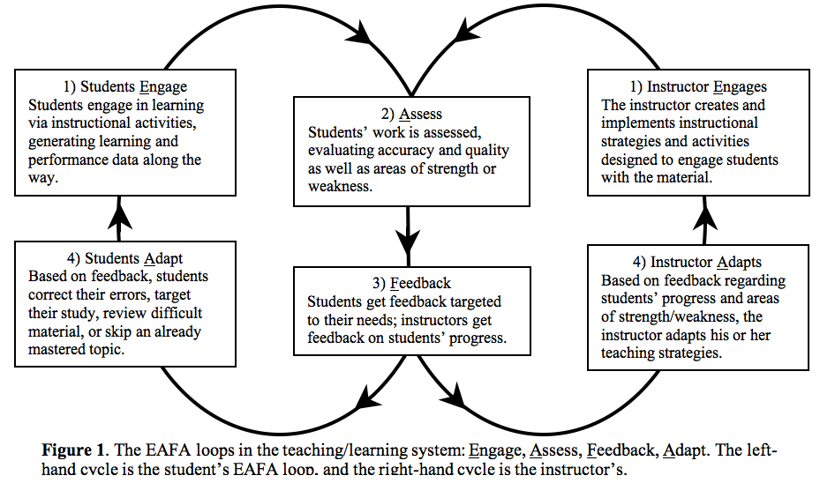
Teaching / Learning System
STUDENTS
STUDENTS
engage in
learning activities
INSTRUCTOR
engages in
teaching activities
ASSESSMENT
of
LEARNING TEACHING
STUDENTS
adapt
learning behaviors
STUDENTS
adapt
INSTRUCTOR adapts
teaching behaviors
FEEDBACK
Too late!
Marsha Lovett,
Carnegie Mellon University

Slide 54
Summary of Findings from Research on Formative Assessments
Synthesis of over 800 meta-analyses relating to achievement:
  ranked #1 among 24 teaching approaches
  ranked #3 among 138 contributors to learning
Formative assessment is shown to be
the most effective instructional intervention
Hattie J., Visible Learning, 2009
Notes:
see also pp.7 and 19 for definitions of terms…..

Slide 55
Key Lessons from Research about
Formative Assessment
Assessments that promote learning provide:
feedback to students on their progress (non-threatening)
feedback to instructors on both individual and class performances
opportunities to close the gap between current & desired performance
practice
leads to
observed
performance
allows for
targeted feedback
guides further
Ambrose at al., (2010),
How Learning Works:
Seven Research-Based Principles for Smart Teaching

Slide 56
Example: Open Learning Initiative (OLI)
Engineering Statics
Part of CMU’s Open Learning Initiative
Free online courseware with over 300 interactive exercises with formative & summative assessments http://oli.web.cmu.edu/openlearning/
Co-authored by:
  Paul S. Steif, Carnegie Mellon University
  Anna Dollár, Miami University

Slide 57
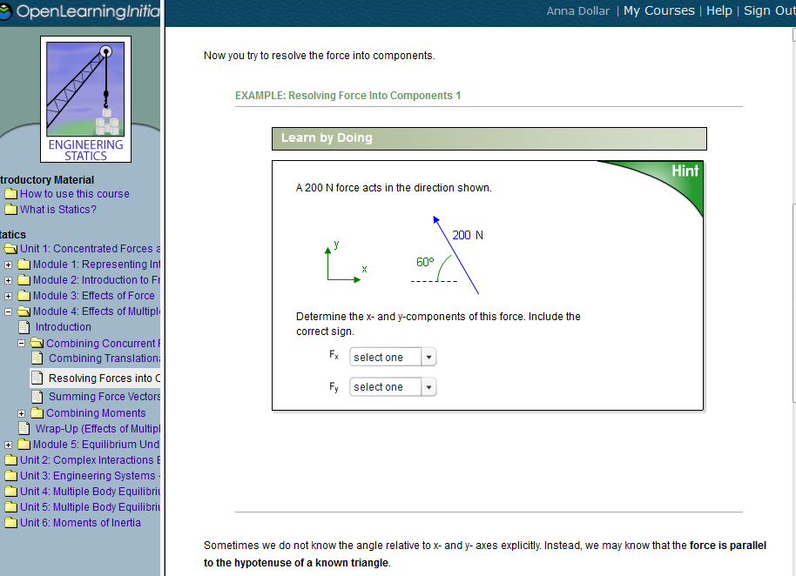
Example of an Interactive Exercise with Feedback
Notes:
screenshot

Slide 58
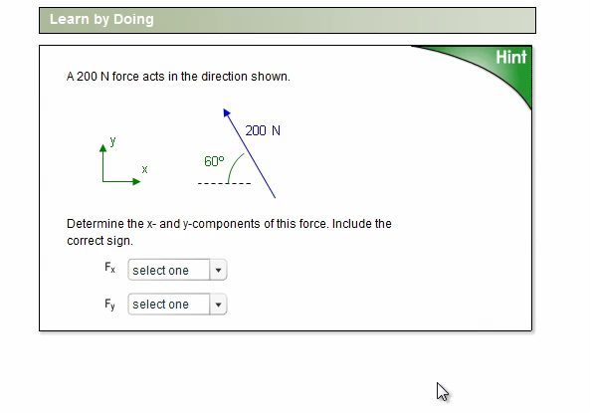
Example of an Interactive Exercise with Feedback and Hints
Notes:
video

Slide 59
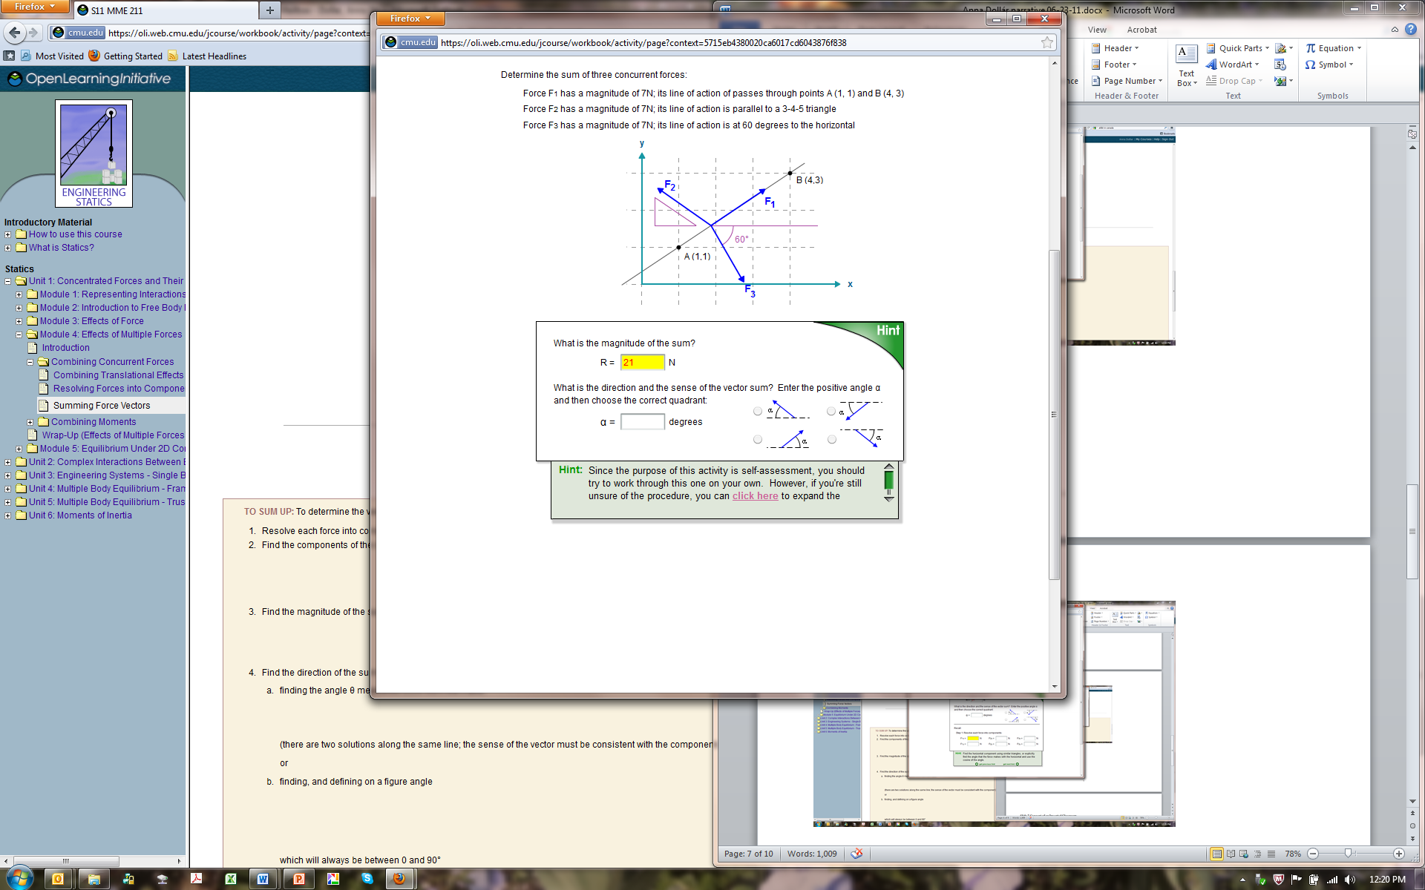
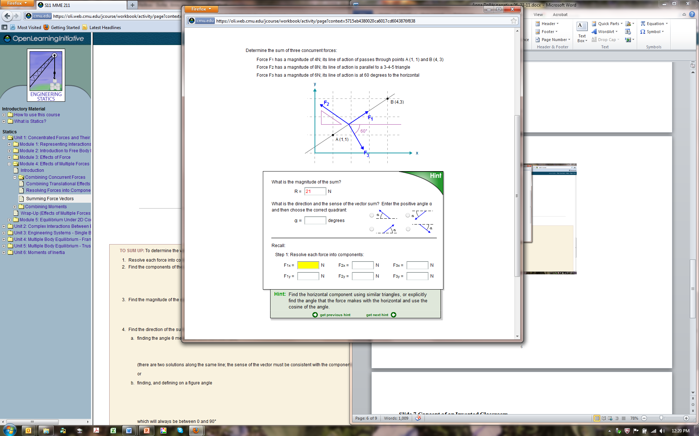
Example of an Interactive Exercise
with Feedback and Scaffolding

Slide 60

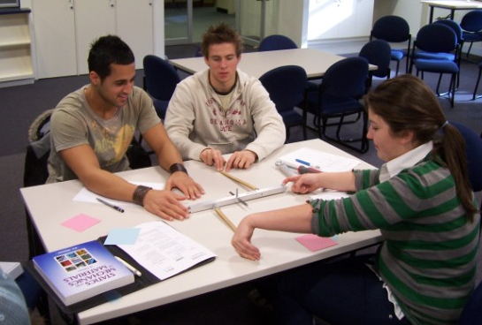
Concept of an Inverted Classroom
Traditional, lecture-based classroom:
students come to class unprepared
listen passively to lecture
Inverted classroom:
first contact with new material and initial formative assessments take place outside of classroom
students come to class prepared to be actively engaged

Slide 61
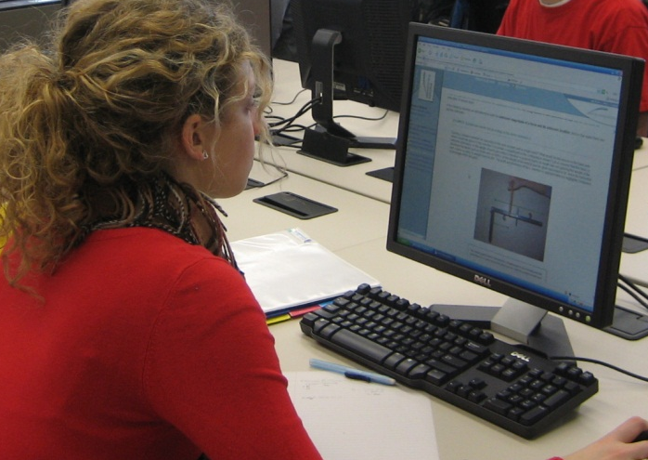
OLI-Statics in Inverted Classroom
Students are required (before class) to:
  complete modules with Interactive Exercises
    – self-regulated, based on formative assessment
  (not graded)
take end of module quiz (low stake grades)
  write feedback to instructor:
  which concepts/ skills were the most difficult
  questions for the instructor to address in class

Slide 62
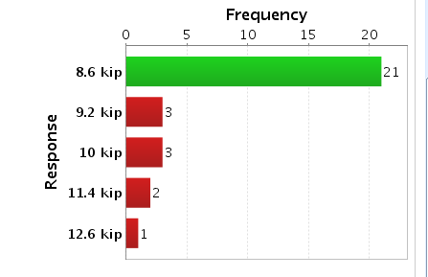
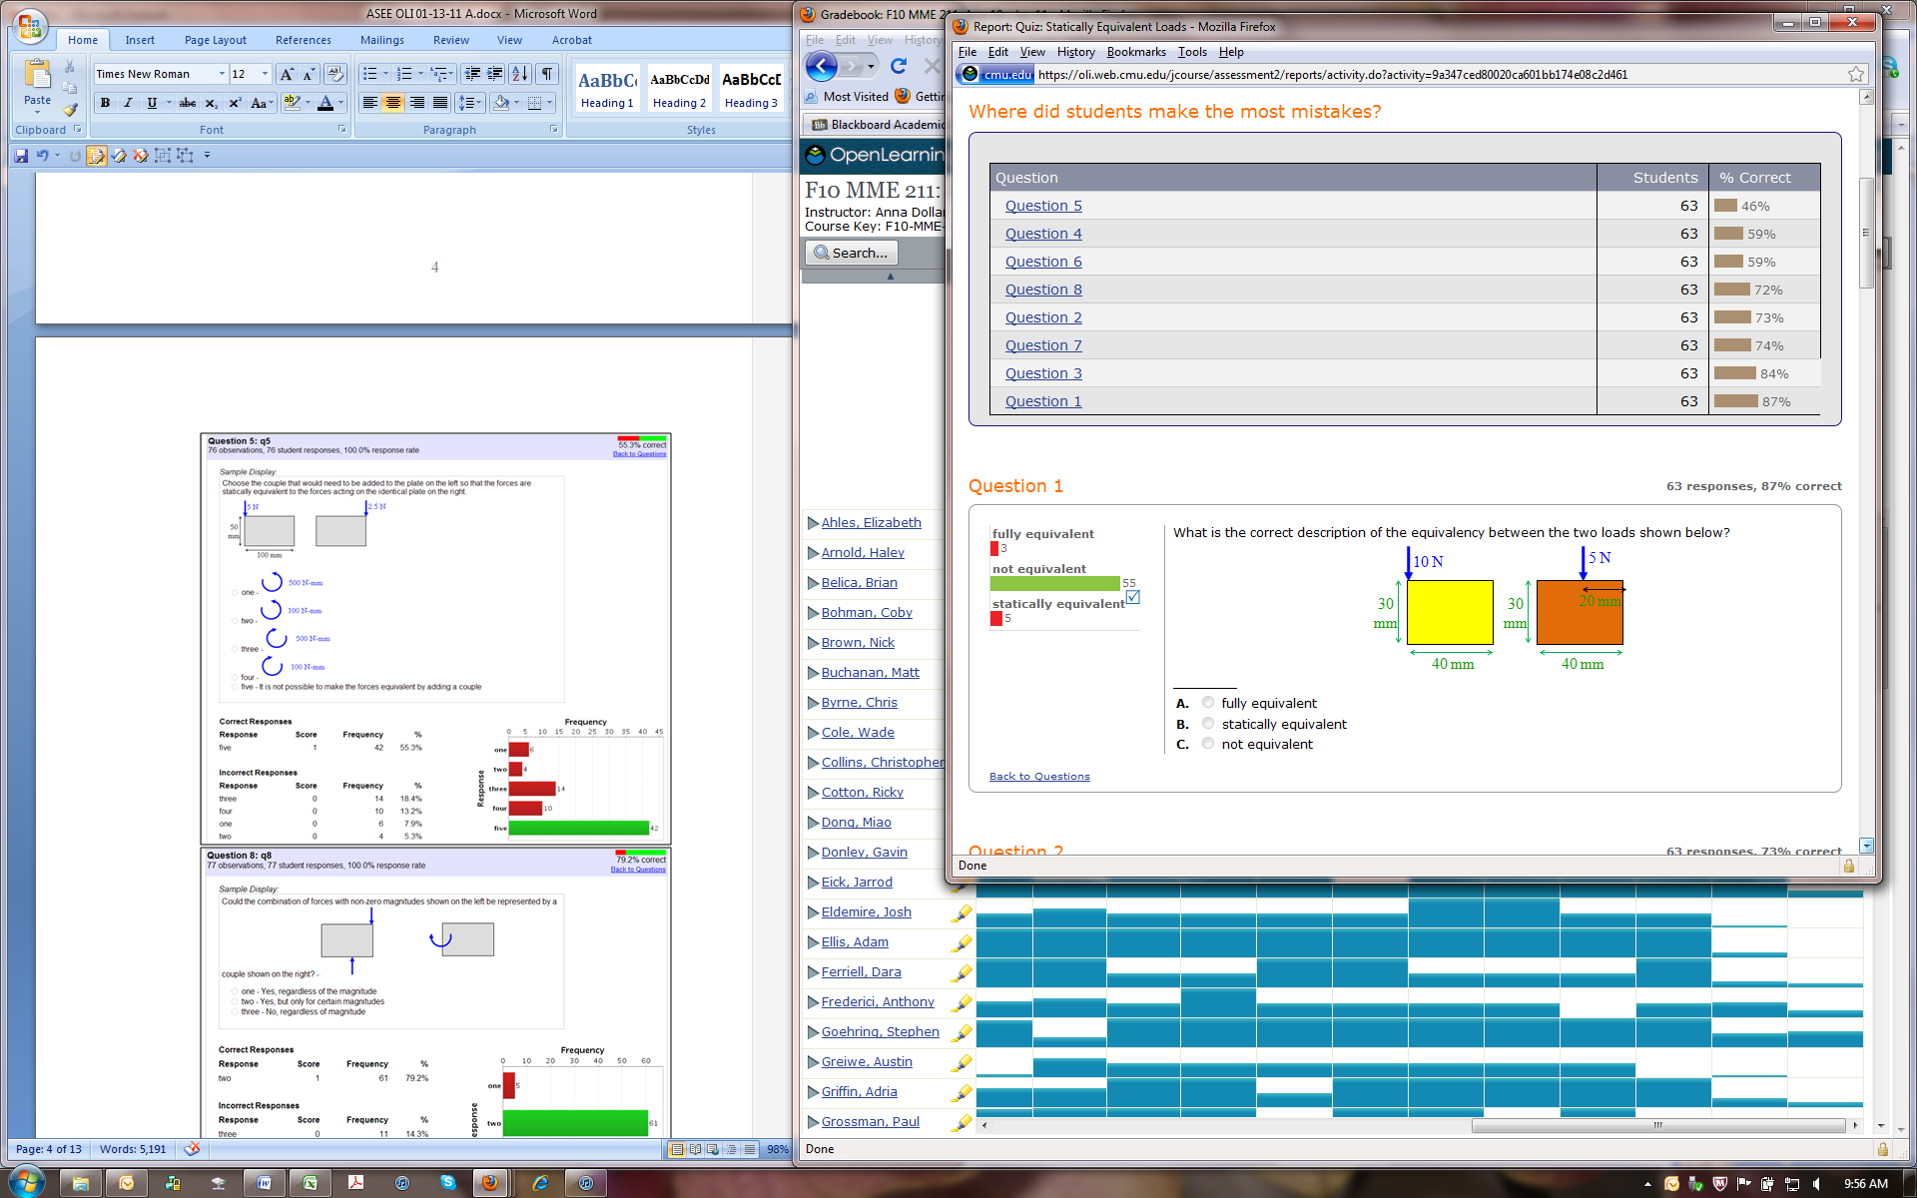
OLI Engineering Statics
Learning Dashboard for Instructor
    Interactive Exercises
    aggregated data on class usage
    individual students’ completion rates
    individual questions’ reports
    Quizzes
    online quizzes’ results
    individual quiz questions’ reports
    Students’ written feedback

Slide 63
OLI Engineering Statics
Classroom Strategy using Learning Dashboard
Instructor:
prior to class studies LD reports to:
  identify common student difficulties
  adjust the classroom strategy
devotes class time to specific topics, concepts, and skills that need elaboration and reinforcement
  exercises causing most difficulties
  quiz questions on which scores are low
  questions raised by many students
provides more opportunities for practice

Slide 64
Studies of Usage and Learning Gains
Box plot of normalized gains for groups of students who had completed low, medium, and high numbers of tutors
Steif, P. S., Dollár, A.
Study of usage patterns and learning gains in a web-based interactive static course. JEE, 2009

Slide 65
Reflection
Take a moment to think about the ideas, strategies, evidence and experiences presented
Identify practices that resonate
Start thinking about follow up

Slide 66
Follow Up Sessions and Next Steps
JEE Centennial
Jamieson & Lohmann Report
M722A - A Celebration of the Engineering Education Research Community (ERM)
  Mon. June 27, 2011 6:00 PM to 8:00 PM, Vancouver International Conference Centre, East Building - Room 14
W304B - Distinguished Lecture: Creating a Culture for Scholarly and Systematic Innovation in Engineering Education: Final Report of a Multi-Year Initiative (ASEE Board of Directors)
  Wed. June 29, 2011 10:30 AM to 12:00 PM, Vancouver International Conference Centre, 122
Explore Resource Web Site and Talk with Presenters

